Slide 1


How to Configure Product Variant Price in Odo V12
Employee Management System
www.openhrms.com

Slide 2

INTRODUCTION
Employees are regarded as the company’s greatest asset as they directly proportionate to company’s growth and expansion in the market. If a company wants to retain their invaluable assets, they have to come up with strong strategies fulfilling the employee satisfaction, desires, and expectations. The company should constantly provide the employee with encouragement, participation or engagement, stimulus, making the employee feel that they are an integral part of the company and the company care for their employees.
The importance of employee management software is rapidly increasing in the HR Market. There is a significant rise in the adoption of employee management software in the human resource sector for attracting and retaining the right talents within the company. In modern business, the role of employee management software is much more crucial as there comprise a heterogeneous and diversified workforce running the company or business.

Slide 3

Modern businesses often come in conglomerated fashions, having multiple office setups or workstations. Therefore managing the employees, giving then timely attention and encouragement under the piles of workloads are difficult to execute. It often becomes challenging and strenuous for an HR manager to look after or care the large employee community in person.
Here comes the role of technology, an efficient employee management software for smartly utilizing the company assets i.e. Employees to their full potential. The implementation of employee management software has numerous benefits to derive. Examples include the elimination of time constraints via automating every task, managing the workforce challenges and also timely giving the attention towards any kind of employee dissatisfaction.

Slide 4
The role of employee management in modern business
Robust database for storing employee records.
An employee management software comes with a strong and highly efficient database that executes a complete, transparent and quick search over the critical data pertaining to employees like their personal details, banking. Emergency contacts, leave management and more. The database holds the crucial data over both former and current employees of an organization. This centralized and robust database help the organization to retrieve employee information anytime, anywhere by anyone (condition: access permission).
Totally eliminates the paper works.
An integrated employee management software comes intuitive allowing the organization employees to request their time off, submit their timesheets and other documentation. An employee management software also comes with easy access to the employee for editing, inserting or deleting any information, processing their requests and automatic generation of approval submissions, finally reducing the amount of paperwork to be carried by the HR.

Slide 5
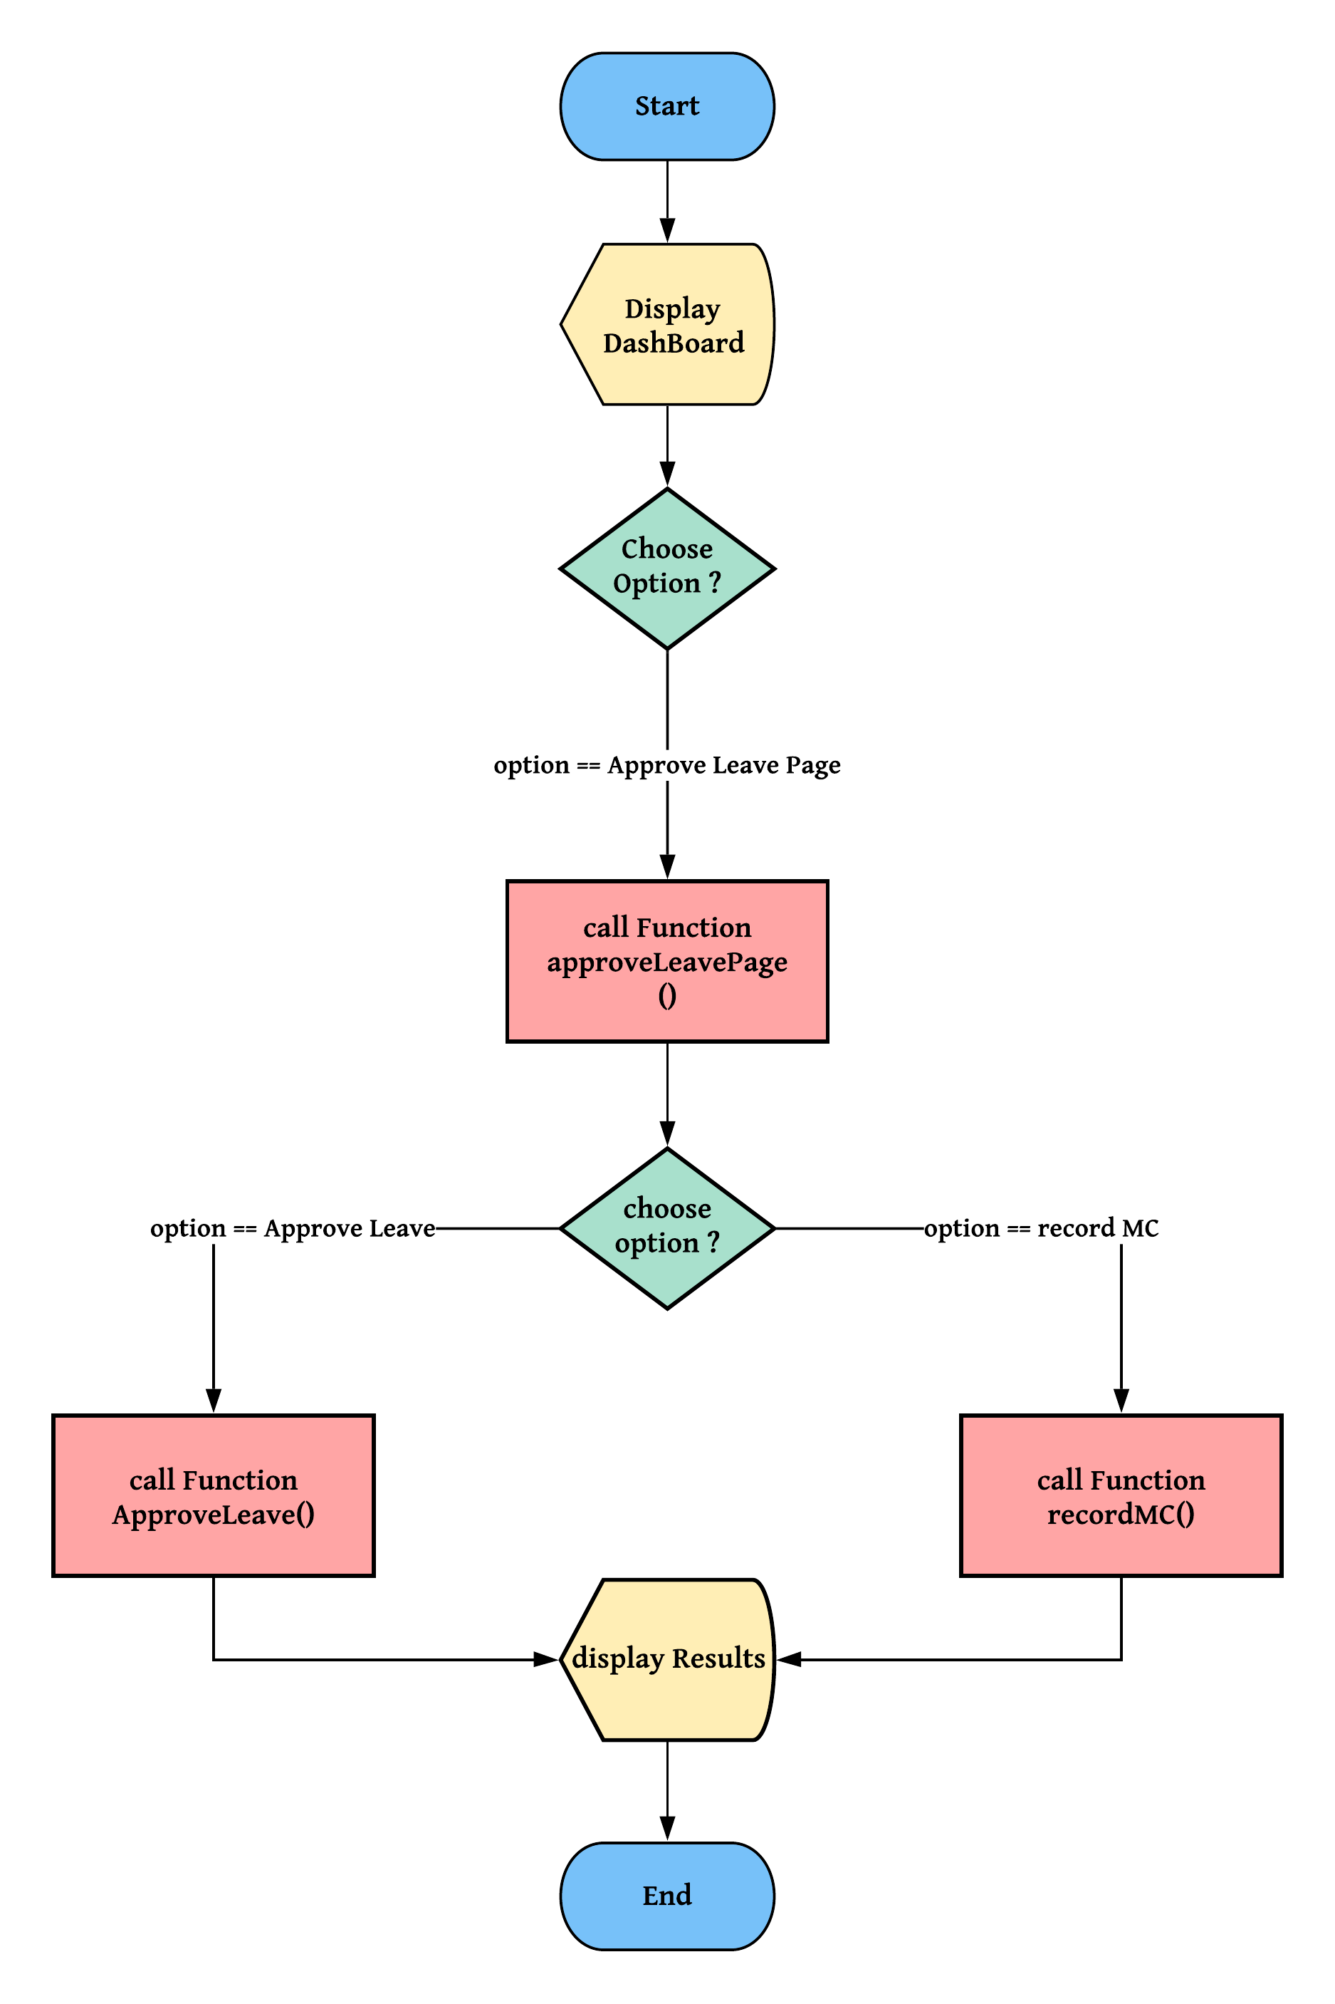
Flow Chart

Slide 6
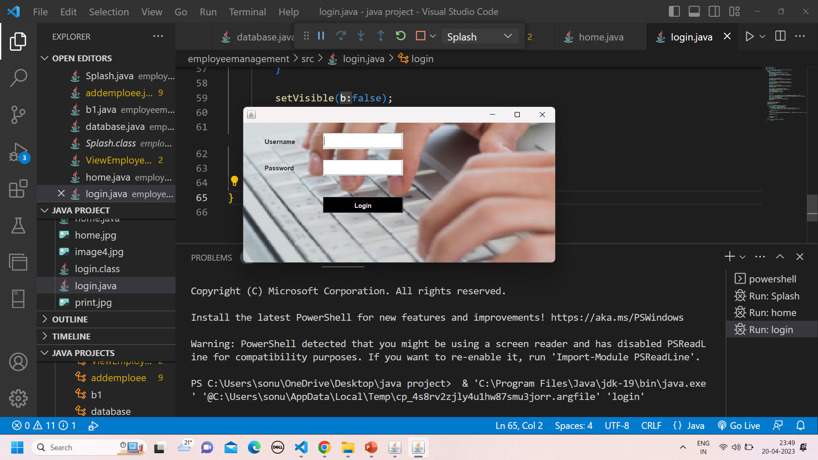
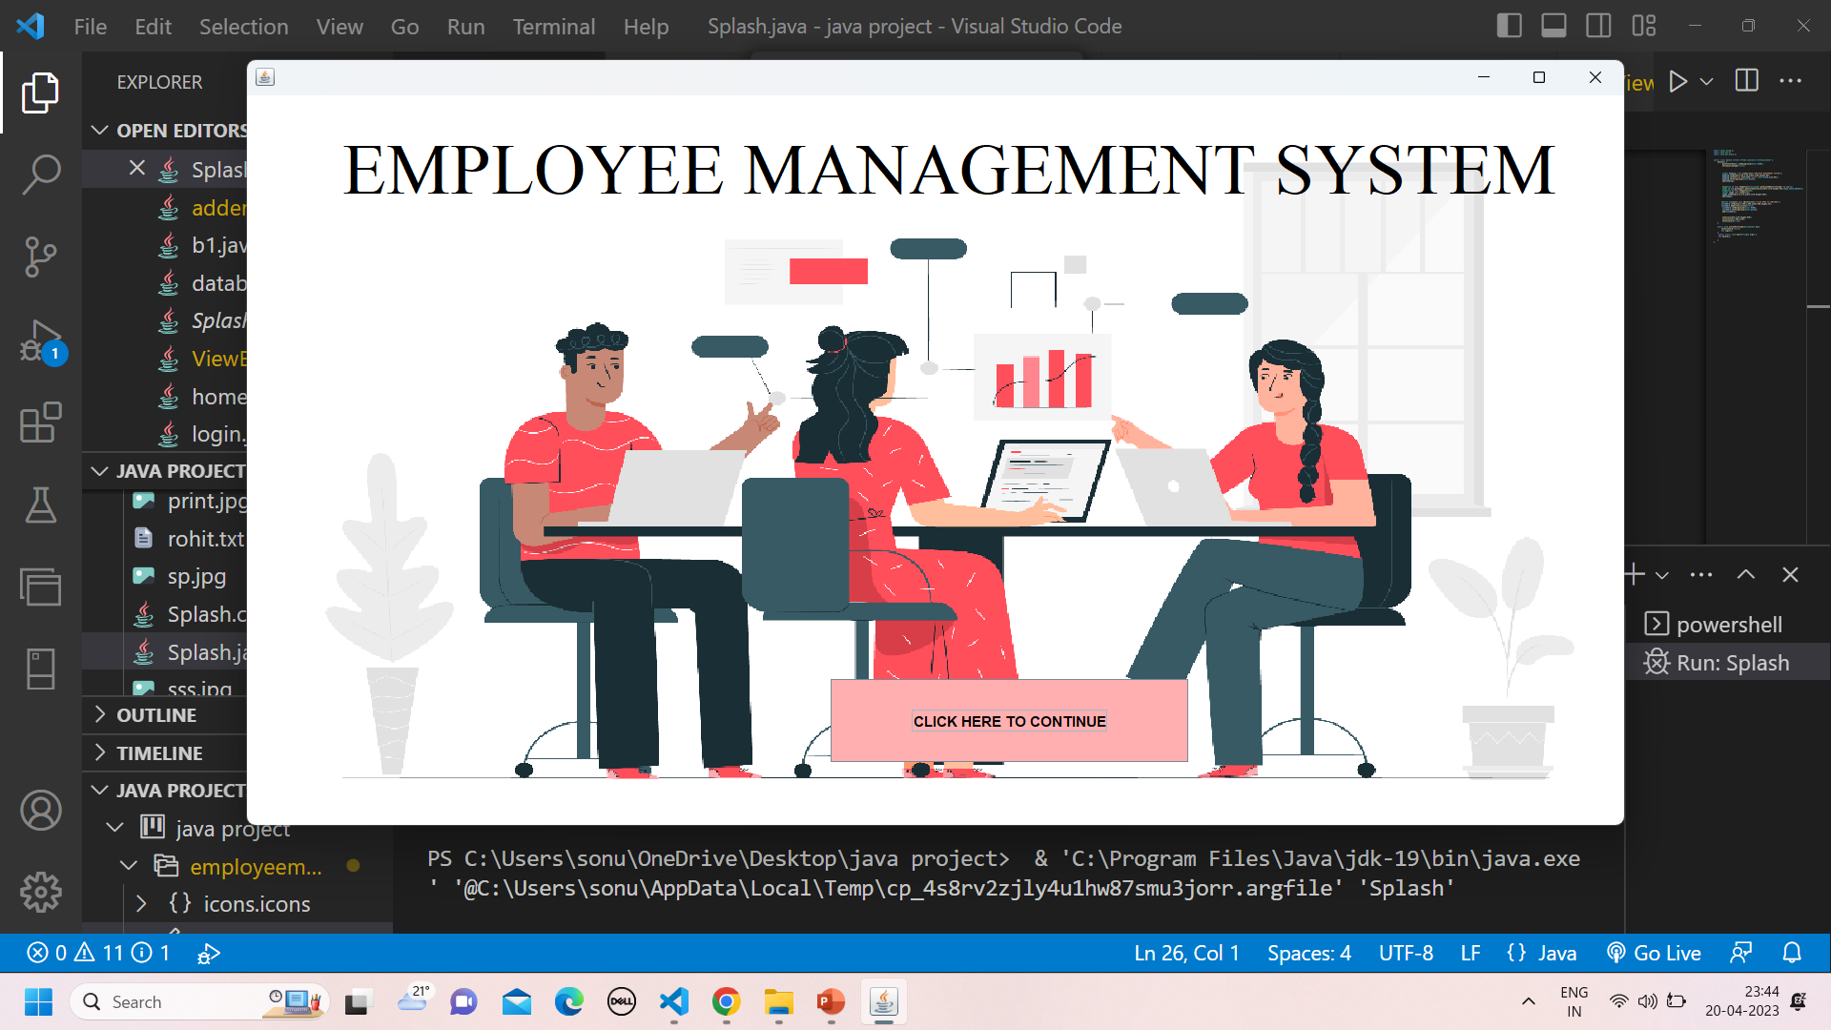
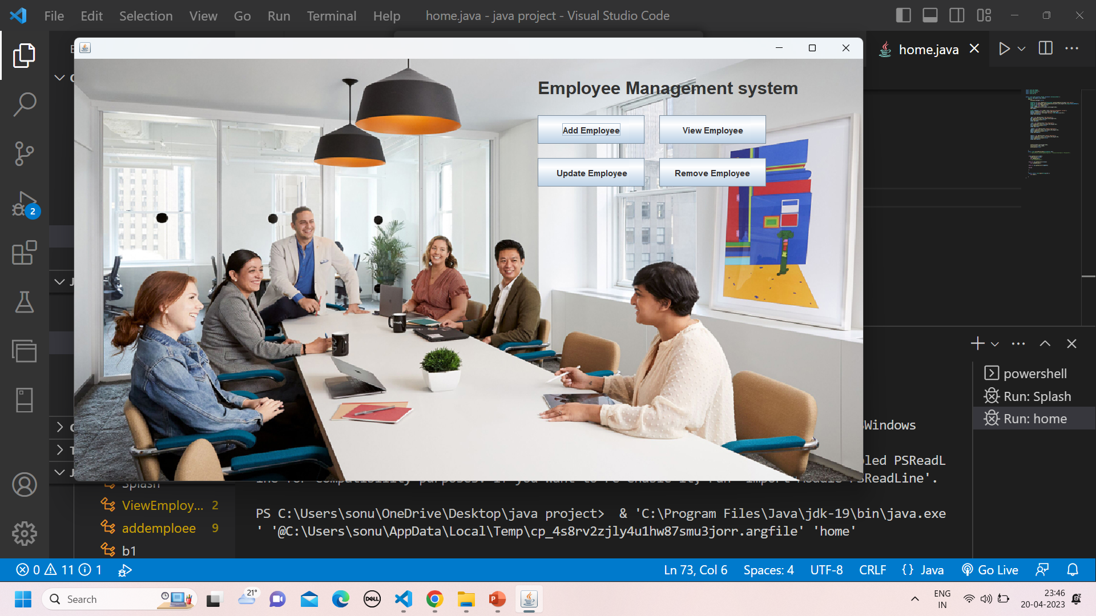
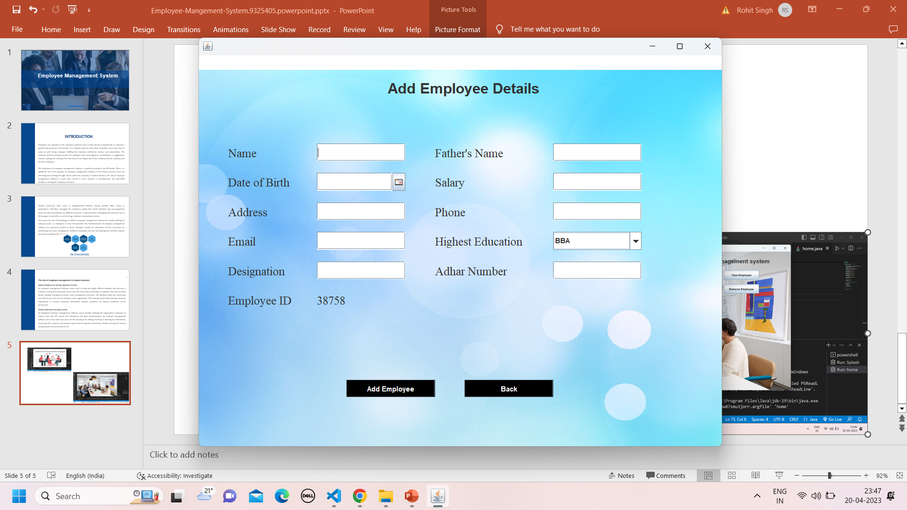

Slide 7
Future Scope
Project Management:
Assign tasks and projects to employees, assign a project team and keep track of the progress.
Report generation:The HR manager will be able to generate timely reports in order to monitor employeesand this can be used for performance appraisals. The reports will be have all their information of an employee from educational background, trainings attended, projects done as well as technical skills.
Recruitment Process : The admin will add an employee and a default password and employee id will be generated and sent to the new employees email. The HR manager will then have the ability to add an employee’s information to the database.

Slide 8
Conclusion
The database of this system can also easily be ported in any other standard database with nominal change.
The manager of office used to spare lot of time even after the normal office hours either at home or office for preparation of daily/weekly report and other necessary record.
Now with the help of this system, the manager has the information on his finger tips and can easily prepare a record based on their requirements apart from daily/weekly report.
Finally, we can say that this system will not only automate the process but save the valuable time of the office manager, which can be well utilized by this institute.
This will be an additional advantage and management of man power based on their free time from his normal duty.

Slide 9
THANK YOU !

