Slide 1
CheckMate-
The AI Chess Engine
SARANSH SINHA(1BM17CS089)
ROHIT MEHRA(1BM17CS079)
PARTH CHATTA(1BM17CS057)

Slide 2
CONTENTS
Abstract
Role of AI in project
AI algorithms used
Frameworks and modules used
Analysis and future works

Slide 3
Abstract
CheckMate is an AI based chess engine developed by us. It allows people to play a game of chess with each other through an intriguing GUI. The user can also play against the computer itself.
With the entire country locked down, we got to know the importance of indoor activities, and there is no game better than chess for a good brain exercise.

Slide 4
Role of AI in project
AI as a host
AI as an opponent
Host a game between two players
Keep track of positions of pieces of all players
Map the pieces accoringly if flip is enabled
Do not allow players from making an illegal or invalid move
Provide user the option of choosing difficulty
Analyse the game after every move.
Give a fun and strong challenge to the user

Slide 5
AI ALGORITHMS
MINI-MAX ALGORITHM
(NEGAMAX Algorithm)
ALPHA-BETA PRUNING

Slide 6
MINIMAX ALGORITHM
Minimax is a kind of backtracking algorithm that is used in decision making and game theory to find the optimal move for a player, assuming that your opponent also plays optimally. It is widely used in two player turn-based games such as Tic-Tac-Toe, Backgammon, Mancala, Chess, etc.
In Minimax the two players are called maximizer and minimizer. The maximizer tries to get the highest score possible while the minimizer tries to do the opposite and get the lowest score possible.
Every board state has a value associated with it. In a given state if the maximizer has upper hand then, the score of the board will tend to be some positive value. If the minimizer has the upper hand in that board state then it will tend to be some negative value. The values of the board are calculated by some heuristics which are unique for every type of game.

Slide 7
ALPHA BETA PRUNING
Alpha-Beta pruning is not actually a new algorithm, rather an optimization technique for minimax algorithm. It reduces the computation time by a huge factor. This allows us to search much faster and even go into deeper levels in the game tree. It cuts off branches in the game tree which need not be searched because there already exists a better move available. It is called Alpha-Beta pruning because it passes 2 extra parameters in the minimax function, namely alpha and beta.
Let’s define the parameters alpha and beta.
Alpha is the best value that the maximizer currently can guarantee at that level or above.
Beta is the best value that the minimizer currently can guarantee at that level or above.

Slide 8
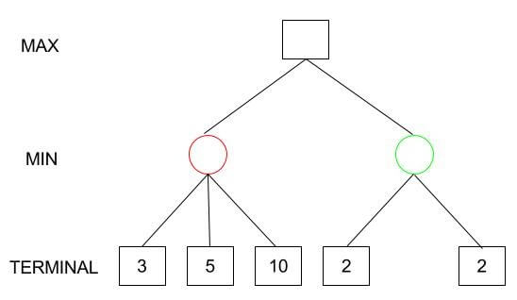
Working of Min-Max algorithm

Slide 9
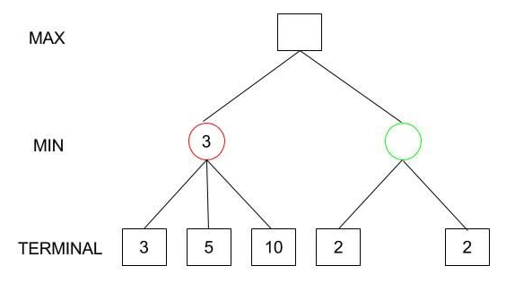

Slide 10
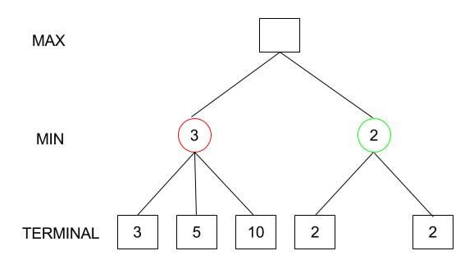
Max(3,2) = 3

Slide 11
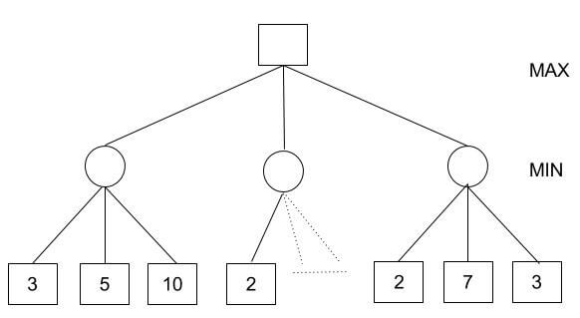
Working of Alpha Beta Pruning
Minimax Decision = MAX{MIN{3,5,10}, MIN{2,a,b}, MIN{2,7,3}}
= MAX{3,c,2} = 3

Slide 12
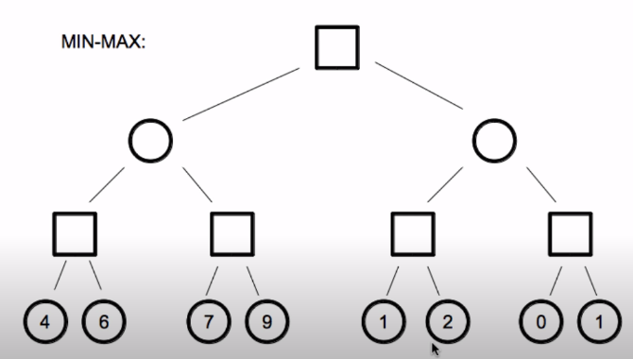

Slide 13
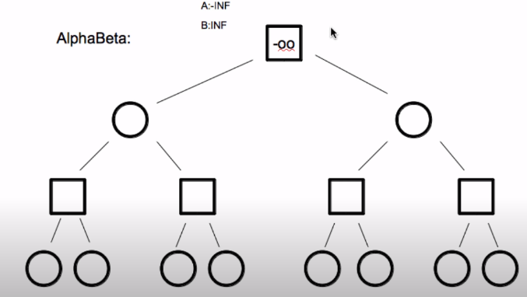

Slide 14
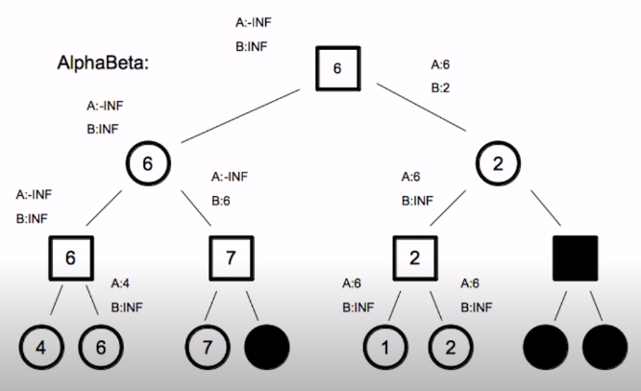

Slide 15
What is Negamax Algorithm?
Negamax search is a variant form of minmax search that relies on the zero-sum property of a two player game.
This algorithm relies on the fact that max(a,b) = -min(-a,-b) to simplify the implementation of the minmax algorithm. More precisely, the value of a position to player A in such a game is the negation of the value to player B.

Slide 16
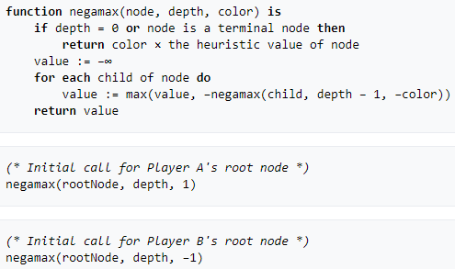
Pseudocode

Slide 17
FRAMEWORK AND MODULES
Programming Language: Python 2.7
Framework: Tkinter 8.6
Module: Pygame 1.9.2
Media file: Images
OS compatibility: Linux/Windows/MacOS

Slide 18
Analysis and future works
The software built by us is a basic artificial intelligent based Chess Engine. We can make it more efficient by applying Machine Learning to it so that it learns from the games played and evolves accordingly.
In future, we plan to add timers and online playing in order to make the game more interesting.

Slide 19
Thank you

