Slide 1

Development of a Data-Driven Crop Advisory System Using Soil and Environmental Parameters Empowering Farmers with AI-Driven Crop Recommendations ------------------------------------------------------------------------------
Presented by:
S.Tanushree Prusty (24CSE078)
Kanak Shahgal (24CSE434)
A.Radha Rani Patra (24CSE063)
Rohit Ohdar (24CSE419)
Department: Computer Science Engg.
Date:23-07-2025

Slide 2
Problem Statement & Need: :-Farmers often rely on traditional knowledge, leading to suboptimal crop choices. :- Unbalanced fertilizer use degrades soil health over time. Climate variability increases risks of crop failure. Impact: :- Low yields, high input costs, and reduced profitability for small farmers. Visuals: :- Comparison image: Traditional vs. scientific farming Graph showing yield variability due to poor crop selection

Slide 3
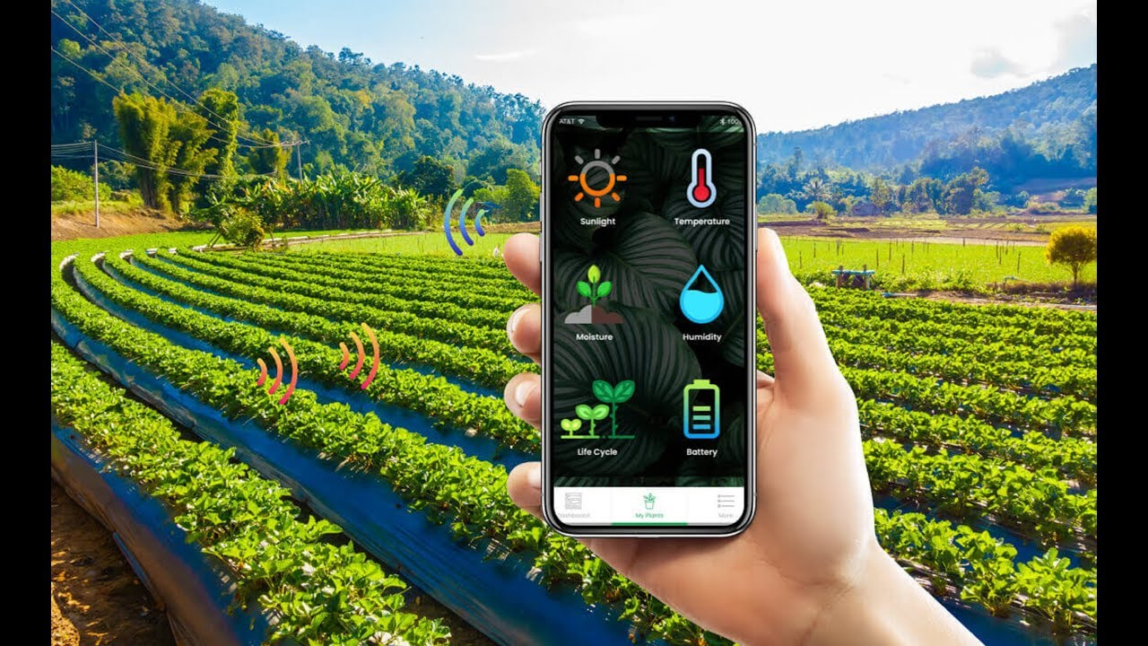
Proposed Solution:
System Overview:
Uses soil parameters (N, P, K, pH) + weather data (temp, humidity, rainfall).
Gives recommendations for best-suited crops and fertilizer advisory.
How It Work:
Enter soil test values (or use defaults)
Add location for weather data
Get instant crop recommendations
View detailed fertilizer guidance

Slide 4
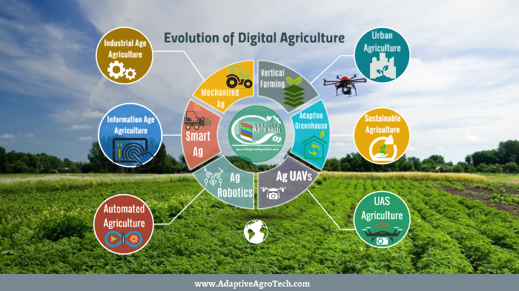
Benefits & Impact:
For Farmers: :- More than 50% Yield with optimized crop choices. :- 30% Cost Save via precise fertilizer use. Climate Resilience with weather-aware planning.
For Agri-Ecosystem:
:-Data-driven policy support.
:-Sustainable soil management.
Benefits & Impact

Slide 5
Tools & Technologies Used: 1. Frontend Development: React.js (Interactive UI) Chart.js (Data visualization) CSS Flexbox/Grid (Responsive design) 2. Backend & Data Processing: Python Flask (API development) Pandas (Data cleaning/analysis) Scikit-learn (ML models: Random Forest/Decision Trees) 3. Machine Learning Pipeline: Soil Data Training: ICAR/FAO datasets (N, P, K, pH) Weather Integration: IMD/OpenWeather API Model Accuracy: ~85% (Cross-validated) 4. Deployment: Netlify (Frontend hosting) Render/Heroku (Backend API) Git/GitHub (Version control) 5. Key Techniques: Feature Engineering (Soil-weather correlation) Geospatial Analysis (Location-based recommendations) User Feedback Loop (Improving model accuracy)

Slide 6
Conclusion: :- This website make crop recommendation analysis simple visual. :- Helps in decision-making for modern farmering. :- Supports smart agriculture using real data. -------------------------------------------------------------------------------------------------------------------------- “Yesterday we plowed with bulls – today we’ll farm with data!” Thank You!

