Slide 1
MCS-218 (Data Communication and Computer Networks. )
Sunil Kushwaha

Slide 2
INTRODUCTION TO INTERNET
Today it is the era of computers, to be more specific, the digital data. Every organization, small or big in size, doing business from a single site or multiplesite, from one nation or over the seas, not only uses computers to handle various transactions but also communicate information among various sites located over various geographically distant places. The means by which the information is exchanged among computers separated apart is known as the computer Internet. a network is; entities connected to each other to exchange some information. when entities are replaced by computing devices, it is the computer network.

Slide 3
OBJECTIVES
After completing this unit, one should be able to:
understand the term computer networks;
differentiate between different types of computer networks;
identify the advantages of using computer networks.
identify the applications of computer networks;
understand various network topologies;
know the significance of network protocols; •
understand the two computer network models: OSI and TCP/IP reference model;

Slide 4
WHAT IS THE INTERNET.
The Internet is a global network of computers and other devices that are all connected and can communicate with each other. It allows people all over the world to share information, access websites, send emails, watch videos, and much more.
Inter" + "Net" = "Interconnected Network“
Main Uses of the Internet:
Browsing websites
Communicating (email, social media, messaging)
Entertainment (YouTube, Netflix, games)
Online services (banking, shopping, cloud storage)

Slide 5
The Internet is the biggest computer network with a world-wide scope. It is the network of networks. The Internet comprises lakhs of organizational networks of types: domestic or international, academic or business, and government, which altogether exchange various kinds of data/information
Worlds first general purpose computer network was ARPANET. ARPANET.(Advanced Research Projects Agency Network,)
The Bob Taylor .is known as the father of the Internet. He initiated the project in 1966 to enable access to remote computers. As a result, in 1969 first time in a computer is accessed remotely.

Slide 6
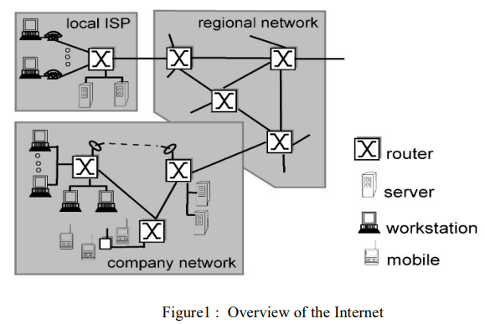

Slide 7
ISP:
ISPs (Internet Service Provides) are responsible for transporting of traffic in the Internet. Internet is very vast in terms of traffic, number of end systems, number of intermediate devices, interconnecting links and distribution of these over geographical locations.
Internet Backbone
Internet backbone is named for core network, can handle traffic at very high speed, interconnecting various networks to allow transmission of data over the worldwide network.
Internet backbone mainly contains a large number of routers, switches and other intermediate devices interconnected with very high speed links (optical fiber links).

Slide 8
Taxonomy of Network
According to the network’s physical area, it can be classified as:
Personal Area Network (PAN)
Local Area Network (LAN):
Metropolitan Area Network (MAN)
Wide Area Network (WAN)

Slide 9
Telephone Network
The PSTN (public switched telephone network) is the telephone network used for voice-communication and spread throughout the world. For data installing a separate infrastructure in parallel to the existing PSTN is not easy and a worthy solution, instead the existing infrastructure for voice communication is used for the data communication also. Hence the telephone network system is inseparable/integral part of the computer data transmission. The very first data communication over telephone lines is implemented through dial-up setup. Further its enhanced version: dedicated lines came into existence.

Slide 10
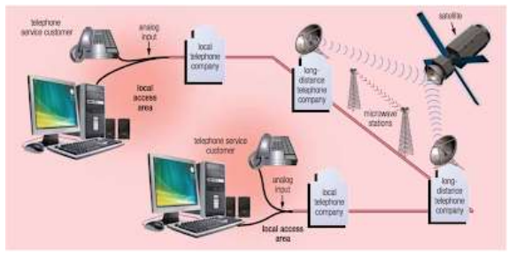

Slide 11
Dial-Up Lines
Setting up data connection over existing analog telephone lines require to install a modem on both the sides (sender side and receiver side). Establishing a data connection over the telephone line using dial-up setup is as similar as establishing a voice call over the same. Before sending the computer data, a connection is required to be established which is temporary in nature between sender and the receiver. To establish the connection modem on sender side dials the telephone number of the receiver side’s modem. Once the connection is established data transmission can takes place. After the completion of the data transmission, either side of the communication can turn down the connection. During thecommunication no other connections can be established between end devices and even at a time either a data or a voice communication can be possible. The speed of the data transmission is very slow over the dialup connection. The maximum speed could be availed is 56kbps over a dial-up connection.

Slide 12
NETWORK TOPOLOGY
NETWORK TOPOLOGY: Topology of a network is defined as: the physical and logical arrangement of the nodes in the network.
In computer networking network topologies are classified into four majoe categories namely:
Bus topology,
Ring Topology,
Star topology
Mesh topology.

Slide 13
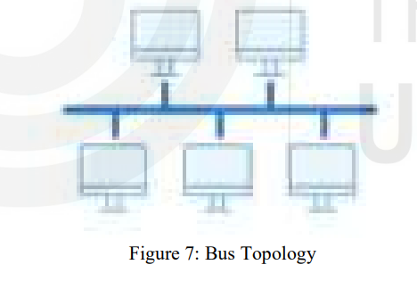
Bus Topology
In a bus topology nodes /computers are connected to a common link (also nown as backbone link). Sometimes bus topology is also called a line or backbone topology. The data flows in single direction on the common channel. In a bus topology at a time only one computer can transmit the data. If more than one computer transmits data at a time, a collision occurs. One of the disadvantage of bus topology is single point of failure i.e. if the backbone link or the common link gets faulty the overall topology gets down.

Slide 14
Some of the advantages of bus topology :
Installation wise bus topology is cheaper as compared to others.
Easy to install
Some of the disadvantages of bus topology
If the backbone link is in fault, the communication of whole topology fails
At a time only one computer can transmit the data, if this rule is not followed collisions occur.
Any information available on the common link is accessible to all connected computers, leading to unsecure communication.

Slide 15
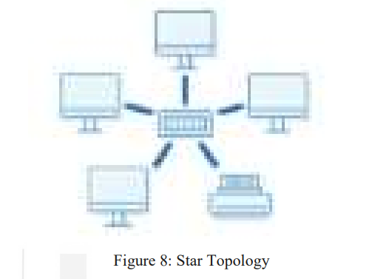
Star Topology
All the computers/devices are connected to a central switch/hub/server forming a star like topology. All the communication in star topology take place through the central node. The centralized node can act as a simple forwarding device or can also act as an intelligent firewall / filtering device.

Slide 16
Some of the advantages of star topology :
Easy to install and extend.
Robust toward fault tolerance.
Some of the disadvantages of star topology:
Single point of failure, i.e. if the central node fails, overall system crash.
Performance of the topology is depended on the central node’s performance.

Slide 17
Ring Topology:
Each device/computer is connected with two devices forming a ring type of tructure.
In general the data can move in one direction in the ring, but by installing another cable the data can move in reverse direction also.
A token message keeps on rotating in the ring topology.
A node having some data to be transmitted, hold the token message and transmits the data, after completion of data transmission, the token is forwarded to next node.
If a node does not have any data to send, it simply forwards the token to next node. Without holding the token data transmission is not allowed in ring topology

Slide 18
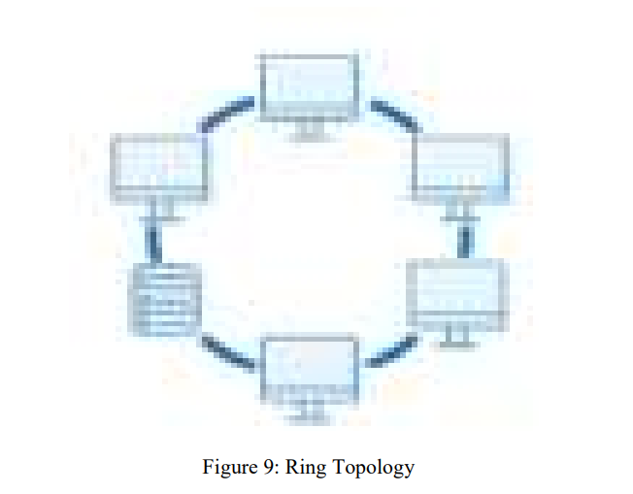

Slide 19
Some of the advantages of ring topology are:
Minimum chances of data collirion, as transmission is restricted with the help of token message.
It is cheap to install.
Some of the disadvantages of ring topology are:
Fauld diagnosis is difficult in ring topology.
Extension of the topology by adding a new device or removing an existing device is not easy.

Slide 20
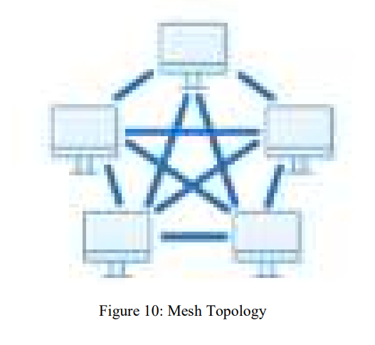
Mesh Topology:
In a mesh topology each device/node is directly connected to every other device/node. It is one of the most reliable and fault tolerant network topology. To connect n device/nodes in a mesh topology, it requires n(n-1)/2 number of cables.

Slide 21
Some of the advantages of mesh topology are
Mesh topology is highly robust.
Easy to diagnose the fault.
As data is sent to destination directly without any intermediate node, hence data transmission is secure in mesh topology.
Some of the disadvantes of Mesh topology:
Installation of mesh topology is High cost
Maintenance is not easy.
For a large number of devices/nodes it is very difficult to manage mesh network.

Slide 22
There are two network models defined in the networking: OSI model and TCP/IP model.
OSI Models: OSI is Open System Interconnection. It is also known as reference model for networking. OSI model is not exactly based on the working of the networking instead it was designed for understanding purpose of the networking. OSI model is seven layer model. It was proposed by ISO (Internation Organization for Standards) in 1984 after the TCP/IP model.

Slide 23
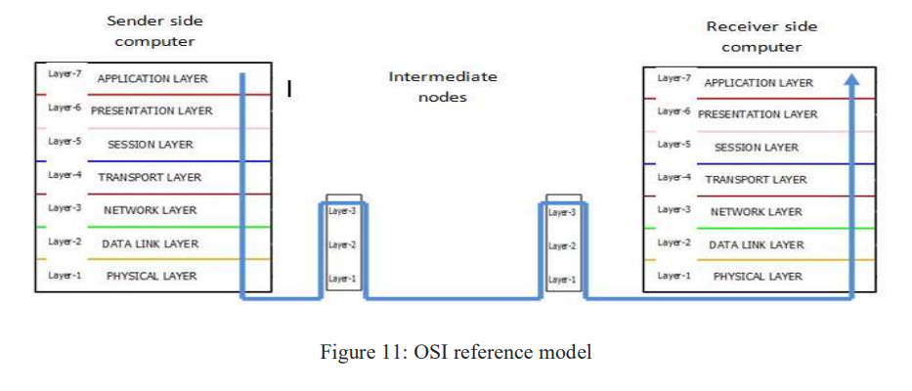
OSI

Slide 24
DATA TRASNMISSION BASICS & Communication TRANSMISSION MEDIA
OBJECTIVES :
After completing this unit,one should be able to:
• understand the Data Communication Terminologies;
• understand Data Transmission Modes;
• understand Analog and Digital Data Transmission;
• understand the terms Attenuation, Delay Distortion, Noise, Signal to Noise ratio etc; understand the Concept of Delays;
• differentiate Guided and Unguided Transmission Media;
• understand the Wireless Data Transmission Mode.

Slide 25
Data communication :Data communication is not just to transfer the data between sender and receiver but also that the interpretation of the data should be same and correct by both the sednder and the receiver
DATA COMMUNICATION TERMINOLOGY
Terminologies commonly used in data communication
Channel: A channel is the medium used to transmit the information between sender and the receiver. In other words channel is the path through which the exchange of information between devices takes place.
Channel is classified into two categories:
wired
wirless.

Slide 26
In metal wired channel the electrons present within the metal carry the information. In fiber optics based guided media concept of total internal reflection of light is used to transmit the information in a fiber glass cable. Wired channels are guided media i.e. as the electrons can move in the metal in restricted way in certain direction carrying the information, whereas in the wireless channels the air particals are responsible for data transmission
Every channel has the channel capacity which limits its maximum data carrying capacity over a certain time period. Based on the type of information could be propagated through channel,

Slide 27
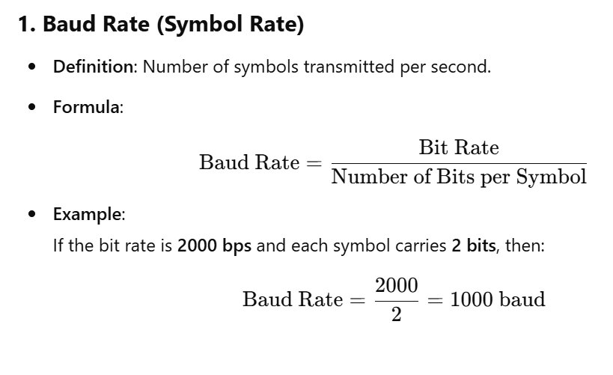

Slide 28
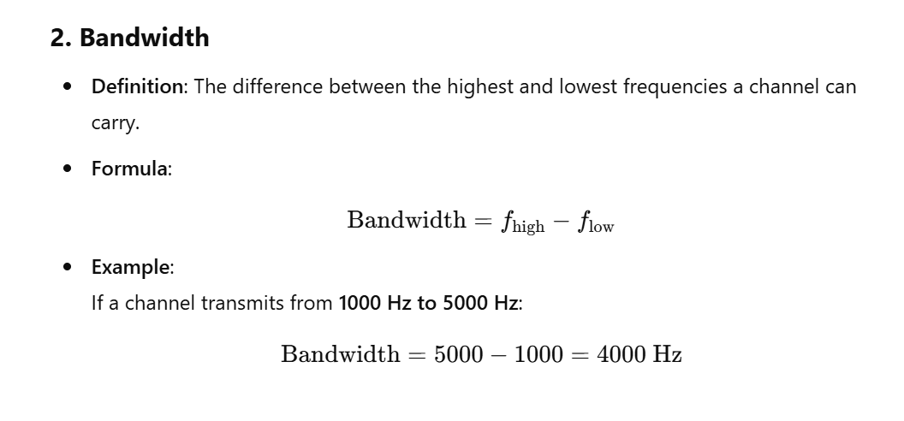

Slide 29
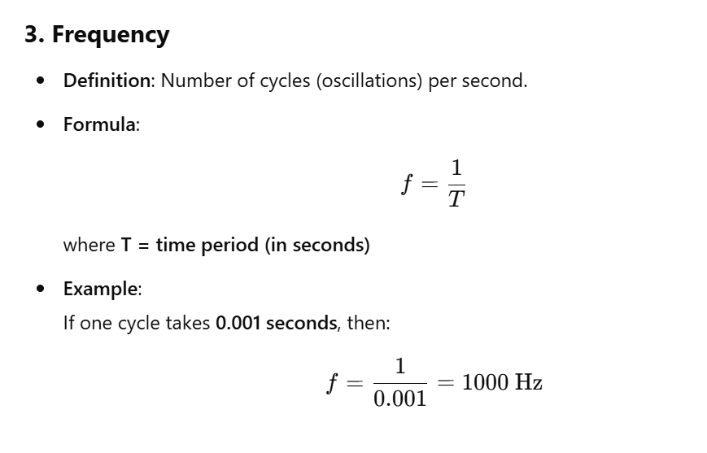

Slide 30
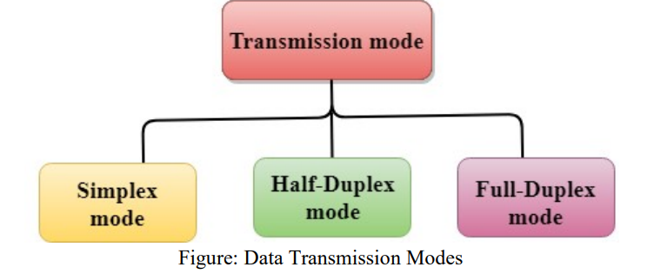
MODES OF DATA TRANSMISSION
Data transmission mode is how data is transferred from sender to receiver over a communication channel in the network. Mode of transmission defines the direction of flow of data.
Based on the mode of data transmission a communication can be classified as:
Simplex Mode,
Half duplex mode
Full duplex mode.

Slide 31
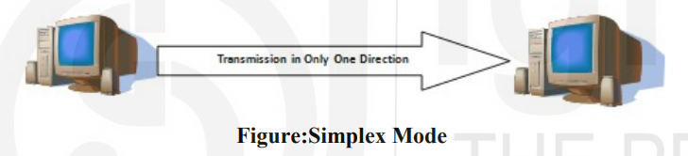
1 Simplex mode, Half Duplex mode and Full Duplex mode transmission:
In Simplex mode of data transmission, the data through the channel can be transferred in one direction only.
This mode of transmission is useful when one device always acts as the transmitter and another as the receiver
Example : The channel used in radio (AM/FM) communication is type of simplex channel where the radio station always transmits the signals and the listeners always receives the signal

Slide 32
2. In computer system: the keyboard, mouse, printer, scanner and monitor also uses the simplex mode transmission, data is always transferred in one direction only.
.Advantage of simplex mode:One of the advantage of simplex mode is that the station (acting as transmitter) can utilize the full bandwidth of the channel. Simplex mode is not suitable for intercommunication among systems due to the constraint of unidirectional transmission.
Duplex Mode of data transmission:
In contrast to the simplex mode in duplex mode of transmission data is allowed to flow in both the direction over the channel.
Further, duplex mode of transmission is classified into two categories namely: Half duplex mode and Full duplex mode.

Slide 33
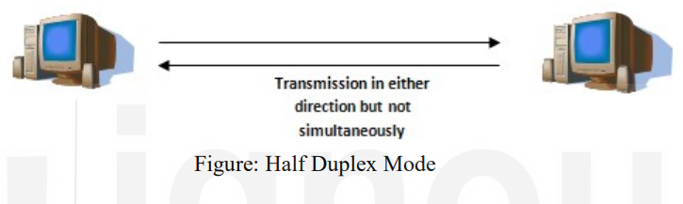
Half Duplex Mode of Data Transmission:
In half duplex mode of transmission the data can flow in both the direction but can be allowed in one direction at a time i.e. at a time one of the communicating devices acts as transmitter and another as receiver. Both cannot act as transmitter simultaneously
half-duplex is two-way communication, but only one device is allowed to send data at a time.
The full bandwidth is used by either of the communicating devices. One of the example of half duplex communication is the walkie-talkie, in which one end speaks and another listens, both are not allowed to transmit voice signals simultaneously.

Slide 34
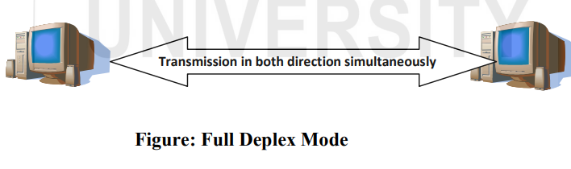
Full Duplex Mode of Data Transmission:
In full duplex mode both the devices can act as transmitter and receiver simultaneously.
Both the ends should be capable of transmitting and receiving the data simultaneously.
In this mode of transmission the data can flow in both directions at a time. The bandwidth of the channel is divided between both end devices.
The most popular full duplex communication is the telephone network where both ends can transmit and receive voice signals simultaneously.

Slide 35
Serial and Parallel Communication
Digital devices works on digital data in the form of binary bits.
Data is transmitted among digital devices in the form of binary bits .
Type of transmission
serial transmission and parallel transmission.
In serial transmission bits are transmitted in serial manner i.e. one after another through a channel whereas,
In parallel transmission bits are transmitted in parallel manner i.e. multiple bits are transmitted simultaneously through multiple channels

Slide 36
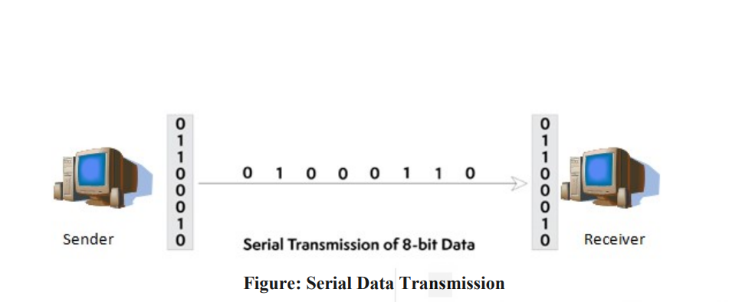

Slide 37
As shown in figure, in serial transmission between sender and receiver the data is sent bit by bit on the channel. In order to interpret the data correctly both ends mutually agree on transmitting the data from LSB (least significant bit) to MSB (most significant bit). On the sender side an extra hardware component is required to convert the bytes of characters (i.e.parallel) to serial. Simillarly on the receiver side some mechanism is to be applied to convert the received serial data into parallel to form the character bytes as sent. Serial transmission is most suitable for transferring small amount of data over long distance. Serial transmission further classified into two categories: asynchronous transmission, synchronoustransmissison and isochronous transmission which are discussed in section 2.3.3.

Slide 38
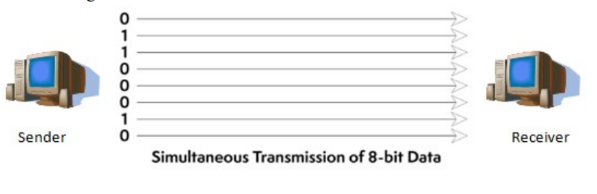
Parallel data communication: In parallel communication multiple bits are transmitted in parallel over multiple channels simultaneously. Data transmission through parallel data communication is much faster in comparision to transmitting the data through serial communication methods. Figure: Parallel Data Transmission In parallel data communication many bits are transmitted simultaneously hence, it is very important to note that the speed of transmission of bits on parallel channel

Slide 39
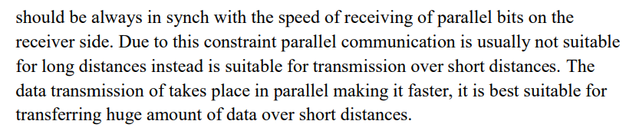
In parallel data communication many bits are transmitted simultaneously hence, it is very important to note that the speed of transmission of bits on parallel channel

Slide 40
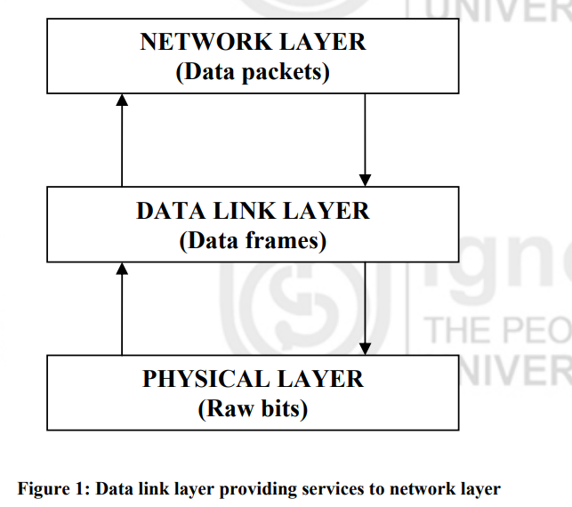
FRAMING
As you already know, the physical layer deals with raw transmission of data in the form of bits and gives services to the data link layer. The data link layer provides services to the network layer as shown in the Figure 1

Slide 41
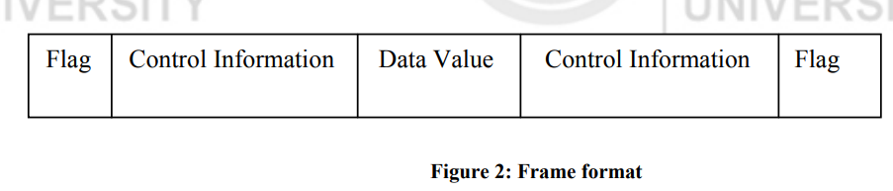
The raw data coming from the Physical layer is converted into frames for forwarding to the network layer. This is done to ensure that the transmission of data is error free. Error detection and correction (if required) is done by the Data link layer, which is discussed in the following sections. The structure of the frame is shown in Figure 2. Converting the bit stream into frames is a tedious process. The beginning and end of each frame should be explicitly marked. The easiest way to do so is to insert some time gap between frames.

Slide 42
But, it is difficult to keep track of counts on timing to mark the start and end time of each frame. So to overcome the same, we will discuss the following methods for framing.
Character Count
Character Patterns
Bit Patterns
Framing by Illegal code (code violation

Slide 43
Cyclic Redundancy Check (CRC) is used to detect burst errors
In this method, you would need to treat strings of bits as coefficients of a polynomial code that uses modulo 2 arithmetic. In modulo 2 arithmetic there are no carriers for addition and borrows for subtraction. Polynomial codes treat bit strings as representative of polynomials with coefficients of 0 and 1 only

Slide 44
In this method the Sender divides frame (data string) by a predetermined Generator Polynomial and then appends the remainder (called checksum) onto the frame before starting the process of transmission. At the receiver end, the receiver divides the received frame by the same Generator polynomial. If the remainder obtained after the division is zero, it ensure that data received at the receiver’s end is error free. All operations are done modulo 2.

Slide 45
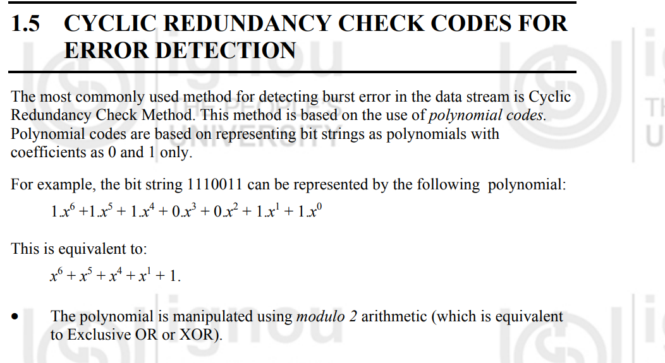

Slide 46
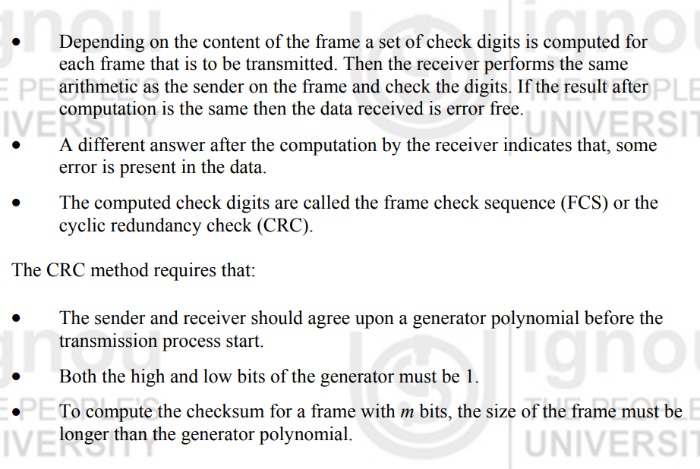

Slide 47
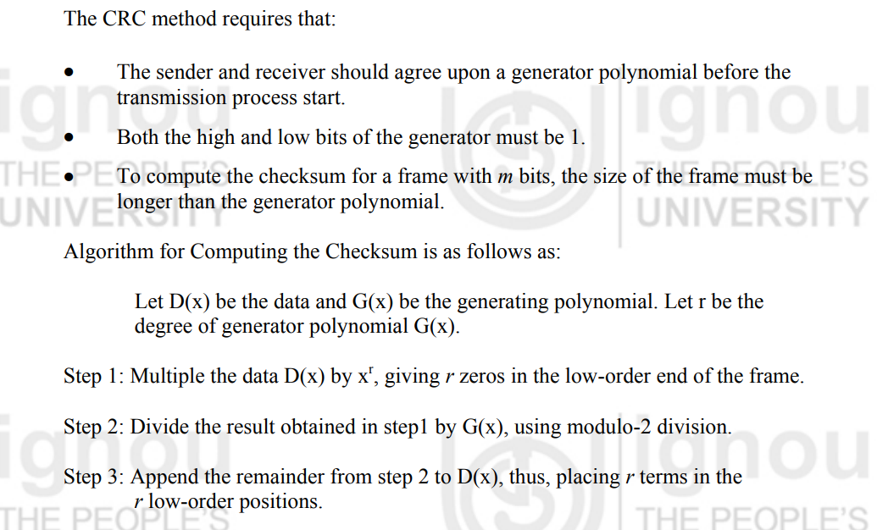

Slide 48
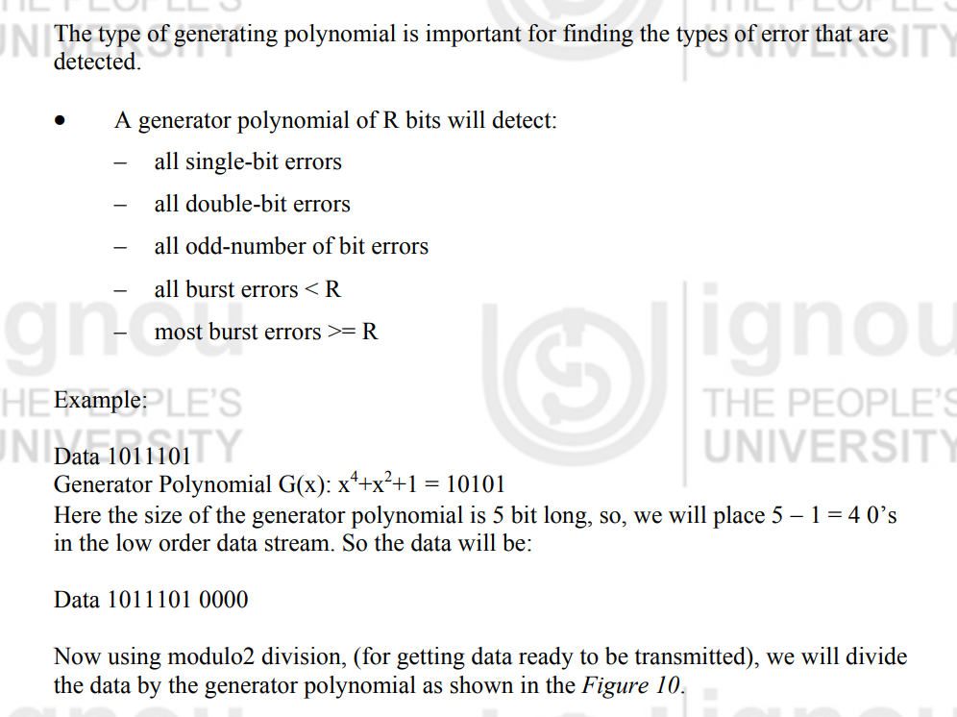

Slide 49
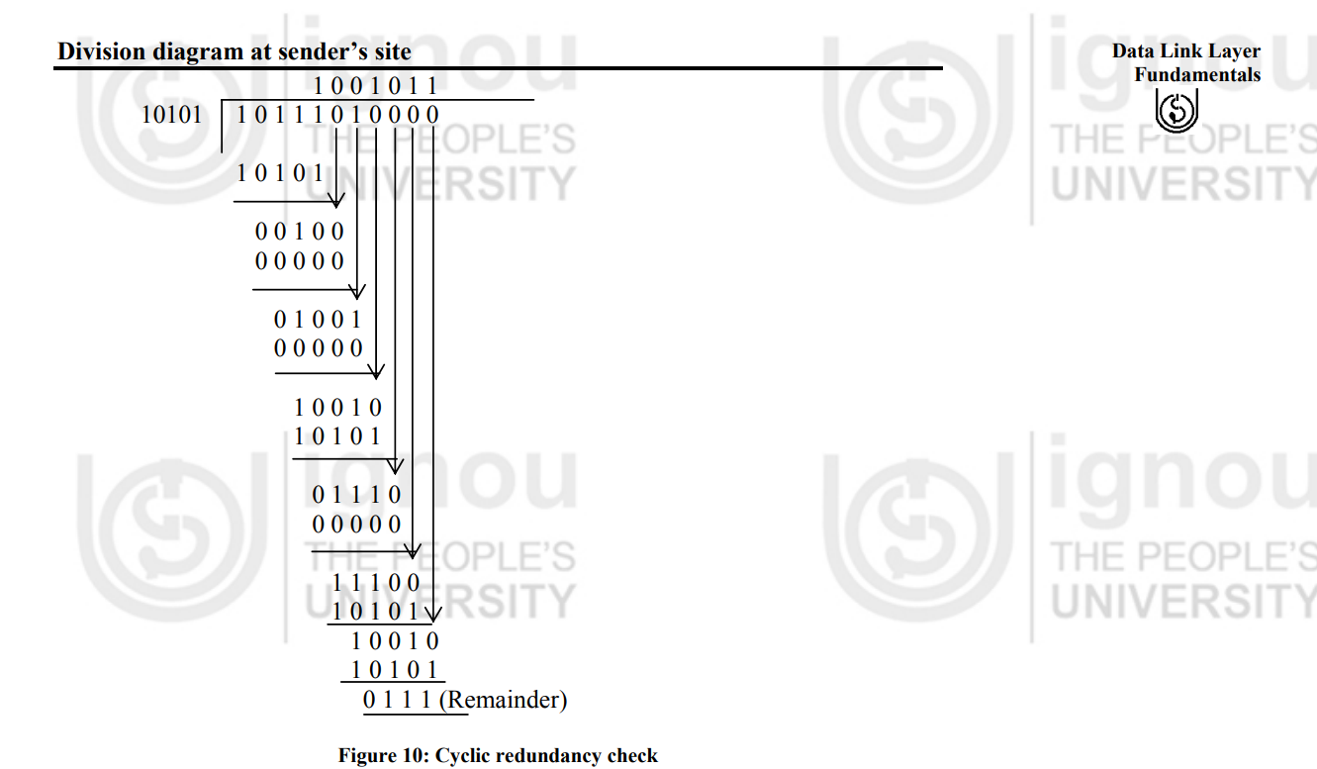

Slide 50
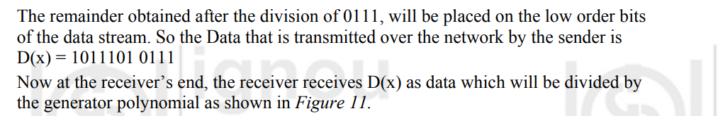
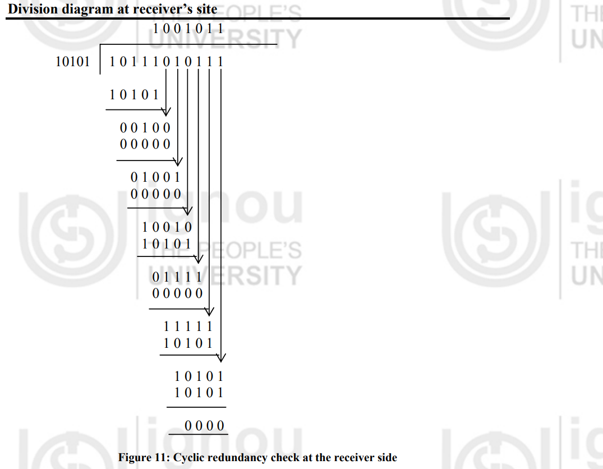
Here the remainder obtained after division is 0000, so it ensure that data received at the receiver end is error free otherwise, it indicates that the data has some error in it. In this way the CRC method can detect whether the data has some error or is error free

Slide 51
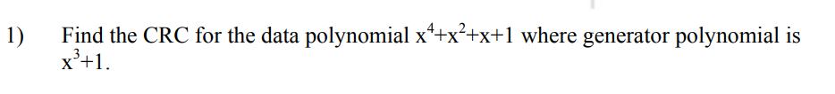

Slide 52
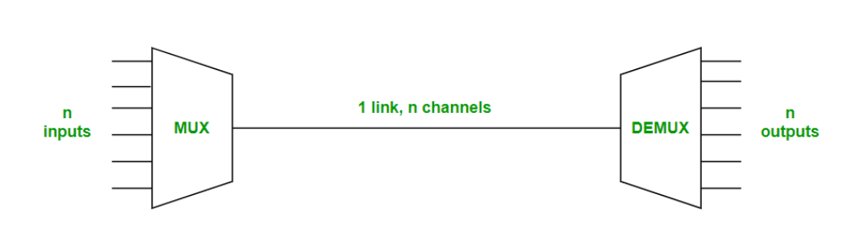
What is Multiplexing?
Multiplexing is the sharing of a medium or bandwidth. It is the process in which multiple signals coming from multiple sources are combined and transmitted over a single communication/physical line.

Slide 53
Uses of Multiplexing
Multiplexing is used for a variety of purposes in data communications to enhance the efficiency and capacity of networks. Here are some of the main uses:
Efficient Utilization of Resources: Multiplexing allows multiple signals to share the same communication channel, making the most of the available bandwidth. This is especially important in environments where bandwidth is limited.
Telecommunications: In telephone networks, multiplexing enables the simultaneous transmission of multiple telephone calls over a single line, enhancing the capacity of the network.
Internet and Data Networks: Multiplexing is used in internet communications to transmit data from multiple users over a single network line, improving the efficiency and speed of data transfer.
Satellite Communications: Multiplexing helps in efficiently utilizing the available bandwidth on satellite transponders, allowing multiple signals to be transmitted and received simultaneously.

Slide 54
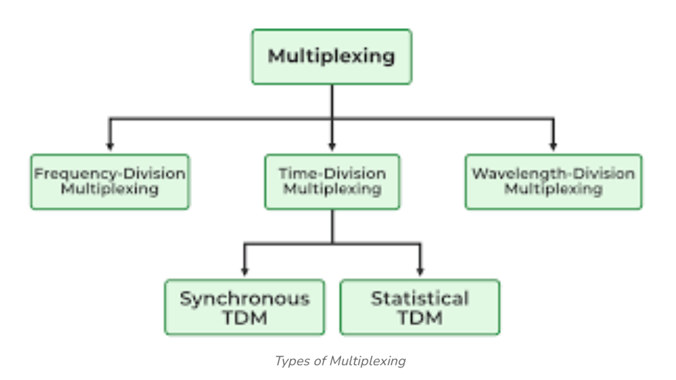
Types of Multiplexing
There are five different types of multiplexing techniques, each designed to handle various types of data and communication needs.

Slide 55
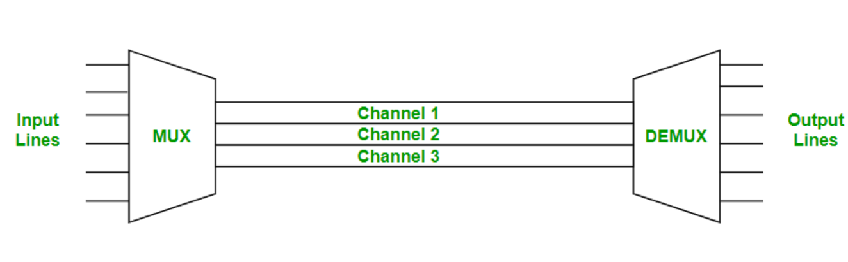
1. Frequency Division Multiplexing
Frequency division multiplexing is defined as a type of multiplexing where the bandwidth of a single physical medium is divided into a number of smaller, independent frequency channels.

Slide 56
Frequency Division Multiplexing is used in radio and television transmission.
In FDM, we can observe a lot of inter-channel cross-talk because in this type of multiplexing the bandwidth is divided into frequency channels. In order to prevent the inter-channel cross talk, unused strips of bandwidth must be placed between each channel. These unused strips between each channel are known as guard bands

Slide 57
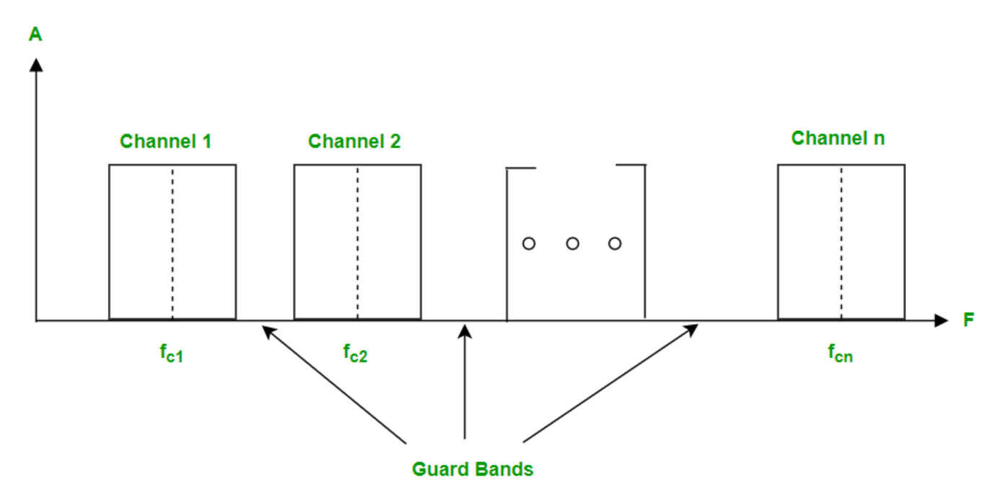

Slide 58
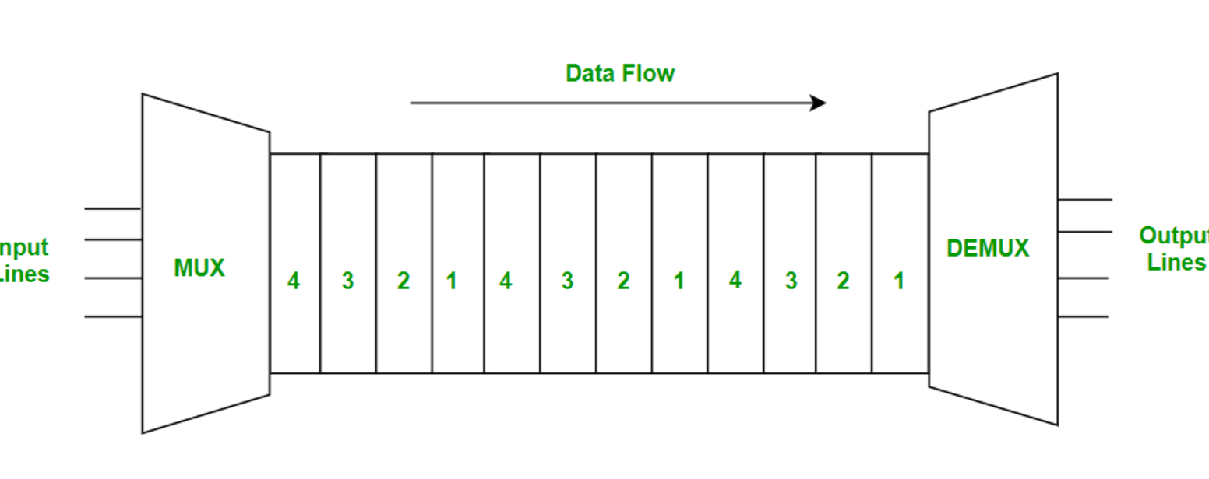
2. Time Division Multiplexing
Time-division multiplexing is multiplexing wherein FDM, instead of sharing a portion of the bandwidth in the form of channels, in TDM, time is shared. Each connection occupies a portion of time in the link. In Time Division Multiplexing, all signals operate with the same frequency (bandwidth) at different times.

Slide 59
There are two types of Time Division Multiplexing :
Synchronous Time Division Multiplexing
Statistical (or Asynchronous) Time Division Multiplexing
synchronous TDM : Synchronous TDM is a type of Time Division Multiplexing where the input frame already has a slot in the output frame. Time slots are grouped into frames. One frame consists of one cycle of time slots. Synchronous TDM is not efficient because if the input frame has no data to send, a slot remains empty in the output frame. In this, we need to mention the synchronous bit at the beginning of each frame.

Slide 60
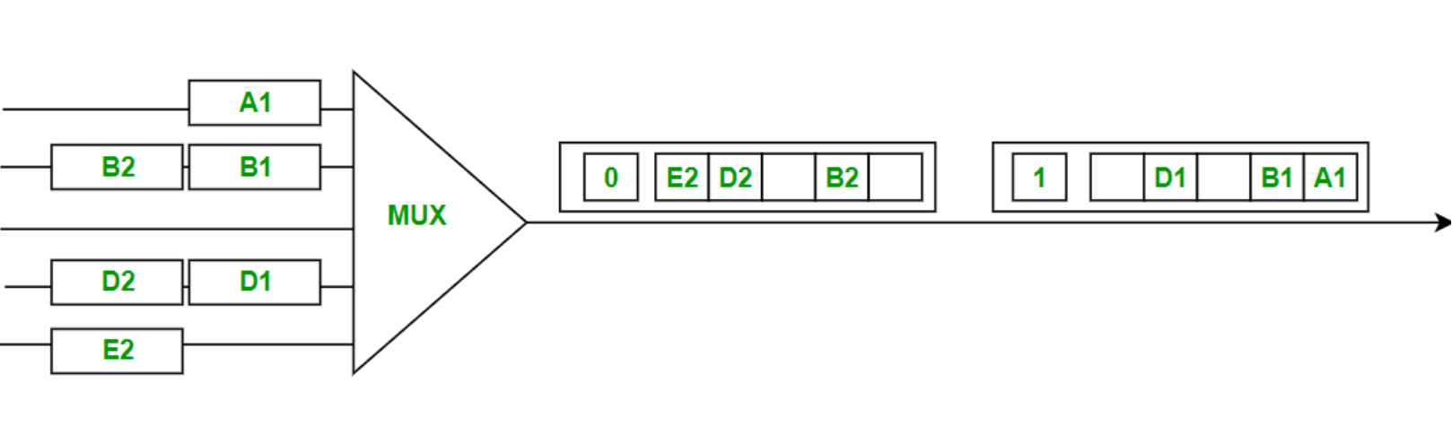

Slide 61
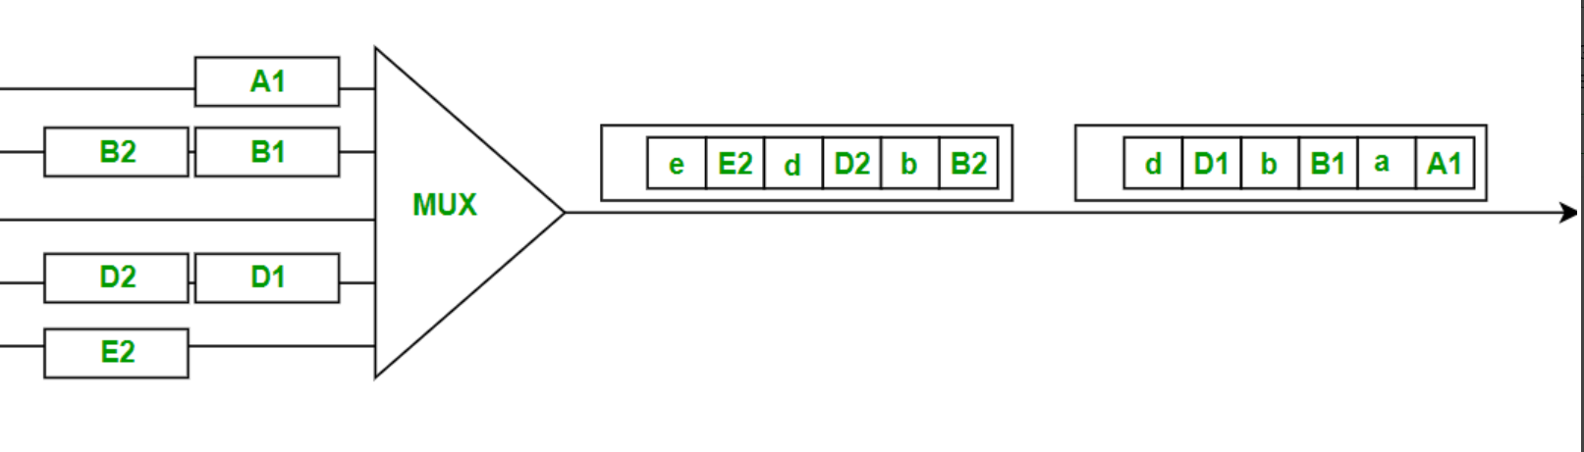
Statistical TDM: Statistical TDM is a type of Time Division Multiplexing where the output frame collects data from the input frame till it is full not leaving an empty slot like in Synchronous TDM. In this, we need to include the address of each particular data in the slot that is being sent to the output frame.

Slide 62
Wavelength Division Multiplexing
Wavelength Division Multiplexing (WDM) is a multiplexing technology used to increase the capacity of optical fiber by transmitting multiple optical signals simultaneously over a single optical fiber, each with a different wavelength. Each signal is carried on a different wavelength of light, and the resulting signals are combined onto a single optical fiber for transmission. At the receiving end, the signals are separated by their wavelengths, demultiplexed and routed to their respective destinations. It is used in telecommunications, cable TV, ISPs, and data centers for high-speed, long-distance data transmission.
WDM can be divided into two categories:
Dense Wavelength Division Multiplexing (DWDM) is used to multiplex a large number of optical signals onto a single fiber, typically up to 80 channels with a spacing of 0.8 nm or less between the channels.
Coarse Wavelength Division Multiplexing (CWDM) is used for lower-capacity applications, typically up to 18 channels with a spacing of 20 nm between the channels.

Slide 63
Advantages of Multiplexing
Efficient Use of Bandwidth: You can send more than one signal over a single channel. This way, you can use the channel’s capacity more efficiently.
Increased Data Transmission: Multiplexing can significantly boost the amount of data that can be sent over a network simultaneously, enhancing overall transmission capacity.
Scalability: Multiplexing allows networks to easily expand and accommodate more data streams without requiring significant changes to the existing infrastructure.
Flexibility: Different types of multiplexing (TDM, FDM, WDM, CDM) can be used based on the specific needs and characteristics of the communication system, providing flexibility in network design.

Slide 64
Disadvantages of Multiplexing
Synchronization Issues: Ensuring that multiple data streams remain properly synchronized can be challenging, leading to potential data loss or errors if not managed correctly.
Latency: Combining multiple signals into one can introduce delays, as each data stream needs to be processed, synchronized, and demultiplexed at the receiving end.
Signal Degradation: Over long distances, multiplexed signals can experience degradation and interference, requiring additional measures such as signal boosters or repeaters to maintain quality.
Resource Management: Allocating and managing resources for multiplexing can be complicated, requiring careful planning and real-time adjustments to avoid congestion and ensure efficient operation.

