Slide 1

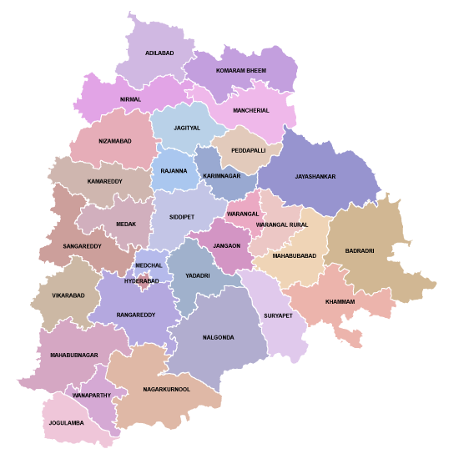
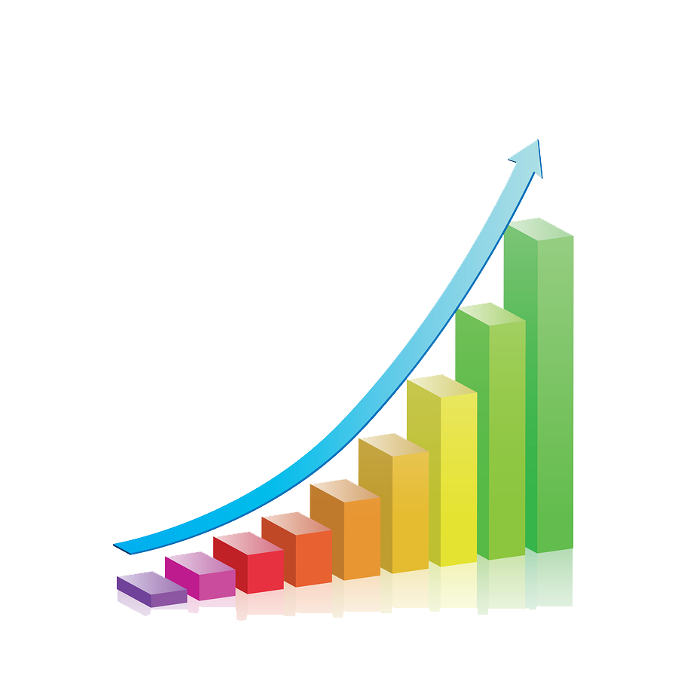
TELANGANA GROWTH ANALYSIS
Transportation
Stamp Registrations
TS-iPASS
Presented By: Rohit Manoj Shahare

Slide 2
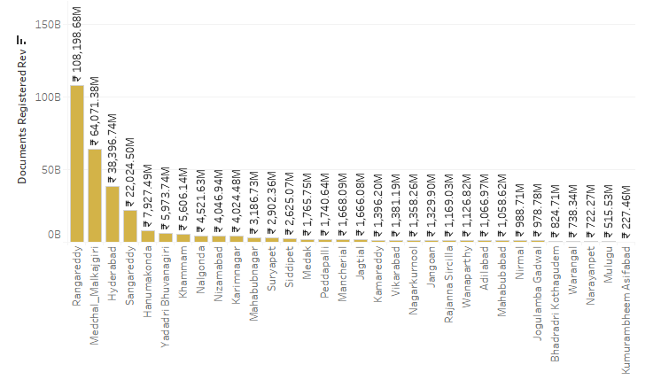
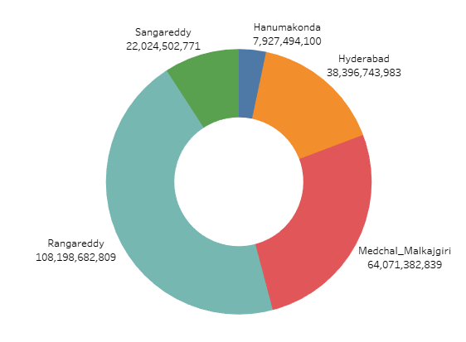
Question 1: How does the revenue generated from document registration vary across districts in Telangana? List down the top 5 district that showed the highest document registration revenue growth between FY 2019 and 2022.
Ans: By looking at Graph we can say that some district generate very much higher amount rhan other districts by very large margin. That because population of these districts are more compare to other districts. And more rich people are lived in these districts

Slide 3
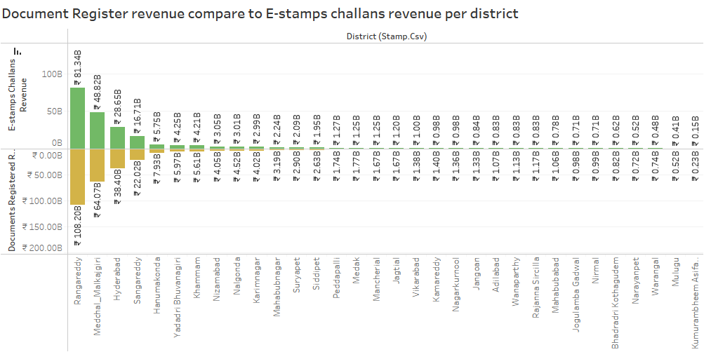
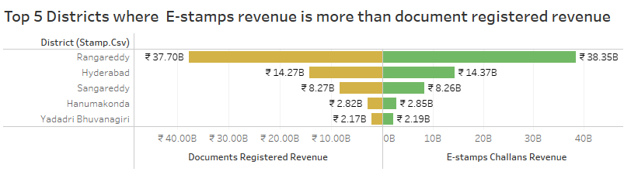
Question 2: How does the revenue generated from document registration compare to the revenue generated from e-stamp challans across districts? List down the top 5 districts where e-stamps revenue contributes significantly more to the revenue than the documents in FY 2022?
Ans - We can see that in 1st graph almost Every District of Telengana state document registration revenue is 20% to 30% is more than the E-stamps challan revenue in 2019 to 2022 FY But in specific FY 2022 E-stamps challan revenue is more than document registration revenue in specific districts. There is Top 5 districts that show in 2nd Graph

Slide 4
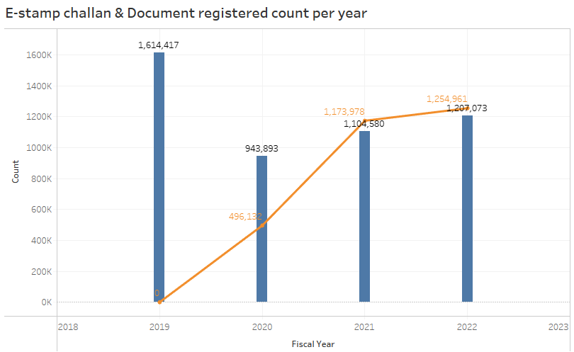

Question 3: Is there any alteration of e-Stamp challan count and document registration count pattern since the implementation of e-Stamp challan? If so, what suggestions would you propose to the government?
As we can see E-stamps challan is started from 2019 and after 1 year later the count of document registration is decreased up to 6,00,000 in 2020

Slide 5
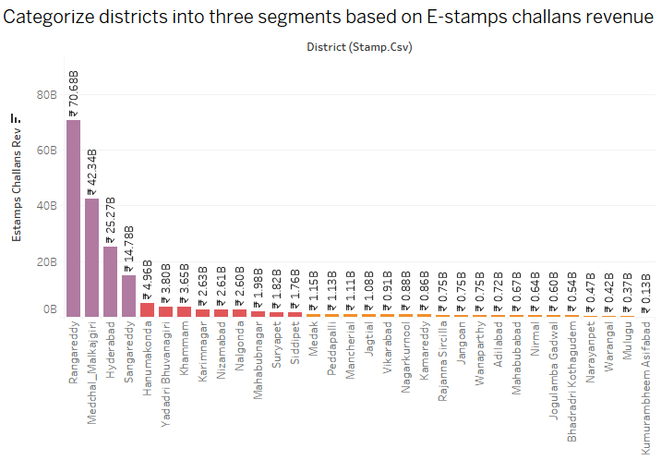

Question 4: Categorize districts into three segments based on their stamp registration revenue generation during the fiscal year 2021 to 2022.
I Categories these districts in to 3 category for FY 2021 To 2022
The E-stamps challan revenue is fall under ₹0 to ₹1.5 Billion then they are under 'lower revenue district' category. Simmilar revenue is between ₹1.5 Billion to ₹5 Billion they are under 'Middle revenue district' and Higher than that they are in 'higher revenue district'.

Slide 6
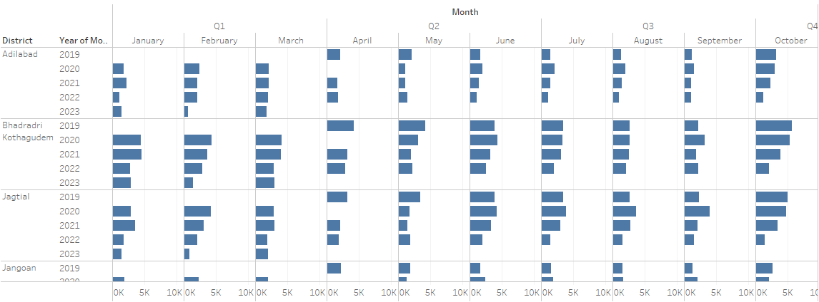
Question 5: Investigate whether there is any correlation between vehicle sales and specific months or seasons in different districts. Are there any months or seasons that consistently show higher or lower sales rate, and if yes, what could be the driving factors? (Consider Fuel-Type category only )
On the basis of analysis of all the districts with respect to different different month i found that in the sales of vehical in most of the month is same in between 20k-45k (in top 3 districts), but there are some specific month that sales goes down that are 2nd querter of 2020, May-2021 , 4th quarter of 2022i think sales of vehical is related to condition of market in specific month in every month vehical sales is more in 3 district compare to other district 1.Hyderabad, 2.Medchal Malkajigiri, 3. Rangarreddy

Slide 7
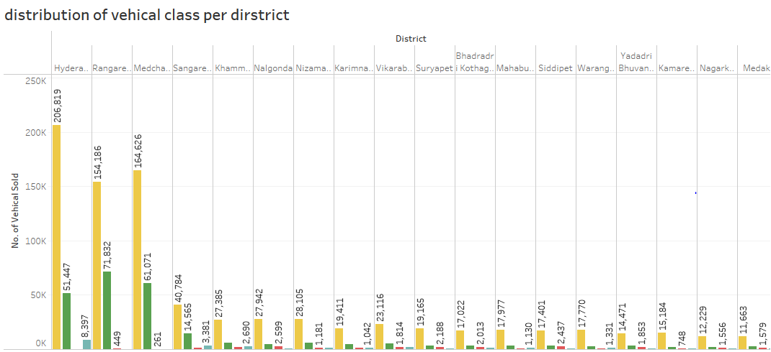
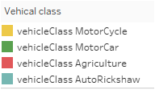
Question 6: How does the distribution of vehicles vary by vehicle class (MotorCycle, MotorCar, AutoRickshaw, Agriculture) across different districts? Are there any districts with a predominant preference for a specific vehicle class? Consider FY 2022 for analysis.
Ans- distribution of vehicles vary by vehicle class across different districts. On the basis of analysis Vehical class MoterCycle is sold significantly more than the other Vehical class. After that Vehicle class MoterCar is on 2nd number, after that AutoRickshaw and Agriculture. Hyderabad, Rengareddy, and Medchal Malkajgiri these districts are predominant preference for MoterCycle and MotorCar Vehical class.

Slide 8
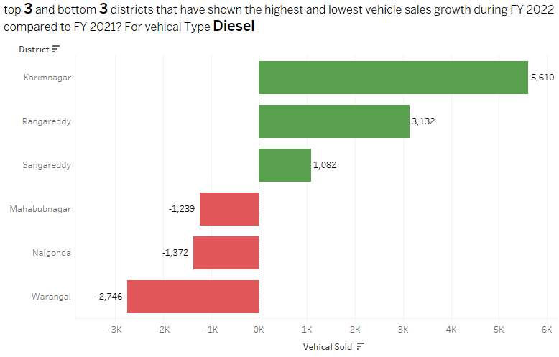
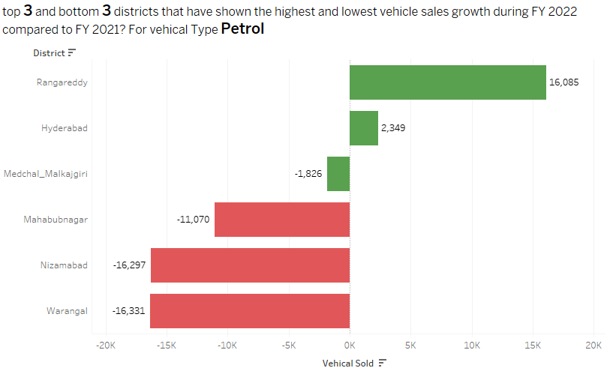
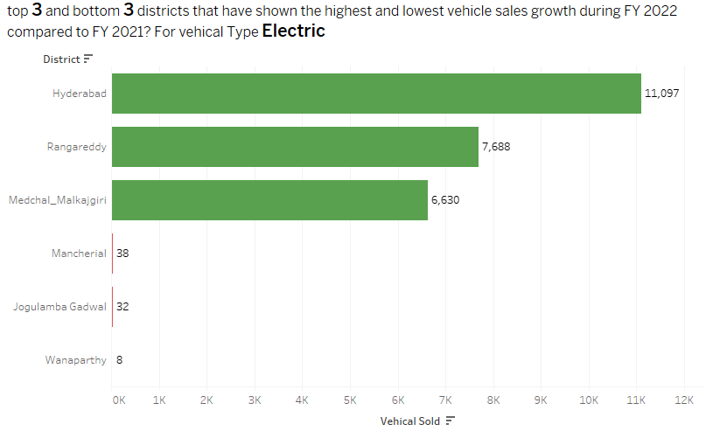
Question 7: List down the top 3 and bottom 3 districts that have shown the highest and lowest vehicle sales growth during FY 2022 compared to FY 2021? (Consider and compare categories: Petrol, Diesel and Electric)
These districts shows the highest and lowest sale of Petrol type of Vehical compare to FY 2021
The sale of Petrol Vehical in only two districts. The sale decrease significantly in all thers districts. In warangal sale decrease by 16,331
We can see that the most profitable and consistent is Electric type of Vehical. In Hyderabad Sale increase by 11,097

Slide 9
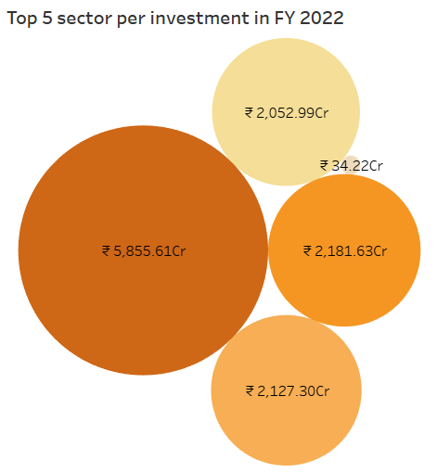
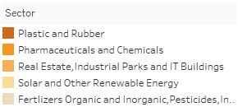
Question 8: List down the top 5 sectors that have witnessed the most significant investments in FY 2022.

Slide 10
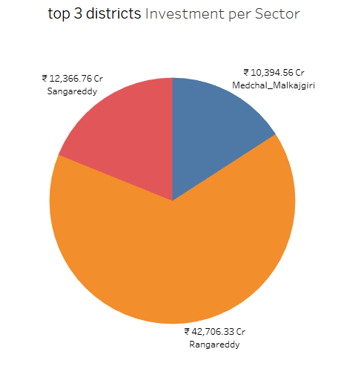
Question 9: List down the top 3 districts that have attracted the most significant sector investments during FY 2019 to 2022? What factors could have led to the substantial investments in these particular districts?
All of these districts are located in close proximity to state capital hyderabad. International airport are there. National highway 7 are there for transport facility. in these district their are lots of ITI colleges, polytechnic & engineering colleges are present. skilled workers, semi skilled workers are there. railway connectiviy are there. Natural Resources like Granite, Quartz ... Lots of other factor are risponsible for this.

Slide 11
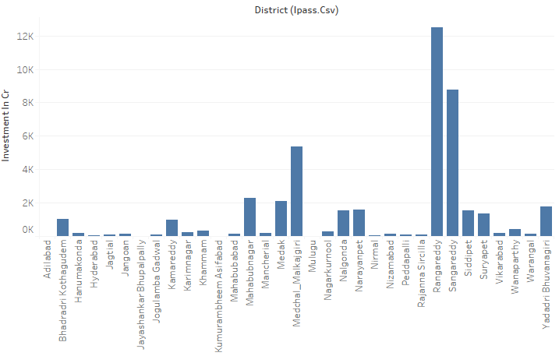
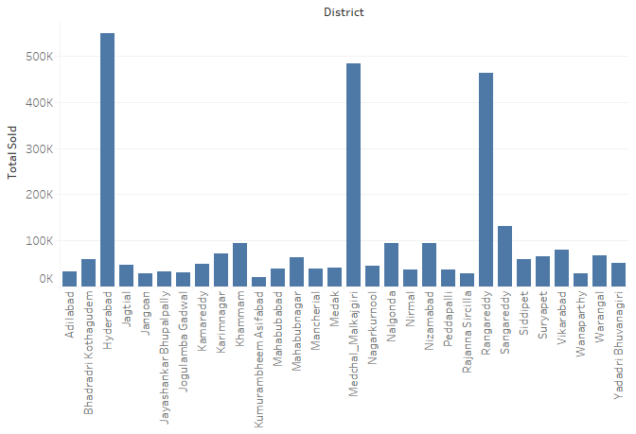
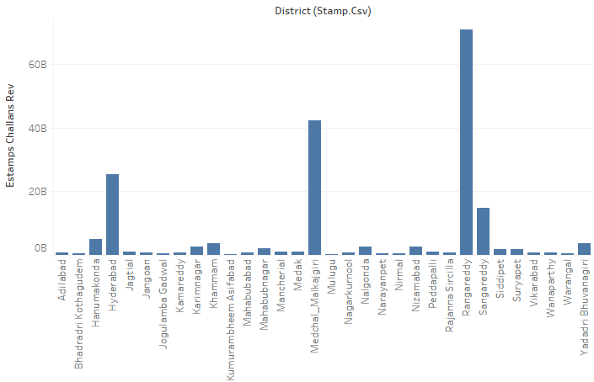
Question 10: Is there any relationship between district investments, vehicles sales and stamps revenue within the same district between FY 2021 and 2022?
District investment
We clearly see the relationship between these 3 w.r.to districts. Rengareddy, Sangareddy, Medchal Malkajgiri & Hyderabad in these districts all department are related to each other.
Vehicla sales
Stamp revenue

Slide 12
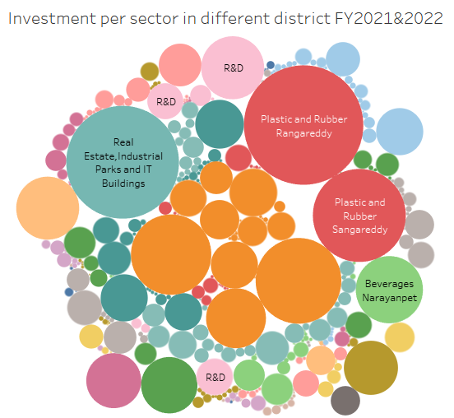
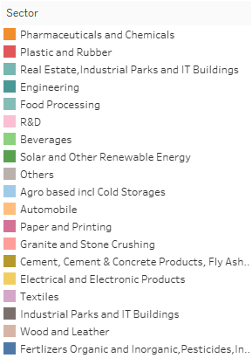
Question 11: Are there any particular sectors that have shown substantial investment in multiple districts between FY 2021 and 2022?
As we can see in fig. their are lot of Districts with respect to Sector( Separateed with colour). Top 3 sector w.r.t Investment 1) Pharmaceutical and chemicals with investment of ₹9043Cr. 2) Plastic and Rubber With ₹7915Cr. 3) Real estate, industrial park &IT building With ₹4143Cr.

Slide 13
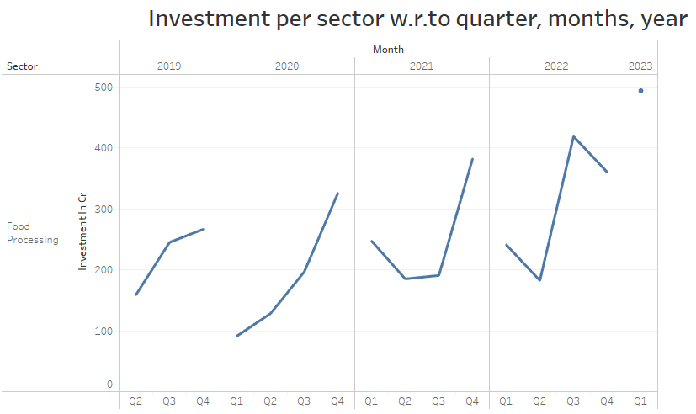
Question 12. Can we identify any seasonal patterns or cyclicality in the investment trends for specific sectors? Do certain sectors experience higher investments during particular months?
We can see that in this chart in food processing sector there is a seasonal pattern starting from quarter Q1&Q2 investment are increasing upto the ending year. This chart is only for food processing sector, but in you can see other sector also, by applying/choosing specific sector in my workbook Tableau Public

Slide 14
Thank You For Visiting...
I'm very thankful to code basics team & Open Data Telangana Government for providing and give the opportunity to Analyze real world dataset and to improve our Analysis skills.
All the visuals in this ppt can be found here on tableau public

