Slide 1

Advanced home security with ESP-32
TEAM B2

Slide 2
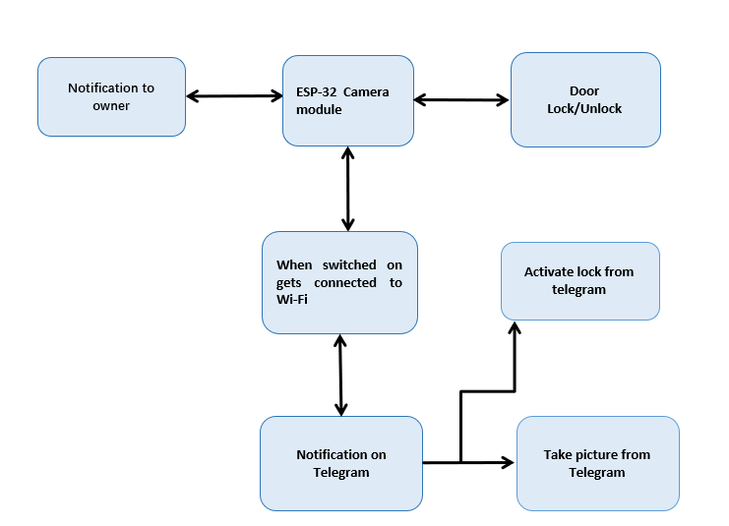
Detailed block diagram

Slide 3
Specifications
System Startup:
Action: ESP32-CAM powers on and connects to Wi-Fi.
Notification: Sends a connection confirmation to the owner via Telegram.
Owner Interaction:
Commands:
/photo: Captures and sends a photo.
/lock: Locks the door.
/unlock: Unlocks the door.
Photo Capture:
Action: Takes a photo on receiving /photo command.
Notification: Sends the photo to the owner via Telegram.
Lock Control:
Action: Controls the lock based on /lock and /unlock commands.
Notification: Sends lock/unlock status updates to the owner.

Slide 4
Algorithm
Library Inclusions and Initialization:
Includes necessary libraries for Wi-Fi, secure client communication, ESP32 camera, and Telegram Bot.
Defines Wi-Fi credentials, Telegram Bot token, chat ID, and camera pin configurations.
Wi-Fi Setup:
Connects the ESP32 to the specified Wi-Fi network.
Prints the IP address once connected.
Camera Configuration:
Configures the camera with specified pin mappings and settings for image quality and frame size.
Initializes the camera and checks for errors.
GPIO Setup:
Sets up GPIO pins for the lock mechanism, flash LED, and a button with appropriate modes (input/output).
Ensures the lock is initially in the locked state (LOW).
Telegram Bot Setup:
Configures the secure client to use the root certificate for Telegram.
Initializes the Telegram bot with the provided token and client.

Slide 5
Photo Capture Trigger:
Captures a photo if the sendPhoto flag is set or the button is pressed.
Turns on the flash LED, captures the photo, sends it via Telegram, and turns off the flash LED.
Resets the sendPhoto flag after sending the photo.
Handle New Messages:
Periodically checks for new messages from the Telegram bot.
Processes each new message to determine actions (photo capture, lock/unlock door, or start command).
Message Handling:
/photo: Sets the sendPhoto flag to true to trigger photo capture.
/lock: Calls lockDoor() to lock the door and sends a confirmation message.
/unlock: Calls unlockDoor() to unlock the door and sends a confirmation message.
/start: Sends a welcome message with command instructions.
Lock and Unlock Functions:
lockDoor(): Locks the door by setting the lock pin LOW if it’s not already locked and returns a status message.
unlockDoor(): Unlocks the door by setting the lock pin HIGH if it’s not already unlocked and returns a status message.
Photo Sending Function:
sendPhotoTelegram(): Captures a photo with the ESP32-CAM, connects to the Telegram API, and sends the photo to the specified chat ID.
Handles potential failures in capturing or sending the photo and retries if necessary.

Slide 6
Plan and need for optimization
Initial Setup:
Configure ESP32-CAM with Wi-Fi credentials.
Set up the Telegram bot and obtain chat ID and BOT token.
Connect the ESP32-CAM to the door lock mechanism.
Develop Core Functionality:
Implement Wi-Fi connection logic.
Integrate Telegram bot to handle commands (/photo, /lock, /unlock).
Program the ESP32-CAM to capture photos and control the lock mechanism.
Testing and Debugging:
Test connectivity and command reception.
Validate photo capture and door lock/unlock functionality.
Debug any issues with communication or hardware interaction.

Slide 7
Need for Optimization
Wi-Fi Connectivity:
Need: Ensure robust and stable connection to handle intermittent network issues.
Optimization: Implement automatic reconnection and error handling.
Security:
Need: Protect against unauthorized access and ensure data privacy.
Optimization: Add encryption for communications and consider two-factor authentication.
Response Time:
Need: Minimize delay in capturing photos and responding to commands.
Optimization: Improve code efficiency and reduce processing overhead.

Slide 8
Project Expenditure
SL NO | NAME OF COMPONENTS | SPECIFICATION | QUANTITY
1 | Microcontroller | ESP - 32 CAM | 1
2 | Electronic door lock | 12v | 1
3 | Transistor | TIP122 NPN | 1
4 | Voltage Regulator | 7805 | 1
5 | Resistor | 10k | 1
6 | Resistor | 220 ohm | 1
7 | Capacitor | 220uF | 1
8 | LED’s | 5 - mm | 2
9 | Diode | 1N4007 | 1
10 | DC adaptor | 12v | 1
11 | USB serial interface board for programming ESP 32 CAM | Base Board | 1
COST
600/-
200/-
15/-
20/-
10/-
10/-
20/-
10/-
10/-
120/-
200/-
TOTAL 1215/-

Slide 9
THANK YOU

