Slide 1
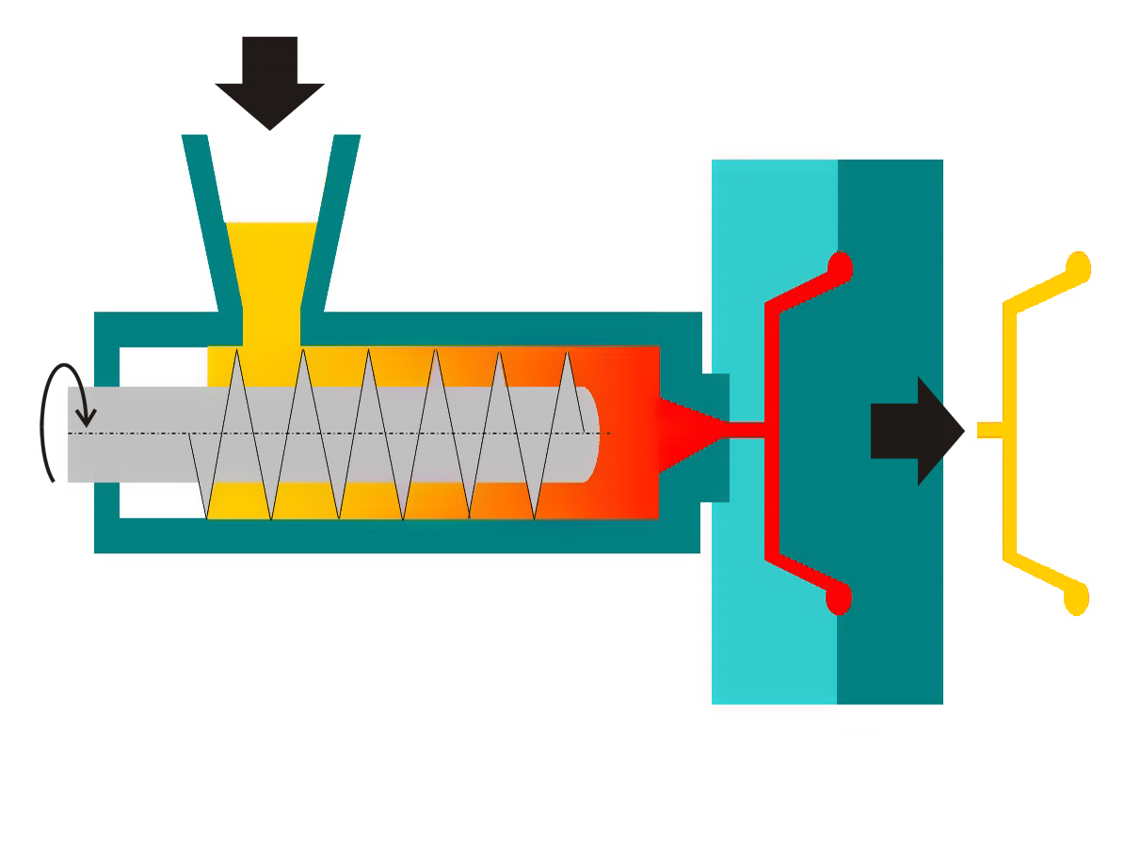



Input Blob
Uncompress
Data Blob
Calculate Characteristics
Characteristics Table
Molding machine
csv
{}
Integration Service
PC Control
{}
Azure IoT Hub
Stream Analytics
Dashboard
Send Event
Environment Sensors
ML Model
Historical Data
Characteristics and Defective

