Slide 1

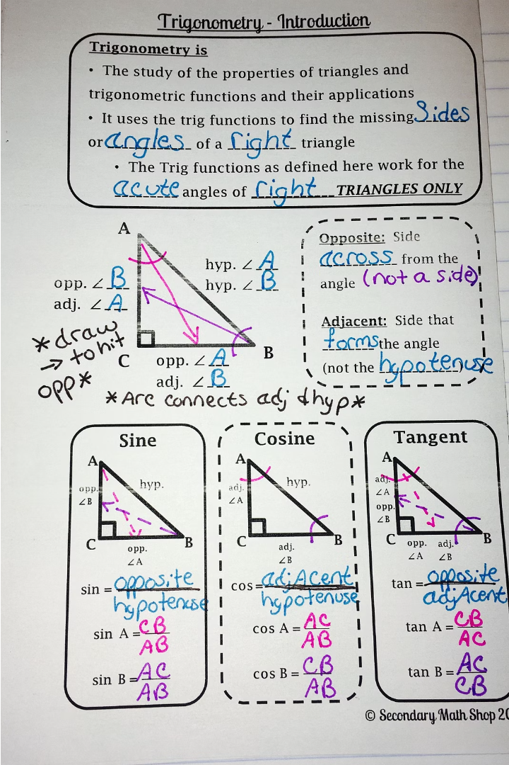

Introduction to Trigonometry
Trigonometry is a branch of mathematics that explores the relationships between the sides and angles of triangles. It has numerous applications in fields like engineering, physics, and navigation.
by Rohit Saraswat

Slide 2
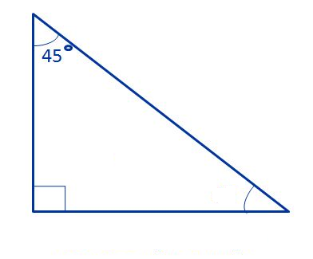
What We Know So Far…
Consider this right-angled triangle.
What will the unmarked angle be?
The square looking angle means a right-angle, which is 90°. Using our rule of triangles that all angles equal 180°, we know that the unmarked angle must be
180 – 90 – 45 = 45°

Slide 3
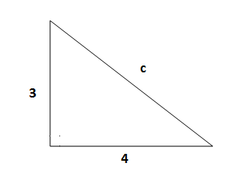
What We Know So Far…
Consider this right-angled triangle.
What will side length c be?
Using Pythagoras’ Theorem, we can say that:
p² + b² = h²
a² + b² = c²
3² + 4² = c²
9 + 16 = 25
c² = 25
c = 5

Slide 4
What We Know So Far…
As long as we are given two angles in a triangle, we can find the third.
As long as we are given two side lengths in a right-angled triangle, we can find the third.
But what if we aren’t given that much information?

Slide 5
What Is Trigonometry
Trigonometry is the method of finding missing sides and angles in triangles when we cannot either use our “angles add up to 180°” rule or Pythagoras’ Theorem to help us.
Most of trigonometry works with right-angles triangles.
It usually involves:
Using two side lengths to find an angle.
Using one angle and one side length to find another side length.

Slide 6
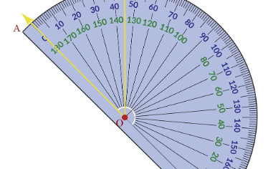
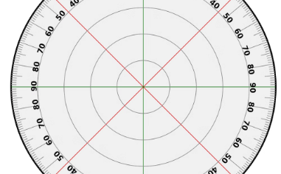
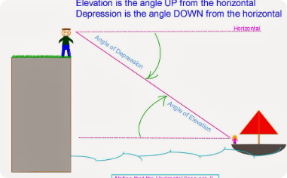
Angles and Their Measurement
Understanding Angles
Circular Angle Measurement
Angles of Elevation and Depression
An angle is the measure of the rotation between two intersecting lines or planes. Angles are fundamental to trigonometry and are measured in degrees (°) or radians (rad).
Angles are often measured on a circular scale, where a full rotation around the circle is 360°. This allows for precise quantification of rotations and orientations.
Angles of elevation and depression are important in trigonometry, used to measure the incline or decline between an observer and an object.

Slide 7
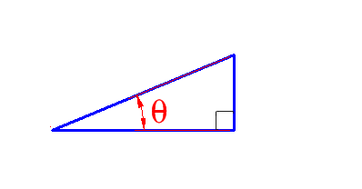
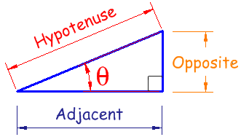
Labeling Sides
The first thing we need to do when using trigonometry is label our side lengths.
This doesn’t mean a, b and c.
Any angle we are trying to find, we call Theta (θ), which is a Greek letter. Could also be called x or any other letter.
We label our sides depending on where θ is.
You may already remember from geometry that the diagonal side of the triangle is called the hypotenuse.
The other side length alongside θ is the adjacent/base.
The third side length is appropriately called the opposite/perpendicular.

Slide 8
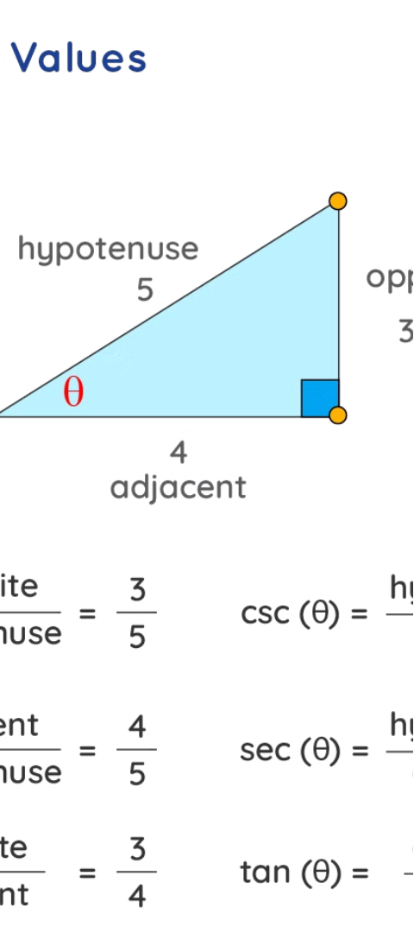
Trigonometric Ratios: Sine, Cosine, and Tangent
Sine (sin)
Cosine (cos)
The sine of an angle is the ratio of the opposite side to the hypotenuse of a right triangle. It represents the vertical component of a unit vector.
The cosine of an angle is the ratio of the adjacent side to the hypotenuse of a right triangle. It represents the horizontal component of a unit vector.
Tangent (tan)
The tangent of an angle is the ratio of the opposite side to the adjacent side of a right triangle. It represents the slope of the line from the origin to a point on the unit circle.

Slide 9
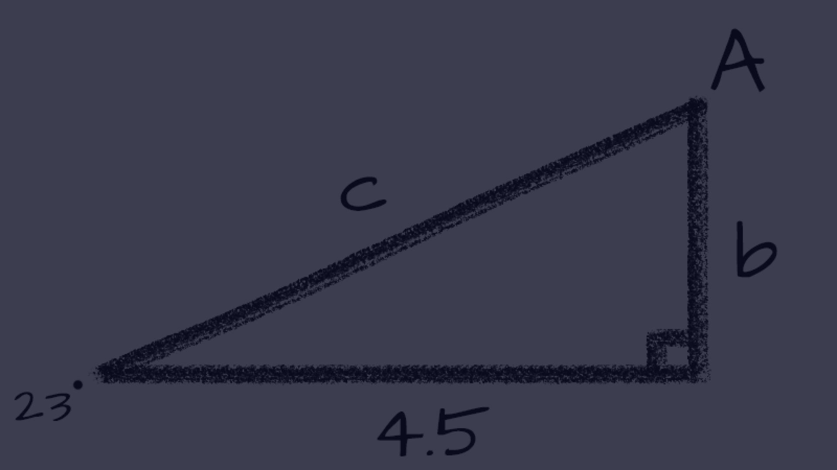
SOH CAH TOA
Sine Function: | sin(θ) = Perpendicular/ Hypotenuse
Cosine Function: | cos(θ) = Base/ Hypotenuse
Tangent Function: | tan(θ) = Perpendicular/ Base
The trig function we use (sin/cos/tan) depends on which two side lengths are given to us.
We use an abbreviation to help us remember which two side lengths are used for each function. This abbreviation is SOHCAHTOA.
For example, SOH means Sin(θ) = Opposite / Hypotenuse

Slide 10
Trigonometric Identities
Fundamental Identities
Pythagorean Identities
Reciprocal Identities
Inverse Identities
The most important trigonometric identities are sine, cosine, and tangent. These relate the sides and angles of a right triangle in a precise mathematical way.
These identities express the relationships between the three trigonometric ratios, such as sin^2(x) + cos^2(x) = 1.
The reciprocal trigonometric functions - cosecant, secant, and cotangent - can be expressed in terms of the basic sine, cosine, and tangent functions.
The inverse trigonometric functions, such as arcsin(x), have their own set of identities that relate them to the basic trig functions.

Slide 11
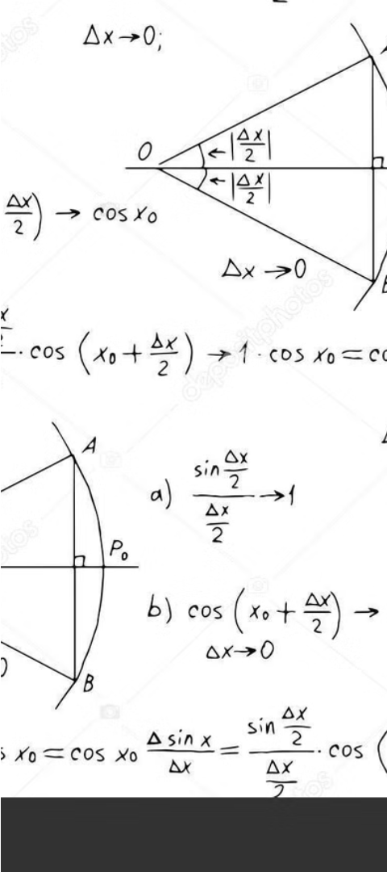
Trigonometric Equations
1
Identifying Unknowns
Trigonometric equations involve finding unknown variables, such as angles or side lengths, using the given trigonometric ratios.
2
Inverse Trigonometric Functions
Solving trigonometric equations often requires using inverse trigonometric functions, like arcsin, arccos, and arctan, to isolate the unknown.
3
Applying Identities
Trigonometric identities, such as Pythagorean and reciprocal identities, can be used to simplify and manipulate trigonometric equations.

Slide 12
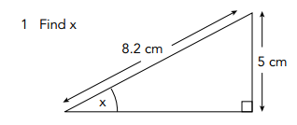
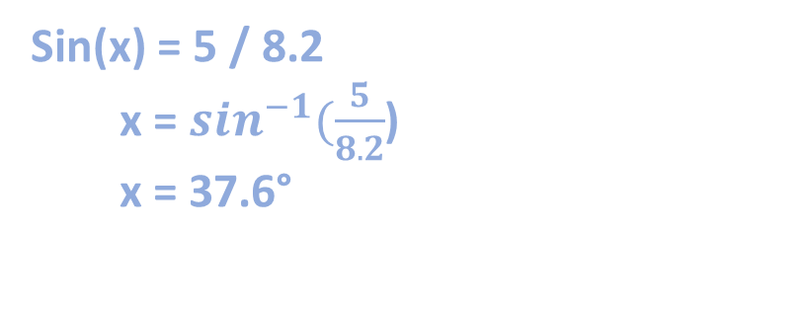
Let’s tackle a question
Step 1: Label the sides.
Step 2: Decide which trig function we will use.
We are given the hypotenuse and the opposite, so using SOHCAHTOA, we know we need to use Sine.
Step 3: Form our equation.
Step 4: Find answer.
Sin(x) = Opposite / Hypotenuse
So…
Sin(x) = 5 / 8.2
Sin(x) = 5 / 8.2
x = $\sin^{−1}(\frac{5}{8.2}$)
x = 37.6°

Slide 13
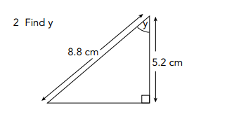
Let’s try another one
Step 1: Label the sides.
Step 2: Decide which trig function we will use.
A
H
We are given the hypotenuse and the opposite, so using SOHCAHTOA, we know we need to use Sine.
O
Step 3: Form our equation.
Step 4: ‘Un-trig’ our answer.
Cos(x) = Adjacent / Hypotenuse
So…
Cos(x) = 5.2 / 8.8
Cos(x) = 5.2 / 8.8
x = 〖𝒄𝒐𝒔〗^(−𝟏) ((𝟓.𝟐)/(𝟖.𝟖))
x = 53.8°

Slide 14

Applications of Trigonometry
Trigonometry has a wide range of practical applications in various fields, including engineering, surveying, navigation, and astronomy. It is used to calculate distances, heights, and angles in construction, land surveying, and mapmaking.
Trigonometry also plays a crucial role in designing electrical circuits, modeling wave behavior, and analyzing periodic functions in physics and engineering.

Slide 15
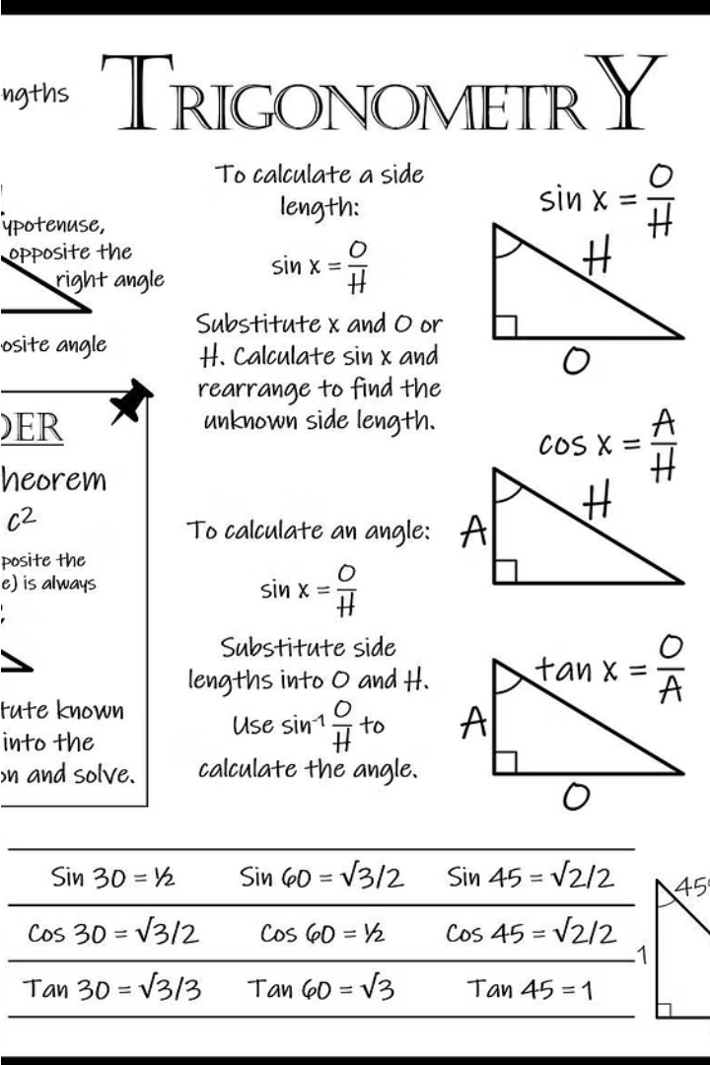
Conclusion and Review
In this final section, we'll summarize the key concepts of trigonometry and review how the various topics covered can be applied in real-world scenarios. We'll also provide guidance on how students can continue to build upon their understanding of this powerful mathematical discipline.

