Slide 1

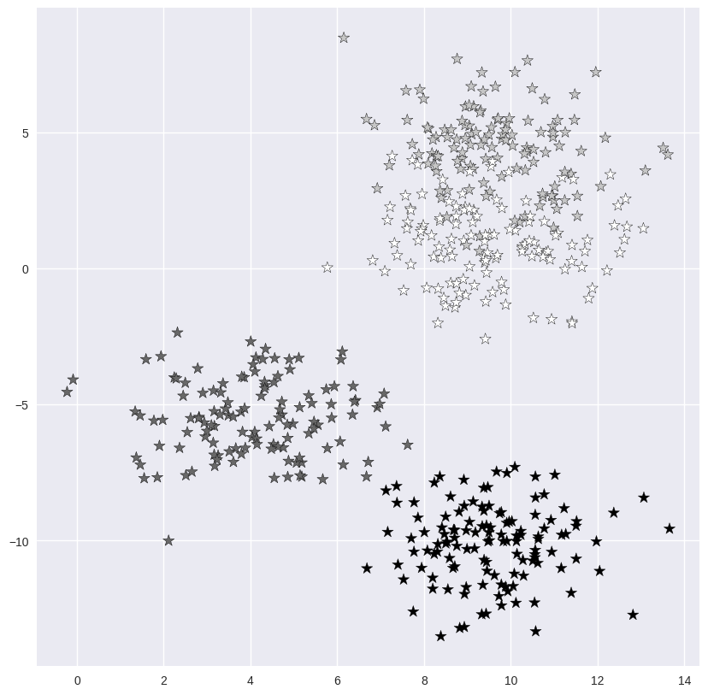
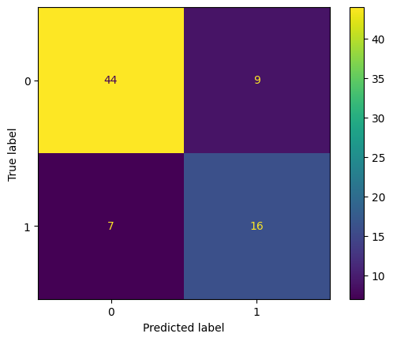
Heart Disease Prediction
Enrollment no:90
T.Rohith - 2103A51573 K.Shanthi kiran - 2103A51525
MD.Waheed - 2103A51475 S.Abhiram - 2103A51444
INTRODUCTION
LIMITATIONS
Heart disease is one of the biggest health risks for association today. The aim of the project is to analyze and predict whether a patient gets heart attack or not by considering different symptoms like chest pain, resting blood pressure, cholesterol, and fasting blood sugar.
OVERVIEW
Heart disease prediction involves assessing the risk of an individual developing cardiovascular conditions like coronary artery disease, heart attacks, and strokes. Various factors contribute to this risk, including age, gender, family history, lifestyle habits (such as smoking, diet, and exercise), blood pressure, cholesterol levels, and other medical conditions like diabetes and obesity.
Predictive models rely heavily on the quality and quantity of data available. If the dataset used for training is incomplete, biased, or contains errors, the accuracy of predictions may be compromised.
Predictive models rely heavily on the quality and quantity of data available. If the dataset used for training is incomplete, biased, or contains errors, the accuracy of predictions may be compromised.
PROBLEM STATEMENT
Identifying the problem in heart attack analysis using KNN and logistic regression involves recognizing limitations in traditional risk assessment methods, data integration challenges, and ensuring model interpretability while addressing privacy and regulatory concerns. Current methods may lack precision and fail to capture dynamic health changes. Data fragmentation hinders comprehensive analysis, and model interpretability is crucial for clinical acceptance.
OBJECTIVES
Continuously enhance the accuracy of heart disease prediction models by refining algorithms, incorporating new data sources, and optimizing feature selection techniques.
MODELS USED
KNN and logistic regression models using the training data. Tune hyperparameters, such as the number of neighbors for KNN or regularization strength for logistic regression, using techniques like cross-validation to optimize model performance.
PROPOSED METHODOLOGY
Gather a comprehensive dataset including patient demographics (age, gender), medical history (diabetes, hypertension, cholesterol levels), lifestyle factors (smoking, alcohol consumption), and clinical measurements (blood pressure, heart rate, electrocardiogram (ECG) readings).
REFERENCES
https://www.sciencedirect.com/science/article/abs/pii/S2352914818300714
https://www.ncbi.nlm.nih.gov/pmc/articles/PMC8081749/
ACKNOWLEDGEMENT
Dr.M.Sheshikala, HOD, CSAI Dept.
PROJECT GUIDE – T.Sampath Kumar

