Slide 1
Project Title: Campus Market-Place Submitted by: Rohit Department of Computer Science and Engineering Starex University, Gurugram

Slide 2
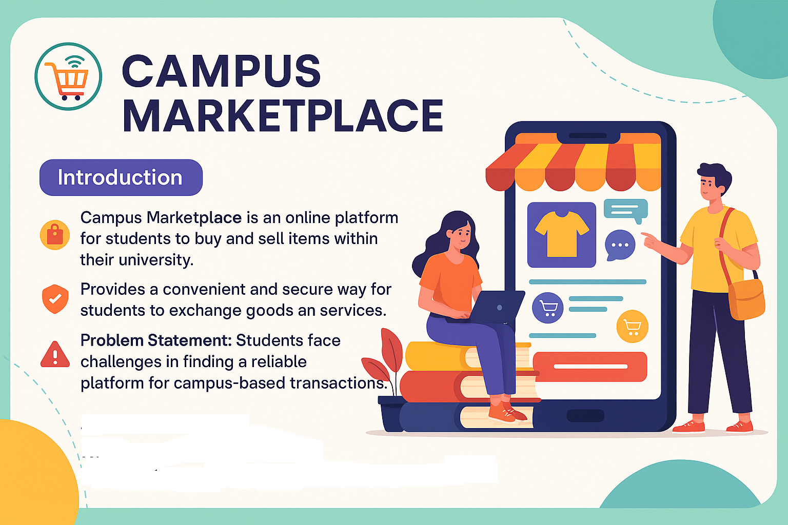

Slide 3
PROBLEM STATEMENT
1. Traditional methods of buying, selling, and
exchanging items on Online are often cumbersome
and lack efficiency.
2. Students face hurdles in finding or disposing of items
relevant to Campus life due to a lack of a centralized
and user-friendly platform.
3. Improves the overall student experience by providing
a convenient and streamlined solution for acquiring
and disposing of items.

Slide 4
Project Overview
Campus Marketplace is a web platform for students and staff to sell or buy products within campus.
Key functionalities include:
- User Registration/Login
- Product Listings
- Profile Management
- Product Detail Views

Slide 5
Tech Stack
Frontend: React.js
Styling: CSS
Backend Logic: JavaScript (components)
Testing: Jest
Icons/Assets: SVG
Version Control: Git

Slide 6
File Structure Overview
Login.js, Signup.js: User Authentication
MyProfile.js, MyProducts.js: Profile and Product Listings
ProductDetail.js, ProductCarousel.js: Product Details
App.js, index.js: App Setup
CSS Files: Styling
Testing Files: setupTests.js, App.test.js

Slide 7
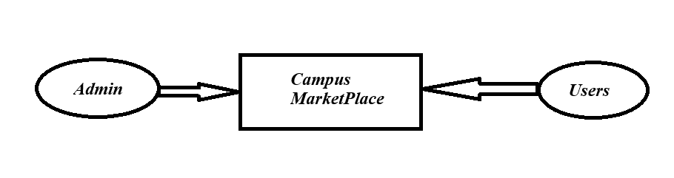
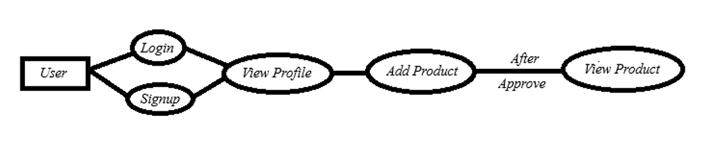
DFD DIAGRAM

Slide 8
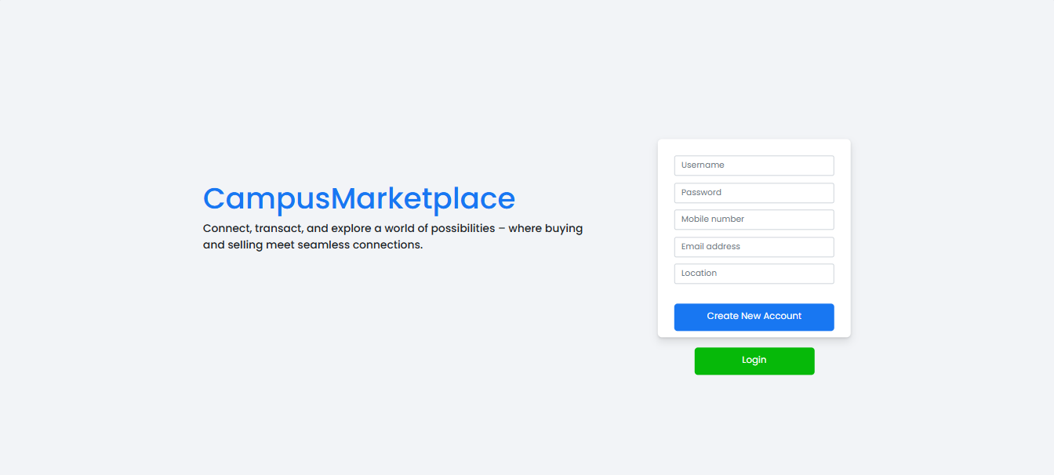
User Flow: Login / Signup
User lands on the main page
Can Login or Signup
After successful auth, navigates to dashboard
New users are registered and data stored
Authenticated users can view/add products

Slide 9
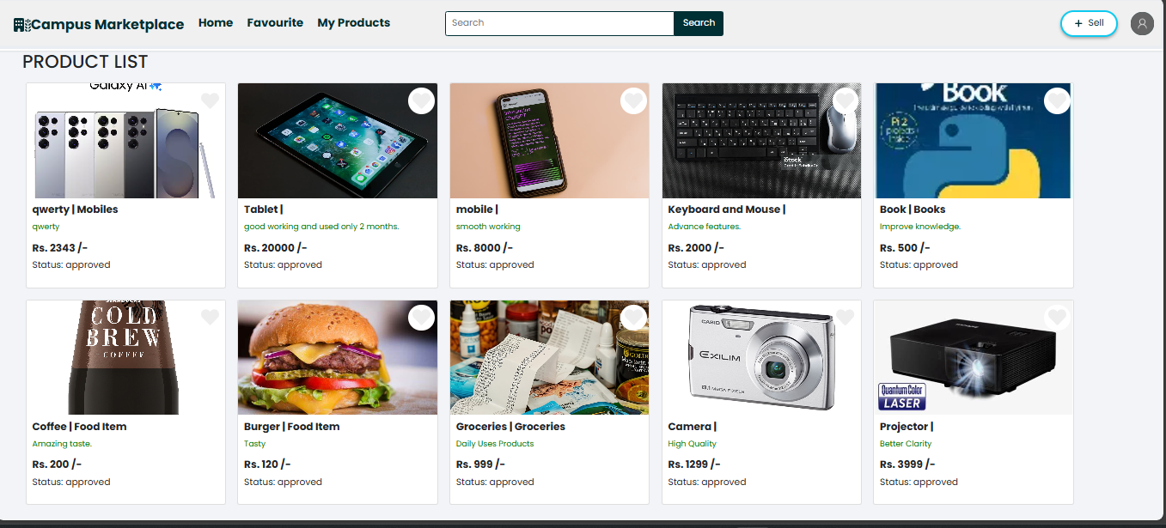
Product Listing & Viewing Flow
User clicks 'Add Product'
Fills in product details
Product is saved to backend
Product appears in user's list (MyProducts.js)
Others can view via ProductDetail.js

Slide 10
Features Overview
👤 User Authentication (Login/Signup)
📦 Product Listings (Add/View Products)
📊 Dashboard with Profile and Activity
📱 Mobile App UI (Future scope)

Slide 11
Security Measures
🔐 Encrypted user data storage
✅ OTP and Email verification
🛡️ Admin moderation for listings

Slide 12
CHALLENGES FACED
1. Challenge: Iterative refinement of the user interface to
align with user preferences and expectations.
2. Resolution: Conducted frequent usability testing,
collected user feedback, and iteratively adjusted design
elements, ensuring an optimal user experience.
3. Challenge: Meeting project milestones within a tight
development timeline.
4. Resolution: Adopted an agile development approach,
prioritized features based on criticality, and conducted
prioritized features based on criticality, and conducted

Slide 13
Future Enhancements
1. In-App Payment System
2. AI-Powered Recommendation Engine
3. Community Challenges and Rewards
4. Integration with Online Clubs and Organizations
5. Blockchain for Transaction Transparency
Geolocation Integration

Slide 14
CONCLUSION
Campus Marketplace is a robust, user-friendly web platform that simplifies item exchange within a university campus. It helps users securely interact and trade in a trusted community setting.

