Slide 1
Blood Pressure Q&A Agent
An AI assistant to answer Hypertension and Hypotension queries
- By Sai Rohit Uddagiri

Slide 2
Introduction
Effective monitoring of blood pressure and medication orders is essential for optimizing patient health outcomes and ensuring timely intervention in cases of hypertension and hypotension.
The main objective of this AI agent is to address the following questions based on the patient vitals and medications prescribed.
- Q1: Did the patient have Hypertension/Hypotension given blood-pressure records from vitals?
- Q2: Did the patient get the medication order to treat hypertension/hypotension if any?
Outline of the designed AI model:
- Data Loading
- Data Processing
- Prompt Engineering
- Ask the model

Slide 3
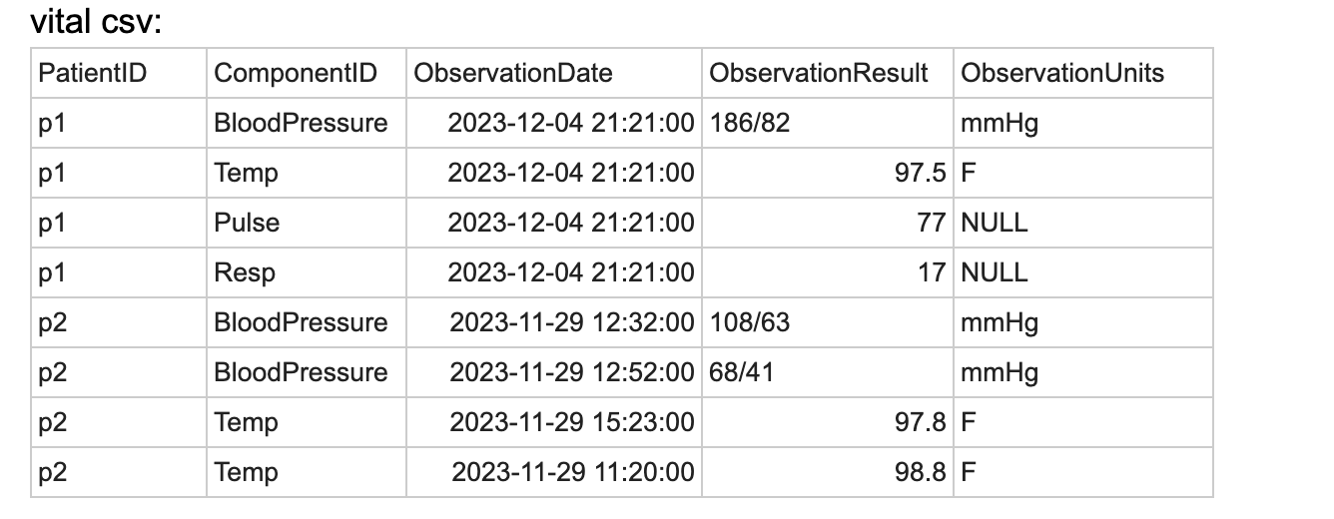
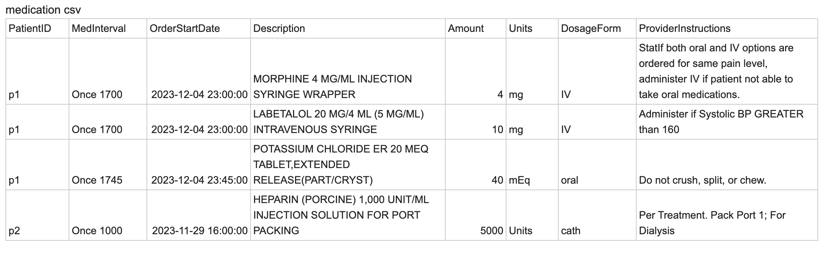
Dataset
Access the relevant information from the respective csv files.
- blood pressure observation data from vital.csv file to answer Q1
- Description of the medication provided for each patient from medication.csv file to answer Q2

Slide 4
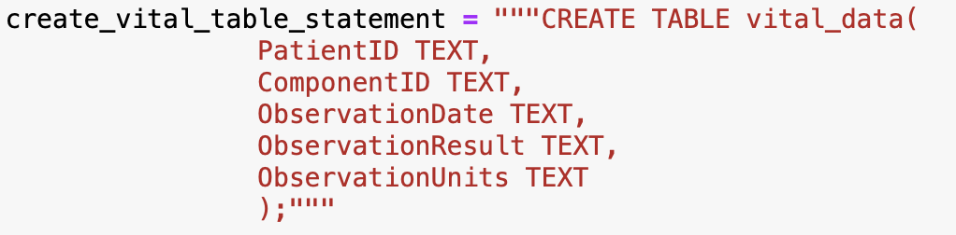
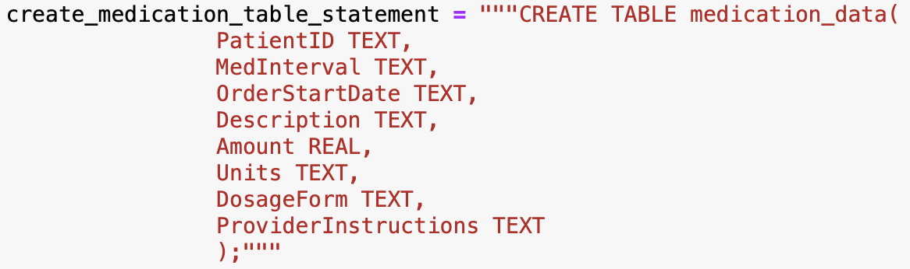
Data Processing
Loading the data from csv files to SQL database:
- Used SQLite for data storage
- Create relevant tables according to the columns in the csv files and load the data.
Table1: vital_data
Table2: medication_data

Slide 5
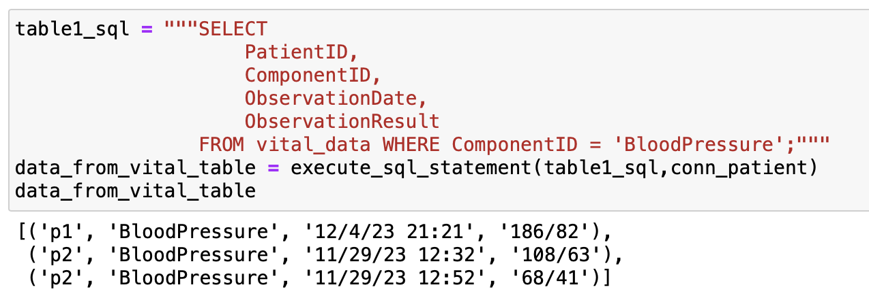
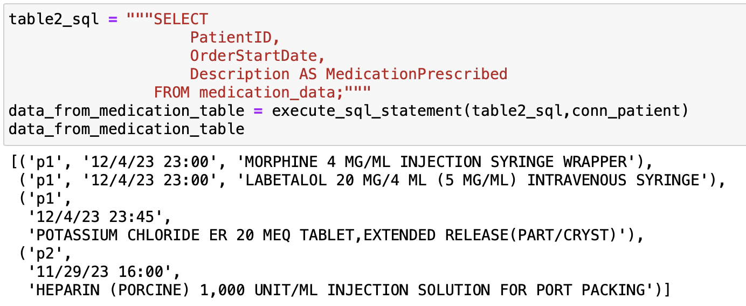
Data Processing
Decide and gather required columns from each table:
- from vital table: PatientID, ComponentID, ObservationDate, ObservationResult
- from medication table: PatientID, OrderStartDate, Description

Slide 6
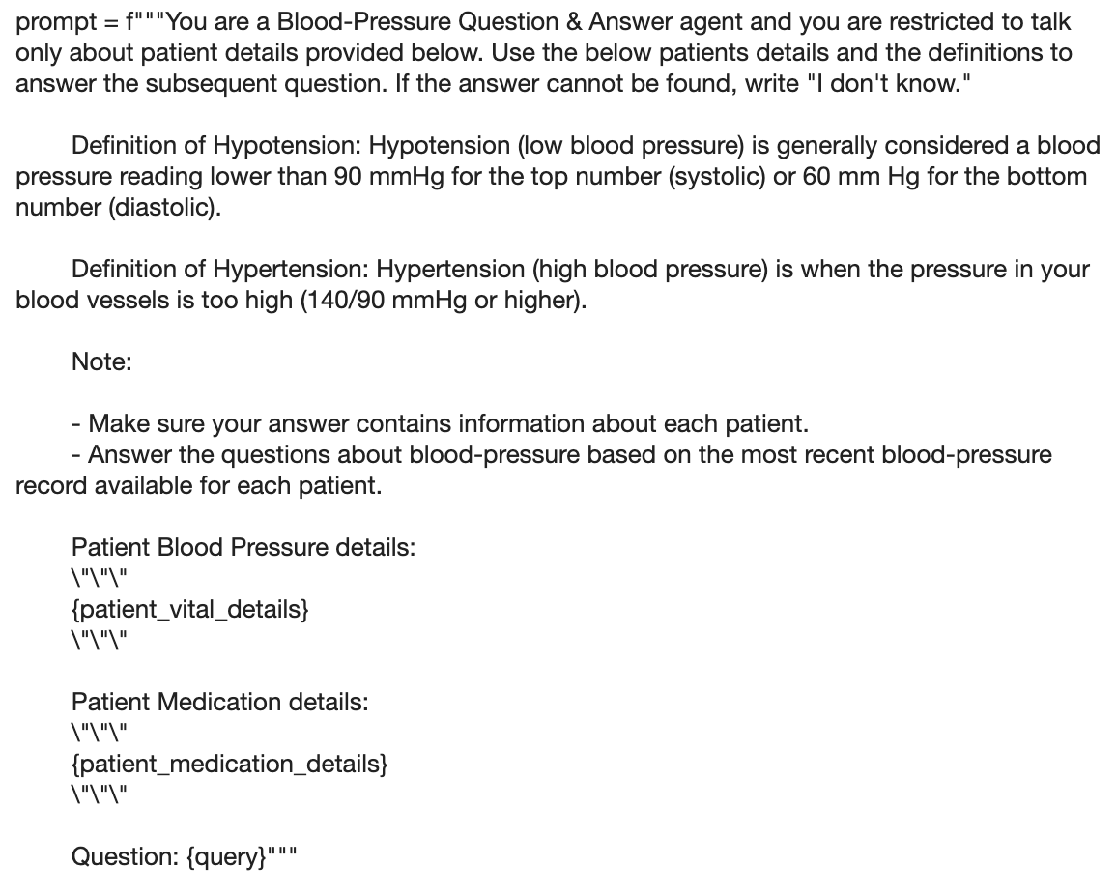
Prompt Engineering
Prompt engineering is the process of designing and formulating input prompts that guide the behavior of AI models to generate desired outputs.
The developed prompt for this use-case:

Slide 7
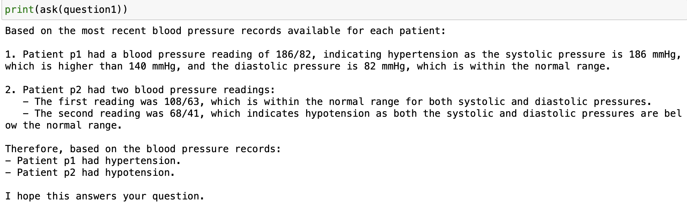
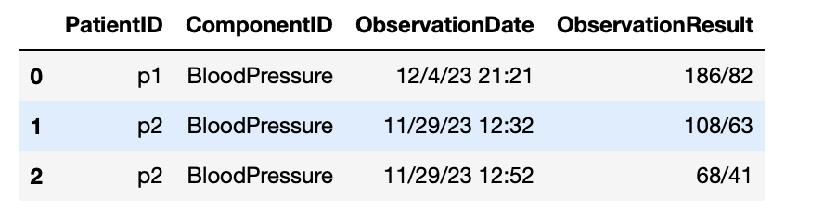
Asking the AI model
Feed the LLM with relevant prompt and the data processed earlier and ask the questions.
Response for the question-
Did the patient have Hypertension/Hypotension given blood-pressure records from vitals?

Slide 8
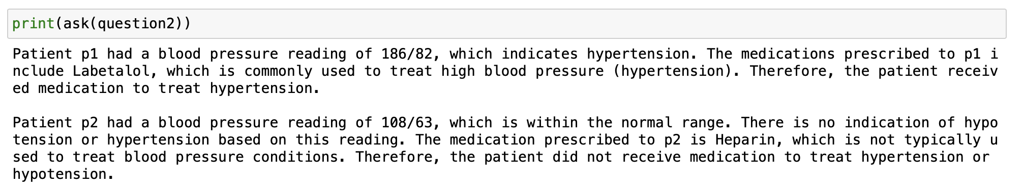
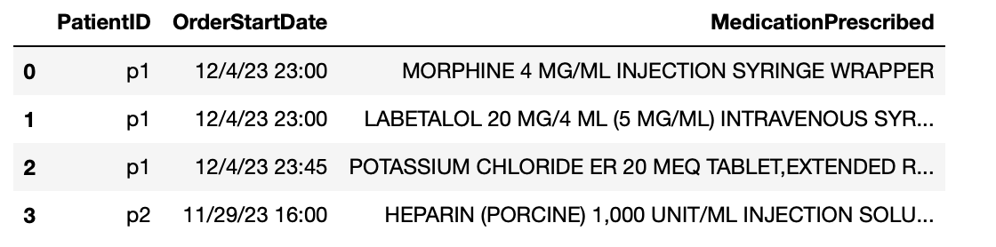
Asking the AI model
Response for the question-
Did the patient get the medication order to treat hypertension/hypotension if any?

Slide 9
Conclusion
The AI model was able to generate relevant answers for the user queries on the dataset.
Clinical Decision Support: Enhance the Q&A agent's capabilities to serve as a clinical decision support tool by providing evidence-based recommendations, treatment guidelines, and risk assessments to healthcare professionals.
Real time Monitoring and Alerts: Integrate the Q&A agent with real-time monitoring systems to provide proactive alerts and recommendations for healthcare providers based on emerging trends or critical patient data.
Expanding the data Source: Incorporate additional sources of medical data, such as electronic health records (EHRs), patient histories, and demographic information, to provide more comprehensive insights and context for answering queries.

