Slide 1
Selenium Capstone Project - SauceDemo
Automation Framework and CI/CD Integration

Slide 2
About Project - SauceDemo
Application: https://www.saucedemo.com/
Objective:
Automate functional flows of SauceDemo site.
Validate login, product selection, cart, and checkout.
Ensure stability through CI/CD integration.
Generate execution reports and logs.

Slide 3
Tools & Technologies
Language: Java
Automation Tool: Selenium WebDriver
Frameworks: TestNG + Cucumber (BDD)
Build Tool: Maven
IDE: Eclipse
Version Control: Git

Slide 4
Test Approach - SauceDemo
POM framework for page separation
TestNG for structured execution
Cucumber BDD for feature validation
Data-driven scenarios for login & checkout
Cross-browser execution (Chrome, Firefox)
Extent Reports with screenshots

Slide 5
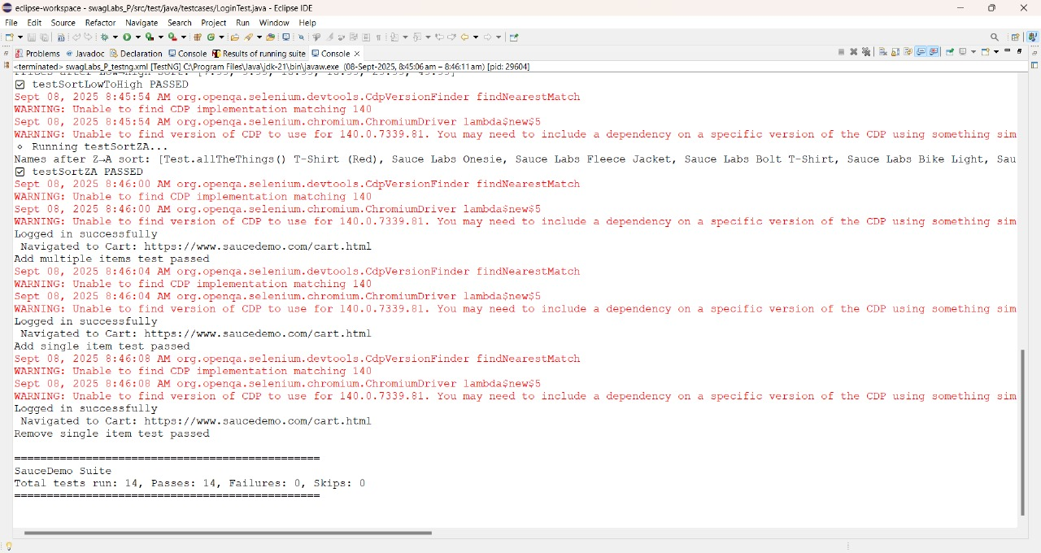
Results through TestNG

Slide 6
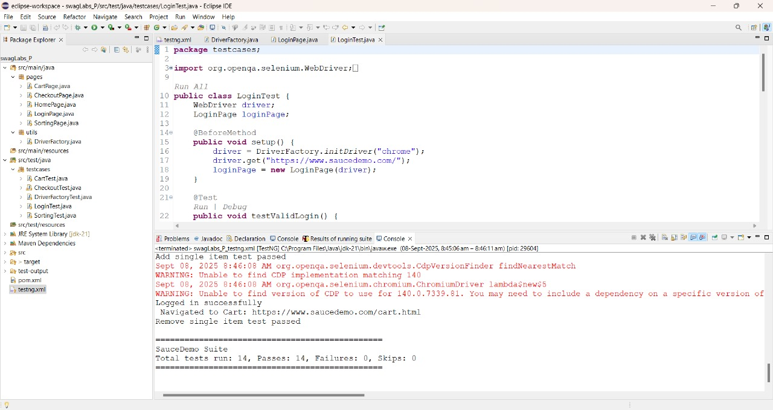
Results through TestNG

Slide 7
Agile & Framework Components
Zephyr/Jira for requirement & defect tracking
Framework Modules:
Pages (POM classes)
Testcases & Runners
Utilities & Config
Reports & Logs
Test Data

Slide 8
Jira -Outcomes

Slide 9
Reporting
Extent Reports (graphical HTML view)
Screenshots captured on test execution
Logs maintained for debugging
Results shared with stakeholders

Slide 10
Jenkins & Git Implementation
GitHub repository for project version control
Jenkins integrated with Git for CI/CD
Automated build trigger on commit
Test execution (Selenium + TestNG + Cucumber)
Report generation after each build

