Slide 1
Sauce Demo QA Automation Framework
Capstone Project – Selenium | TestNG | Cucumber | Jira
Submitted by:
Vanjarapu Rohit Kumar Java Selenium Batch #3

Slide 2
Project Overview
Application: saucedemo.com
Objective:
Automate functional flows of SauceDemo
Validate login, product selection, cart, and checkout
Ensure stability via CI/CD pipeline
Generate execution reports and log

Slide 3
Tools & Technologies
Language: Java
Automation Tool: Selenium WebDriver
Frameworks: TestNG + Cucumber (BDD)
Build Tool: Maven
IDE: Eclipse
Version Control: Git

Slide 4
Test Approach
POM framework for page separation
TestNG for structured execution
Cucumber BDD for feature validation
Data-driven scenarios for login & checkout
Cross-browser execution (Chrome, Firefox)
Extent Reports with screenshots

Slide 5
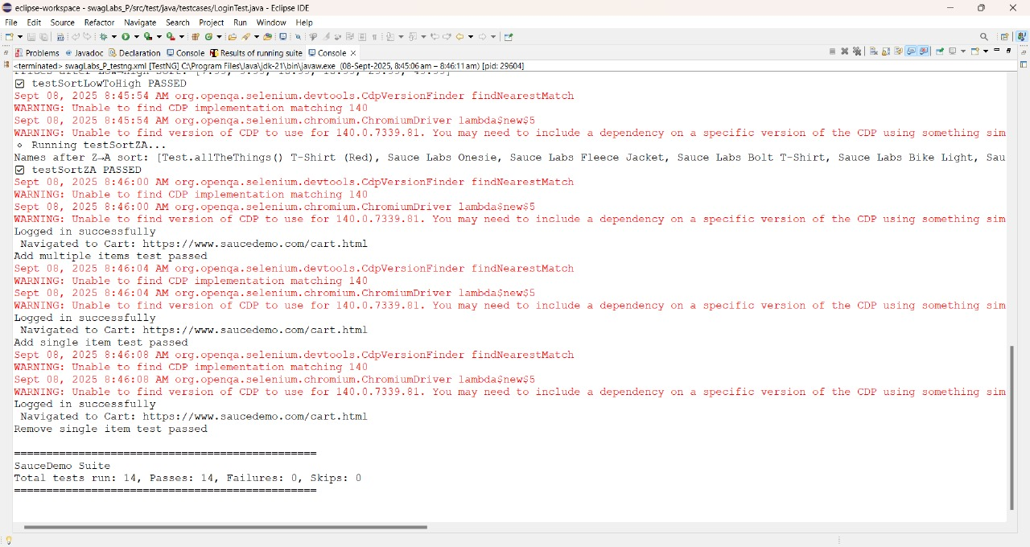
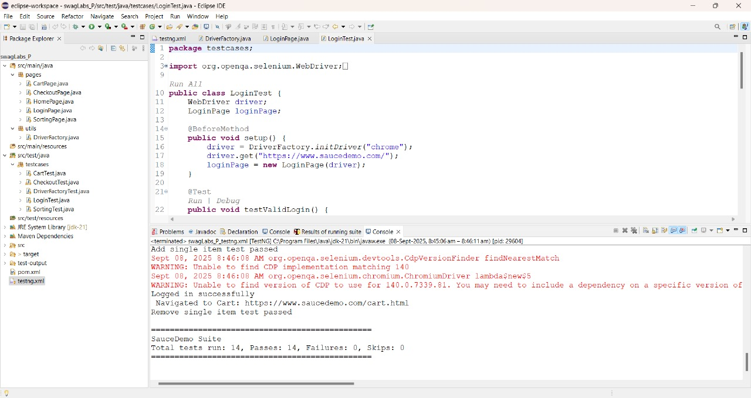
Results through TestNG

Slide 6
Agile & Framework Components
Zephyr/Jira for requirement & defect tracking
Framework Modules:
Pages (POM classes)
Testcases & Runners
Utilities & Config
Reports & Logs
Test Data

Slide 7
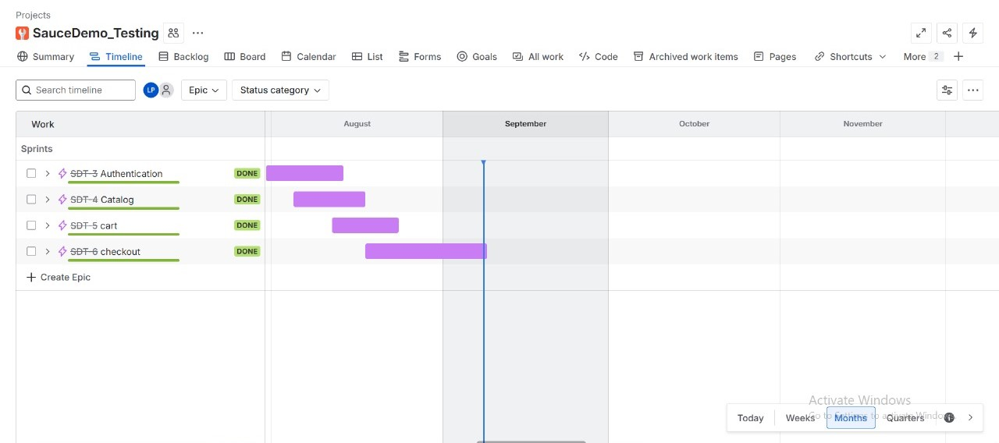
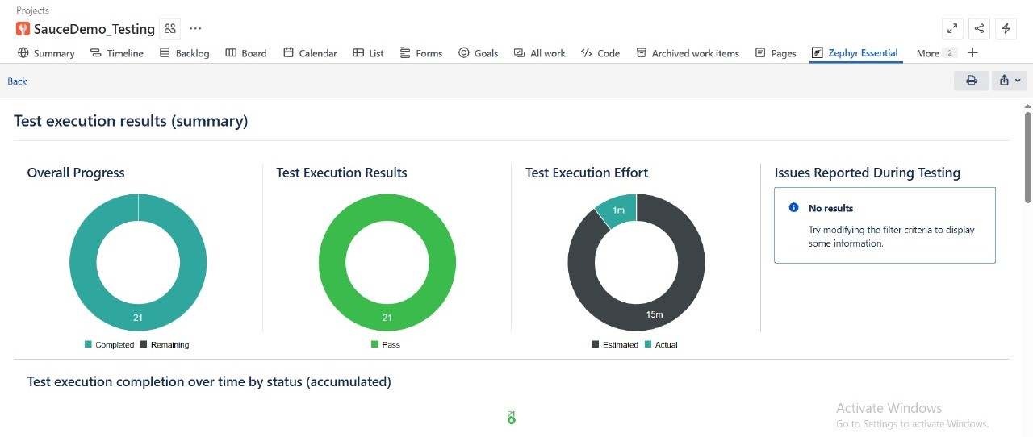
Jira – Test Management & Defects

Slide 8
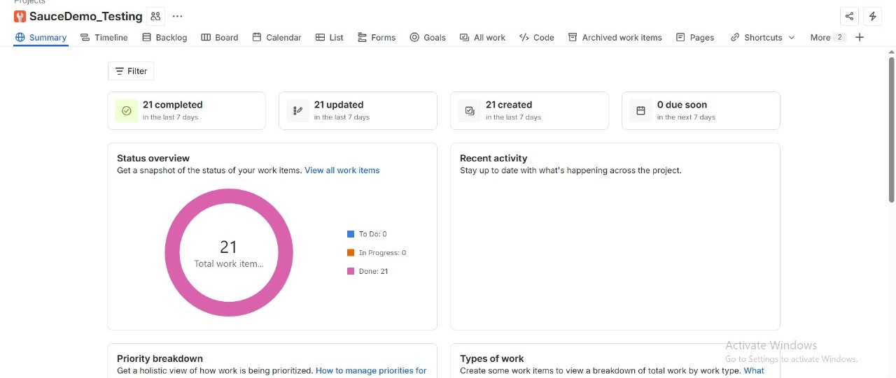
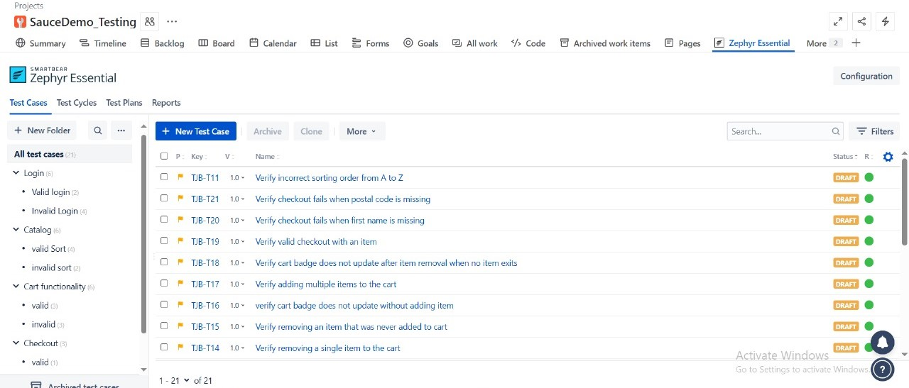
Jira – Test Management & Defects

Slide 9
Reporting
Extent Reports (graphical HTML view)
Screenshots captured on test execution
Logs maintained for debugging
Results shared with stakeholders

Slide 10
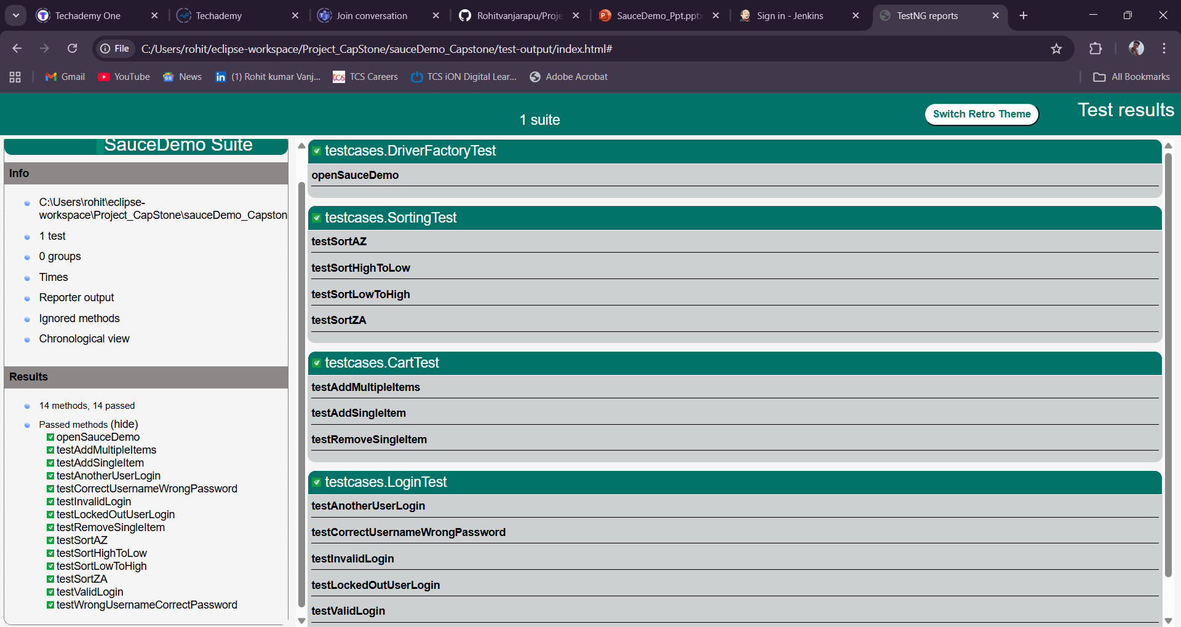
HTML Reports

Slide 11
Jenkins & Git Implementation
GitHub repository for project version control
Jenkins integrated with Git for CI/CD
Automated build trigger on commit
Test execution (Selenium + TestNG + Cucumber)
Report generation after each build

Slide 12
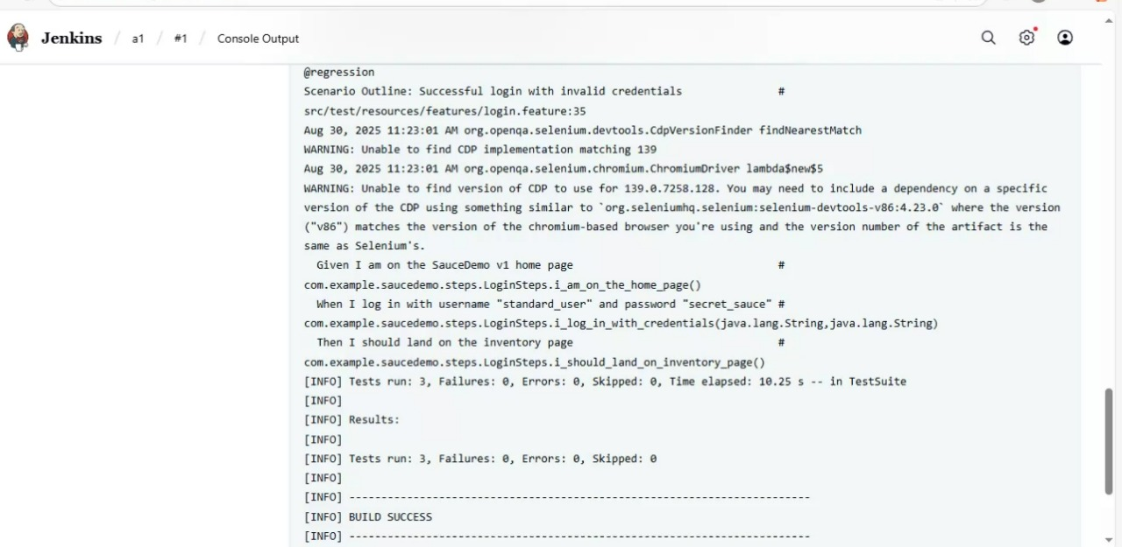
Jenkins Outcomes

Slide 13
Thank You
Presented by Rohit Kumar V

