Slide 1


MITans Mind Optimizers
Problem statement: To develop a system electronically detecting occupancy of beds in nearby hospitals
PS Code: TK1052
Ministry: Government of Rajasthan
Institute Code: 2126
Theme Name: MedTech/ Biotech/ Health-Tech
Institute Name: MIT Aurangabad
Team Leader: Rohit Waghmare

Slide 2
Team members
Rohit Waghmare (Team Leader)
Rafat Naaz
Sakshi Munde
Sarita Hrakanche
Pratik Deshpande
Shravani Dandge
Priya Nagargoje (Mentor)

Slide 3
introduction
The problem statement of our website was to detect the occupancy of beds in nearby hospitals.
As we all know the impact of Covid-19 was caused globally and it became difficult to detect the occupancy of beds in hospital.
So, we developed such a website that shows the availability of beds in hospitals in an easy to understand way.
The name of our website is “SAWASTHA” ,derived from Sanskrit word “SWASTHA” which means health and well-being, we’re aiming for the well-being of the human nation.
The major role of “SAWASTHA” is to let the user know the occupancy of beds in hospitals from the comfort of their homes.

Slide 4
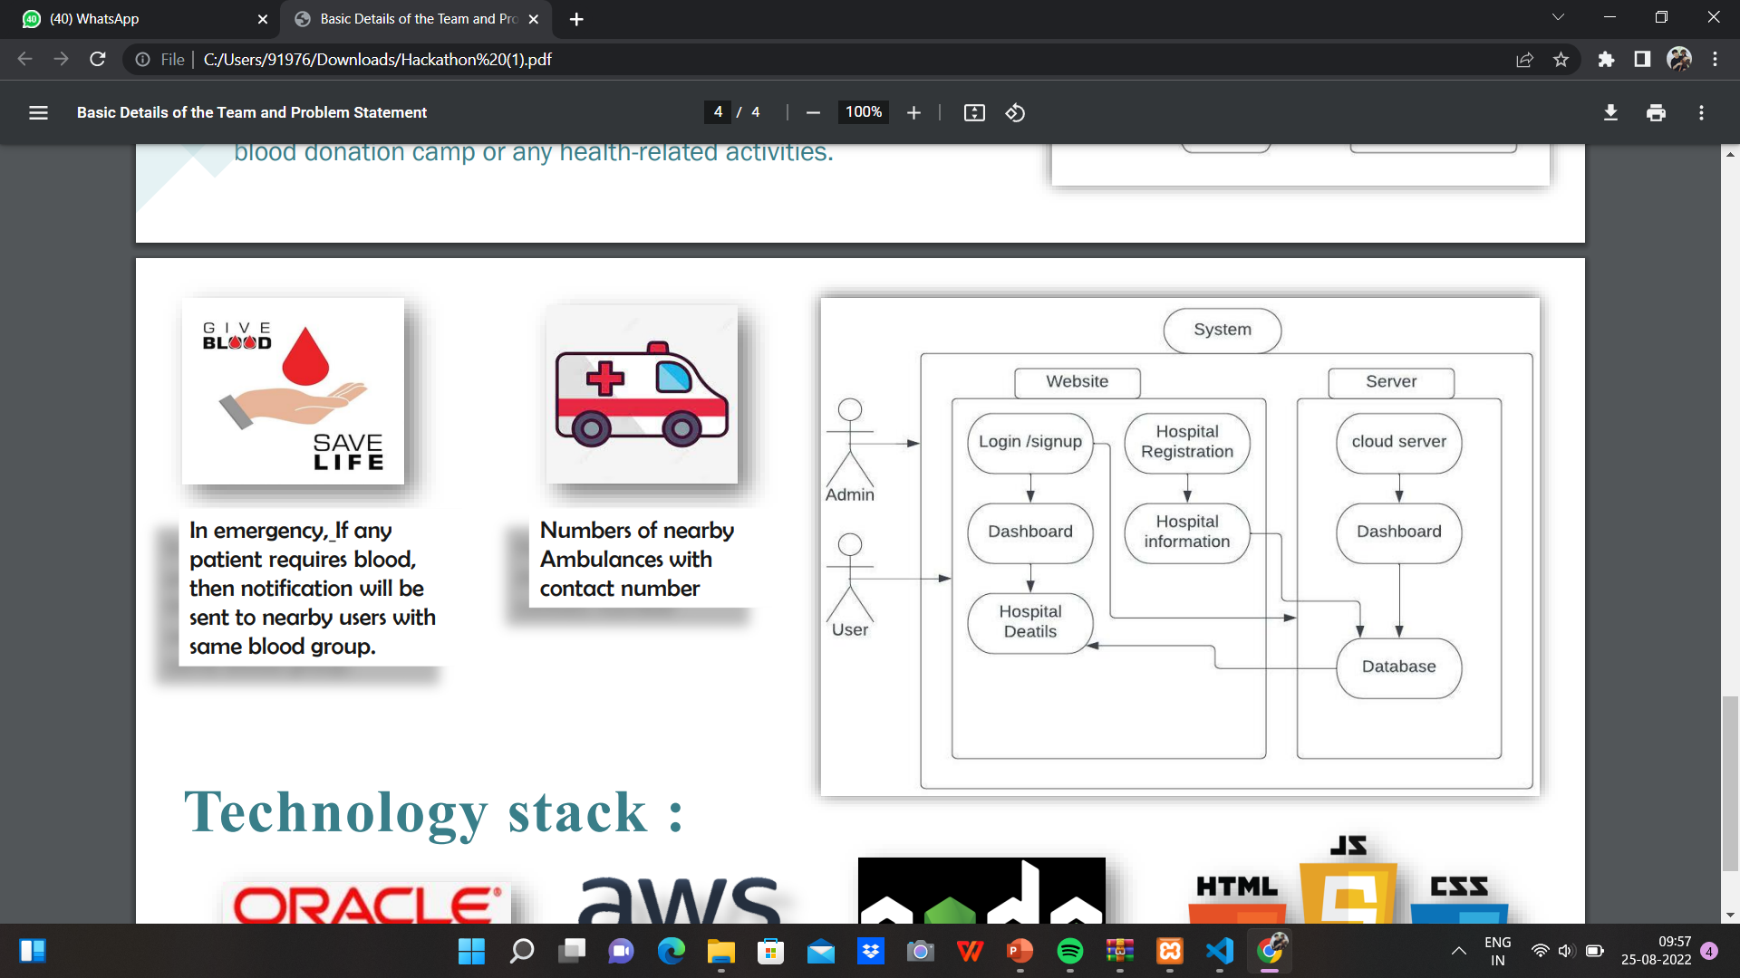
Architecture Diagram
The architecture design includes user, hospital and Admin Interface.
The hospital will register by filling the required details such as name, ID, occupancy of beds, etc. then all data will be stored in database and will be reflected on the index page.
The user will get to know about all the data related to hospital including the details of occupied beds, providing virtual assistance as well as a facility for blood donation.
The admin will have the control on user as well as hospitals and can delete any user or hospital.

Slide 5
Features and specialties
Virtual Assistance : It helps the user to get immediate cure of any disease or accident in case of emergency.
User can also book for beds in hospital.
In case of emergency, ambulance details of each hospital is also provided.
Booking of beds is very simple i.e. just on a single click!
The site is well-categorized according to the specialities of hospitals.
Facility of blood donation is also provided .

Slide 6
Future scope
The system can be further expanded by including medicine details, hospital staff details, doctor details and the equipment availability details.
Also, in future we can also predict about the viral diseases by collecting the data from hospitals about patients with which disease are being admitted the most. So that we can predict about pandemics and epidemics at an earlier stage.
We can also expand the booking of beds and can provide more security by using QR – codes. It will help in reducing the transperancy issues of the website.

Slide 7
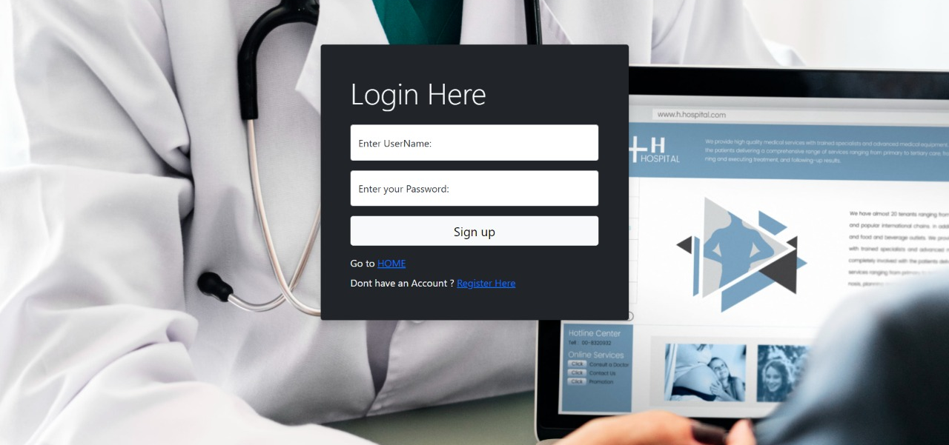
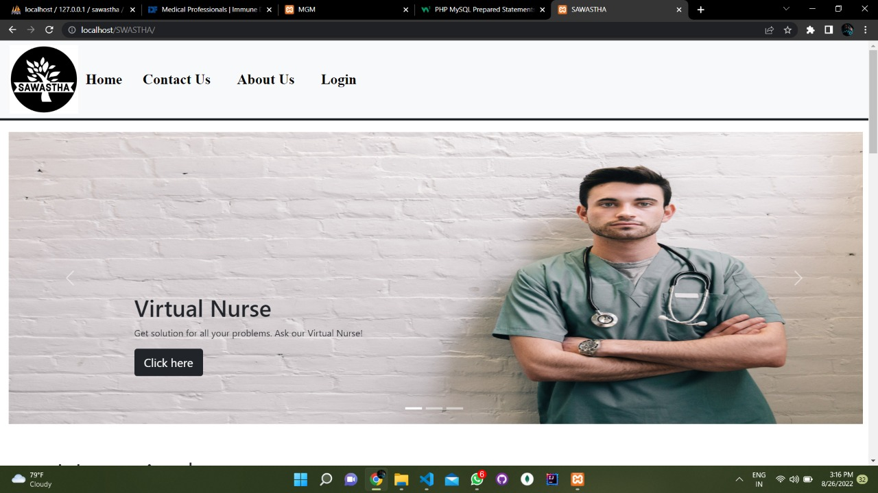
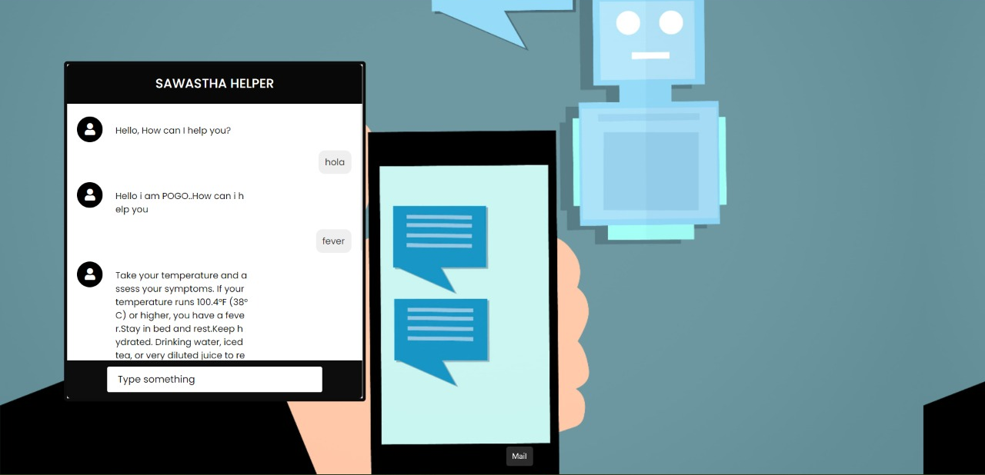
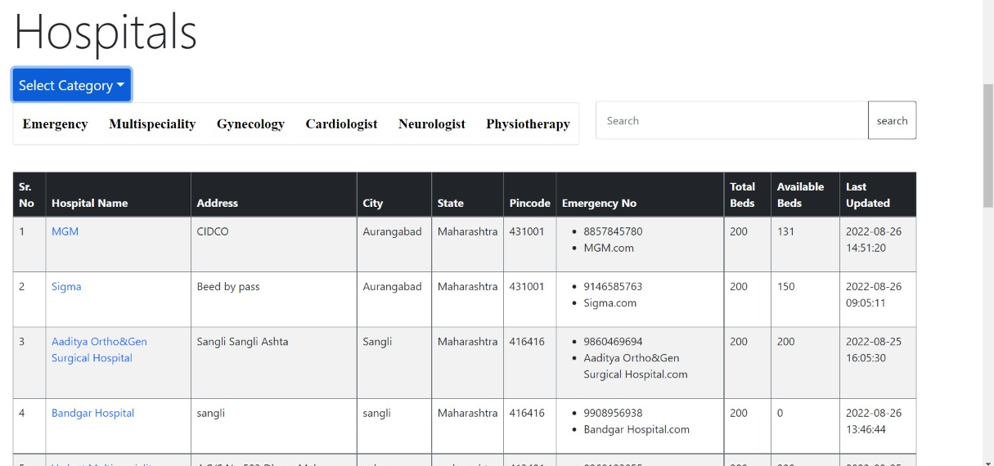
OUTPUT OF SWASTHA

Slide 8
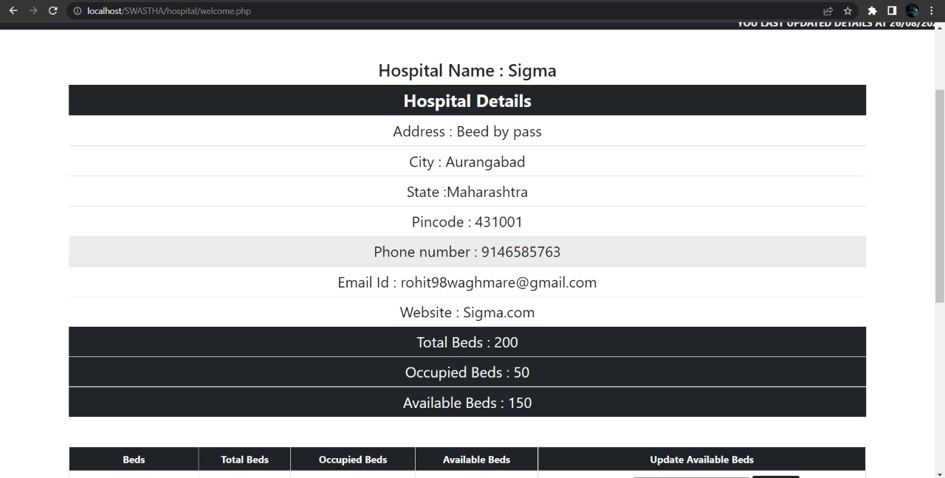
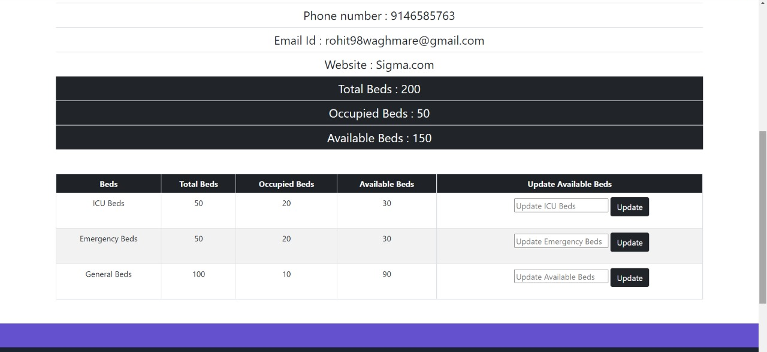

Slide 9
THANKYOU
BY TEAM: MIND OPTIMIZERS
Pd id: tk1052

