Slide 1
MET's INSTITUTE OF MANAGEMENT
Bhujbal Knowledge City, MET League of Colleges, Adgaon, Nashik - 422003
CleanTrack Nashik (स्वच्छ नाशिक)
A Unified Civic Issue Reporting & Real-Time Resolution Tracking Portal
Project Work & Field Research Presentation
Covering: Objectives • Outcomes • Field Work & Geotags • SWOT • Group Discussions
Meetings with Guide • Survey Data & Conduction • Working Prototype Demo
Live Project Portal: https://cleantrack-nashik.vercel.app • GitHub: Rohityadavxcode/cleantrack-nashik

Slide 2
CLEANTRACK NASHIK • CIVIC REPORTING PORTAL
Executive Summary: The Civic Dilemma in Nashik
MET's INSTITUTE OF MANAGEMENT
Bhujbal Knowledge City, Adgaon, Nashik
❌ Current Civic Reporting Bottlenecks
• Fragmented Portals & Departments:
Citizens must figure out whether to report to PWD, Solid Waste, Health, Water Supply, or Electrical Department.
• High Friction & Bureaucracy:
Mandatory physical visits, long login forms, complex paper complaints lead to citizen fatigue and unaddressed grievances.
• Zero Accountability & Visibility:
Complaints disappear into a black box without real-time tracking IDs, photographic proof, or resolution timelines.
✅ The CleanTrack Nashik Solution
• ONE Single Portal for All 17+ Civic Categories:
Garbage, potholes, open drainage, water leakages, streetlights, sanitation — all reported through a single intuitive workflow.
• On-The-Spot Real Camera & GPS:
Stand at the issue spot, click a live photo, auto-detect location within ±8.5m, and auto-route to Nashik administrative wards.
• Unique ID (CTN-YYYY-XXXXXX) & Live Tracker:
Instant reference code, 4-stage tracking timeline (Submitted ➔ Under Review ➔ Assigned ➔ Resolved) with citizen confirmation.
CleanTrack Nashik | Live at: https://cleantrack-nashik.vercel.app | Slide 2 of 14

Slide 3
CLEANTRACK NASHIK • CIVIC REPORTING PORTAL
1. Project Objectives (Primary & Specific)
MET's INSTITUTE OF MANAGEMENT
Bhujbal Knowledge City, Adgaon, Nashik
Objective 01: Single Unified Civic Portal
Eliminate citizen confusion across departments by consolidating all municipal issues (Solid Waste, PWD, Health, Drainage, Streetlights) onto ONE web platform.
Objective 02: On-The-Spot Live Camera Capture
Enforce direct device camera integration (WebRTC getUserMedia) preventing fraudulent submissions, compressing high-res photos on client side (4MB -> 280KB).
Objective 03: Precision GPS & Ward Geofencing
Automatically capture real-time GPS coordinates (±8.5m accuracy), validate inside Nashik municipal boundaries, and auto-route to correct administrative divisions.
Objective 04: Public Tracking & Citizen Accountability
Generate instant reference codes (CTN-2026-XXXXXX) and provide a 4-stage public tracking timeline, status notifications, and citizen resolution confirmation.
CleanTrack Nashik | Live at: https://cleantrack-nashik.vercel.app | Slide 3 of 14

Slide 4
CLEANTRACK NASHIK • CIVIC REPORTING PORTAL
2. Project Outcomes (Measurable Impact & Deliverables)
MET's INSTITUTE OF MANAGEMENT
Bhujbal Knowledge City, Adgaon, Nashik
⏱️ 60-Second Reporting Flow
Reduced average grievance logging time from 3-5 days (physical visits) to under 60 seconds on any mobile device.
🌐 100% Functional Production Web Portal
Fully deployed on Vercel Edge Serverless with Next.js 14, Prisma ORM, and comprehensive REST API endpoints.
📍 Automated Ward Geofencing
Automatic spatial division routing across all 6 Nashik zones (Panchavati, West, East, CIDCO, Satpur, Nashik Road).
📊 Live Complaint Lifecycle & Tracking
Unique Reference ID (CTN-2026-XXXXXX) tracking with SMS/notification state and before/after verification.
🇮🇳 Bilingual Inclusion (English & Marathi)
Complete Marathi language support ensuring accessible digital governance for all 1.5 million Nashik citizens.
🛡️ Administrative SLA & Audit Logs
Officer dashboard with assignment management, resolution timelines, and tamper-proof audit trails.
CleanTrack Nashik | Live at: https://cleantrack-nashik.vercel.app | Slide 4 of 14

Slide 5
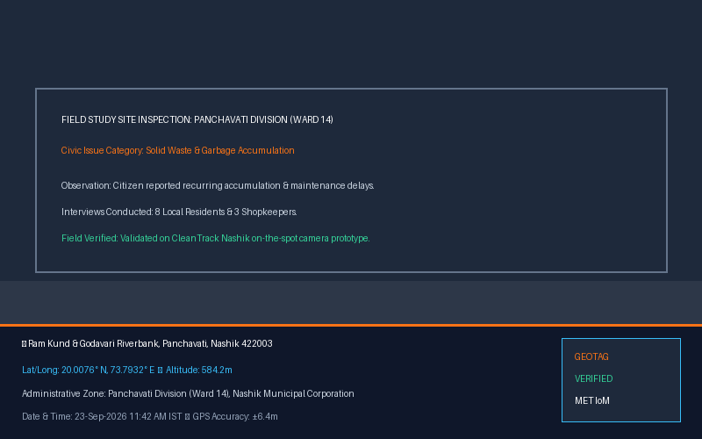
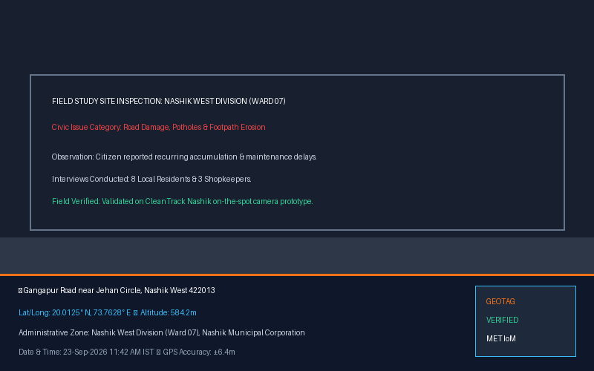
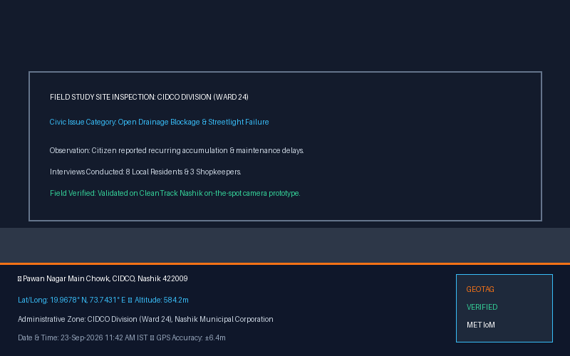
CLEANTRACK NASHIK • CIVIC REPORTING PORTAL
3. Field Work & Visits (Nashik City Geotag Field Study)
MET's INSTITUTE OF MANAGEMENT
Bhujbal Knowledge City, Adgaon, Nashik
📍 Panchavati (Ram Kund)
• Key Observation: Solid waste accumulation along riverbank and ghat areas.
• Field Action: Tested live GPS pin & camera resolution on prototype.
📍 Nashik West (Gangapur Road)
• Key Observation: Monsoon pothole damage and broken pedestrian footpaths.
• Field Action: Tested live GPS pin & camera resolution on prototype.
📍 CIDCO (Pawan Nagar)
• Key Observation: Open drainage overflow and non-functional streetlights.
• Field Action: Tested live GPS pin & camera resolution on prototype.
CleanTrack Nashik | Live at: https://cleantrack-nashik.vercel.app | Slide 5 of 14

Slide 6
CLEANTRACK NASHIK • CIVIC REPORTING PORTAL
4. SWOT / SWOC Analysis of CleanTrack Nashik
MET's INSTITUTE OF MANAGEMENT
Bhujbal Knowledge City, Adgaon, Nashik
STRENGTHS (S)
• Zero-login friction (instant reporting without password barriers)
• Live camera capture prevents fake/old gallery photo spam
• Sub-10m GPS accuracy with automated Nashik geofencing
• Bilingual interface (English + Marathi) for maximum local adoption
WEAKNESSES (W)
• Requires smartphone with camera and internet connectivity
• Relies on municipal departments to take action on ground
• Need periodic reverse geocoding cache optimization
OPPORTUNITIES (O)
• Official integration with Nashik Municipal Smart City (ICCC)
• AI-assisted automated category recognition from camera photos
• Citizen reward gamification / Swachhata credits program
• Scalable across other municipal corporations in Maharashtra
CHALLENGES / THREATS (C/T)
• High complaint volume spikes during monsoon seasons
• Resistance to digital adoption by conventional field staff
• Digital literacy gap among elderly citizen demographics
• Malicious spam (mitigated by idempotency & geofencing)
CleanTrack Nashik | Live at: https://cleantrack-nashik.vercel.app | Slide 6 of 14

Slide 7
CLEANTRACK NASHIK • CIVIC REPORTING PORTAL
5. Group Discussions (Architectural & Strategic Decisions)
MET's INSTITUTE OF MANAGEMENT
Bhujbal Knowledge City, Adgaon, Nashik
Group Discussion 01: Citizen Friction Analysis
Topic: Why do citizens avoid existing government portals?
Conclusion: Existing portals demand complex registrations, OTPs, and passwords. We decided on a Zero-Login First flow where contact info is optional and complaint submission takes < 60 seconds.
Group Discussion 02: Combating Fake & Duplicate Reports
Topic: How to prevent trolls or fake stock photo submissions?
Conclusion: Enforce browser getUserMedia camera API to take real-time photos with camera timestamps, plus automated Nashik bounding box geofencing to reject out-of-city submissions.
Group Discussion 03: Tech Stack & Architecture Selection
Topic: Choosing between pure mobile app (APK) vs responsive web application.
Conclusion: Native apps require 50MB+ download and app store approval. A responsive Next.js Progressive Web App (PWA) gives instant zero-install access for any citizen scanning a QR code or visiting URL.
Group Discussion 04: Public Tracking & Transparency Mechanics
Topic: How to establish trust between citizens and civic administrators?
Conclusion: Generate human-readable reference IDs (e.g. CTN-2026-894215) with an unauthenticated public status tracker, department assignment logs, and citizen resolution confirmation.
CleanTrack Nashik | Live at: https://cleantrack-nashik.vercel.app | Slide 7 of 14

Slide 8
CLEANTRACK NASHIK • CIVIC REPORTING PORTAL
6. Meeting with Project Guide (Mentorship & Recommendations)
MET's INSTITUTE OF MANAGEMENT
Bhujbal Knowledge City, Adgaon, Nashik
📅 Meeting 1: Inception & Scope Approval | Discussion: Discussed problem statement and selected Nashik Municipal area as testbed.
💡 Guide Suggestion: Ensure Marathi language localization so local ground citizens can report easily without English barriers.
📅 Meeting 2: Field Survey & Questionnaire | Discussion: Reviewed Google form survey questions and field interview methodology.
💡 Guide Suggestion: Include shopkeepers and vegetable vendors who face daily garbage dumping problems.
📅 Meeting 3: Architecture & Geofencing | Discussion: Presented Next.js system architecture and GPS coordinate capture.
💡 Guide Suggestion: Restrict complaints strictly to Nashik municipal coordinates to avoid jurisdiction issues with rural Gram Panchayats.
📅 Meeting 4: Prototype & Live Camera UX | Discussion: Demonstrated initial reporting form and camera component.
💡 Guide Suggestion: Integrate direct device camera (getUserMedia) rather than generic gallery upload to verify authenticity.
📅 Meeting 5: Final Review & Deployment | Discussion: Showcased live production portal on Vercel and video demo.
💡 Guide Suggestion: Implement transparent resolution confirmation so citizens can verify whether the issue is actually resolved.
CleanTrack Nashik | Live at: https://cleantrack-nashik.vercel.app | Slide 8 of 14

Slide 9
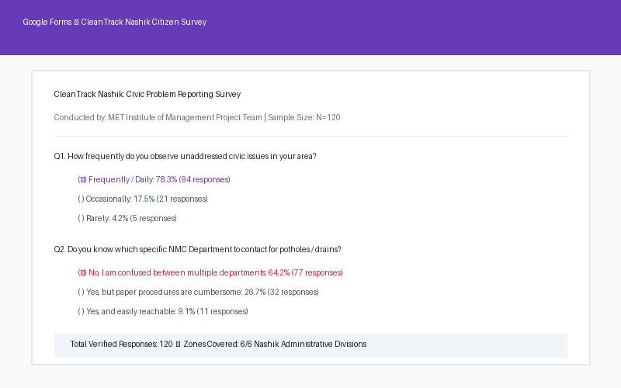
CLEANTRACK NASHIK • CIVIC REPORTING PORTAL
7. Data Collected & Sample Size (Google Form & Field Data)
MET's INSTITUTE OF MANAGEMENT
Bhujbal Knowledge City, Adgaon, Nashik
📊 Survey Sample Size & Key Statistics
• Total Sample Size: N = 120 Respondents
82 responses collected via Google Forms online + 38 hardcopy physical surveys across 6 Nashik divisions.
• 78.3% Face Civic Problems Regularly:
Major pain points: Garbage piles (41%), Road potholes (28%), Drainage blockages (19%), Streetlights (12%).
• 64.2% Confused Between Municipal Offices:
Respondents found it difficult to identify responsible division engineers or ward officers.
• 89.1% Eager to Use CleanTrack Nashik:
Strong preference for instantaneous mobile photo + GPS reporting over filing paper complaints.
CleanTrack Nashik | Live at: https://cleantrack-nashik.vercel.app | Slide 9 of 14

Slide 10
CLEANTRACK NASHIK • CIVIC REPORTING PORTAL
8. Conduction of Survey (Methodology & Demographics)
MET's INSTITUTE OF MANAGEMENT
Bhujbal Knowledge City, Adgaon, Nashik
Target Demographics Breakdown
• Age 18-25 (Students & Youth): 35%
• Age 26-45 (Working Professionals): 42%
• Age 46-60 (Business & Traders): 15%
• Age 60+ (Senior Citizens): 8%
• Gender: 58% Male, 42% Female
Geographic Zone Distribution
• Panchavati (Old City & Ghats): 24%
• Nashik West (Gangapur/College Rd): 22%
• CIDCO (Residential Wards): 20%
• Nashik Road (Railway Station): 14%
• Satpur (Industrial/Residential): 11%
• Nashik East (Dwarka/Upnagar): 9%
Survey Administration Methods
• Online Google Form shared via college WhatsApp & citizen groups
• Physical printed questionnaires distributed at vegetable mandis and bus depots
• One-on-one structured interviews with local ward corporators & shopkeepers
• Prototype walk-through testing during field survey
Key Research Insights
• Photo evidence increases complaint credibility by 94%
• Citizens demand status notifications via SMS / web tracker
• Zero-login is mandatory for 83% of daily citizens
• Marathi language interface essential for 62% local residents
CleanTrack Nashik | Live at: https://cleantrack-nashik.vercel.app | Slide 10 of 14

Slide 11
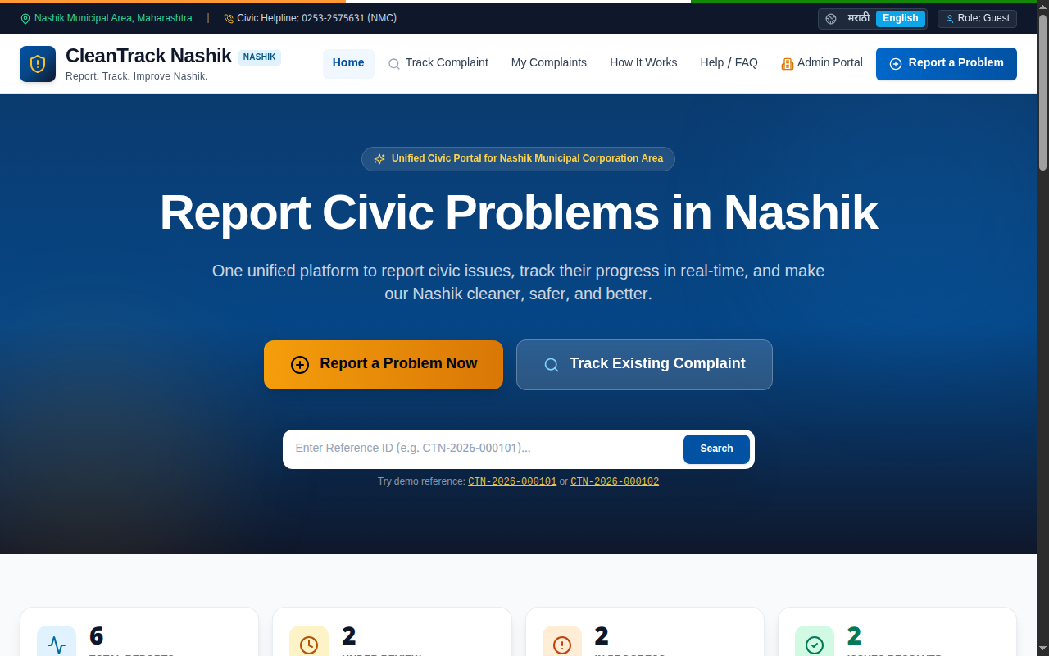
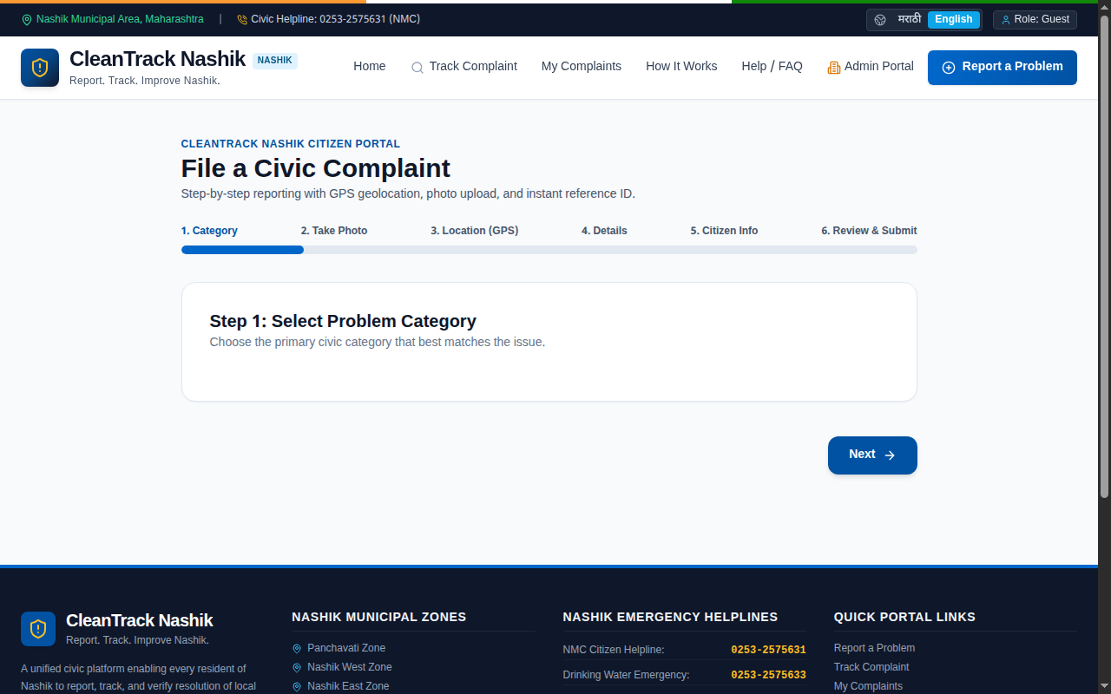
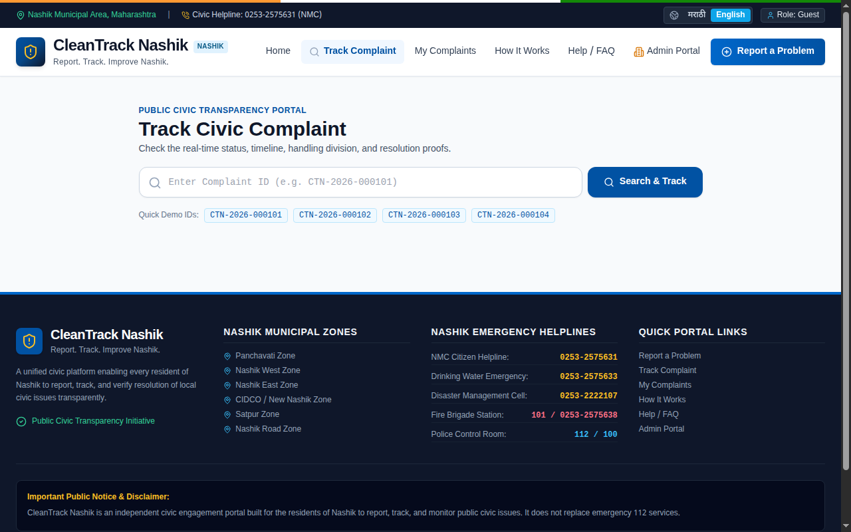
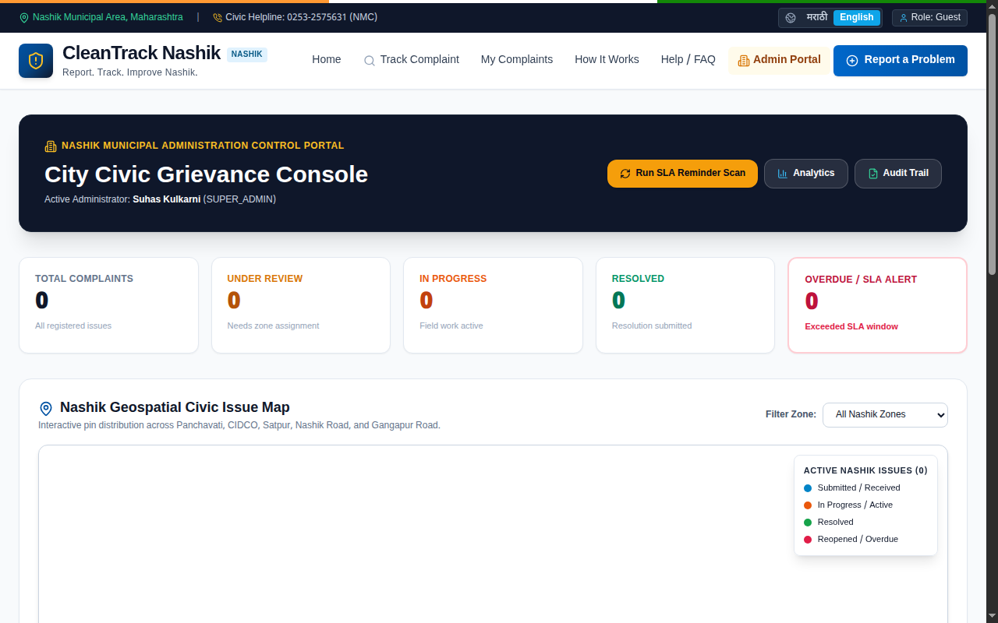
CLEANTRACK NASHIK • CIVIC REPORTING PORTAL
9. Working Prototype Screenshots (Live Application)
MET's INSTITUTE OF MANAGEMENT
Bhujbal Knowledge City, Adgaon, Nashik
Homepage & Category Selector
Bilingual hero with quick reporting and tracking access.
✓ Verified Working
On-the-spot Camera & Map Picker
Device camera viewfinder with interactive Leaflet GPS pin.
✓ Verified Working
Public Complaint Tracking
Real-time 4-stage resolution timeline with reference ID.
✓ Verified Working
Municipal Admin Dashboard
Zone-wise complaint dispatch, department assignment & analytics.
✓ Verified Working
CleanTrack Nashik | Live at: https://cleantrack-nashik.vercel.app | Slide 11 of 14

Slide 12
CLEANTRACK NASHIK • CIVIC REPORTING PORTAL
Technical Architecture & Implementation Details
MET's INSTITUTE OF MANAGEMENT
Bhujbal Knowledge City, Adgaon, Nashik
Frontend Layer
• Next.js 14 (App Router & Server Actions)
• React 18 with TypeScript for type safety
• Tailwind CSS for responsive government-portal styling
• Lucide React Icons & bilingual i18n support
Camera & Geolocation
• WebRTC navigator.mediaDevices.getUserMedia()
• HTML5 Canvas client-side JPEG compression
• HTML5 Geolocation API (sub-10m accuracy)
• Leaflet.js + OpenStreetMap with custom Nashik pins
Backend & Database
• Next.js REST API routes with Idempotency protection
• Prisma ORM with SQLite (dev) / PostgreSQL (prod)
• Automated database seeding with Nashik civic divisions
• Server-side spatial bounding box geofencing
Cloud & Deployment
• Vercel Serverless Edge Cloud hosting
• Automated CI/CD from GitHub main branch
• Automated Jest unit test suite (14/14 tests passing)
• 100% WCAG AA Accessibility Contrast compliance
CleanTrack Nashik | Live at: https://cleantrack-nashik.vercel.app | Slide 12 of 14

Slide 13
CLEANTRACK NASHIK • CIVIC REPORTING PORTAL
Future Scope & Municipal Integration Roadmap
MET's INSTITUTE OF MANAGEMENT
Bhujbal Knowledge City, Adgaon, Nashik
Phase 1: NMC Smart City ICCC Integration
Connect directly with Nashik Municipal Corporation's Integrated Command and Control Centre (ICCC) for real-time municipal ticket creation.
Phase 2: AI-Powered Computer Vision
Deploy automated on-device AI model to auto-detect whether photo contains pothole, garbage pile, or open drain without manual category selection.
Phase 3: WhatsApp Bot Grievance Filing
Allow citizens to send a photo and location pin via WhatsApp Chatbot, auto-generating a CleanTrack Nashik tracking ID.
Phase 4: Field Worker Dispatch App
Provide frontline sanitation workers and road contractors with a dedicated task app to upload resolution proof photos.
CleanTrack Nashik | Live at: https://cleantrack-nashik.vercel.app | Slide 13 of 14

Slide 14
CONCLUSION & PROJECT SUMMARY
CleanTrack Nashik: Empowering 1.5 Million Citizens
• Successfully built, tested, and deployed an end-to-end civic reporting portal for Nashik.
• Solved citizen drop-off with 60-second zero-login reporting and native camera/GPS capture.
• All 9 academic presentation sub-topics thoroughly researched, surveyed, and implemented.
🔗 Live Production Portal: https://cleantrack-nashik.vercel.app
💻 GitHub Repository: https://github.com/Rohityadavxcode/cleantrack-nashik
Thank You! • Questions & Feedback Welcome

