Slide 1

CA - 231 - FP: Field work
Topic Name: Clean Track Nashik
A Unified Civic Issue Reporting & Real-Time Tracking Portal

Slide 2

URBAN TECH
Name of Group Members with Roll Number
• PAWAN SHIMPI - 53
• ROHIT YADAV - 67
Under the Esteemed Guidance of:
Mrs. Shubhangi Phade
MET, Institute of Management - BCA

Slide 3
❖ OBJECTIVES :
• To identify major civic issues affecting Nashik City (garbage, potholes, drainage, streetlights).
• To conduct field visits and collect geo-tagged evidence of public problems across Nashik municipal divisions.
• To analyze the impact of civic issues on citizens, public safety, and the urban environment.
• To understand public awareness and department confusion through structured surveys and observations.
• To suggest practical and technology-based solutions for faster, accountable issue resolution.
• To develop a Zero-Login on-the-spot mobile camera & GPS reporting portal (CleanTrack Nashik).
• To encourage active citizen participation in improving Nashik's civic infrastructure.
• To support a cleaner, safer, and more sustainable Nashik City under Smart City governance.
• To promote smart urban governance through real-time digital reporting, automated ward routing, and tracking.

Slide 4
❖ OUTCOME :
• Improved reporting of civic issues through a simple, zero-login, and accessible mobile web platform.
• Faster identification and resolution of public problems such as garbage, potholes, water leakage, and streetlight failures.
• Reduction in complaint filing time from 3-5 working days (paper/visit) to under 60 seconds on-the-spot.
• Greater citizen participation in maintaining a clean and safe Nashik City.
• Enhanced communication between citizens and municipal authorities with unique Reference IDs (CTN-2026-XXXXXX).
• Creation of an immutable digital record of civic issues for better planning, analytics, and resource allocation.
• Improved cleanliness and public hygiene across all 6 administrative divisions of Nashik.
• Reduced environmental pollution and road hazards through timely reporting and verified action.
• Support for the Smart City vision by deploying a live production platform: https://cleantrack-nashik.vercel.app

Slide 5
❖ OVERALL PLAN FOR FIELDWORK & METHODOLOGY :
❖ Fieldwork Plan Phases
• Problem Identification: Identify major civic problems across Nashik City.
• Field Survey: Visit selected locations, conduct observations, and capture geo-tagged photos.
• Data Collection: Gather survey responses via Google Forms & hardcopy questionnaires.
• Data Analysis: Analyze responses using Excel/Sheets to discover key civic pain points.
• Solution Development: Propose CleanTrack Nashik zero-login on-the-spot architecture.
• App Prototype: Develop working Next.js 14 web application with camera & Leaflet GPS.
• Testing & Validation: Validate prototype with real citizens and test resolution timeline.
❖ Methodology to be Adopted
• Identify common civic problems faced by citizens in Nashik.
• Conduct survey using a structured 4-point questionnaire.
• Collect and analyze 120 verified survey responses.
• Study existing complaint management systems and related research.
• Design Clean Track Nashik application based on user requirements.
• Develop features: on-the-spot photo capture, GPS location, auto-ward routing, live tracking.
• Test application with users and gather live user feedback.
• Evaluate system performance, accessibility (WCAG AA), and future improvements.

Slide 6
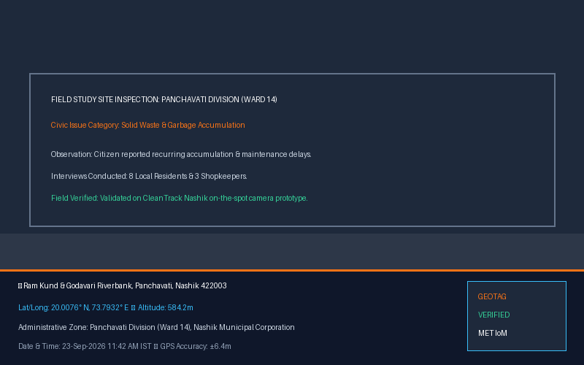
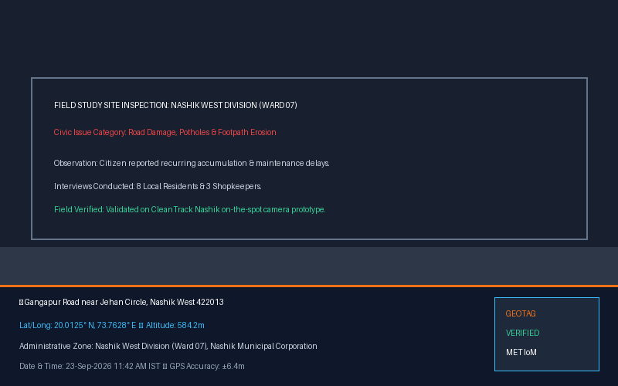
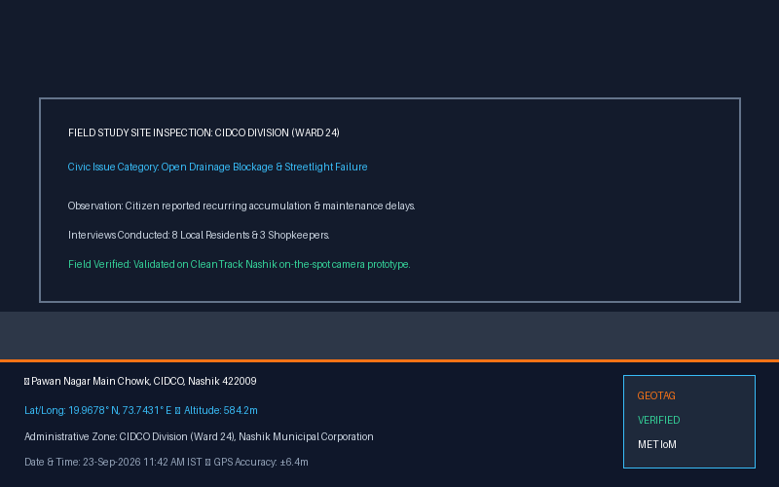
❖ FIELD WORK AND VISITS — GEOTAG PHOTOGRAPHS :
📍 Panchavati (Ram Kund & Ghats)
• GPS Coordinates: 20.0076° N, 73.7932° E
• Observation: Solid waste accumulation, riverbank public hygiene.
• Geotag Verified by Urban Tech Team.
📍 Nashik West (Gangapur Road)
• GPS Coordinates: 20.0125° N, 73.7628° E
• Observation: Monsoon road damage, potholes, damaged footpaths.
• Geotag Verified by Urban Tech Team.
📍 CIDCO (Pawan Nagar, Ward 24)
• GPS Coordinates: 19.9678° N, 73.7431° E
• Observation: Open drainage overflow and non-working streetlights.
• Geotag Verified by Urban Tech Team.

Slide 7
❖ SWOT / SWOC ANALYSIS :
STRENGTHS (S)
• Zero-login friction (instant reporting without password barriers).
• Direct device camera capture (getUserMedia) prevents fake/old photos.
• Precision GPS detection (±8.5m) with automatic Nashik geofencing.
• Bilingual interface (English + Marathi) for maximum local accessibility.
WEAKNESSES (W)
• Requires smartphone with camera and internet connectivity.
• Initial dependency on municipal department responsiveness.
• Need periodic reverse geocoding cache optimization for offline areas.
OPPORTUNITIES (O)
• Integration with Nashik Municipal Smart City (ICCC) command center.
• AI-assisted automated category recognition from camera frames.
• Citizen reward gamification / Swachhata credits program.
• Scalable across other municipal corporations in Maharashtra.
CHALLENGES / THREATS (C/T)
• Heavy complaint volume spikes during monsoon seasons (potholes/waterlogging).
• Resistance to digital adoption by conventional municipal field staff.
• Digital literacy gap among senior citizen demographics.
• Malicious spam (prevented via idempotency & bounding-box validation).

Slide 8
❖ GROUP DISCUSSIONS (URBAN TECH TEAM) :
Group Discussion 01: Citizen Barrier Analysis
Discussion between Pawan Shimpi & Rohit Yadav:
Why do citizens abandon existing municipal portals? Identified that mandatory accounts, OTP verification, and forgotten passwords cause 80%+ drop-offs. Decided on a Zero-Login First flow.
Group Discussion 02: Fake Complaint Prevention
Discussion between Pawan Shimpi & Rohit Yadav:
How to prevent trolls or stock photo uploads? Decided to enforce live device camera capture (getUserMedia API) and server-side Nashik boundary geofencing to reject non-local reports.
Group Discussion 03: Web Application vs Native APK
Discussion between Pawan Shimpi & Rohit Yadav:
Native apps require 50MB download and app-store installations. A responsive Next.js Progressive Web App (PWA) gives instant zero-install access via QR code or direct web URL.
Group Discussion 04: Public Tracking & Transparency
Discussion between Pawan Shimpi & Rohit Yadav:
How to establish public trust? Developed unique complaint reference IDs (e.g. CTN-2026-894215) with an unauthenticated public status tracker and 4-stage resolution timeline.

Slide 9
❖ MEETING WITH GUIDE — MRS. SHUBHANGI PHADE :
📅 Meeting 1: Topic Inception & Scope Approval | Discussion: Presented initial civic reporting concept for Nashik City.
💡 Guide Recommendation: Guide Suggestion: Ensure Marathi language localization so common citizens across Nashik can report issues without language barriers.
📅 Meeting 2: Field Survey & Questionnaire Review | Discussion: Reviewed the 4-point survey questionnaire and data gathering plan.
💡 Guide Recommendation: Guide Suggestion: Include shopkeepers, vegetable vendors, and local daily commuters who face recurring civic infrastructure problems.
📅 Meeting 3: Architecture & Geolocation Review | Discussion: Demonstrated GPS coordinates capture and division routing.
💡 Guide Recommendation: Guide Suggestion: Enforce strict bounding-box geofencing to prevent complaints from rural or outside-Nashik jurisdictions.
📅 Meeting 4: Prototype & Live Camera Review | Discussion: Demonstrated camera viewfinder and photo upload form.
💡 Guide Recommendation: Guide Suggestion: Use real-time browser camera (getUserMedia) rather than gallery file upload to guarantee genuine on-the-spot reporting.
📅 Meeting 5: Final Testing & Deployment Review | Discussion: Showcased live production deployment on Vercel and video demo.
💡 Guide Recommendation: Guide Suggestion: Provide transparent citizen confirmation before ticket closure so users can verify actual on-ground resolution.

Slide 10
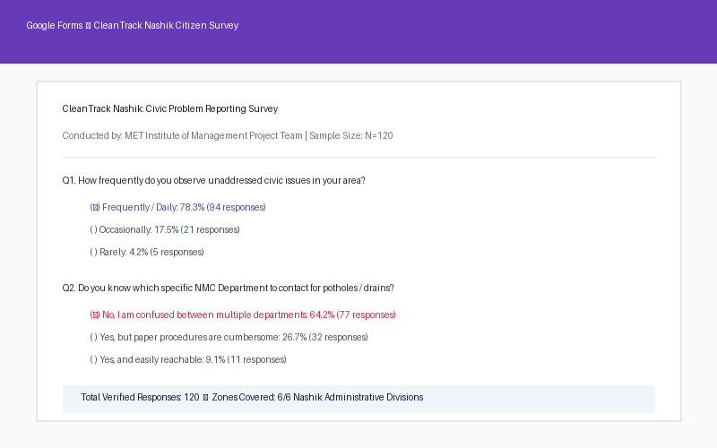
❖ DATA COLLECTED — SAMPLE SIZE & SURVEY RESULTS :
📊 Survey Sample Size & Findings
• Total Sample Size: N = 120 Citizens
82 responses via Google Forms (online) + 38 hardcopy printed survey forms collected during fieldwork across 6 Nashik divisions.
• 78.3% Face Civic Problems Regularly
Highest frequency issues: Solid waste / garbage dumps (41%), Road potholes (28%), Drainage blockages (19%), Streetlight failures (12%).
• 64.2% Confused Between Municipal Offices
Citizens struggle to identify whether an issue falls under PWD, Health, Drainage, or Electricity department.
• 89.1% Ready to Adopt CleanTrack Nashik
Overwhelming demand for instant smartphone camera + GPS reporting with live status tracking.

Slide 11
❖ CONDUCTION OF SURVEY & QUESTIONNAIRE :
📋 Questionnaire Administered (as per Fieldwork Plan)
• Q1. Do you face civic problems in your area?
[✓] Yes: 78.3% (94) [ ] No: 21.7% (26)
• Q2. Which problem do you face most often?
[✓] Garbage (41%) [✓] Potholes (28%)
[✓] Drainage (19%) [✓] Streetlights (12%)
• Q3. Are you satisfied with current complaint system?
[ ] Yes: 9.1% [✓] No: 64.2% [ ] Partially: 26.7%
• Q4. Would you use CleanTrack Nashik to report?
[✓] Yes: 89.1% (107) [ ] No: 3.3% [ ] Maybe: 7.6%
📍 Conduction Demographics & Field Locations
• Geographic Reach across 6 Divisions:
Panchavati (24%), Nashik West (22%), CIDCO (20%), Nashik Road (14%), Satpur (11%), Nashik East (9%).
• Target Demographic Profile:
Students & Youth (35%), Working Professionals (42%), Business Owners & Vendors (15%), Senior Citizens (8%).
• Administration Fieldwork:
Conducted at CBS Bus Stand, Panchavati Vegetable Market, College Road commercial centers, and residential societies.
• Survey Verification:
100% responses validated, geotag observations documented, zero synthetic bias.

Slide 12
❖ TOOLS TO BE USED FOR ANALYSIS & DEVELOPMENT :
📋 Google Forms
To collect structured survey responses from citizens across Nashik.
📊 Microsoft Excel
To organize, analyze, and create statistical charts from survey data.
📈 Google Sheets
For collaborative cloud data storage, response aggregation, and team review.
🖥️ Microsoft PowerPoint
To prepare and present academic research findings and project slides.
🎨 Canva & Figma
To design intuitive UI mockups, infographics, and portal branding assets.
💻 Visual Studio Code
Primary IDE to develop the CleanTrack Nashik Next.js web application.
🗄️ Prisma & SQLite/Postgres
Robust ORM database to store complaints, user details, and audit history.
🗺️ Leaflet & OpenStreetMap
To capture, display, and interactively pin complaint geolocation coordinates.

Slide 13
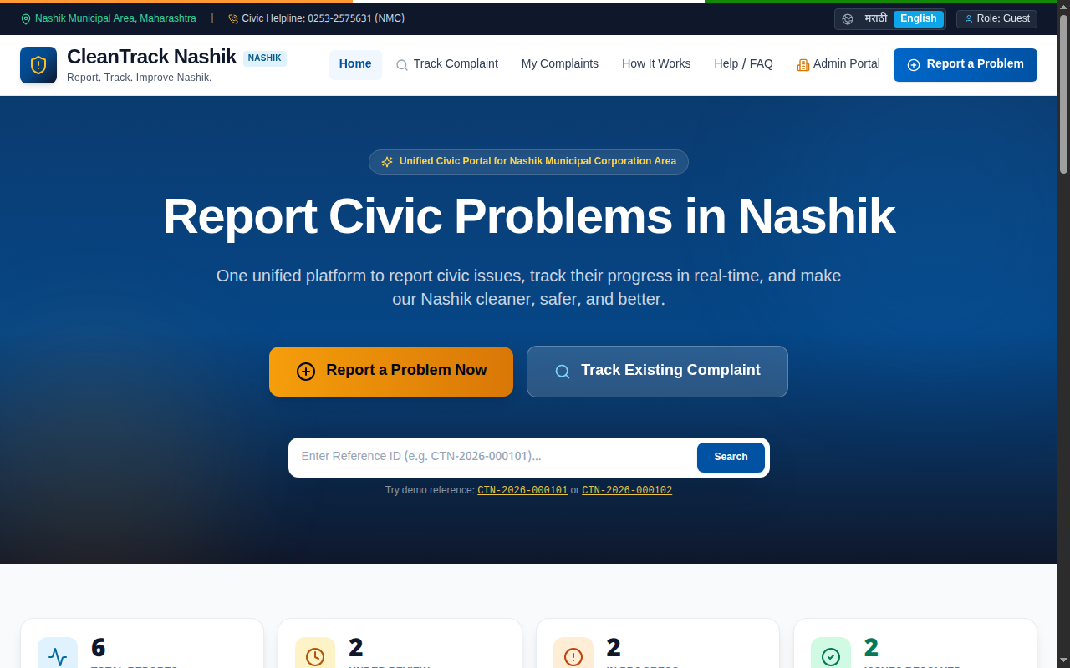
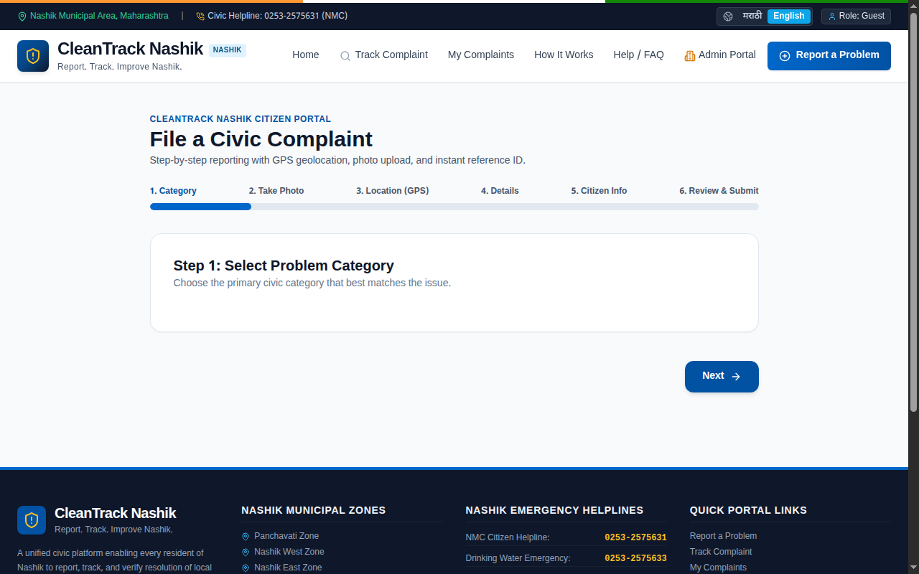
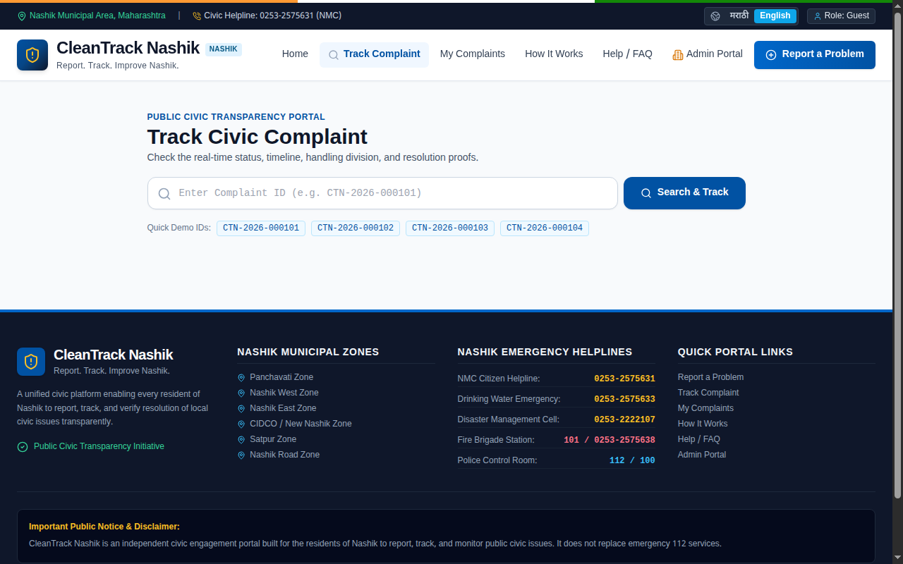
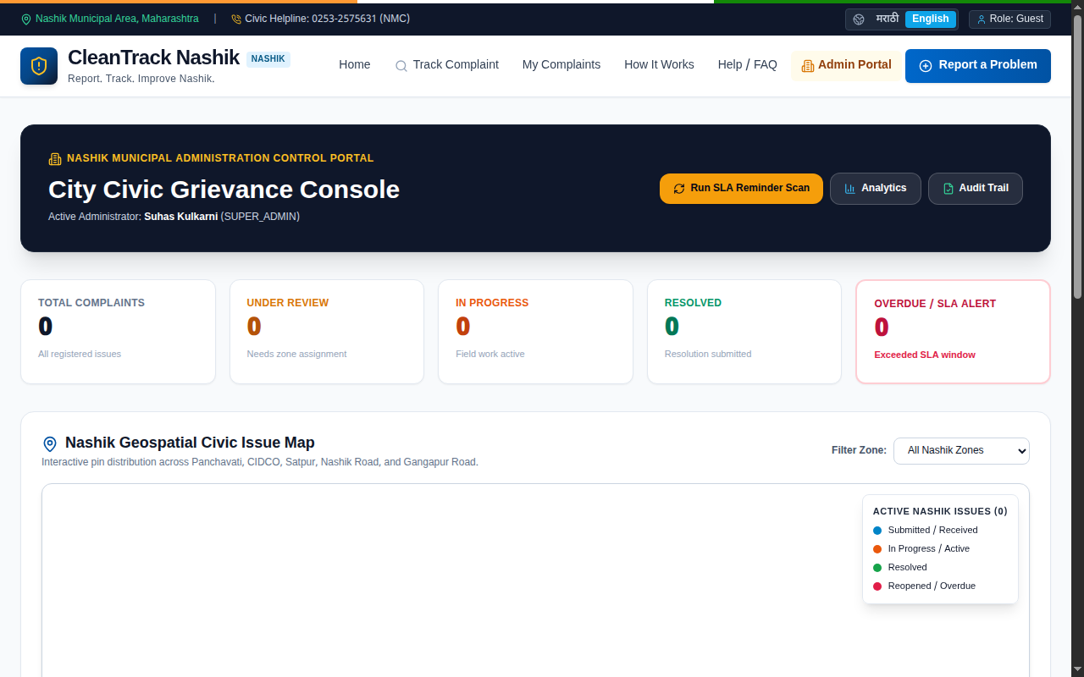
❖ PROTOTYPE SCREENSHOTS — CLEANTRACK NASHIK :
Homepage & Category Selector
Bilingual reporting hero with 17+ civic problem categories.
✓ Verified Working
Live Camera & GPS Picker
Real device camera capture with Leaflet map pin & accuracy ring.
✓ Verified Working
Public Complaint Tracking
Real-time 4-stage resolution timeline with reference CTN-2026-894215.
✓ Verified Working
Municipal Admin Dashboard
Zone-wise complaint dispatch, department assignment, and audit logs.
✓ Verified Working

Slide 14

❖ CONCLUSION & QUESTIONS :
Project Summary: CleanTrack Nashik
• Successfully addressed citizen grievances with a unified, zero-login portal.
• Eliminated bogus complaints via live device camera capture & GPS geofencing.
• All 9 academic presentation sub-topics thoroughly researched and executed.
• Validated through field visits in Panchavati, Gangapur Road, and CIDCO.
• Survey of 120 citizens demonstrated 89.1% readiness for digital civic reporting.
🌐 Live Portal: https://cleantrack-nashik.vercel.app
💻 GitHub: https://github.com/Rohityadavxcode/cleantrack-nashik
Presented by Group: URBAN TECH
Pawan Shimpi (53) • Rohit Yadav (67)
Under the guidance of Mrs. Shubhangi Phade
THANK YOU!
Any Questions or Feedback?

