Slide 1
FoodHub Data Analysis
Foundation of Data Science
29 May,2023

Slide 2
Contents / Agenda
Executive Summary
Business Problem Overview and Solution Approach
Data Overview
EDA - Univariate Analysis
EDA - Multivariate Analysis
Appendix

Slide 3
Executive Summary
The food aggregator company should had been focusing on customer experience with reference to various factors like total delivery time i.e., delivery time and time for preparing the meal, cuisine type, the time of the week when customer ordered and the cost of the order.
The data showed that there are not strong correlations between the factors. Secondly it was evident from analysis that if food preparation time is higher than cost of the order is also higher and vice versa.
Surprisingly, the analysis brought to attention that if cost of the order is higher than delivery time is less and vice versa.
Finally, survey determined the most ordered food cuisine to be American as it takes less food preparation time and people ordering mainly on weekends.
Note: You can use more than one slide if needed

Slide 4
Business Problem Overview and Solution Approach
Food Hub is a food aggregator company. It has data from various customer base about different restaurants in New York. The company wanted to study the reasons behind increasing or decreasing demand which could facilitate them in integrating policies that encourage better customer experience.
The data is arranged according to its attributes. Initially just structure of data is analyzed after that Uni-variate analysis are done to show how each individual factor is affecting the total order count.
As the last step multivariate analysis are done where the links between variables, covariations are taken into account.

Slide 5
Data Overview
Data Shape
Number of rows are 1898
Number of columns 9
Types of values in different categories
Orderid has integer values.
Customer id has integer values.
Restaurant name are object and so is cuisine type.
Cost of the order are floating values(decimal values).
Day of the week has object values
Food preparation time, delivery time and rating has integer values.

Slide 6
Continued..
There was not any missing value in data.
Minimum time it takes is 20 minutes. Average time restaurant takes is 27.37 minutes. Maximum time it takes is 35minutes.
There are 736 orders which are not given any ratings or are not rated by customers.

Slide 7
Univariate Analysis
American and Japanese are the most ordered cuisine type. Italian and Chinese are almost equally favored they have a minor difference of almost 50 counts.
Cost of the order is mainly between 12 to 15 dollars.
There are more orders on weekend in comparison to week , which makes sense.
Most of the restaurants do not have any ratings. Less than 200 restaurants have the rating of three which is lowest. Almost 600 restaurants have highest rating of 5.
Maximum time to prepare food is more than thirty-four minutes. Most of the food is prepared in the range of 24 to 30 minutes.
The maximum time to deliver food is 32.5 minutes. Maximum orders are delivered in between 27 to 29 minutes.
The top five names are: ['Shake Shack', 'The Meatball Shop', 'Blue Ribbon Sushi', 'Blue Ribbon Fried Chicken', 'Parm’.

Slide 8
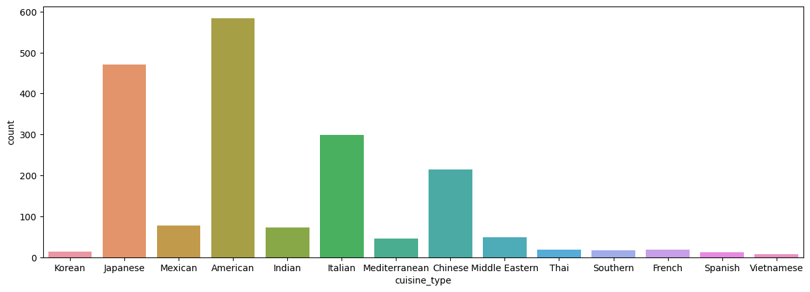
Graphs

Slide 9
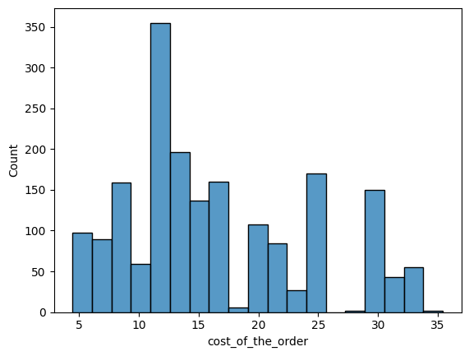

Slide 10
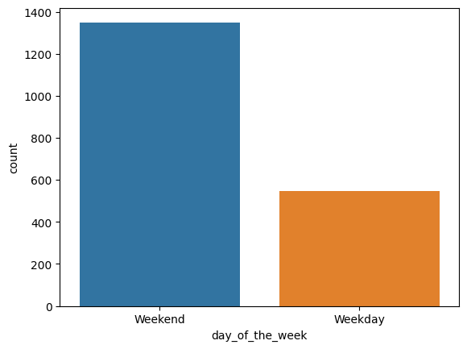

Slide 11
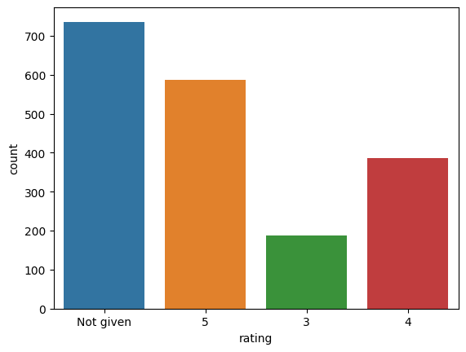

Slide 12
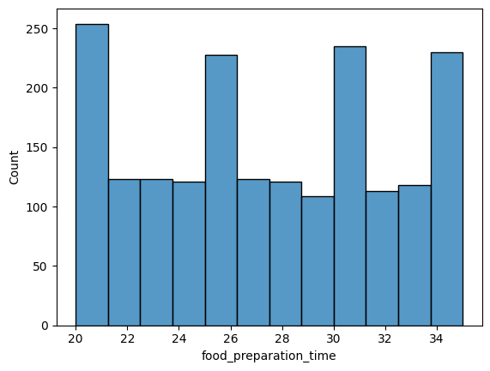

Slide 13
Continued…
The data shows that American is the most popular cuisine on weekend.
The number of total orders that cost above 20 dollars is: 555 Percentage of orders above 20 dollars: 29.24 %
The mean delivery time for this dataset is 24.16 minutes.
The customer ids with the greatest number of orders placed are 52832(13),47440(10) and 83287(9).

Slide 14
Multivariate Analysis
Southern cuisine type has most fluctuating cost as well as highest cost of order. Korean is the least expensive cuisine to order.
Southern food takes most preparation time.
Thai food has widest range for preparation time.
Korean cuisine takes least time for food preparation.
Mexican, American, Indian, Italian and Mediterranean food has same preparation time and have the same range for food preparation time.
The graph shows that on weekdays delivery time is higher than on weekend. It makes sense because on weekdays generally people call for delivery during rush hours.

Slide 15
Continued…
The restaurants with lowest ratings have highest delivery-time. So, it can be assumed that delivery time is one of the major reason which can make individual decide to order or not to order from a particular restaurant.
The food with the lowest rating has highest preparation time. So, it's kind of evident that customers prefer food which is easily available to them.
The findings depict what is generally expected that lower the ratings higher the cost of the order.
The mean delivery time on weekdays is around 28 minutes.
The mean delivery time on weekends is around 22 minutes.

Slide 16
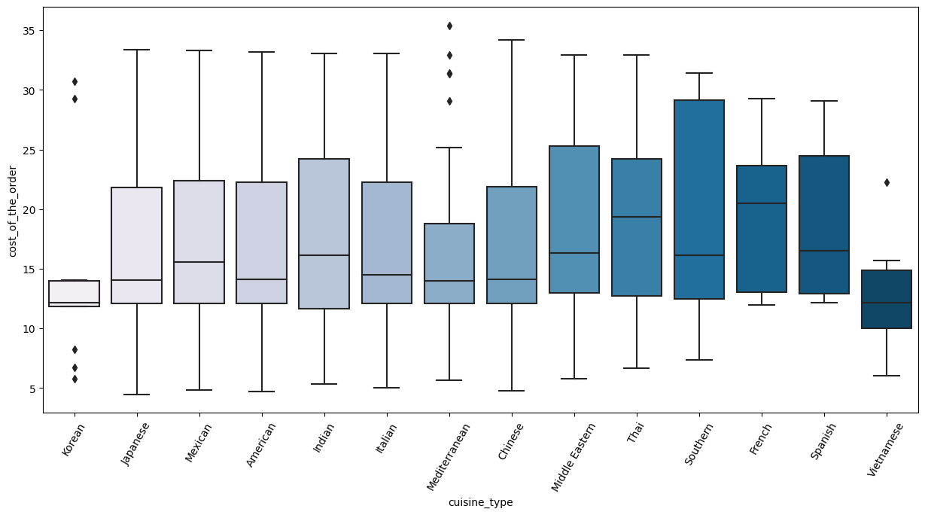

Slide 17
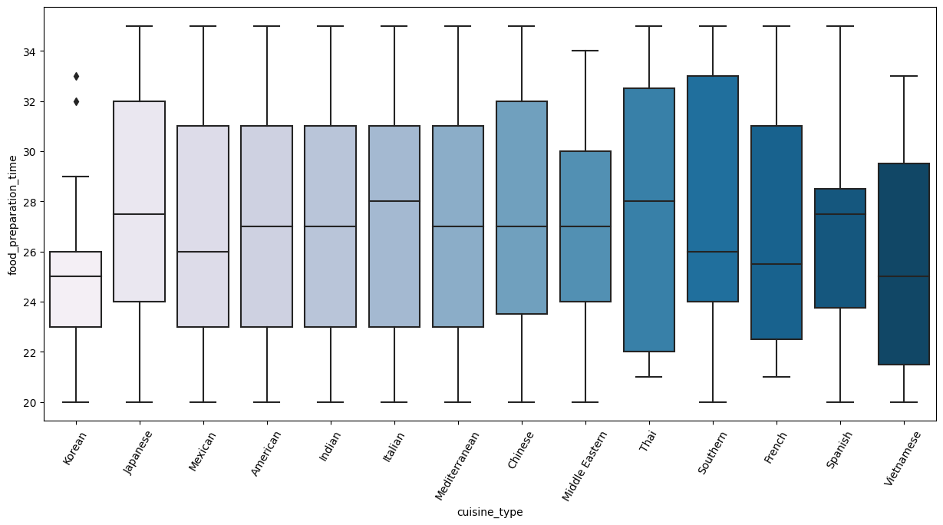

Slide 18
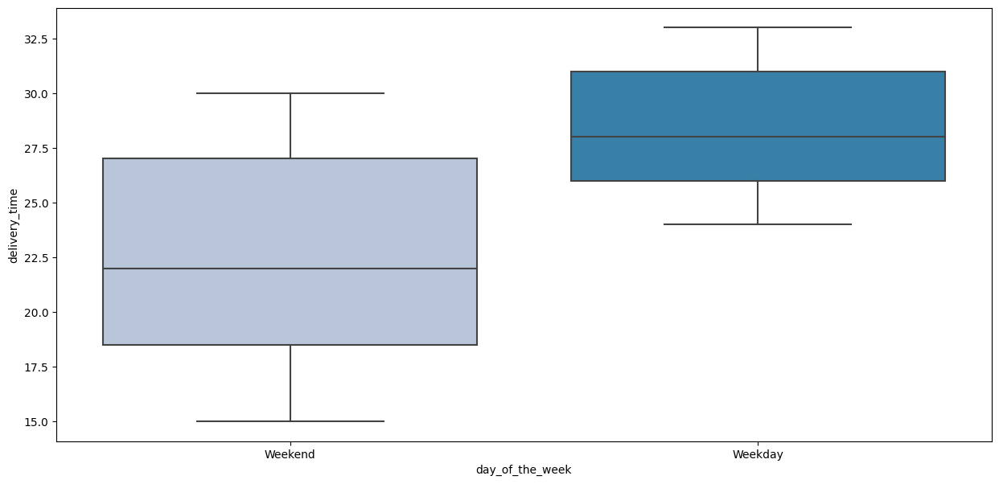

Slide 19
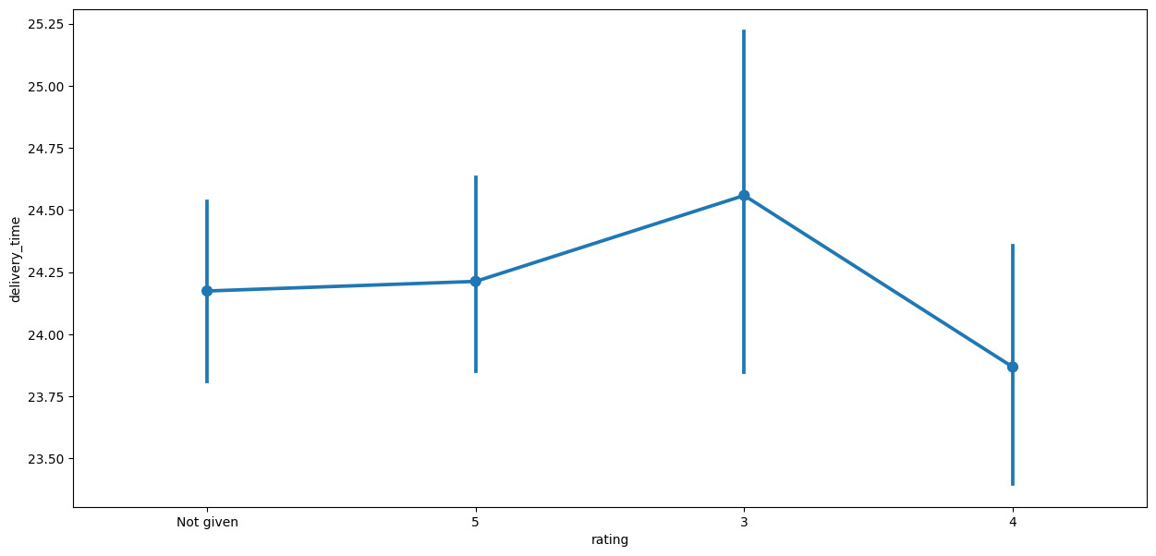

Slide 20
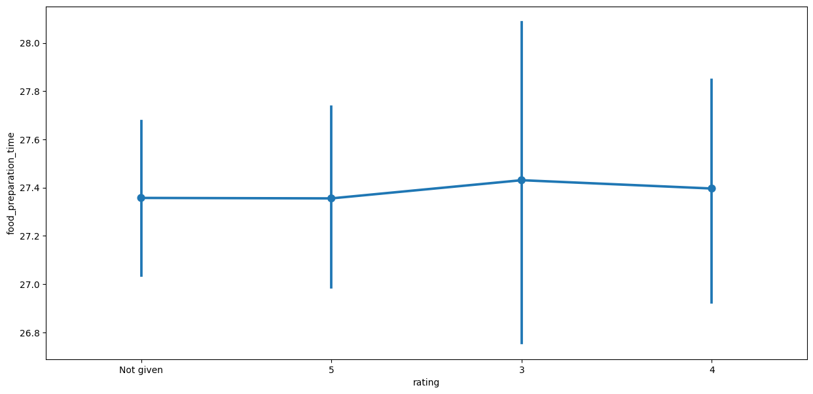

Slide 21
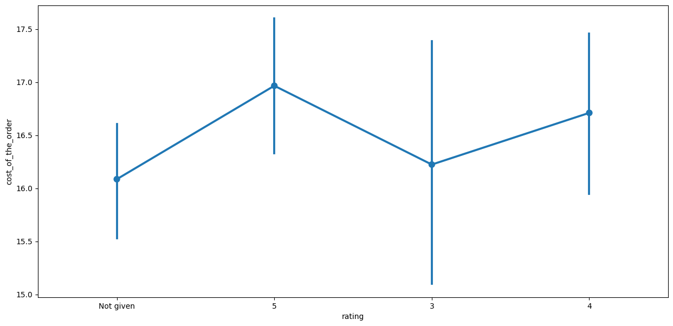

Slide 22
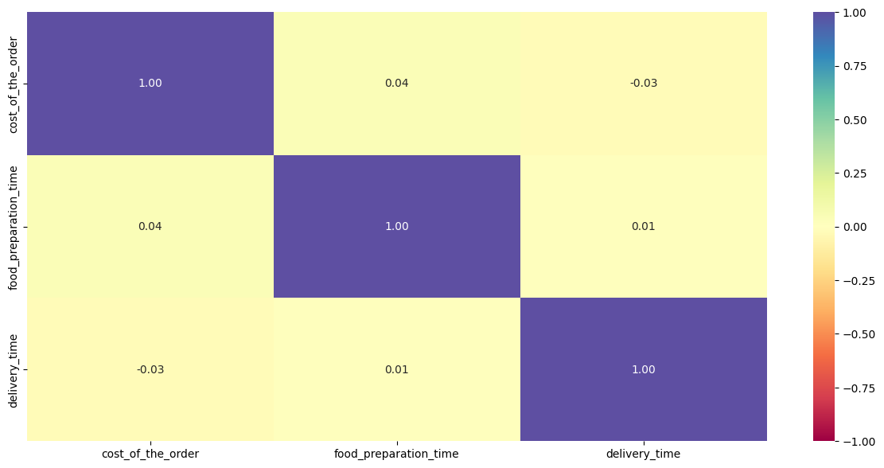

Slide 23
Recommendations
If restaurants wants to increase their sales and encourage the demand, they need to switch or add in their menu more American recipes.
They are quick to make and delivered in a good amount of time .
If restaurants want to increase sales, they should have discount offers on weekdays instead of weekend to increase the number of people ordering out on weekdays.

Slide 24
APPENDIX

Slide 25
Link to the file
https://colab.research.google.com/drive/1blZI3540kGMFDKdwSqAIF0ynwREk8DKP#scrollTo=1pMy5LynnHD_

