Slide 1
Analysing British Airways Customer Data

Slide 2
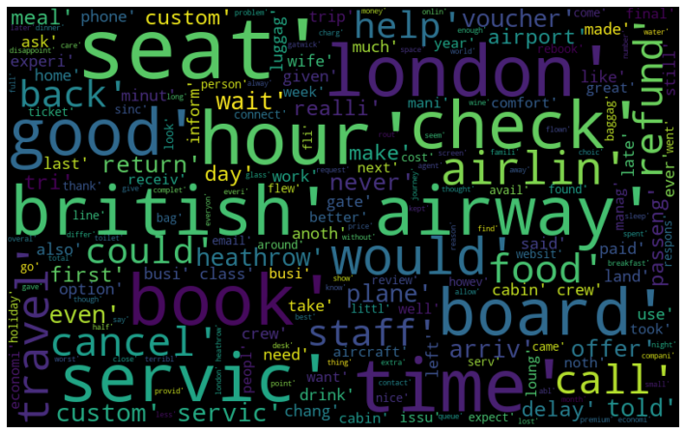
Wordcloud of the Customer Data
Data suggests British Airways should heed to the following issues: staff, services, delay, lounge, cabin crew, etc.

