Slide 1


Customer Booking Analysis

Slide 2
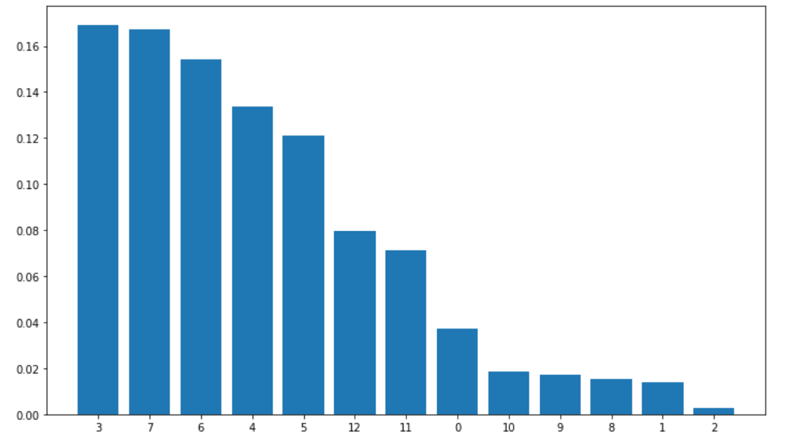
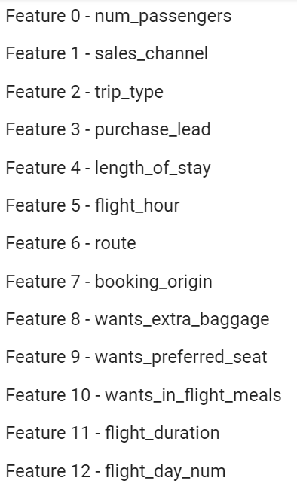
Feature Importance
The given data is highly imbalanced. So, we use random oversampler to balance the data.
Out of all the models developed, Random Forest gives the best outcome of 77% accuracy and a good precision & recall after hyperparameter tuning and cross validation.
The feature importance graph shows that when we predict the booking success of customers, the machine first go through the purchase_lead (number of days between travel date and booking data) which is followed by booking_orgin (country from where booking was made) and route (origin → destination flight route). The graph shows the importance of different features and box in the right shows the features corresponding on the graph.

