Slide 1
CS2007 Human Computer Interaction
Introduction

Slide 2
Introduction
Introduction to Human Computer Interaction
HCI Applications in Industry
Job outlook in Pakistan and beyond
HCI professional societies
Social and Crowd Computing

Slide 3

Information Processing in Human Sensation and Memory
Human sensation
Perception
Cognition
Philosophy of mind
Users as information processing systems
Information processing in human memory (sensory, long-term, short-term), recall and recognition

Slide 4
User Interface Design and Usability Essentials
Interaction Models
Dialog Styles
Menus
form-filling
GUI
Usability Principles
Jacob Nielsen’s Heuristics
Common errors and mistakes
Design process (Designer Bias, User requirements gathering techniques, personas and storyboards)
Design prototyping types

Slide 5

Exploring Multimodal User Interfaces and Technologies
User Interface Technologies
Multimodal Input using standard devices
Bio-signals
Acoustics
Hand Gestures and Depth Sensing
Multimodal Output via standard devices
Haptics, VR, 3d Printing, Drones
Navigations, Screen Designs & Layouts
Device constraints (e.g. mobile screens)

Slide 6
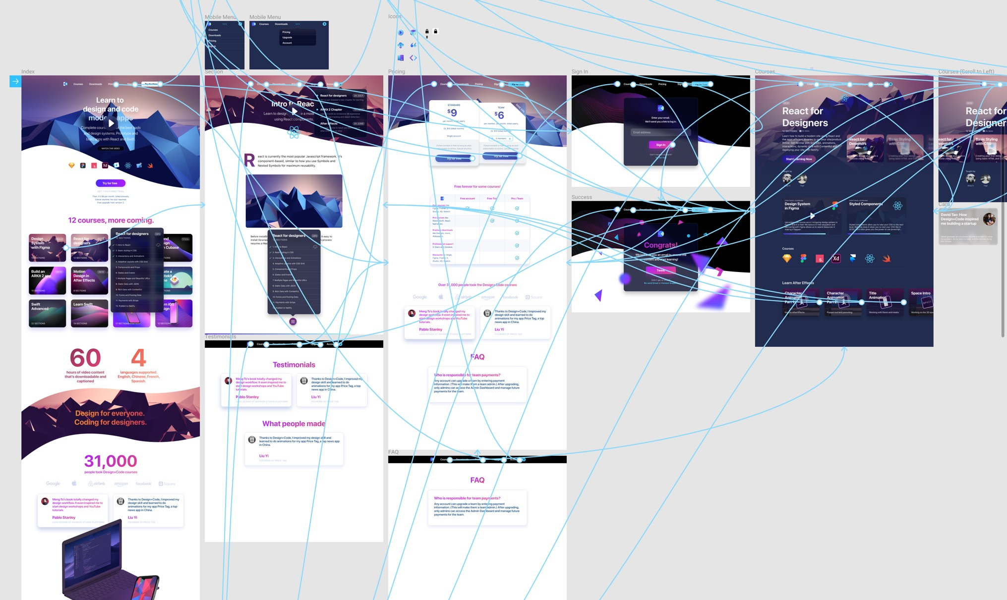
Figma
Interface design tools

Slide 7

Comprehensive Study of Design Evaluation, Hypothesis Testing, and Cognitive Models
Design evaluation (experimental and empirical methods)
Hypothesis tests
Sample size
Sata analysis
Experiment design
Design Tools Overview (Wireframing using Silk/Balsamiq, D.tools prototyping, parameter tuning)
Cognitive Models (i.e. cognitive load, sensory processing, Dunns Model)

Slide 8

Exploring UI and UX Testing Tools and Techniques
UI Testing, Testing tools (any of Watir, Sahi, Sikuli, AutoIT, TestComplete, Testomato, Visbug, Page Ruler, Colorzilla)
UI Testing Checklists
UX Testing (User session statistics, heat maps)
UX Testing tools (any of GTmetrix, optimizely, crazy egg, zurb, browsershots, UXpunk)
UX Testing checklists
AgileUX
Design Patterns

Slide 9

Inclusive Multimodal Design: Principles, Visual Preferences, and Auditory Displays
Universal Design (UD)
Multimodal Designs
Visual Design principles
Quantifying Visual preferences
UD principles
Fitt’s law
Human audition and auditory displays (sensation, perception, cognition, hearing physiology, text to speech, speech to text, 3D spatialized sound)

Slide 10
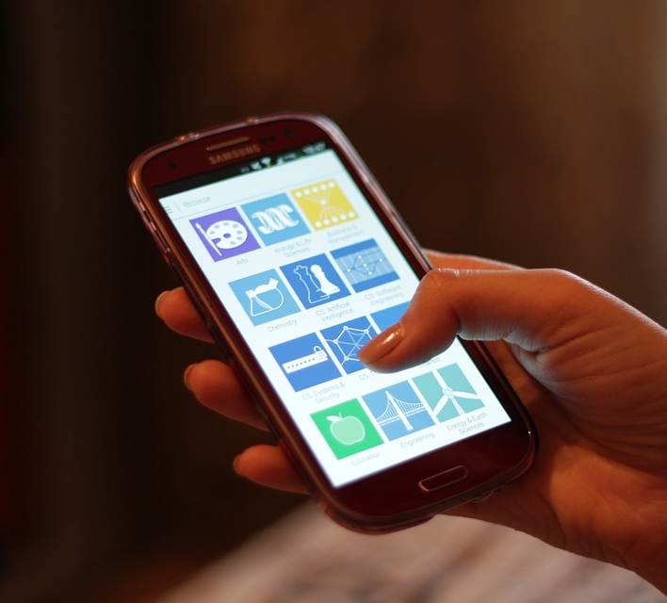
Exploring Tactile Displays and Human Touch Interaction
Human touch and tactual displays
Touch subsystem types (cutaneous, kinesthetic, haptic)
Mechanoreceptors
Hand movement patterns

Slide 11
Smartphone Interfaces: Challenges and Usability Consideration
Smart phone interfaces
output displays and problems
smartphone information input and its processing
Smartphone Usability considerations

Slide 12
Sensory Interaction and Applications
Smart phone sensors (accelerometers, gyroscopes, magnetometers, GPS, proximity, light)
Sensory interaction
Applications (fitness, location, gestures)

Slide 13
Exploring Brain Biophysics and Interfaces
Brain biophysics (Perception, Consciousness & Awareness, Creativity)
Brain Computer Interfaces
Brain plasticity

Slide 14
Neuroergonomics, Neurocognitive Engineering, and Ethical Considerations
Neuroergonomics
Neurocognitive engineering
Neuroprosthetics
ethical considerations
Sensory substitutions

Slide 15
EEG and EMG in HCI
Introduction to EEG and EMG
Neural Signal Acquisition
Muscular Signal Acquisition
Signal Processing
Brain-Computer Interfaces (BCIs)
Neuromarketing
Cognitive Load Assessment
Gesture Recognition
User Experience Enhancement
Neurofeedback
Accessibility and Inclusion
Privacy and Ethical Considerations

Slide 16
Comparing Virtual Reality, Augmented Reality, and Emerging Technologies
Virtual Reality vs Augmented Reality
Ubiquitous Computing
Ambient Intelligence
Wearable Devices
Virtual Position
3D coordinate Space

Slide 17
Visual Pathways, Depth Perception, and Display Techniques
Visual pathways
Spatial Vision
Depth Cues
Monocular displays
Binocular displays

Slide 18
Comparing Tactile and Force Feedback
Tactile and Force Feedback
Optical vs Beacon vs Electromagnetic trackers

Slide 19
Gesture tracking, Navigation
Technologies
Applications
Challenges

Slide 20

IoT Architecture
Communication
Processing
Storage
Power
Functionality
Sub-systems

Slide 21
Sensing IoT environment

Slide 22
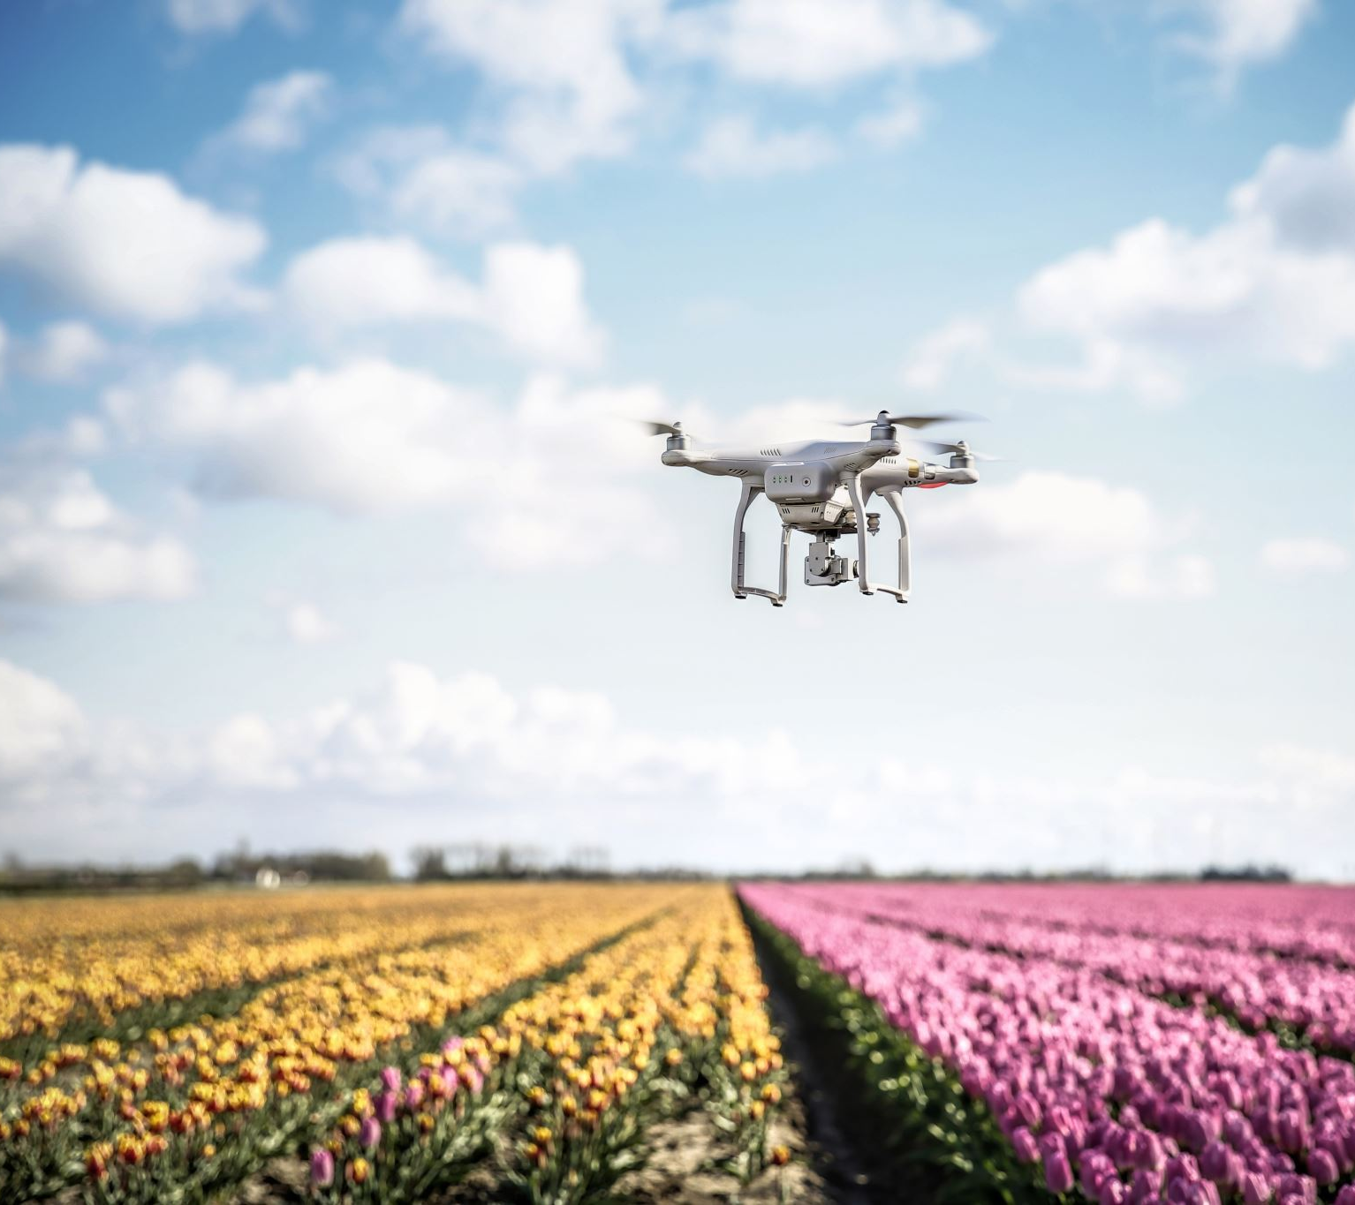
Drones, UAVs, Quadcopters Overview, Flight Dynamics

Slide 23
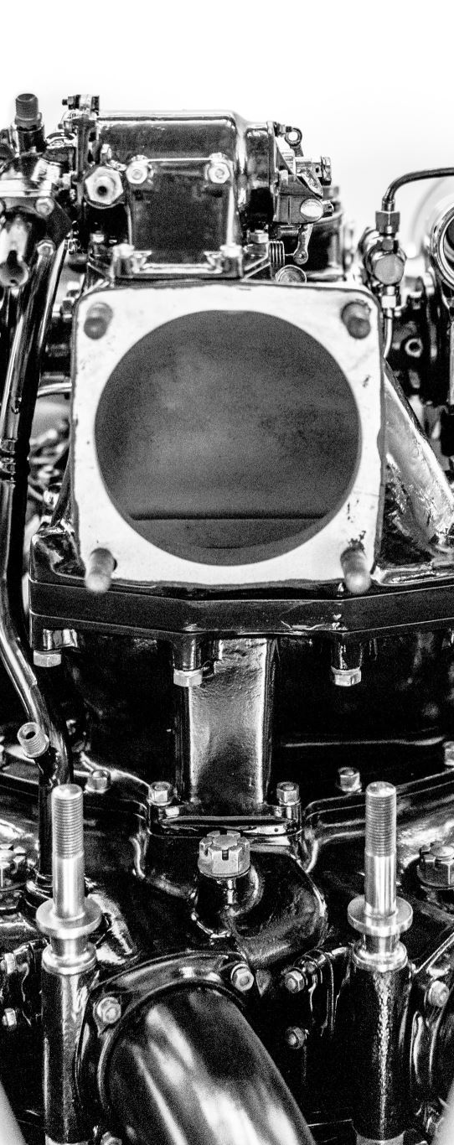
Drone Architecture, Motors, Servos, Propellers

Slide 24
Translational Kinematics

Slide 25
Rotational Kinematics

Slide 26

HCI professional societies
Association for Computing Machinery (ACM) Special Interest Group on Computer-Human Interaction (SIGCHI)
Usability Professionals' Association (UPA)
The Interaction Design Foundation (IDF)
User Experience Professionals Association (UXPA)
British Human-Computer Interaction Group (BCS HCI)
International Federation for Information Processing (IFIP) Technical Committee on Human-Computer Interaction (TC 13)

Slide 27

HCI professional societies
Cognitive Science Society
The European Association for Cognitive Ergonomics (EACE)
IEEE Computer Society Technical Committee on Human-Computer Interaction (TC-HCI)
Human Factors and Ergonomics Society (HFES)
International Society for Research on Internet Interventions (ISRII)
The User Experience Professionals' Association of South Africa (UXPA-SA)

Slide 28
Future HCI themes

