Slide 1

Figma
UI Design Tool

Slide 2

Introduction
In today's fast-paced design landscape, collaboration and prototyping are crucial for success. Designers and teams need tools that empower creativity while facilitating effective communication.
Figma rises as a cutting-edge cloud-based design platform that meets these demands seamlessly. By enabling real-time collaboration and efficient prototyping, Figma transforms design workflows.

Slide 3

What is Figma?
Figma is a revolutionary cloud-based design tool that transcends traditional design software. Its unique strength lies in its ability to facilitate real-time collaboration, enabling designers to create, iterate, and prototype together no matter their geographical location.
Unlike traditional design tools that rely on local installations, Figma operates entirely in the cloud. This enables instant sharing and editing, making it a game-changer for remote teams and collaborative projects.

Slide 4
Key Features
Real-time Collaboration: Work together with team members in real time, regardless of location.
Design Components: Create reusable design components for consistent UI elements.
Prototyping: Easily build interactive prototypes and transitions within Figma.
Version Control: Track and manage design version history seamlessly.

Slide 5
User Interface
Toolbar: Explain the functions available in the toolbar, such as selection tools, drawing tools, and text tools.
Layers Panel: Detail how the layers panel helps organize and manage design elements.
Canvas: Describe the main design area where your work takes place.
Inspector: Highlight the inspector panel for adjusting properties of selected objects.

Slide 6
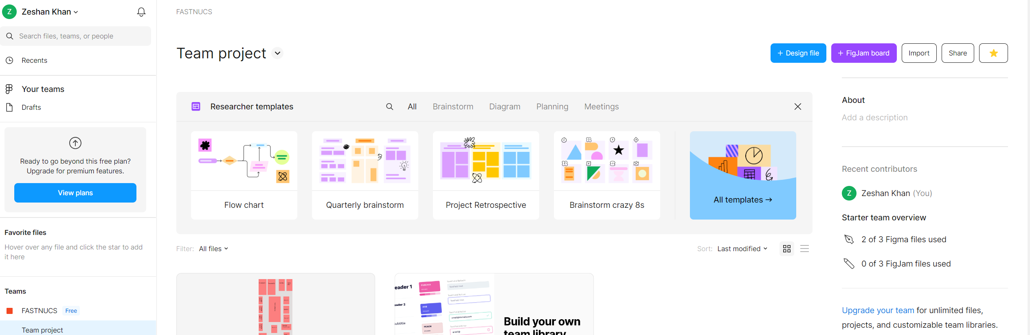

Workspace Setup
Creating a Project
Files, Frames, and Pages

Slide 7
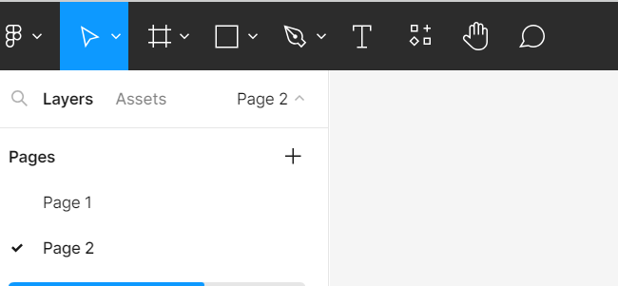
Design Tools
Selection Tools
drawing tools
vector editing
text tools

Slide 8
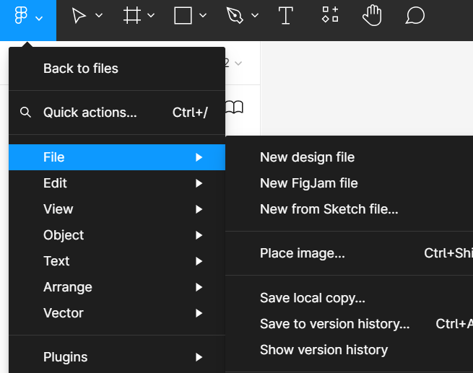
Components
Introduction to design components
How to create, edit, and use components for consistent design

Slide 9
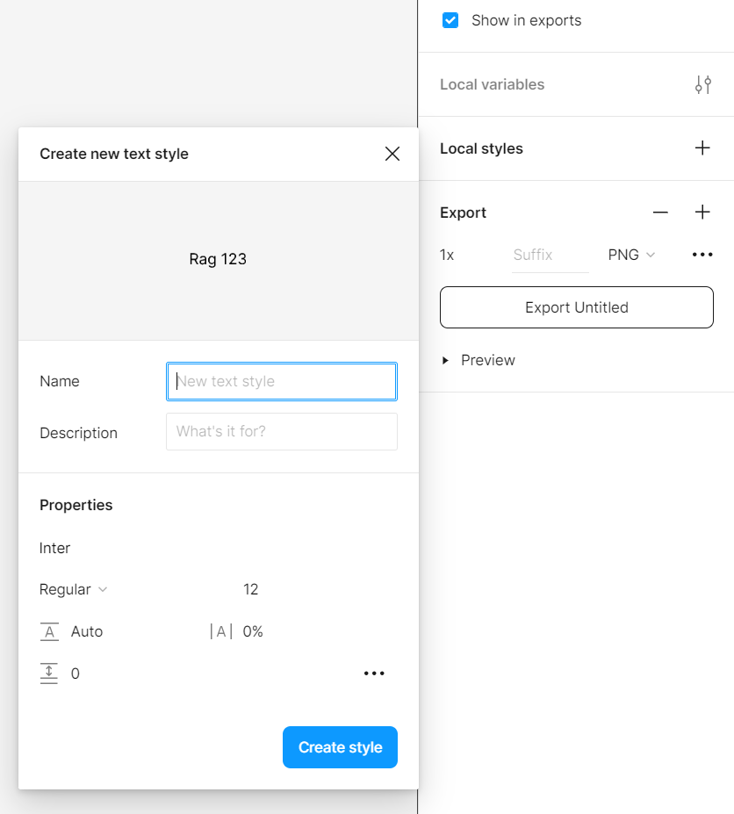
Styles and Libraries
Explanation of styles in Figma
Creating and applying text and color styles
Utilizing design libraries for brand consistency

Slide 10
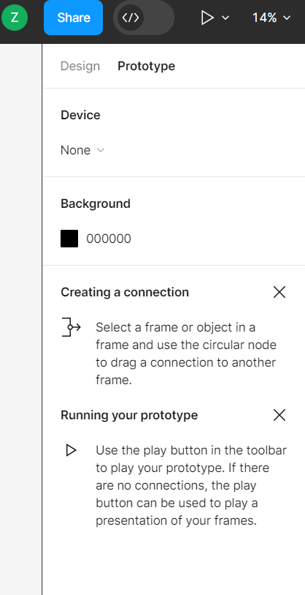
Prototyping
Creating interactive prototypes
linking frames
adding transitions

Slide 11
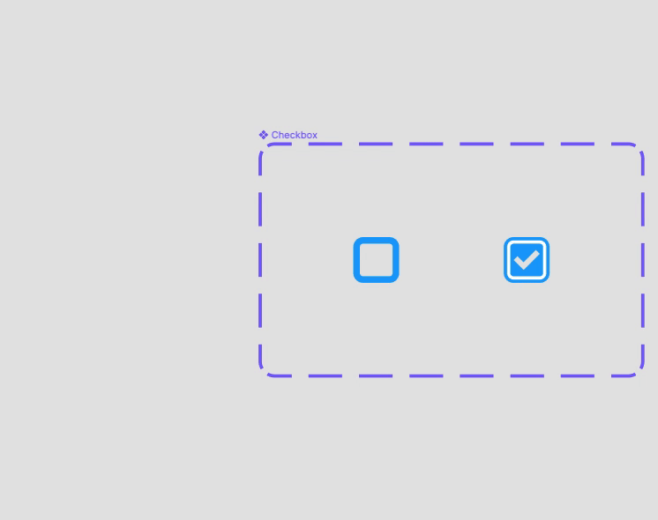
Interactive Components
Introduction to interactive components
Select the starting variant for the interaction from within the component set.
Navigate to the Prototype tab of the right sidebar.
Click the on the right of the frame's bounding box and drag it to the destination variant. You can also click the in the Interactions section of the Prototype panel, set the action to Change to, then select the destination variant using the dropdown menu.
Once the connection has been made, use the Interaction details panel to adjust the trigger and action.

Slide 12
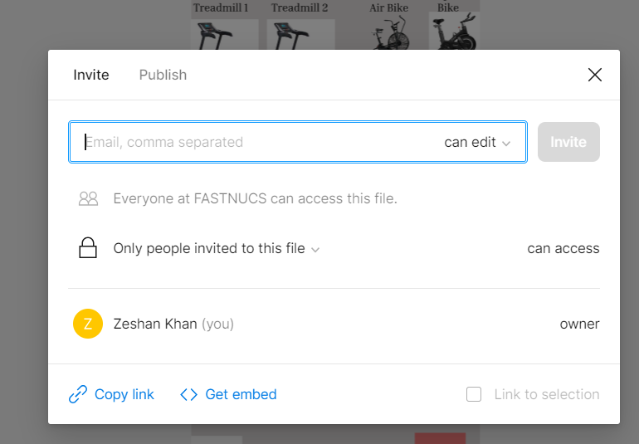
Collaboration
Importance of collaboration in design
Real-time collaboration features in Figma

Slide 13
Comments and Feedback
Using comments to collaborate and gather feedback
Resolving comments and tracking changes

Slide 14
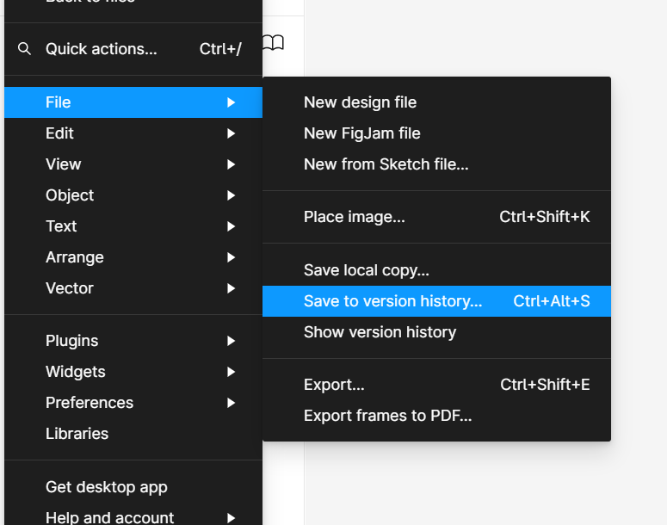
Version History
Understanding version history in Figma
Reverting to previous versions and collaborating safely

Slide 15
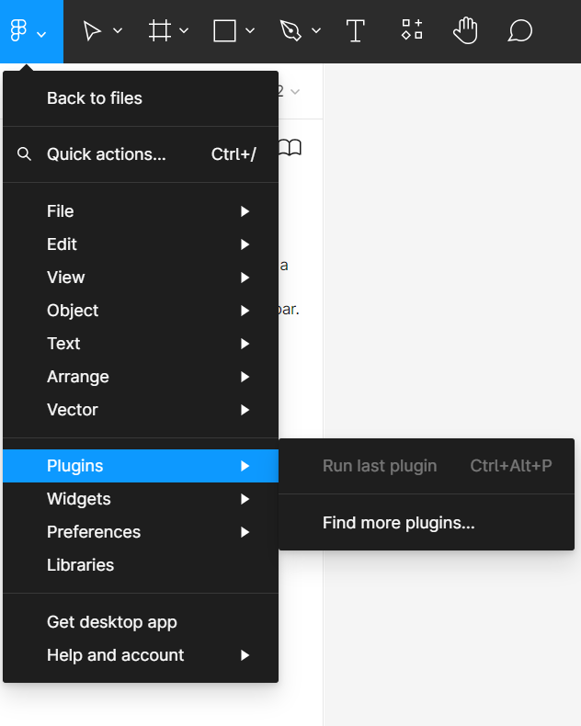
Plugins
Installation
Management
Use plugins to enhance your workflow

Slide 16
Design System
Building a design system in Figma
Organizing components, styles, and guidelines

Slide 17
Handoff
Using Figma for design handoff to developers
Generating assets, specs, and code snippets

Slide 18
Integrations
Integrating Figma with other tools (e.g., Slack, Jira)
Enhancing collaboration and workflow efficiency

Slide 19
Keyboard Shortcuts
Commonly used keyboard shortcuts in Figma
Speeding up your design process

Slide 20

Tips and Tricks
Keyboard shortcuts, hidden features, and time-saving techniques

Slide 21

Case Studies

Slide 22

Design Trends
Examples of responsive design, dark mode, etc.

Slide 23

Mobile Design
Responsive design considerations

Slide 24
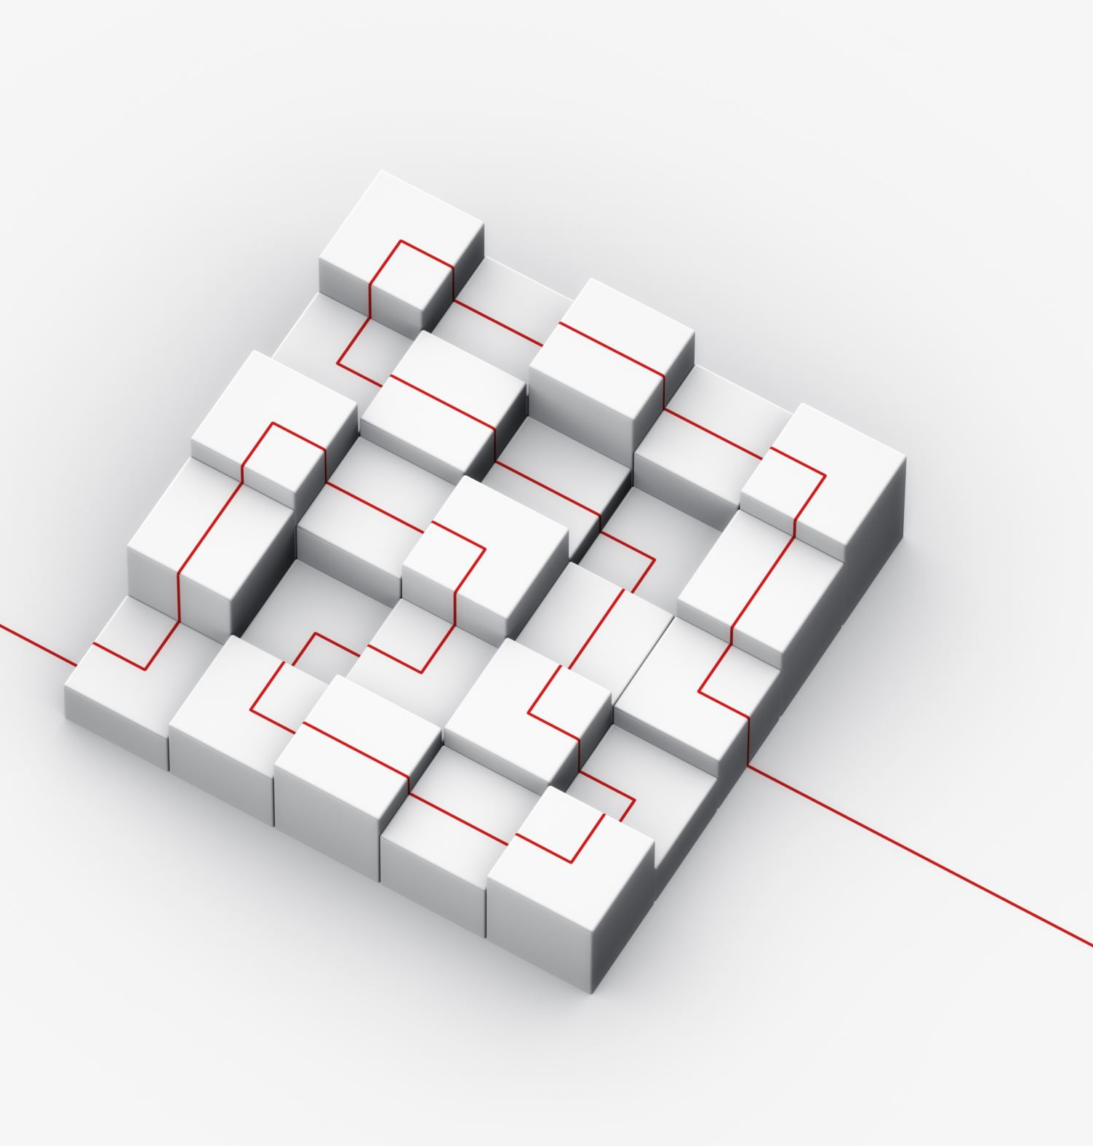
Web Design
Grid systems, breakpoints, and layout design

Slide 25
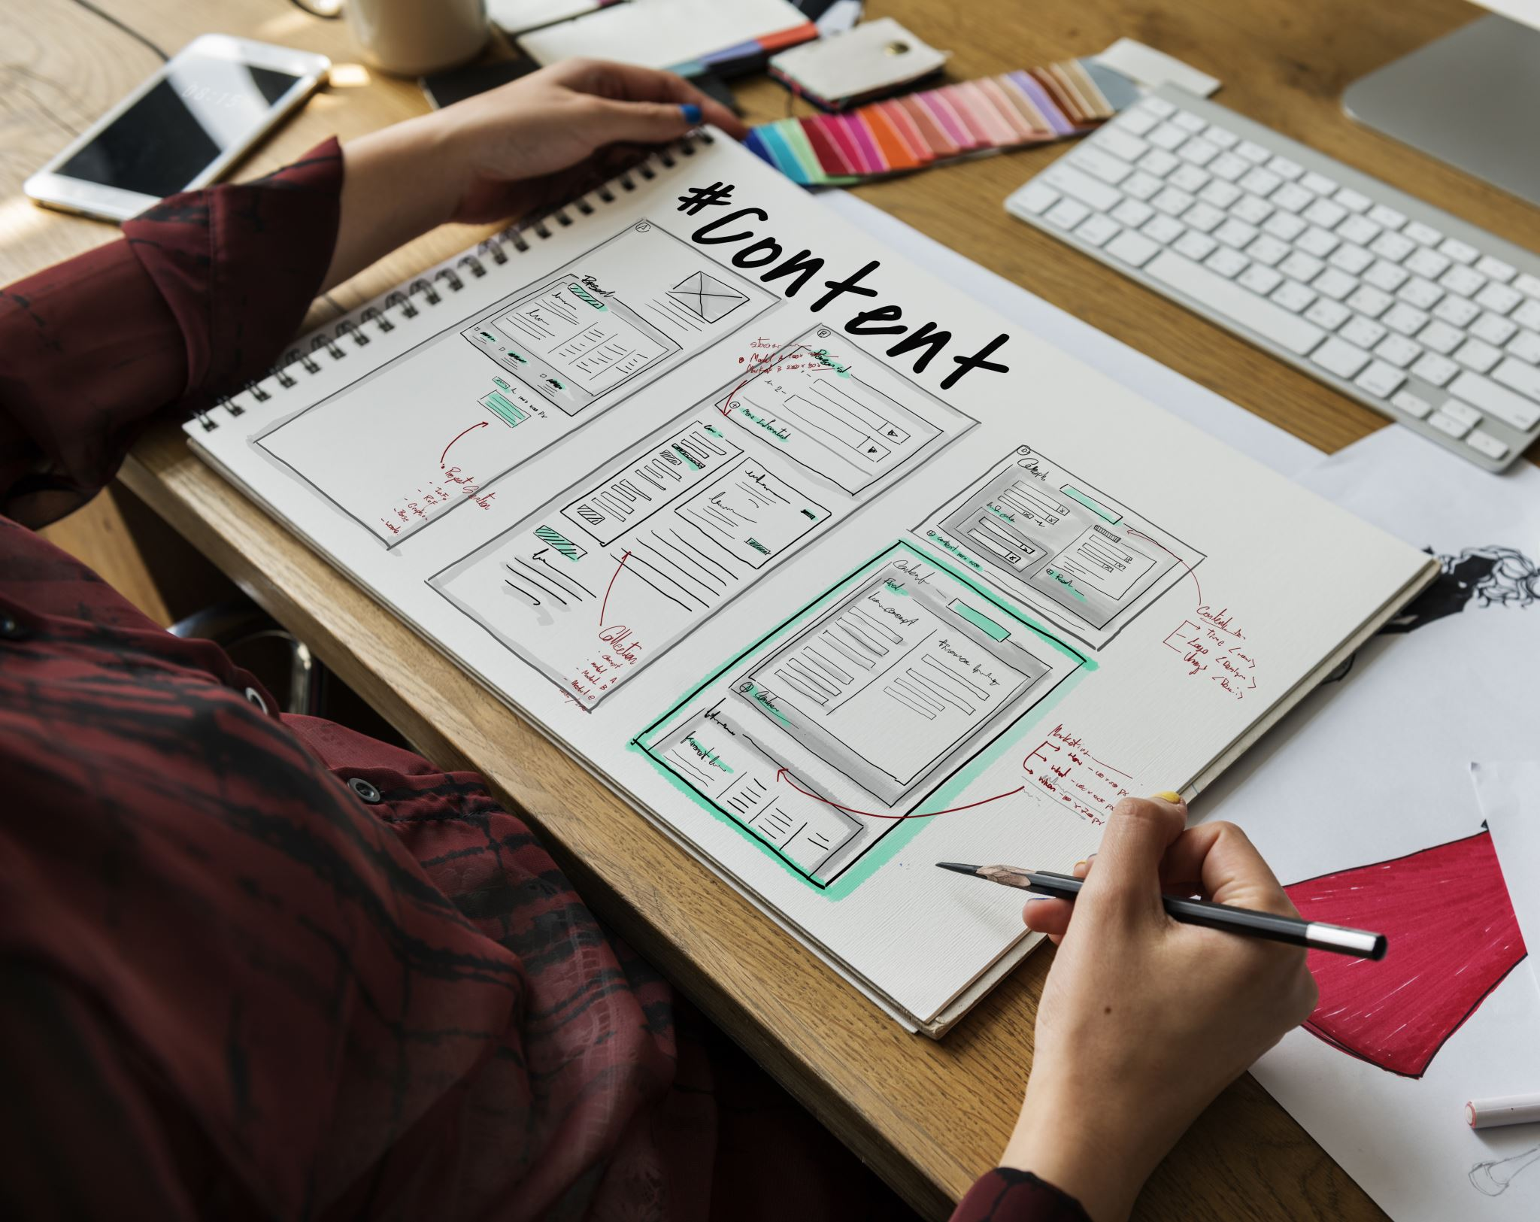
UI/UX Best Practices
Applying user-centered design in Figma

Slide 26

User Testing
Introduction to User Testing
Advantages of Figma for User Testing
Creating Interactive Prototypes
User Task Scenarios
Remote Testing and Collaboration
Gathering Feedback
Iterative Design
Sharing Prototypes
Analyzing User Behavior
Incorporating Insights
Conclusion

Slide 27
Pricing Plans
Overview of Figma's pricing plans
Free plan, individual plan, and team plan options

