Slide 1
Interaction

Slide 2
The Interaction
interaction models
translations between user and system
ergonomics
physical characteristics of interaction
interaction styles
the nature of user/system dialog
context
social, organizational, motivational

Slide 3
What is interaction?
communication
user  system

Slide 4
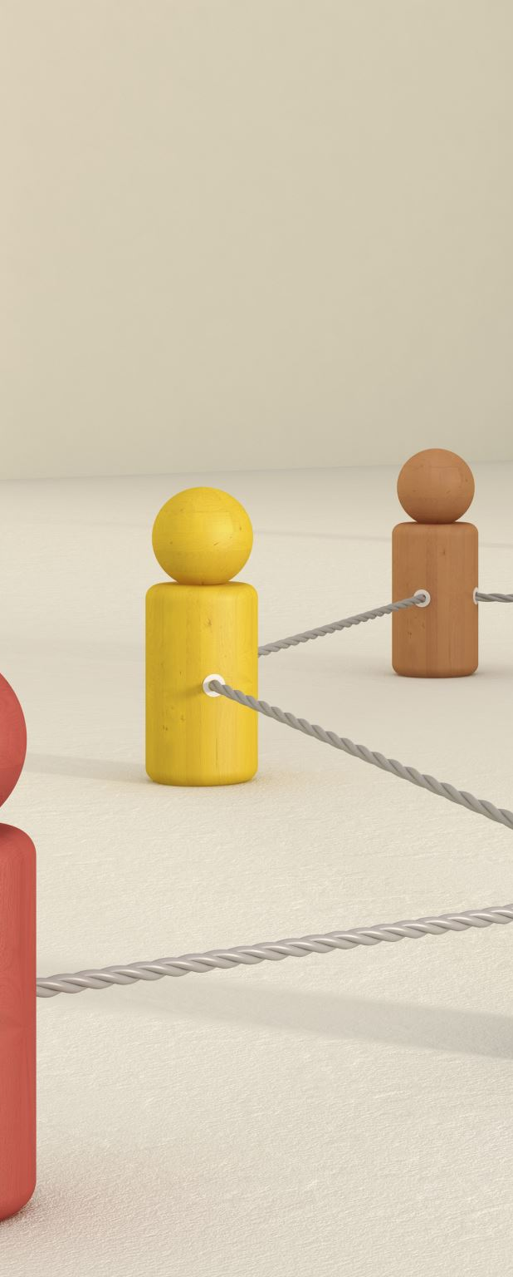
models of interaction
terms of interaction
Norman model
interaction framework

Slide 5

Some terms of interaction
Domain
The area of work under study
e.g. graphic design
Goal
what you want to achieve
e.g. create a solid red triangle
Task
how you go about doing it
ultimately in terms of operations or actions
e.g. … select fill tool, click over triangle
Note …
traditional interaction …
use of terms differs a lot especially task/goal !!!

Slide 6
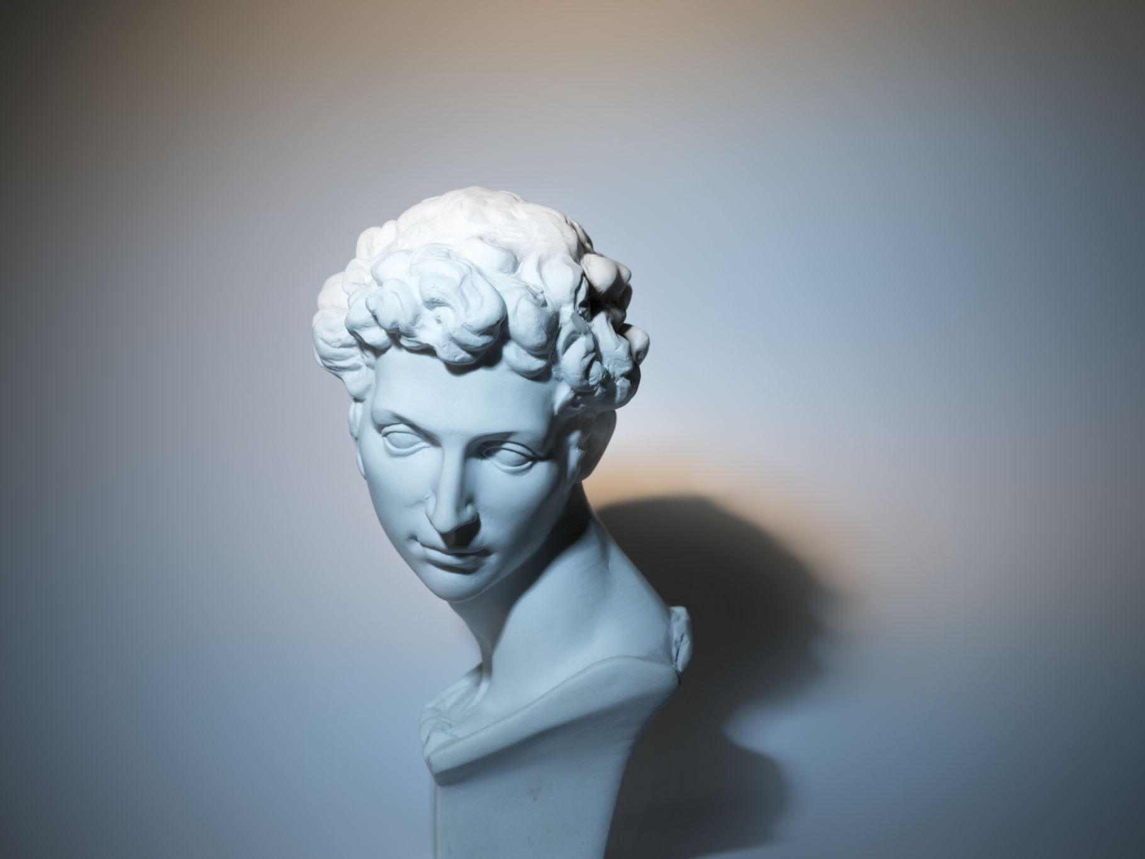
Donald Norman’s model
Interaction Model: Concentrates on user’s view of the interface

Slide 7
Donald Norman’s model stages
user establishes the goal
formulates intention
specifies actions at interface
executes action
perceives system state
interprets system state
evaluates system state with respect to goal

Slide 8
execution/evaluation loop
goal
execution
evaluation
system
user establishes the goal
formulates intention
specifies actions at interface
executes action
perceives system state
interprets system state
evaluates system state with respect to goal

Slide 9
execution/evaluation loop
goal
execution
evaluation
system
user establishes the goal
formulates intention
specifies actions at interface
executes action
perceives system state
interprets system state
evaluates system state with respect to goal

Slide 10
execution/evaluation loop
goal
execution
evaluation
system
user establishes the goal
formulates intention
specifies actions at interface
executes action
perceives system state
interprets system state
evaluates system state with respect to goal

Slide 11
execution/evaluation loop
goal
execution
evaluation
system
user establishes the goal
formulates intention
specifies actions at interface
executes action
perceives system state
interprets system state
evaluates system state with respect to goal

Slide 12
Using Norman’s model
Some systems are harder to use than others
Gulf of Execution
user’s formulation of actions ≠ actions allowed by the system
Gulf of Evaluation
user’s expectation of changed system state ≠ actual presentation of this state

Slide 13
Human error - slips and mistakes
slip
understand system and goal
correct formulation of action
incorrect action
mistake
may not even have right goal!
Fixing things?
slip – better interface design
mistake – better understanding of system

Slide 14
Abowd and Beale framework
extension of Norman…
their interaction framework has 4 parts
user
input
system
output
each has its own unique language interaction ⇒ translation between languages
problems in interaction = problems in translation
O
output
S
core
U
task
I
input

Slide 15
Using Abowd & Beale’s model
user intentions → translated into actions at the interface → translated into alterations of system state → reflected in the output display → interpreted by the user
general framework for understanding interaction
not restricted to electronic computer systems
identifies all major components involved in interaction
allows comparative assessment of systems
an abstraction

Slide 16
ergonomics
physical aspects of interfaces
industrial interfaces

Slide 17

Ergonomics
Study of the physical characteristics of interaction
Also known as human factors – but this can also be used to mean much of HCI!
Ergonomics good at defining standards and guidelines for constraining the way we design certain aspects of systems

Slide 18
Ergonomics - examples
arrangement of controls and displays
e.g. controls grouped according to function or frequency of use, or sequentially
surrounding environment
e.g. seating arrangements adaptable to cope with all sizes of user
health issues
e.g. physical position, environmental conditions (temperature, humidity), lighting, noise,
use of colour
e.g. use of red for warning, green for okay, awareness of colour-blindness etc.

Slide 19
Industrial interfaces
Office interface vs. industrial interface?
Context matters!
office industrial
type of data textual numeric
rate of change slow fast
environment clean dirty

Slide 20
Indirect manipulation
office– direct manipulation
user interacts with artificial world
system
industrial – indirect manipulation
user interacts with real world through interface
issues ..
feedback
delays
interface
plant
immediate
feedback
instruments

Slide 21
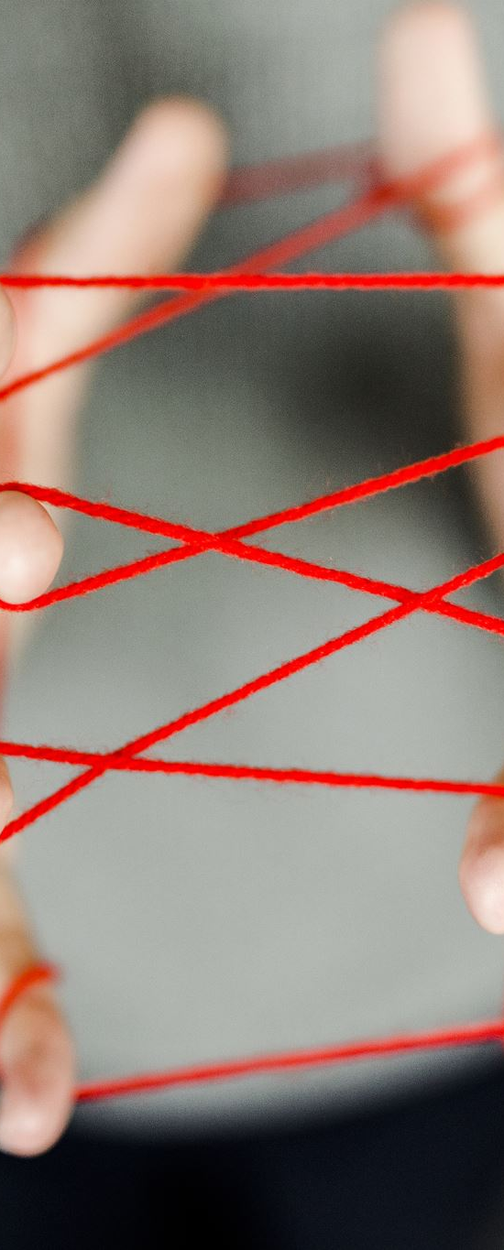
interaction styles
dialogue … computer and user
distinct styles of interaction

Slide 22
Glass interfaces
cheaper, more flexible, multiple representations, precise values
not physically located, loss of context, complex interfaces
Vessel B Temp
0
100
200
113
multiple representations of same information

Slide 23
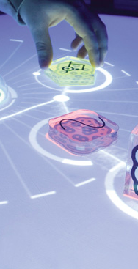
Common interaction styles
command line interface
menus
natural language
question/answer and query dialogue
form-fills and spreadsheets
WIMP
point and click
three–dimensional interfaces
This Photo by Unknown author is licensed under CC BY-SA-NC.

Slide 24

Command line interface
Way of expressing instructions to the computer directly
function keys, single characters, short abbreviations, whole words, or a combination
suitable for repetitive tasks
better for expert users than novices
offers direct access to system functionality
command names/abbreviations should be meaningful!
Typical example: the Unix system

Slide 25
Menus
Set of options displayed on the screen
Options visible
less recall - easier to use
rely on recognition so names should be meaningful
Selection by:
numbers, letters, arrow keys, mouse
combination (e.g. mouse plus accelerators)
Often options hierarchically grouped
sensible grouping is needed
Restricted form of full WIMP system

Slide 26
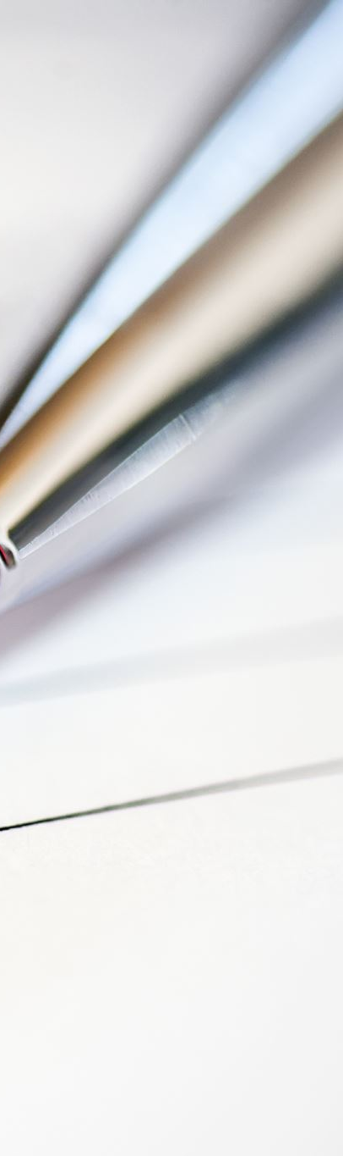
Form-fills
Primarily for data entry or data retrieval
Screen like paper form.
Data put in relevant place
Requires
good design
obvious correction facilities

Slide 27

Spreadsheets
first spreadsheets
MS Excel most common today
sophisticated variation of form-filling.
grid of cells contain a value or a formula
formula can involve values of other cells e.g. sum of all cells in this column
user can enter and alter data spreadsheet maintains consistency

Slide 28

WIMP Interface
Windows
Icons
Menus
Pointers
… or windows, icons, mice, and pull-down menus!
default style for majority of interactive computer systems, especially PCs and desktop machines

Slide 29
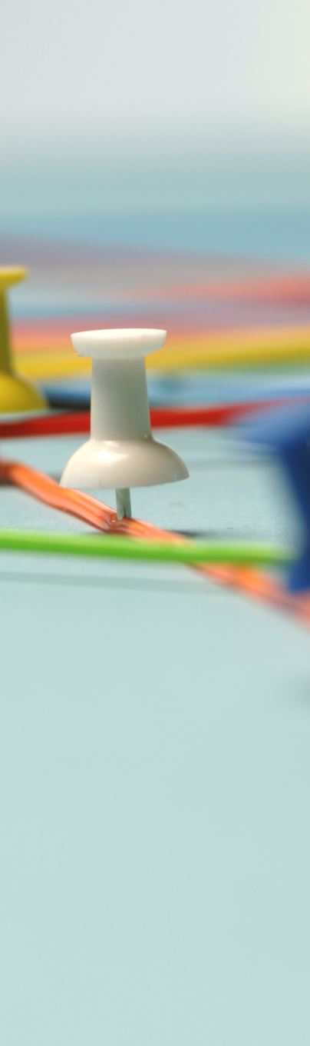
Point and click interfaces
used in ..
multimedia
web browsers
hypertext
just click something!
icons, text links or location on map
minimal typing

Slide 30

Natural language
Familiar to user
Speech recognition or typed natural language
Problems
vague
ambiguous
hard to do well!
Solutions
try to understand a subset
pick on key words

Slide 31
Query interfaces
Question/answer interfaces
user led through interaction via series of questions
suitable for novice users but restricted functionality
often used in information systems
Query languages (e.g. SQL)
used to retrieve information from database
requires understanding of database structure and language syntax, hence requires some expertise

Slide 32
Three dimensional interfaces
virtual reality
‘ordinary’ window systems
highlighting
visual affordance
indiscriminate use just confusing!
3D workspaces
use for extra virtual space
light and occlusion give depth
distance effects
flat buttons …
click me!
… or sculptured

Slide 33
Interactivity
easy to focus on look
what about feel?

Slide 34
Speech–driven interfaces
rapidly improving … … but still inaccurate
how to have robust dialogue? … interaction of course!
e.g. airline reservation: reliable “yes” and “no” + system reflects back its understanding “you want a ticket from New York to Boston?”

Slide 35

Look and … feel
WIMP systems have the same elements: windows, icons., menus, pointers, buttons, etc.
but different window systems … behave differently
e.g. MacOS vs Windows menus
appearance + behaviour = look and feel

Slide 36
Initiative
who has the initiative? old question–answer – computer WIMP interface – user
WIMP exceptions … pre-emptive parts of the interface
modal dialog boxes
come and won’t go away!
good for errors, essential steps
but use with care

Slide 37
Error and repair
can’t always avoid errors … … but we can put them right
make it easy to detect errors … then the user can repair them
hello, this is the Go Faster booking system
what would you like?
(user) I want to fly from New York to London
you want a ticket from New York to Boston
(user) no
sorry, please confirm one at a time
do you want to fly from New York
(user) yes
… … …

Slide 38

Context
Interaction affected by social and organizational context
other people
desire to impress, competition, fear of failure
motivation
fear, allegiance, ambition, self-satisfaction
inadequate systems
cause frustration and lack of motivation

Slide 39

Experience, engagement and fun
designing experience
physical engagement
managing value

Slide 40
Experience
home, entertainment, shopping
not enough that people can use a system
they must want to use it!
psychology of experience
flow (Csikszentimihalyi)
balance between anxiety and boredom
education
zone of proximal development
things you can just do with help
wider ...
literary analysis, film studies, drama

Slide 41
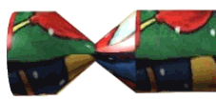
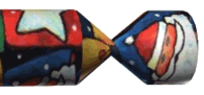
Designing experience
real crackers
cheap and cheerful
bad joke, plastic toy, paper hat
pull and bang

Slide 42
Designing experience
virtual crackers
cheap and cheerful
bad joke, web toy, cut-out mask
click and bang

Slide 43


Designing experience
virtual crackers
cheap and cheerful
bad joke, web toy, cut-out mask
click and bang

Slide 44


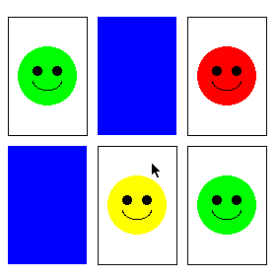
how crackers work
fill in web form
sender
To: wxv
From: ..
receive email
recipient
closed cracker page
open
message
watches
progress
recipient clicks
cracker opens ...
very slowly
open cracker page
joke
links
sender
mask
web toy

Slide 45
The crackers experience
real cracker virtual cracker
Surface elements
design cheap and cheerful simple page/graphics
play plastic toy and joke web toy and joke
dressing up paper hat mask to cut out
Experienced effects
shared offered to another sent by email message
co-experience pulled together sender can't see content until opened by recipient
excitement cultural connotations recruited expectation
hiddenness contents inside first page - no contents
suspense pulling cracker slow ... page change
surprise bang (when it works) WAV file (when it works)

Slide 46

Physical design
many constraints:
ergonomic – minimum button size
physical – high-voltage switches are big
legal and safety – high cooker controls
context and environment – easy to clean
aesthetic – must look good
economic – … and not cost too much!

Slide 47

Design trade-offs
constraints are contradictory … need trade-offs
within categories:
e.g. safety – cooker controls
front panel – safer for adult
rear panel – safer for child
between categories
e.g. ergonomics vs. physical – MiniDisc remote
ergonomics – controls need to be bigger
physical – no room!
solution – multifunction controls & reduced functionality

Slide 48

Fluidity
do external physical aspects reflect logical effect?
related to affordance
logical state revealed in physical state?
e.g. on/off buttons
inverse actions inverse effects?
e.g. arrow buttons, twist controls

Slide 49
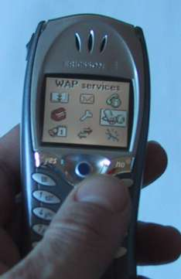
inverse actions
yes/no buttons
well sort of
‘joystick’
also left side control

Slide 50
spring back controls
one-shot buttons
joystick
some sliders
good – large selection sets
bad – hidden state

Slide 51
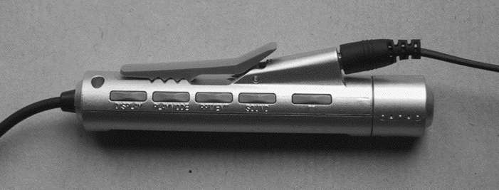
a minidisk controller
twist for track movement
pull and twist for volume
– spring back
– natural inverse for twist
series of spring-back controls
each cycle through some options
–natural inverse back/forward

Slide 52
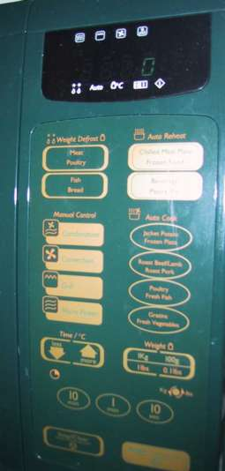
physical layout
controls:
logical relationship ~ spatial grouping

Slide 53
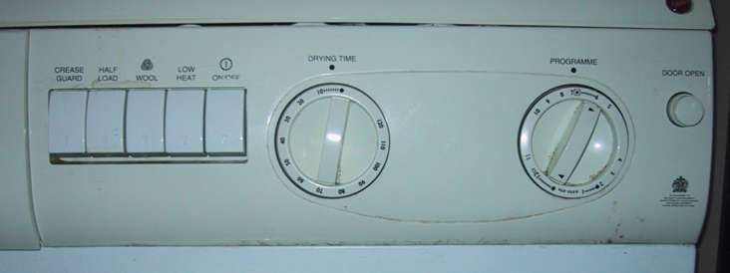
compliant interaction
state evident in mechanical buttons
rotary knobs reveal internal state and can be controlled by both user and machine

Slide 54
Managing value
people use something ONLY IF it has perceived value AND value exceeds cost
BUT NOTE
exceptions (e.g. habit)
value NOT necessarily personal gain or money

Slide 55
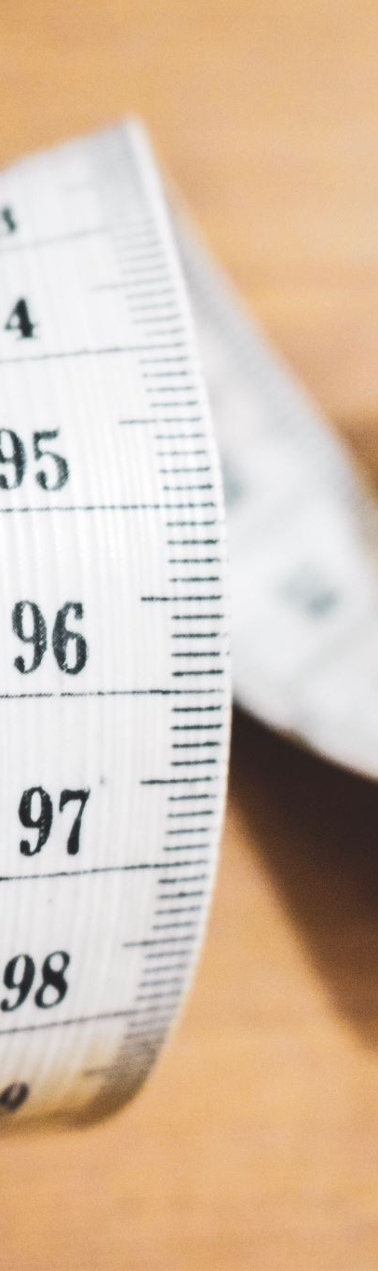
Weighing up value
value
helps me get my work done
fun
good for others
cost
download time
money £, $, €
learning effort

Slide 56

Discounted future
in economics Net Present Value:
discount by (1+rate)^{years to wait}
in life people heavily discount
future value and future cost
hence resistance to learning
need low barriers and high perceived present value

Slide 57
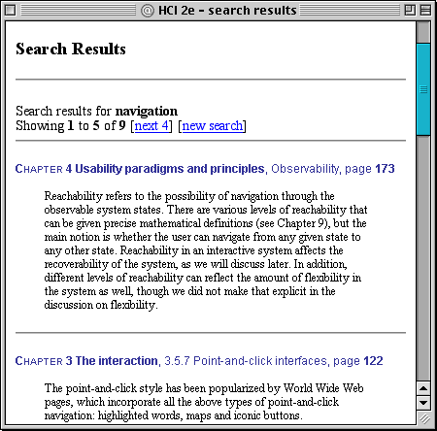
example – HCI book search
value for people who have the book helps you to look up things
chapter and page number
value for those who don’t … sort of online mini-encyclopaedia
full paragraph of context
… but also says “buy me”!!

Slide 58
Value and organisational design
coercion
tell people what to do!
value = keep your job
enculturation
explain corporate values
establish support (e.g share options)
emergence
design process so that individuals value → organisational value

Slide 59
General lesson …
if you want someone to do something …
make it easy for them!
understand their values

