Slide 1
Software Requirements Engineering
Lecture 1
Sara Rehmat
Lecturer, CS Department
Notes:
‹#›

Slide 2
To be covered today
Course Overview:
General Information
What is Software Requirements Engineering?
Why study Software Requirements Engineering?
Problems with Software Requirements
Cost of requirements problems
Benefits of high quality software requirements
Phases involved in Software Requirements Engineering
Notes:
‹#›

Slide 3
General Information
Course Code: SE 2001
Course Title: Software Requirements Engineering
Total Credits: 3
Prerequisite of: Software Design and Architecture
Instructor: Sara Rehmat
Email: sara.rehmat@nu.edu.pk
Office no. 33, 1st floor (Timings will be specified soon)
Notes:
‹#›

Slide 4
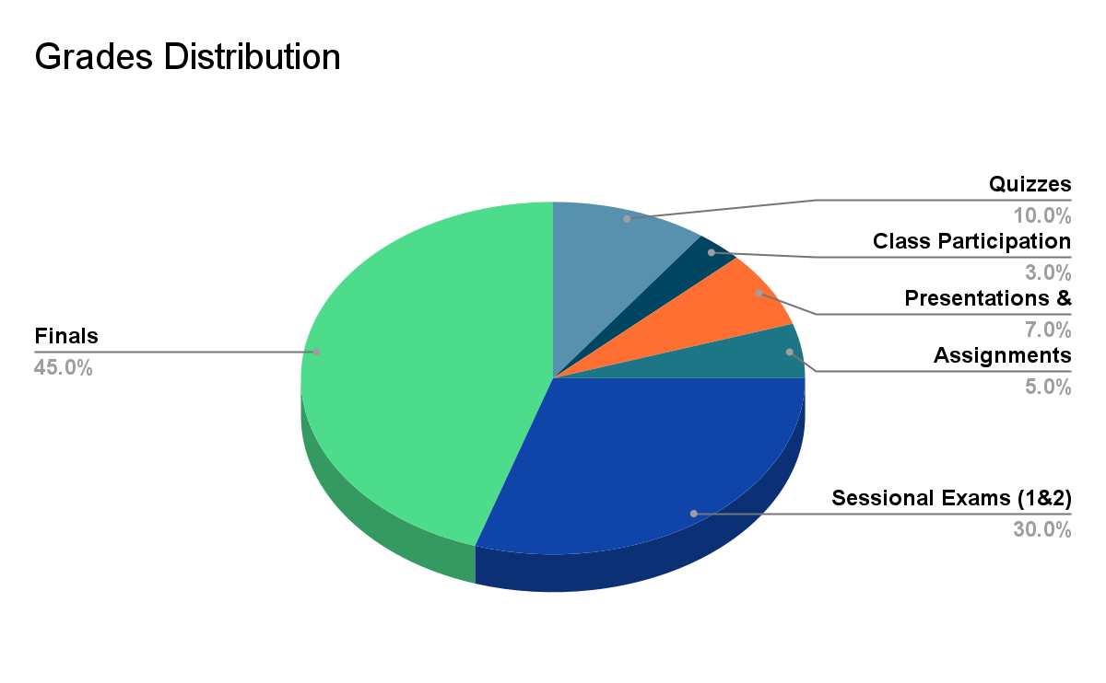
Grade Distribution
Notes:
‹#›

Slide 5
Policies
Grading Policy:
Inter Quartile Range (relative) method will be used for grading.
Attendance Policy:
Minimum 80% attendance is required for appearing in final exams. Anyone joining class later than 20 minutes will be marked absent.
Plagiarism Policy:
Zero tolerance policy will be adopted towards plagiarism of any sort. Plagiarism includes copying the contents from the internet or from the class fellows as they are. The students copying and the students from whom the assignments are copied, will be awarded zero.
Notes:
‹#›

Slide 6
Books
Text Book:
Software Requirements, Third Edition by Karl Weigers and Joy Beatty (pdf version uploaded on Google Classroom)
Reference Books:
Requirements Engineering, A Good Practice Guide by Ian Sommerville and Pete Sawyer, 1997
Requirements Engineering by Dick, Jeremy Hull, Elizabeth Jackson (2017)
Notes:
‹#›

Slide 7
Course Learning Outcomes (CLOs)
Describe the activities involved in the requirements engineering process.
Apply different requirements elicitation, analysis, prioritization, and validation techniques
Author requirements in natural language using different templates
Distinguish between different types of requirements
Use a Requirements Management tool to store requirements and manage changes to them
Notes:
‹#›

Slide 8
Course Overview

Slide 9
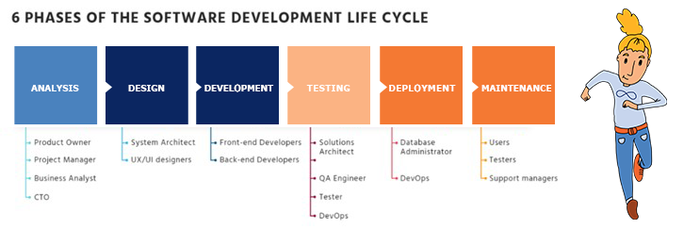
Software Development Lifecycle
https://kruschecompany.com/what-is-the-software-development-process/
Notes:
‹#›

Slide 10
Purpose of Software Engineering
The right product
Done right
Managed right
To achieve done right and managed right, software development must start with a quality set of software requirements, which are later planned, designed, implemented, and tested.

Slide 11
Software Requirement Engineering
Software Requirement Engineering is the 1st step in Software Engineering Process
Software Requirements Engineer is the face to the customer and the liaison between the customer and the developers and the rest of the software development team.
Notes:
‹#›

Slide 12
What is Software Requirement Engineering?
The process of finding out, analyzing, documenting, checking and managing the requirements for the Software Systems is called requirements engineering (RE).
Finding out -> Elicitation
Analyzing -> Analysis
Documenting-> Specification
Checking-> Validation
Managing-> Management
Notes:
‹#›

Slide 13
Why the term Engineering?
Notes:
‹#›

Slide 14
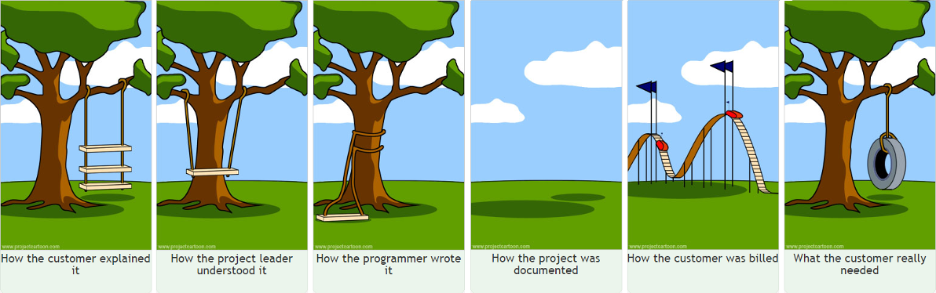

Slide 15
Problems with requirements: Ambiguity in Natural Language
“She saw the man with the telescope.”
Is she using the telescope or did she see the man with a telescope?
"Visiting relatives can be boring."
Are the relatives visiting or being visited?
"I saw her duck."
Did she duck down or did she have a pet duck?
"Time flies like an arrow; fruit flies like a banana."
Is "flies" a verb or a noun in each case?

Slide 16
Problems with requirements
https://youtu.be/xLRMkjwzJeI

Slide 17
Problems with requirements: Inconsistency
Speed vs. Accuracy in Financial Software:
Stakeholder A: "The financial software needs to process transactions as quickly as possible."
Stakeholder B: "Accuracy is crucial in financial calculations. We can't compromise on that."
User Privacy vs. Personalization in E-commerce:
Stakeholder A: "We should collect user data to personalize product recommendations."
Stakeholder B: "We need to respect user privacy and limit data collection."

Slide 18
Problems with requirements: Inconsistency
Cost vs. Features in Mobile App Development:
Stakeholder A: "We want to include all possible features in the app."
Stakeholder B: "We have a tight budget and need to prioritize cost efficiency."
Security vs. Usability in Healthcare Software:
Stakeholder A: "Access to patient records should be quick and easy for healthcare providers."
Stakeholder B: "Patient data security is paramount. We need strict access controls."

Slide 19
Problems with requirements: Gold Plating
Gold plating in software requirements refers to the practice of adding extra features, functionalities, or enhancements to a project that were not originally specified or requested by the client or stakeholders.

Slide 20
Problems with requirements: Gold Plating
Let's consider a scenario where a development team is working on an e-commerce website for a client.
The client's initial requirement was to create a simple and straightforward website for selling products.
However, during the development process, the team decides to add a complex rewards and loyalty program without consulting the client.

Slide 21
Problems with requirements: Gold Plating
Time and Resources
Complexity
Client Expectations
Scope Creep

Slide 22
Problems with requirements: Scope Creep
Scope creep refers to the uncontrolled expansion of a project's scope, where new requirements, features, or tasks are added to the project without proper evaluation, planning, or change management.

Slide 23

Problems with requirements: Scope Creep
Initial Scope: Develop a web application for an online bookstore with features for browsing books, adding them to the cart, and completing purchases.
Customer

Slide 24
Problems with requirements: Scope Creep
Let's add a live chat support feature so customers can ask questions while browsing the website.
"We should have a personalized recommendation system that suggests books based on the user's browsing history."
Marketing Manager
Customer Service

Slide 25
Problems with requirements: Scope Creep
Can we also implement a blog section to engage customers with book-related articles?
It would be great if we could integrate a loyalty program that rewards customers for repeat purchases.
Finance
CEO

Slide 26
Problems with requirements: Scope Creep
How about integrating with social media platforms so users can share their favorite books?"
We should revamp the user interface to include more interactive elements and animations."
Design Team
Technical Team

Slide 27
Problems in Requirements Engineering
Insufficient user involvement
Inaccurate planning
Creeping user requirements
Ambiguous requirements
Gold plating
Overlooked stakeholders
Notes:
‹#›

Slide 28
Introduction to Software Requirement Engineering
Requirements Engineering
Requirements Development
Requirements Management
Elicitation
Analysis
Specification
Validation
Notes:
‹#›

Slide 29
Why Requirement Engineering
“The hardest single part of building a software system is deciding precisely what to build. No other part of the conceptual work is as difficult as establishing the detailed technical requirements, including all the interfaces to people, to machines, and to other software systems. No other part of the work so cripples the resulting system if done wrong. No other part is more difficult to rectify later.”
Frederick Brooks, “No Silver Bullet: Essence and Accidents of Software Engineering”
Notes:
‹#›

Slide 30
Cost of Requirements Problems
The major consequence of requirements problems is rework—doing again something that you thought was already done—late in development or after release.
Rework often consumes 30 to 50 percent of your total development cost (Shull, et al. 2002; GAO 2004), and requirements errors can account for 70 to 85 percent of the rework cost (Leffingwell 1997).
Notes:
‹#›

Slide 31
Cost of Requirements Problems
In September 1999, NASA lost its $125-million Mars Climate Orbiter when it tried to enter the orbit, just 100 kilometers too close to Mars. The mission failed due to poor requirements management: it was not discussed earlier in the stage whether the ‘navigation software’ required metric units or imperial units.
Notes:
‹#›

Slide 32
Benefits from a high-quality requirements process
Fewer defects in requirements and in the delivered product.
Reduced development rework.
Faster development and delivery
Fewer unnecessary and unused features.
Lower enhancement costs.
Fewer miscommunications.
Reduced scope creep.
Reduced project chaos.
Higher customer and team member satisfaction.
Products that do what they’re supposed to do
Notes:
‹#›

