Slide 1
Quiz App

Slide 2
Objective
Developing Quiz App to learn End to end functioning of quiz app in reactjs, this will help to conduct mcqs type exams

Slide 3
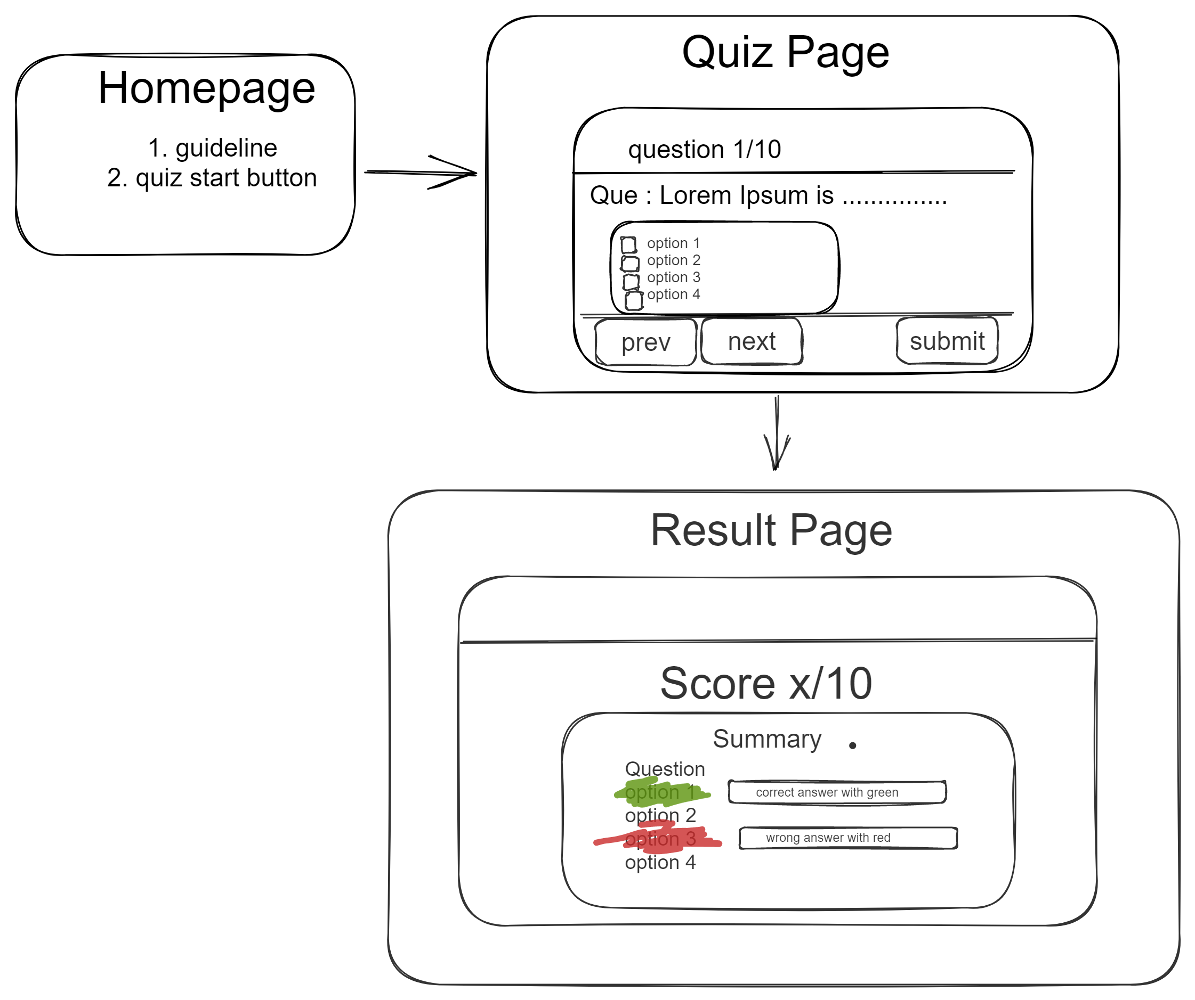
Architecture

Slide 4
Data Source
Using axios we could fetch any api document
this demo quiz app using custom json file : https://cdn.jsdelivr.net/gh/RohtashTalan/quiz-app@master/src/components/data/question.json

Slide 5

Technology used
Html, TailwindCss, Reactjs, Axios

