Slide 1

Kabul University Computer Science Faculty Information Systems Department
Masks Detection

Slide 2
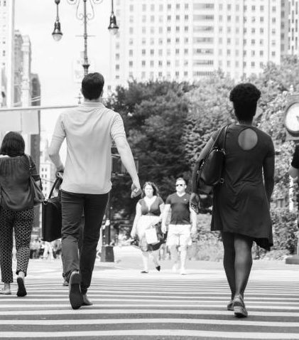
REAL-TIME FACEMASK DETECTION (CORONAVIRUS)
- Hasibullah Aman

Slide 3
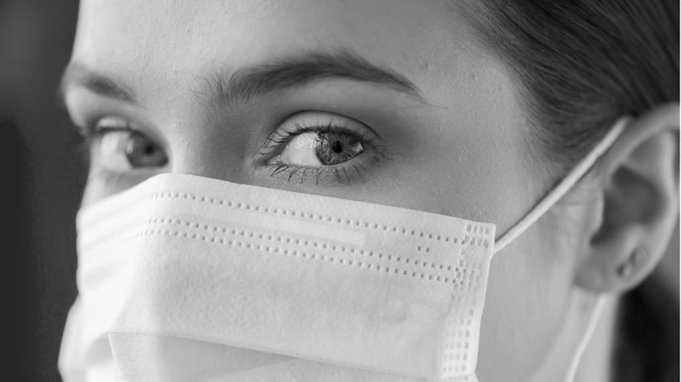
HELLO!
Even though we are living a difficult time, our future is still bright

Slide 4
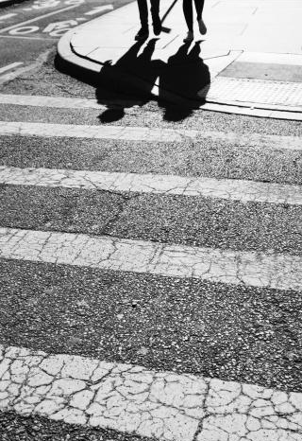
TABLE OF CONTENTS
01
02
03
04
05
Introduction
Methodology
Dataset
Results
Conclusion

Slide 5
Introduction
9,916,230
Team Members:
Hasibullah Aman
Rohullah Akbari
Fazludin Saleh
Qadir Ali Adalat
Aminullah Nazari
Barat Haidari
Subject: Machine Learning
Director: Abdelrahman “Safi”

Slide 6
Introduction
- My application helps people find mosques quickly and easily using computer vision techniques. It can also be useful for emergency services during times of crisis. In this presentation, I will explain how my application works, the dataset I used, and the results of its performance.

Slide 7
Methodology - Face detection
- Haar Cascade is a computer algorithm used to detect objects in images or video streams. It can be used in face mask detection to identify faces, which can then be used to determine if a person is wearing a mask or not..

Slide 8
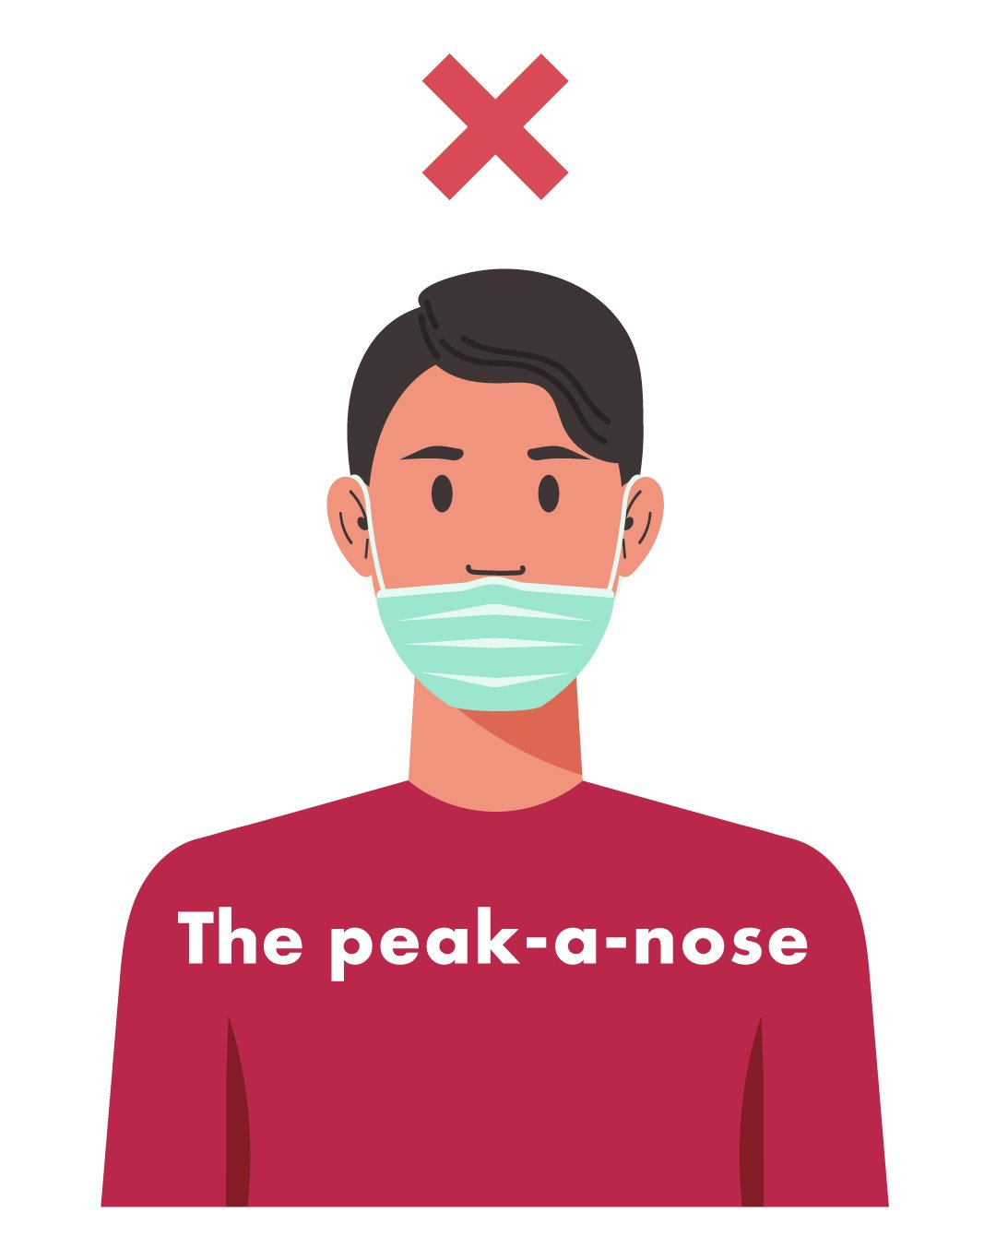


Methodology - Machine Learning – labeled

Slide 9
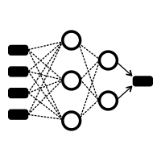
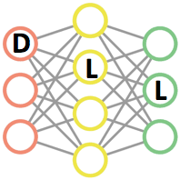
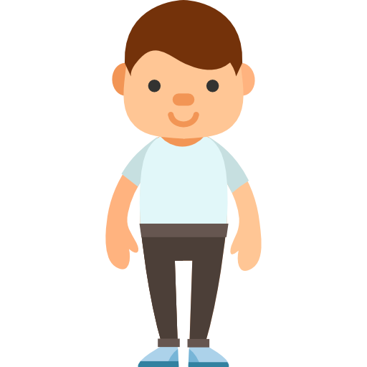
Methodology - Machine Learning

Slide 10
Methodology – Performance
Train Accuracy: 0.9882
Val_accuracy: 0.7285

Slide 11
Methodology – Computer vision libraries
OpenCV
haarcascade_frontalface_default
Keras
TensorFlow

Slide 12
Methodology – Hardware and software
Google Colab
Kaggle Notebook + GPU

Slide 13
Dataset
Without Mask
Incoreact Mask
With Mask
4746 images
2165 images
4789 images

Slide 14
Results

Slide 15
Conclusion

Slide 16
Resources
https://www.who.int/publications/i/item/advice-on-the-use-of-masks-in-the-community-during-home-care-and-in-healthcare-settings-in-the-context-of-the-novel-coronavirus-(2019-ncov)-outbreak
https://www.pyimagesearch.com/2018/09/10/keras-tutorial-how-to-get-started-with-keras-deep-learning-and-python/
http://www.image-net.org/
https://www.youtube.com/watch?v=IOI0o3Cxv9Q&t=275s

Slide 17
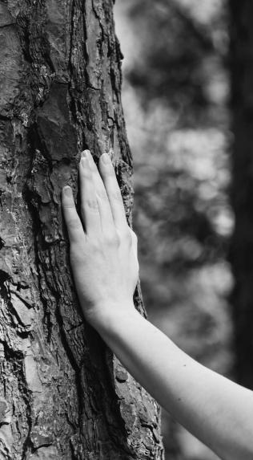
We’ll Get Through This

Slide 18
Questions

