Slide 1
WMSU – ICS Website Prepared by: Jan Carlo Duterte, Myra Abduhari, Louise Ladiao

Slide 2
CHAPTER 1 INTRODUCTION

Slide 3
BACKGROUND OF THE STUDY Nowadays, website used as a communication, advertisement and serves as information for the people. Every person or groups has their own website with different contents. As for school website, the content for the student are the events, announcements, etc. and also the important thing is their grades. A grade plays a major role for the student because without the grades, the student cannot be evaluated. There are a lot of schools where they inserted the grading system to their website to help the student to easily check and to be aware about their grades because sometimes, when the teacher already submitted their reports they cannot be seen until the school started. In this manner, students do not use too much effort just to find the teacher but instead they just need to check their grades online. Since the Institute of Computer Studies will be added to the Western Mindanao State University, the researchers/developers came up an idea to develop a website exclusively for the WMSU-ICS community since there are no existing systems yet. The website will let the student of WMSU-ICS to be updated and also we included the student-teacher direct message for some inquiries direct to the teachers of the WMSU-ICS and the teacher scheduling of subjects.

Slide 4
STATEMENT OF THE PROBLEM The following lists are common problems that we have research and observe from the existing website of institute of computer studies. - Cancellations of classes and other announcements, institute of computer studies (ICS) don’t have a website that can inform them of special announcement or urgent cancellation of their classes. - List of events and activities, the ICS do not have a website that can inform student of staff about the upcoming events or the set of activities that the ICS have. - List of teachers, the ICS student, especially the new ones (freshmen) do not really know the professor the ICS have. - Lectures, assignments and class activities, the ICS does not have a website that can let their teacher share lectures, post assignment and class activities to his/her students. - Communication on ICS, maybe with the use of other social media the teachers uses it as a communication. They don’t use their website for their communication as for teacher and student.

Slide 5
GENERAL OBJECTIVES The WMSU ICS website provides the information of the set of events and announcements to the student/faculty, gives the list of professor, form of posting of lectures, assignments, and a bridge that will let the students and teachers communicate. SPECIFIC OBJECTIVES - To design a website that is easy to navigate with a user-friendly design. - To develop a website that can inform the ICS community about their activities, events and announcements. - To enable teachers to upload lectures activities, assignments in which class using the website. - To provide another means of communication to the student and ICS. - To give students another options to have a view on their grades.

Slide 6
SIGNIFICANCE OF THE STUDY This research will be beneficial to the WMSU-ICS students and teachers for them to have a means of communication, like when they have some inquiries to their professor, the student and teachers will be informed of events/announcements within the WMSU-ICS. The students can also view their grades, etc. And this will also be significant to other future web developers who are planning to develop at least similar website for a future improvement or enhancement of the website considering all information that this research has to offer. Scope and Limitations This research focuses only on the development of a website that can benefit the WMSU-ICS specially the students and teachers. This website caters features that the WMSU-ICS community is in far most in need. A website that can inform them of events, announcements, cancellations of classes, viewing/printing of lectures/assignments/grades and for the students and teachers to communicate via message.

Slide 7
CHAPTER 2 – REVIEW OF RELATED LITERATURE

Slide 8
2.1 Importance of a Website in Schools By definition a Web site is a related collection of World Wide Web (WWW) files that includes a beginning file called a home page. A company or an individual tells you how to get to their Web site by giving you the address of their home page. According to Puripong Koomsin (2010), internet has become one of the largest platforms of communication. It is the most effective technology available today. Building a website for school can prove to be extremely beneficial if it is done in the right way. It maybe time consuming and include a lot of effort to be put in for developing a website for the school, but it is very advantageous for the school community. The school website gives the school's information and also clear idea about what they are good at. School websites will provide the up to dates, as well as help them to link between schools, their communities and also to the entire world.

Slide 9
Html HyperText is the method by which you move around on the web — by clicking on special text called hyperlinks which bring you to the next page. The fact that it is hyper just means it is not linear — i.e. you can go to any place on the Internet whenever you want by clicking on links — there is no set order to do things in. CSS According to John Urban (2011), CSS is a newer animal and is not as familiar to beginning web designers as HTML. CSS was created to allow designers to have even more creativity and control over their designs. PHP PHP is probably the most popular scripting language on the web. It is used to enhance web pages. With PHP, you can do things like create username and password login pages, check details from a form, create forums, picture galleries, surveys, and a whole lot more. Javascript According to Mark Marquis (2016), JavaScript’s ability to access and modify elements on the page is undeniable, and the Document Object Model is an essential component of that.

Slide 10
jQuery According to Julien Dubios (2010), JQuery aims to ease all these problems by providing a lightweight library that adds many advanced and cross-browser functions to the standard language. In addition, there is a very dynamic community that adds more-advanced components based on JQuery. AJAX According to Jesse James Garrett (2005), Ajax isn’t a technology. It’s really several technologies, each flourishing in its own right, coming together in powerful new ways BOOTSTRAP According to Chris Youderian (2015), Bootstrap is the most popular CSS framework on the web. It makes it incredibly easy to create beautiful, responsive designs that just work. However, it’s not always possible to use Bootstrap for your entire website. Often the website’s main CSS is outside of your control. You just need to use a portion of Bootstrap CSS.

Slide 11
2.2 De La Salle University Grading System Listed below are graduate grades and their descriptions. Individual subject grades are used to compute for the cumulative grade point average (GPA). The cumulative GPA refers to the weighted average of grades from the first term in which the student was enrolled up to the trimester just finished. The following grading system is for the graduate programs of the Colleges of Business and Economics, Computer Studies, Education, Engineering, Liberal Arts, and Science.
Grade | Master's Program Description | Doctoral Program Description
4.0 | Excellent | Excellent
3.5 | Very Good | Very Good
3.0 | Good | Good
2.5 | Satisfactory | Fair/Pass
2.0 | Fair/Pass | No credit
1.5 | No credit | No credit
1.0 | No credit | No credit
0.0 | Fail | Fail

Slide 12
2.3 Polytechnic University of the Philippines Grading System A student receiving a grade below 1.75 (for a doctorate degree) and 2.5 (for a Master’s degree) in any course requirements will have to either repeat the course or take a substitute course in the same discipline or area with the approval of the Dean. However, for purposes of graduation, the overall grade average in the academic course should be 1.75 for a doctorate degree and 2.0 for a master’s degree. The grading system for qualifying courses shall be either “P” or “NC” (Pass/No Credit), with the number of units indicated in parenthesis. The following rating system is adopted by the Graduate School: Doctorate Degree 1.00 - Excellent 1.25 - Very Good 1.50 - Good 1.75 – Passed Below 1.75 - Failed INC - Incomplete, lack of course requirement i.e. failed to take the examination and/or submit other final requirements

Slide 13
2.4 Ateneo De Manila University Grading System Following the example of St, Ignatius, every Atenean is called to strive continuously for academic excellence, and at the same time, develop social awareness and a Christian approach to learning. The Atenean puts into practice the Ignatian concept of MAGIS, of giving more than what is required of him, towards his wholistic development. Homework assignments aim to reinforce lessons learned in school. Thus, it is very important for parents to help supervise their children's studies at home. Parental supervision consists of ensuring that a specific schedule for study is adhered to, and that a quiet place devoid of noise and distraction is available. Students are encouraged to show their homework, seatwork, quizzes and quiz charts to their parents, for them to gain an idea of their children's day-to-day performance, which will ultimately form the basis of class standing marks.

Slide 14
2.5 Conclusion Grading system is very useful when it comes to website especially for the students because they can check their grades online. As we all know that grades is important for the students because without the grades of the subjects that they took, they cannot be advised for the next semester because there are subjects that consists of prerequisite. Since the enrolment is being done during school breaks, students intend to go for vacation and as their teacher and sometimes teachers do have a long vacation. Since the teacher do submit their reports to the dean, with the use of the website they can just upload the grades of the student online. In this state, the website has the history of the student’s subjects and grades that the student’s enrolled.

Slide 15
CHAPTER 3 – RESEARCH METHODOLOGY

Slide 16
Introduction
The researcher conducted exploratory and descriptive research to gain an understanding of what type of method should be used appropriately in developing the proposed mobile application. We came up of choosing Agile Methodology in this study rather than Waterfall Methodology.
Why Agile? Because Agile development methodology provides opportunities to assess the direction of a project throughout the development lifecycle. By focusing on the repetition of abbreviated work cycles as well as the functional product they yield, agile methodology is described as “iterative” and “incremental.” (The Agile Development Lifecycle 2012).

Slide 17
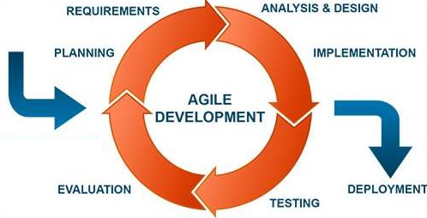
The developers are following the seven (7) sequential phases cycle in developing the mobile application shows on Fig. 1 below: Planning Planning as the first phase in developing the WMSU – ICS Website is the basis on what to do sequentially. With the use of Gantt chart as the reference for list of steps or activities to be done and by also by conducting survey to determine solutions to issues and create a scope for it. This leads the developers to a more organize and successful performance.

Slide 18
Data Gathering This second phase includes the gathering of several information through research that is related to the study. The research is done by collecting data online from articles, websites, and other sources including individual surveys to come up with the best approach or solution to the problem that is suitable and knowledgeable in helping in the development of the WMSU – ICS Website. Analysis and Design After we came up with the gathering of information it is now time to analyze the flow of the application and conceptualized it by means of creating Entity Relationship Diagram (ERD) and Data Flow Diagram (DFD) .This will determine the scope and limitation or how big WMSU – ICS Website is. The developers will use Photoshop to create the logo and the screen designs for the User Interface of the WMSU – ICS Website. Any feedbacks from the user will reflect on the changes that will be done. Implementation Implementation comes in after the three phases. This will ensure/train for the coding practices and develop code testing. This will include the development of Functional Requirement. The stakeholders will take now the opportunity to check defects or any other revisions needed for the improvement of the mobile application.

Slide 19
Testing The testing phase will determine the minor and major defects of the functionality in the mobile application. In this phase it very much important to ensure the security. This can be done by conducting Alpha and Beta testing and by the Tester. Evaluation After the testing was done it is now time to evaluate and list down the errors and defects found while using the mobile application. The evaluation may include the security, user interface acceptance and performance to re-plan and repeat the cycle as soon as the mobile application is ready for deployment. This phase will also allow the developers to conduct training. Deployment After repeating the cycle and the continuous evaluation and improvement, the WMSU – ICS Website is now ready for deployment and ready to use.

Slide 20
CHAPTER 4 – USER INTERFACE

Slide 21
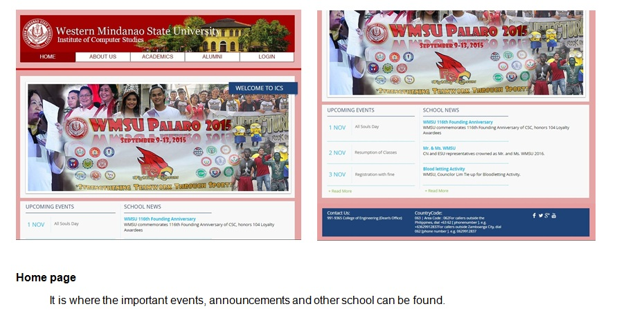
About Us & History In this tab, you can see the foreword of Institute of Computer Studies from the president this is where you can also see the history of the ICS and its goals.

Slide 22
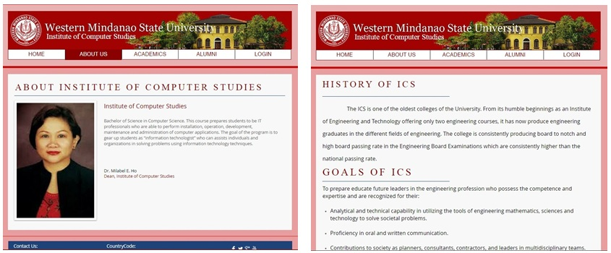
Mission, Vision and Objectives This tab is where the Mission, Vision and Objectives of the Institute of Computer Studies located. To see the Mission and Vision tab you just need to hover the About Us tab.

Slide 23
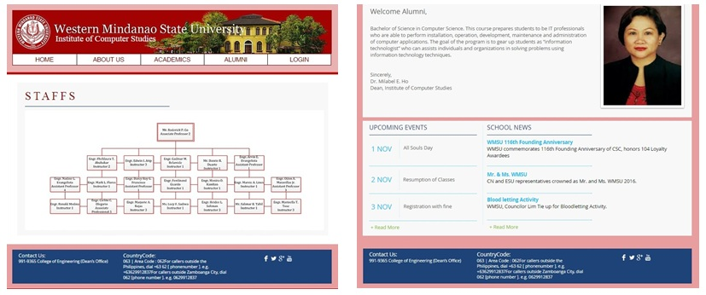
Academics – Staffs The academics tab is where the list of the Staffs located. It is listed from Department Head down to Instructors. Alumni The alumni content is more about the announcements and upcoming events for the Alumnus.

Slide 24
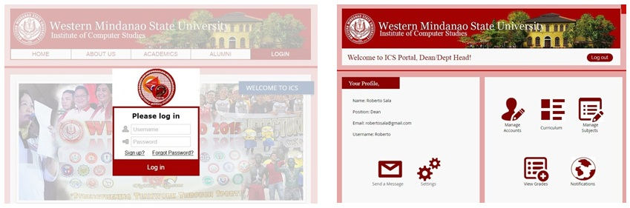
Login The login is for Super Admin (Dean), Admin (Dept. Head), Teachers and Students. The system will identify whose account was logged in and what page will show. On the shown image, the view is both for Dean and Department Head. The Manage Account (Dean) is where they can Add, Edit, Delete the Admin’s , students and Teachers account while Manage Account (Admin) the only account he can Add, Edit, Delete is for Teachers and student only. Curriculum (Dean & Dept Head) is where they can set new curriculum. Manage Subjects (Dean & Dept Head) is for Adding, Deleting or Editing the Subjects and its details.

Slide 25
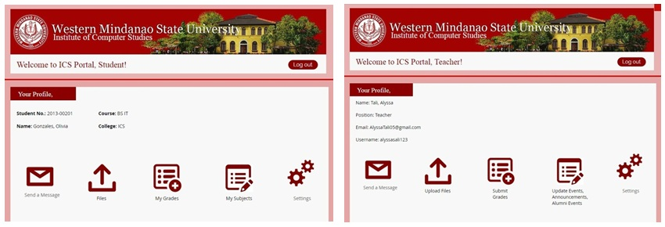
Login View (Student & Teacher) This UI shows that after logging in the users will directly go to their profile. The Students and the Teachers can send a message to each other. The Files button (Student) is where they can see their lectures and other file uploaded by their corresponding teachers. The My Grades (Students) is where they can see their grades; also the Submit Grades (Teachers) is where they input their students’ grades by class. My Subjects (Student) is the list of subjects currently enrolled. Update Alumni Events and Announcements (Teacher) is where they can update the content in the website. In the Settings (Student & Teachers) is where they can change their Username and Password.

Slide 26
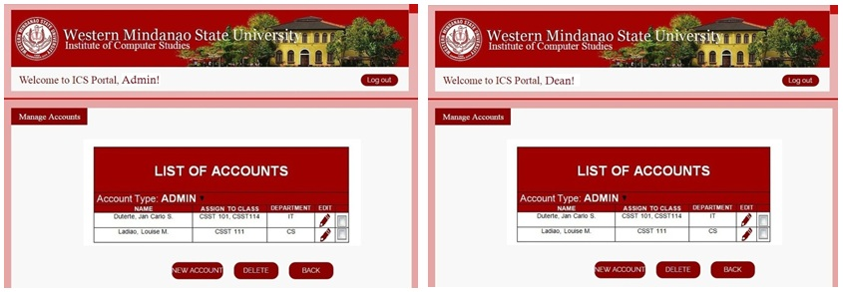
Manage Accounts (Dean & Dept. Head) For the Dean and the Dept. Head, they can both manage accounts but the difference is that the Dean can only manage the Dept. Head’s and students account while the Dept. Head can manage the Teachers’ and students’ account. Both users also can assign teachers to a certain class.

Slide 27
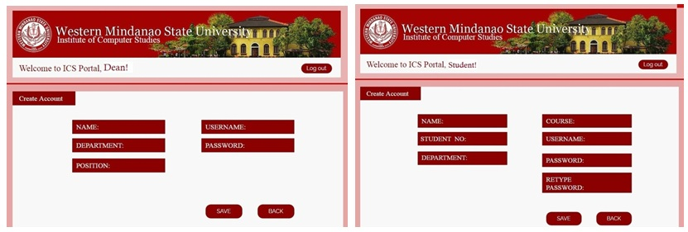
Create Account (Dean & Student) This page is for creating account both in Student’s and Dean but the only difference is that the Dean is creating account for the Dept Head (Admin) and Teachers.

Slide 28
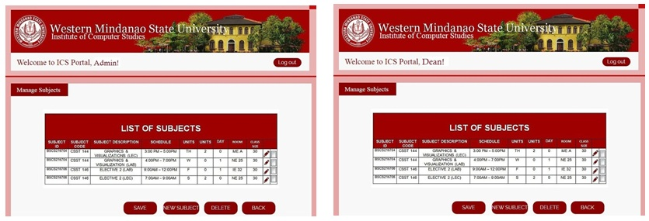
Manage Subjects (Dean & Dept. Head) The Dean and the Dept. Head can also manage subjects by either adding, deleting or editing.

Slide 29
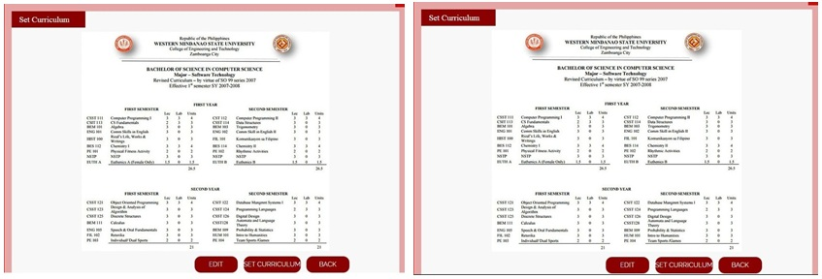
Set Curriculum (Dean & Dept. Head) In this page, both Super Admin and Admin can edit and set curriculum.

Slide 30
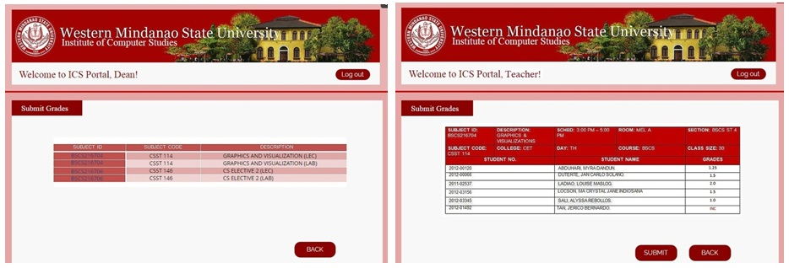
Grades (Dean & Teachers) The Dean can view the grades that are submitted by the Teachers just by clicking the Subject ID. The Teachers have the same view as the Dean’s by clicking the Subject ID, he/she will be proceeding to the list of subject/s assigned to that teacher and can proceed in affixing the grades of the students. Teachers can only update or change grade if and only if the grade was INC or Incomplete.

Slide 31
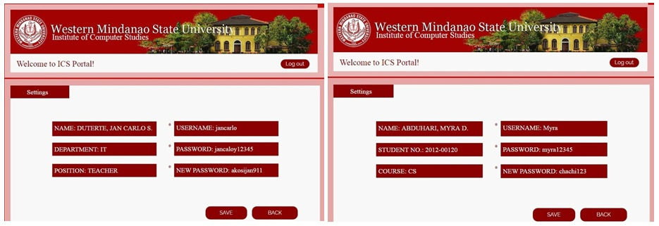
Settings (All users) The setting is appeared in every user they can only update or change their username or password.

Slide 32
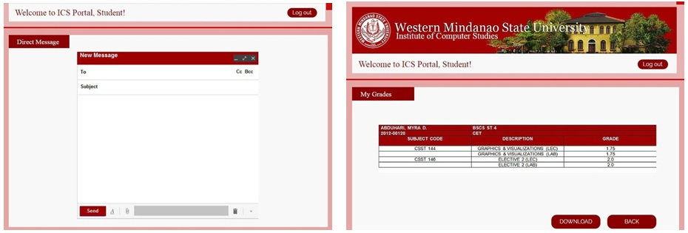
Direct Message (Student & Teachers) The direct message is for clarifications for the requirements or lectures that the teachers uploaded. It can be done vice versa. My Grades (Student) The viewing of grades for students is just like in the WMSU portal. The purpose of having this the same as the WMSU portal is that they don’t need to log in another to their account just to check their grades. It is for made the same for them to be hassle – free to have more logins.

Slide 33
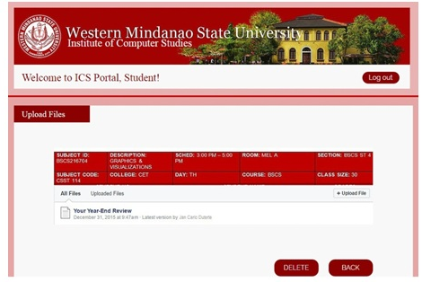
Upload Files (Teachers) For the upload files, just like how the teachers do submit the student’s grades they just need to click the Subject ID for the chosen class where he/she will uploading lecture or other files then the students that are part of the class can view the files uploaded by the teachers.

