Slide 1

Memory game
Roi Markovitz
01/06/2021
Seminar in Python - GUI and Design Patterns
The code of the program was written by the author from scratch.

Slide 2
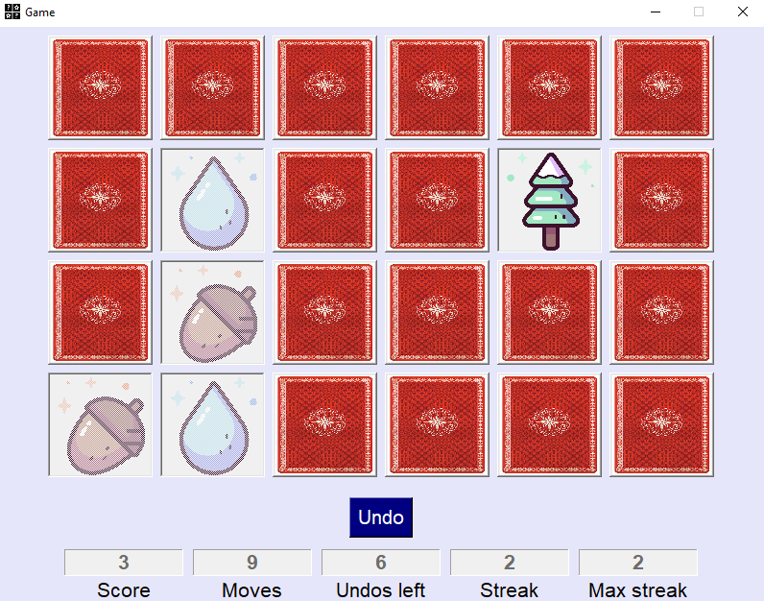
Memory Game description
The game object is to match pairs of cards in as few attempts as possible.
The player chooses from 3 difficulty levels: Beginner, Intermediate and Expert.
The game board appears when all the cards are hidden.
A game round takes place when a player selects two cards.
If both cards match, the player earns point(s), and the cards remain visible.
Otherwise, the cards become hidden.
The game ends when there are no more cards to compare.

Slide 3
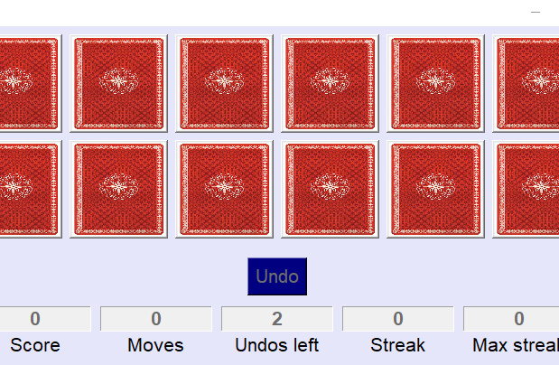
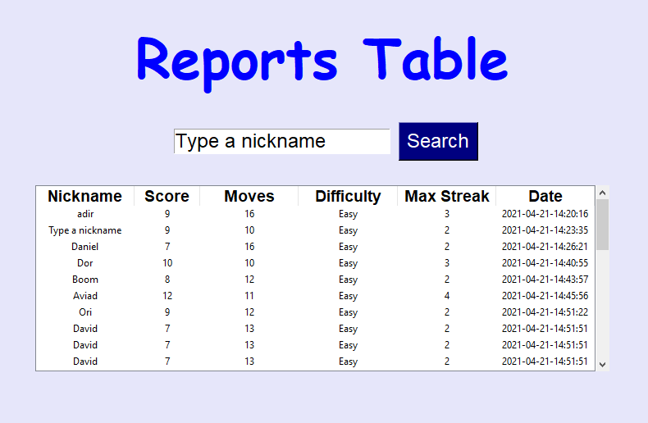
Memory Game features
Undo button allows the player to go back to the last game move.
3 difficulty levels to choose from: Beginner, Intermediate and Expert.
15 different types of cards.
Game stats: Score, Moves, Undos left, streak and max streak.
Scoring based on a sequence of matching successes.
Table of game history of all players.
Option to search the table by player’s nickname.

Slide 4
Singleton
Singleton is a design pattern which restricts the instantiation of a class to one single instance.
The singleton was chosen because it was decided that only one game could exist at a time in the system.
This concept has also been used to prevent the opening of selected windows more than once at a time.
The singleton was implemented in the following classes: GameManager, GameOptionsWindow and ReportsWindow.

Slide 5
Memento
Memento is a design pattern which provides the ability to restore an object to its previous state.
Memento is implemented with three objects: the originator, the caretaker and a memento.
The originator creates and stores states in Memento objects.
Memento contains a state of an object to be restored.
The caretaker is responsible to restore object state from Memento.

Slide 6
The use of memento
Saving previous game states allows the player to undo bad moves and thus maintain good game stats.
Four classes were created: Memento, Originator, CareTaker and GameState.
The originator saves the latest game state to Memento.
The caretaker takes the Memento object from the originator to be kept in a list of Mementos.
To undo a move, the originator takes the latest Memento from the caretaker.

Slide 7
Conclusions
Using singleton helped preventing the same screen to exist at once. But I could simply maintain only one screen open at a time or disable buttons that open screens, once these screens are already open.
However, doing so is a bad practice. the use of the singleton illustrates the desired use of the system: only one game instance should exist. The business logic should decide on the implementation and limitation of the game. That is not the view’s job.
Using memento enriched the game experience and added a strategic aspect. It’s a great and interesting addition to the game.

Slide 8
Resources
Card images pack and window icon:
https://www.flaticon.com/
Memento java code reference:
https://www.tutorialspoint.com/design_pattern/memento_pattern.htm

