Slide 1

Exam Management System

Slide 2
Motivation

Slide 3
With the increase in the size of the student body, it has become difficult to manage grading within the given time constraints. This has led many courses to adopt a multiple-choice format, which is faster to grade, and easier to analyze.
The creation of one-time-use questions is costly and unsustainable- We want to ease the process of creating those exams.
The creation of challenging multiple-choice questions is not a trivial task.

Slide 4
Current solution

Slide 5
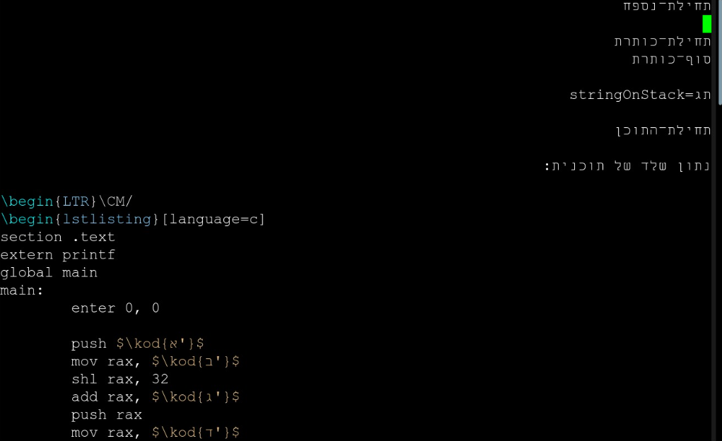
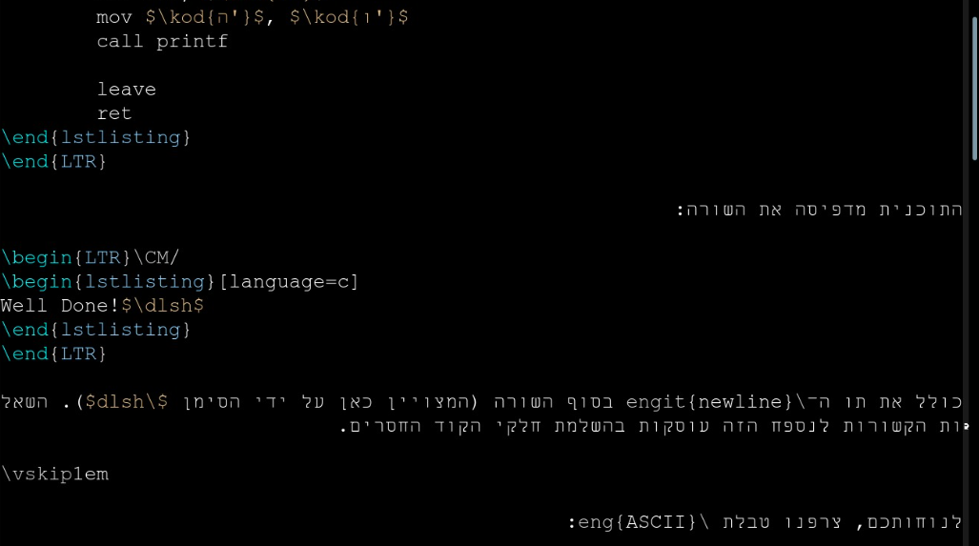
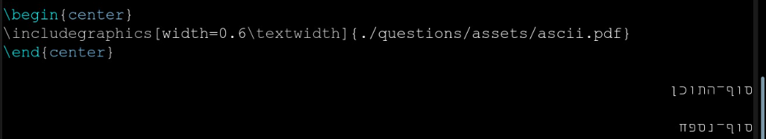
The client, Mayer Goldberg, has developed a theory of meta-questions and their translation into multiple-choice questions.
A local, scheme-based system was created to synthesize & generate multiple-choice and implement said theory.
The existing system has now been in use for 6-7 years in a large number of courses.
Current system’s low accessibility is too hard for people without deep knowledge and understanding to use comfortably.

Slide 6
Our Vision

Slide 7

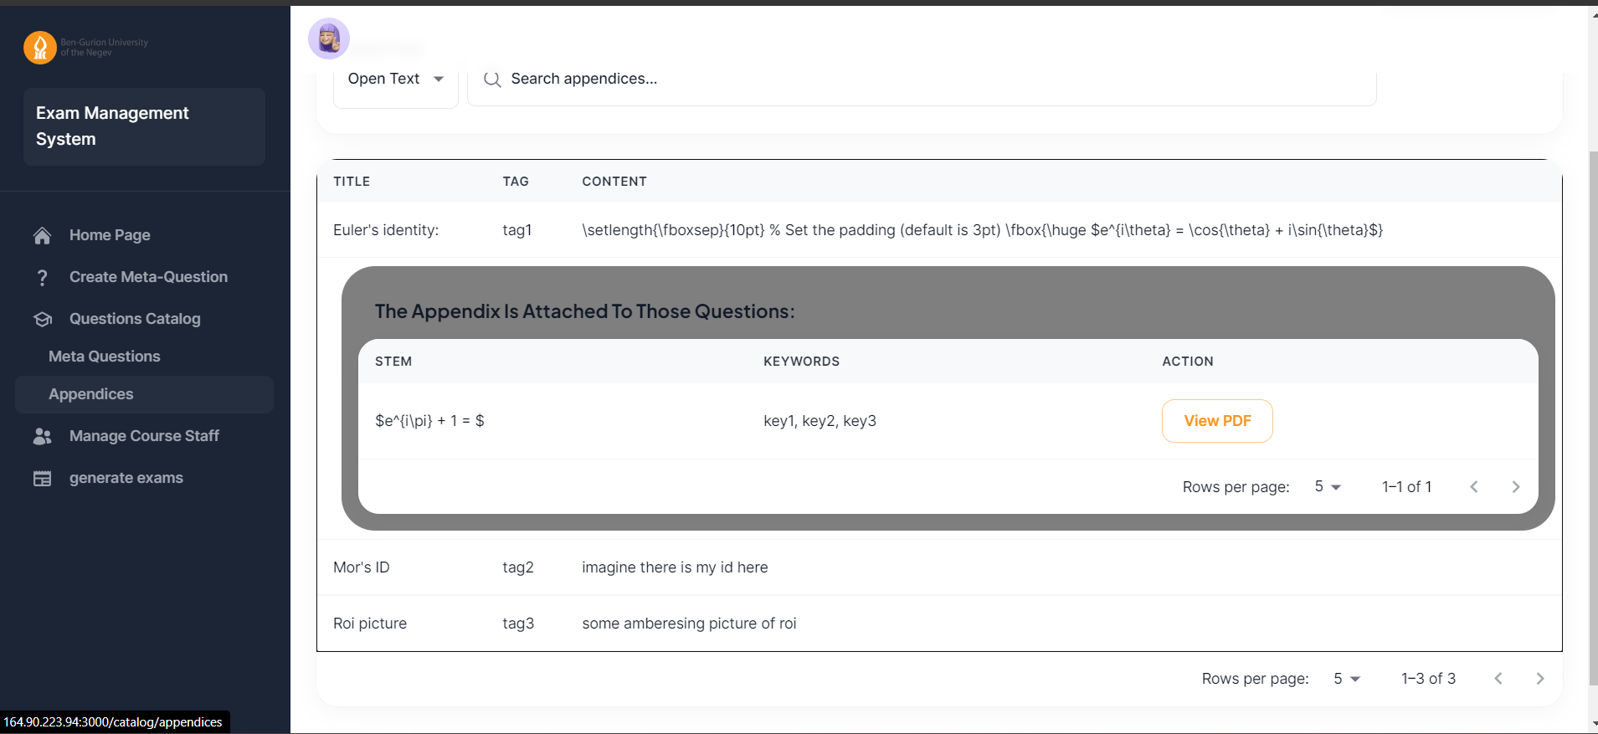
Recreate the system as a web application to increase accessibility to all staff members.
Easy to use UI will decrease mental load when creating all different parts of the questions and exams.
Integration of workflow features will allow staff members the tools needed to maintain a strong and correct database of qustions
Easy to install an easy to migrate.

Slide 8
What’s new

Slide 9
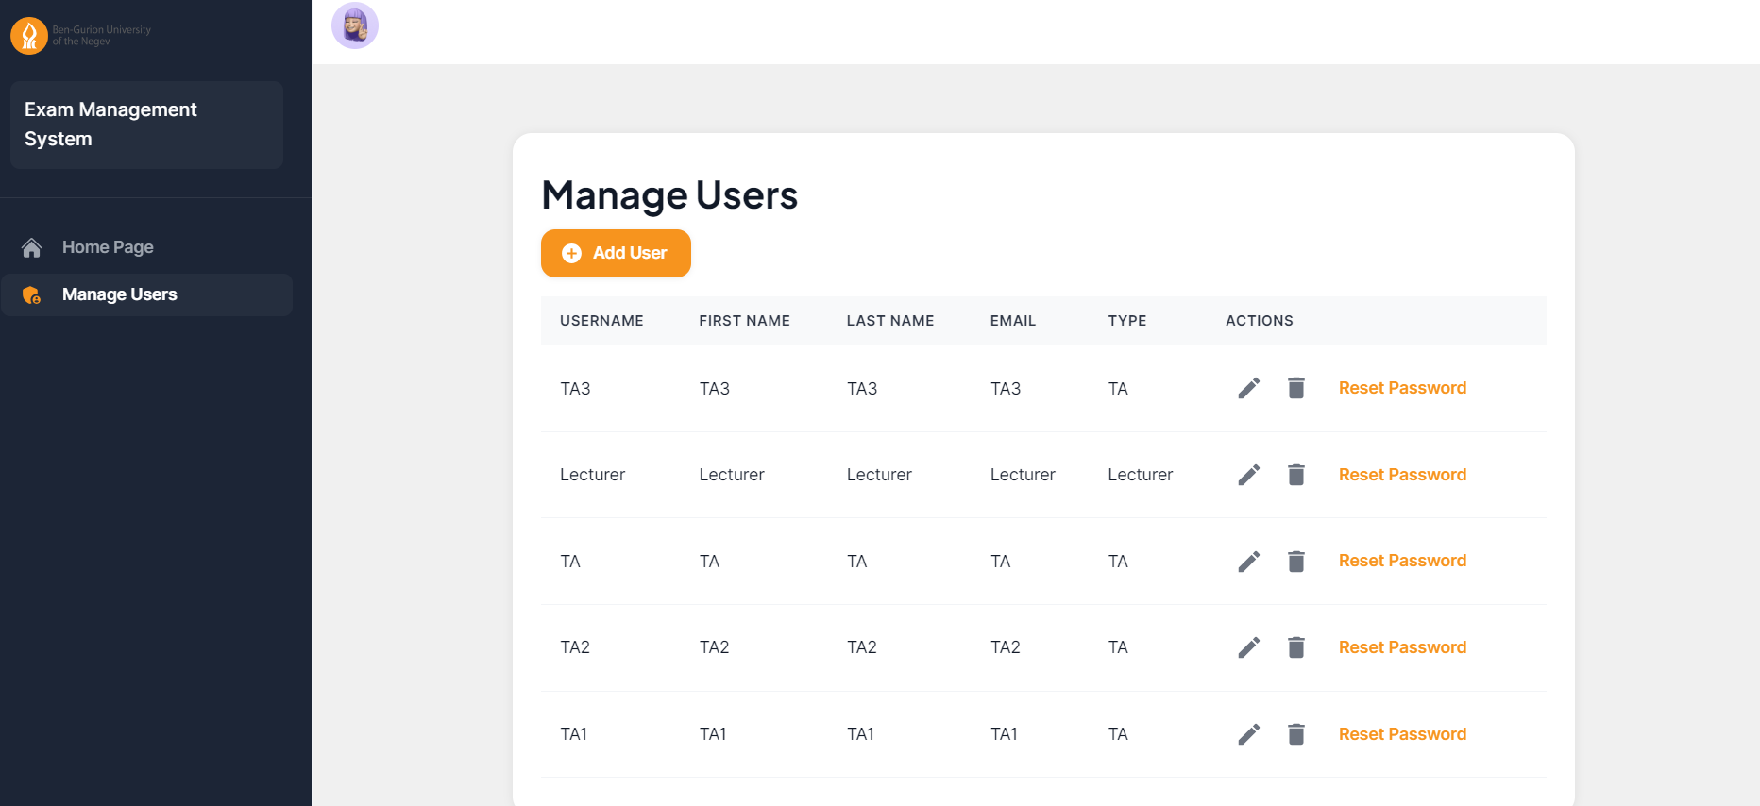
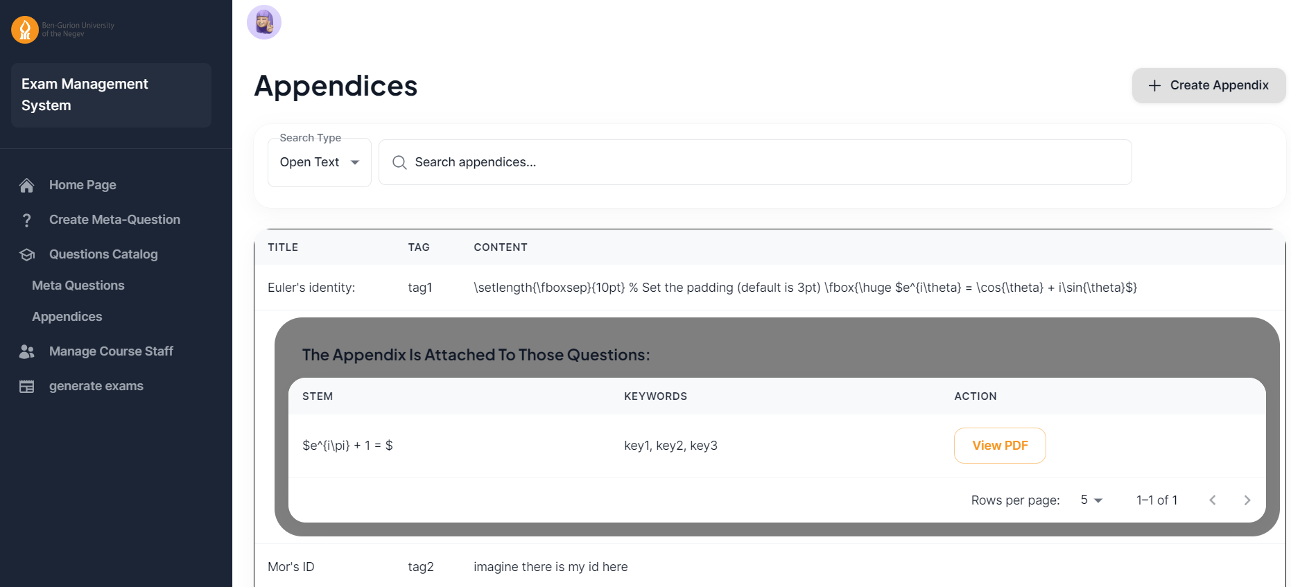
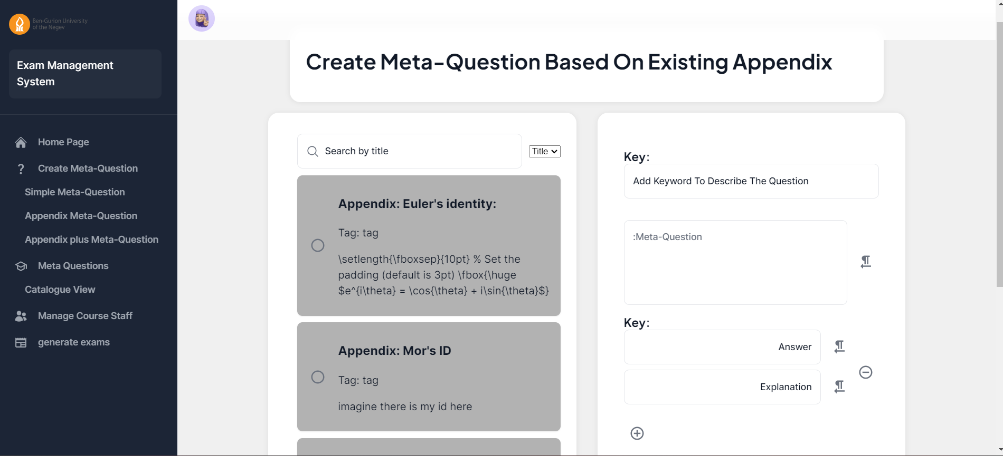

Slide 10
User Study

Slide 11
Task: Access the system through the browser and perform a first time login into a ‘lecturer’
Finished: yes
Hints: yes, explained why he should change the password
Time: 40 seconds
Rating: 4
Notes:
Didn’t understand why he needed to change the password
The system allowed to him to change his password to ‘’ (empty string), but the system didn’t allow him to connect without entering a password.

Slide 12
Task: Browse the Meta-Question database and add a new Meta-Question to the system
Finished: yes
Hints: yes, instructed on how to correctly add keywords
Time: 10 minutes
Rating: 4
Notes:
didn't enter keywords properly
took his time and entered values seriously
should fix rerouting after submitting.

Slide 13
Task: Complete day to day tasks such as ‘Add a key’ and ‘Tag am existing answer as key or distructor’
Finished: no
Hints: no
Time: 0 minutes
Rating: 0
Notes: Due to system bug/crash, task could not be presented and test by the client, a fix and recheck by the user will be done soon

Slide 14
Task: Build an exam and publish it
Finished: yes
Hints: Yes, explained what each button do, and how to build a complete exam
Time: 8:45 minutes
Rating: 2
Notes:
- Question keys and distractors should be choose randomly
Change FE functionality of the buttons
Add more functionality to edit and creating an exam
Saving always regenerate the exam, instead of saving in the cache

Slide 15
User feedback
The Administration component still does not work properly, And the building exam component work partially.
But the question editing component is already in a relatively advanced state. Easy to generate meta-questions, add answers and solutions.
The system produces a PDF at the level of questions and exams.
The exam format still requires changes and improvements, but what I have seen is beautiful, informative, and very easy to use.

