Slide 1

Exam Management System

Slide 2
What’s new

Slide 3

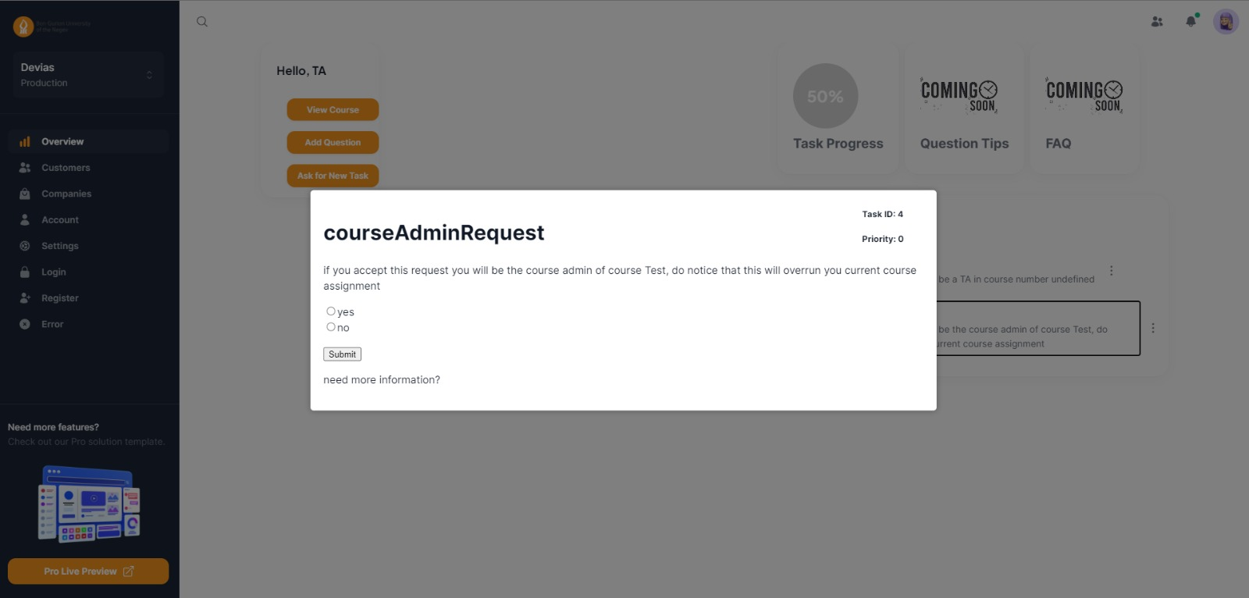
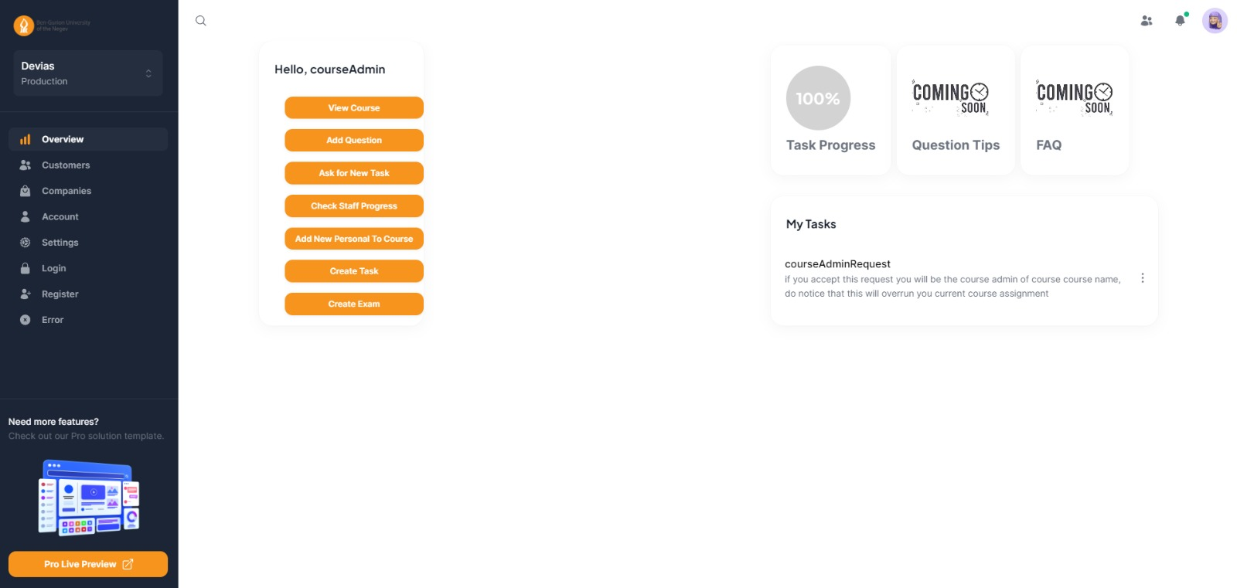

Slide 4
Semester Goals

Slide 5
Completion of Main Functionalities
Finalize the implementation of all main functionalities outlined in the project requirements.
Ensure that the system supports various roles effectively and efficiently.
Finalization of User Interface (UI)
Complete the design and implementation of remaining UI elements.
Ensure that the UI is intuitive, user-friendly, and consistent across all screens.
Improvement of Database (DB)
Review and enhance the current database design to optimize performance and scalability.
Implement any necessary changes or optimizations to improve data storage and retrieval.

Slide 6
Gantt

Slide 7
Example of how it looks

