Slide 1

Exam Management System

Slide 2
What’s new

Slide 3

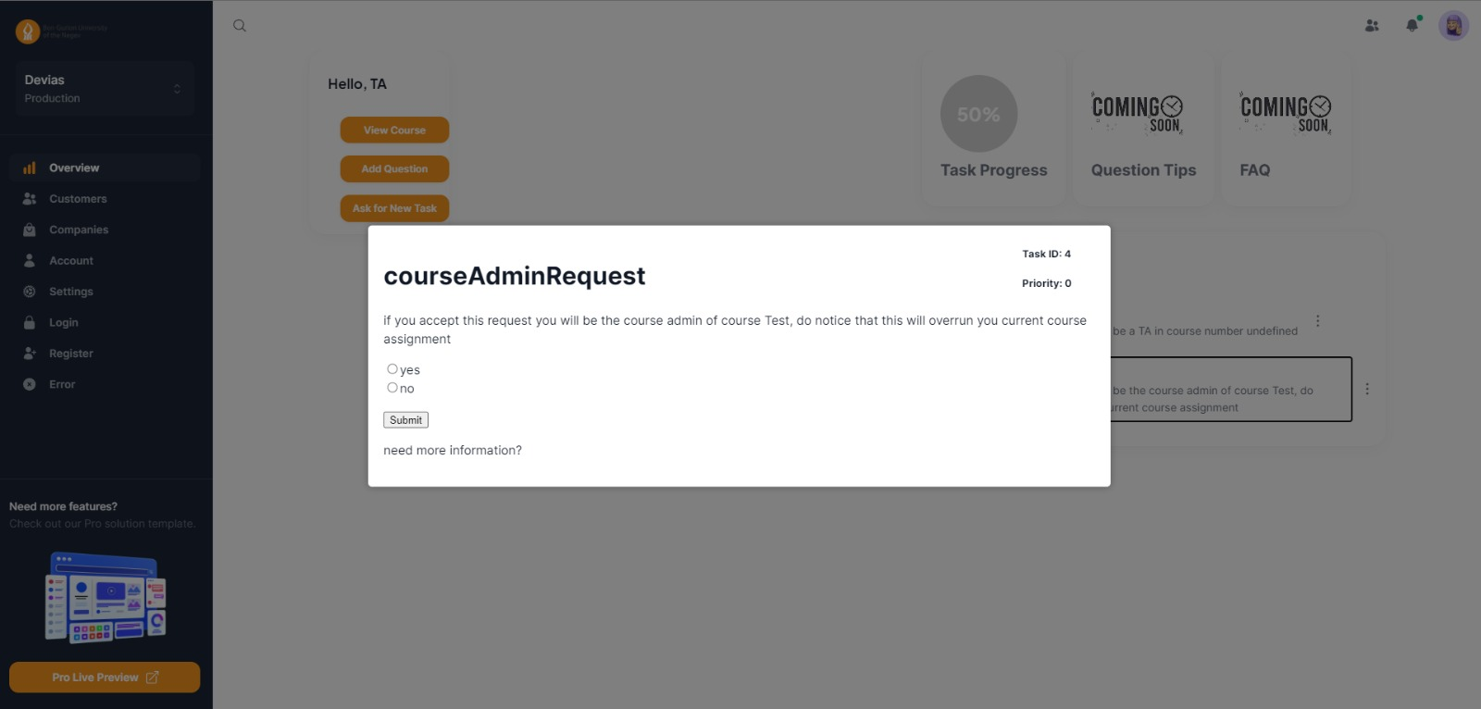
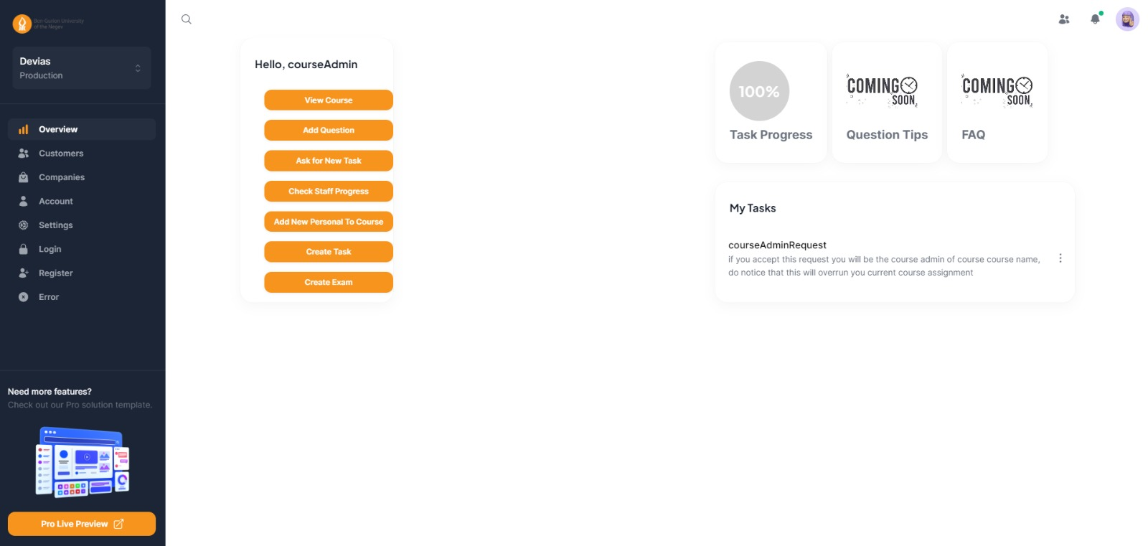

Slide 4
Semester Goals

Slide 5
Completion of Main Functionalities
Finalize the implementation of all main functionalities outlined in the project requirements.
Ensure that the system supports various roles effectively and efficiently.
Finalization of User Interface (UI)
Complete the design and implementation of remaining UI elements.
Ensure that the UI is intuitive, user-friendly, and consistent across all screens.
Improvement of Database (DB)
Review and enhance the current database design to optimize performance and scalability.
Implement any necessary changes or optimizations to improve data storage and retrieval.

Slide 6
Gantt

Slide 7
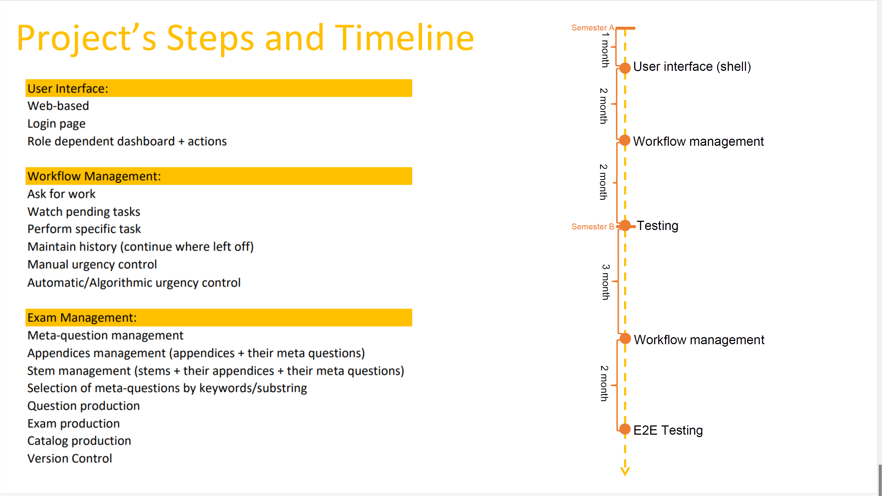

Slide 8
User Study

Slide 9
Task: Access the system through the browser and perform a first time login into a ‘lecturer’
Finished: yes
Hints: yes, explained why he should change the password
Time: 40 seconds
Rating: 4
Notes:
Didn’t understand why he needed to change the password
The system allowed to him to change his password to ‘nothing’, but the system wont allow him to connect without entering a password

Slide 10
Task: Browse the Meta-Question database and add a new Meta-Question to the system
Finished: yes
Hints: yes, instructed on adding keywords
Time: 10 minutes
Rating: 4
Notes:
didn't enter keywords properly
took his time and entered values seriously
should fix rerouting

Slide 11
Task: Complete day to day tasks such as ‘Add a key’ and ‘Tag am existing answer as key or distructor’
Finished: no
Hints: no
Time: 0 minutes
Rating: 0
Notes: Due to system bug/crush, task could not be presented and test by the client, a fix and recheck by the user will be done soon

Slide 12
Task: Build an exam and publish it
Finished: yes
Hints: Yes, explained what each button do, and how to build a complete exam
Time: 8:45 minutes
Rating: 2
Notes:
- Question keys and distractors should be choose randomly
Change FE functionality of the buttons
Add more functionality to edit and creating an exam
Saving always regenerate the exam, instead of saving in the cache

Slide 13
User feedback
The Administration component still does not work properly, And the building exam component work partially.
But the question editing component is already in a relatively advanced state. Easy to generate meta-questions, add answers and solutions.
The system produces a PDF at the level of questions and exams.
The exam format still requires changes and improvements, but what I have seen is beautiful, informative, and very easy to use.

