Slide 1




Detection of Business Email Compromise
Gal Hadida
Roi Abramovich
Shira Baron
Hadar Baron
Supervisor: Dr. Amit Dvir

Slide 2
Introduction
Business email compromise
an attack that targets specific employee roles within an organization by sending a spoof email (or series of spoof emails) which fraudulently represent a senior colleague (CEO or similar) or a trusted customer.

Slide 3
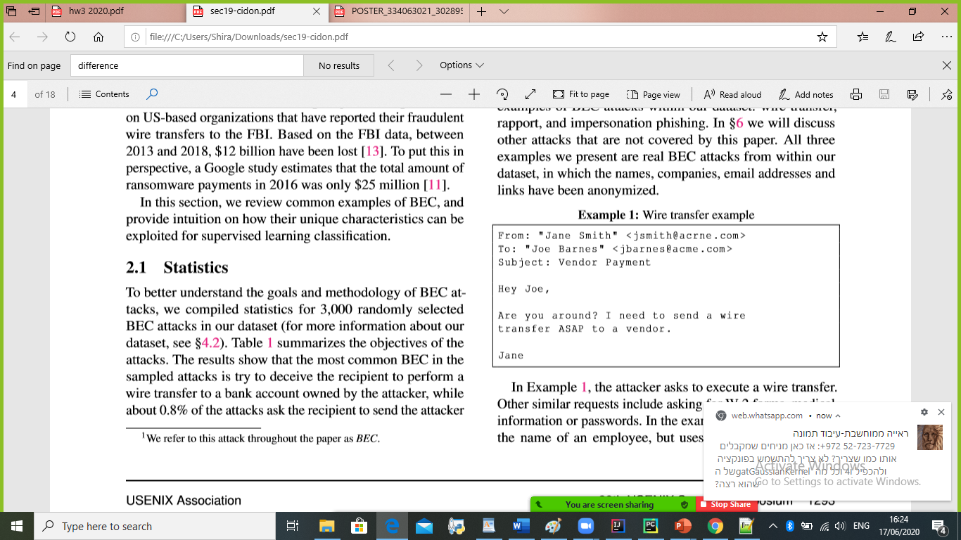
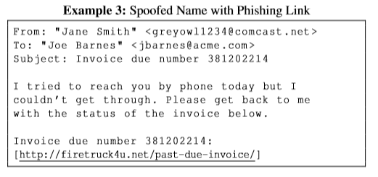
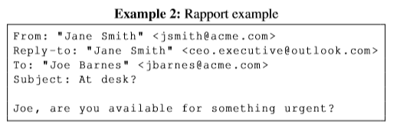
BEC takes several forms:
Wire transfer
impersonation phishing
rapport

Slide 4
The problem
Most email security systems are not effective in detecting BEC.

Slide 5
Why?
Impersonation emails do not contain malicious volumetric attributes
They typically do not contain malware, and are not sent from well-known malicious IPs
Do not contain a link
Are sent to a small number of recipients

Slide 6
The solution
BEC-Guard, a detector that prevents business email compromise attacks using supervised learning

Slide 7
In our project:
The first part is to implement the BEC-Guard.
The second is to classify an email that his body is a picture format by extract the text from pic using text from picture techniques
Our key insight is to split the classiﬁcation problem in to two parts and implement :
Analyzing the header of the email
Applying natural language processing to detect phrases associated with BEC or suspicious links in the email body.
https://github.com/Roiabr/Final-Project-Phishing-Detection-On-BEC-Attack

Slide 8
Analyze the header of the email
Use a different email address than the corporate email address.
The attacker spoofs the legitimate email address of the sender, but the reply-to email address is different than the sender address

Slide 9
Analyze the body
Discusses sensitive information (a wire transfer).
Asking for a special, immediate request

Slide 10
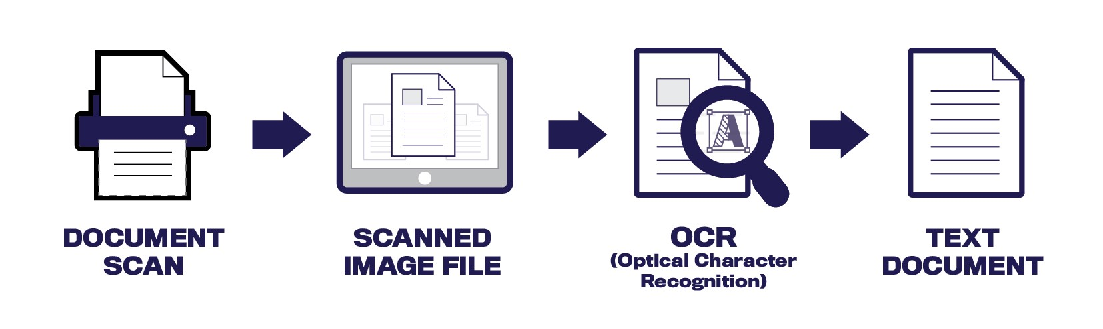
Future Improvements:
The idea is to extract the text from the picture using text from picture techniques(OCR) and then continue with the body machine classifier.
To the current dataset will add emails that include picture as email body.
Each email will include of course all the features of Bec attack.

Slide 11
Thank You

