Slide 1
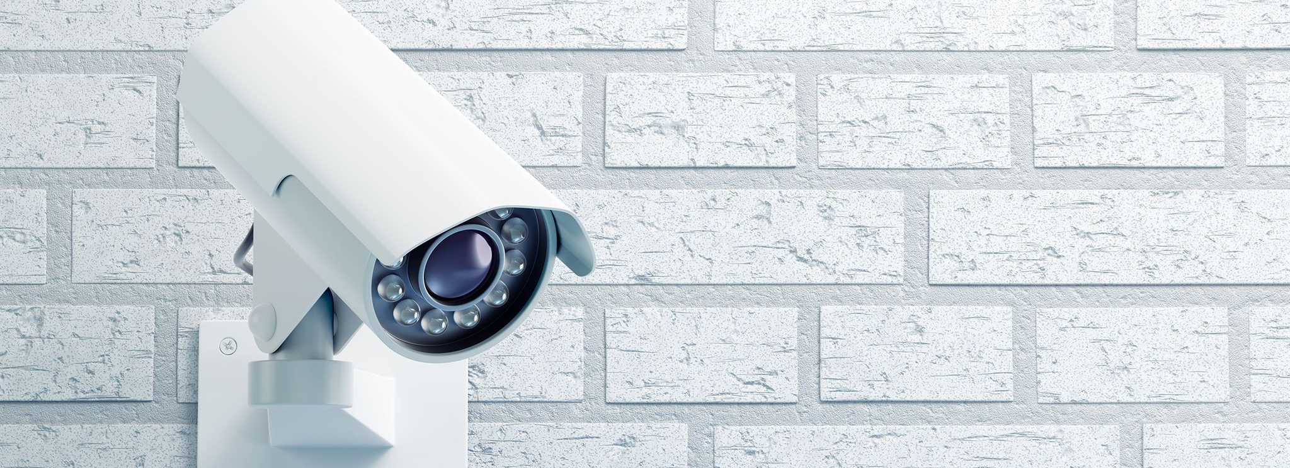
Smart Camera Monitor System Presentation
Innovative surveillance technology enhancing security and monitoring
Notes:
AI-generated content may be incorrect. ---

Slide 2
System Overview and Architecture
Notes:
Smart Camera Monitor System Diagram

Slide 3
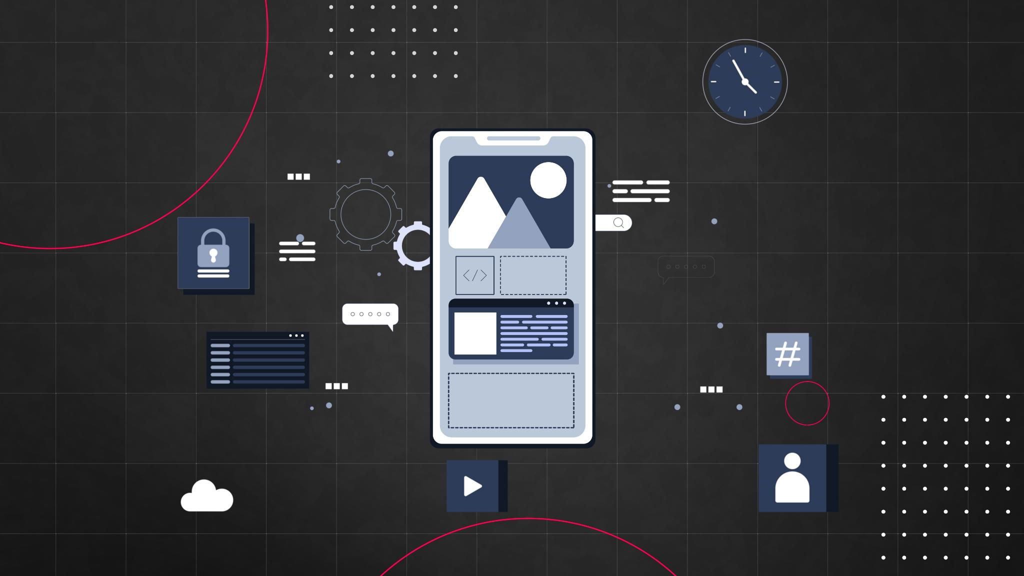
Smart Camera Monitor System Diagram
Image Capture and Processing
Raspberry Pi camera module captures images processed by Python script generating JSON data with timestamps and event labels. – camera_capture.py – is used to capture image, Create Json, Save file and Send HTTP
Backend Data Handling
Flask backend server receives JSON data via HTTP POST, processes it and serves it to the front-end dashboard. Server.py is used to receive POST, request JSON, and Process the data.
Web-based User Interface
Dashboard uses HTML templates to display images and metadata, enabling real-time monitoring with color-coded components. – Status HTML
System Architecture Visualization
Color-coded layers and arrows in the diagram illustrate data flow from capture to processing to user display on a dark security-themed background.
Notes:
The Smart Camera Monitor System demonstrates an integrated approach to real-time image capture, data processing, and web-based monitoring using a Raspberry Pi and Python technologies. At the core of the system is the Raspberry Pi camera module, which captures images using the Picamera2 library. These images are processed by a Python script named camera_capture.py, which not only captures the images but also generates structured JSON data including timestamps and event labels. This data is saved locally and then transmitted via an HTTP POST request to a Flask-based backend server. The Flask server receives this data using request.json, processes it, and makes it available to the front-end dashboard. The dashboard, developed using HTML templates within Flask, displays the captured images alongside relevant metadata, allowing users to monitor activity in real time. The use of color-coded components in the diagram visually distinguishes between the camera layer (blue), backend processing (purple), and user interface (green), making the system architecture clear and intuitive. Additionally, the inclusion of arrows in the diagram illustrates the direction of data flow, from image capture through processing to user display. The presentation slide also incorporates a dark, security-themed background to reflect the system’s purpose as a monitoring or surveillance solution. This visual design choice enhances the professional appearance of the presentation and aligns with the application context. Overall, the system demonstrates key concepts such as client-server communication, data serialization using JSON, and web integration using Flask, making it a solid example of an IoT-based monitoring application.

