Slide 1
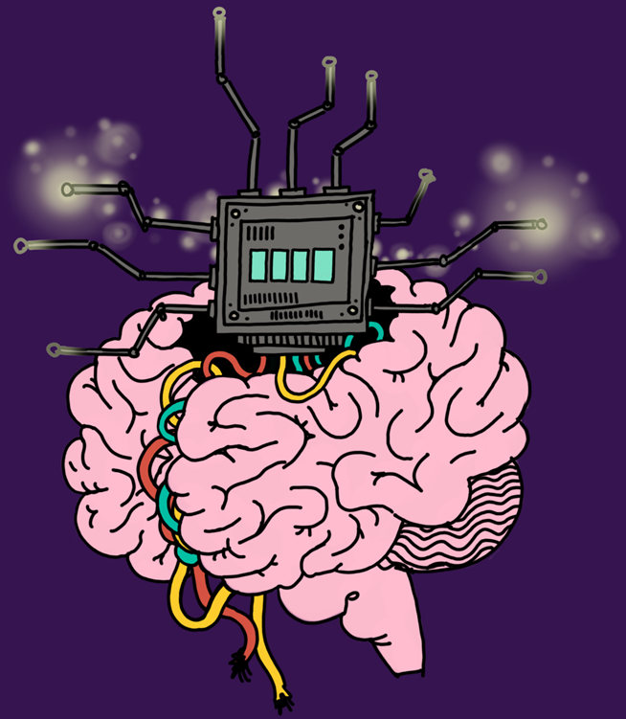
The neural correlates of shared and individual experience- Coppola et al. (2026)
07/05/2026 Fulton 102 17:00
Cognitive Research Article Society Journal Event

Slide 2
1. Understanding refresher
fMRI
- Time-by-time similarity matrix (TTM)
- Instantaneous Phase Synchrony (IPS)
- Networks suggested to be relevant to conscious experience in the study and support individual + shared experience: default mode network (DNM), dorsal attention network (DAN) and auditory networks (AUD)

Slide 3
2. How is ‘consciousness’ defined here, and does this differ from other definitions you’ve encountered? How does this affect comparisons across consciousness research?

Slide 4
3. How do the authors create a distinction between shared and individual consciousness, and what do you think of this?

Slide 5
4. Discuss the limitations of the paper, and suggest ways these could have been overcome
- When suggesting alternative approaches, we can discuss how and to what extent that this would have impacted findings- evaluate trade-offs.

Slide 6
5. What strengths does this paper have? How does this improve the quality of the study?

Slide 7
‘I am happy that this paper utilizes Shannon entropy! But, I remain skeptical about many things: primarily, using any sort of complexity measure in general, but ESPECIALLY trying to ignore differences in neurological tone drive via propofol and how these changes in global or lateralized resonance may give rise to the network specificities they found; general concerns surrounding things like BOLD and metabolic differences throughout the brain; and I guess, really, just this idea that we can tease apart experiential complexity in this manner. It is nice that they didn't rely on retrospective self-report as an index of "happened experiences", but I am sure a clip of audio from a suspenseful film comes with an ENORMOUS amount of cross-structural and trans-hierarchical confounds that a 5-minute 3-Tesla scanner simply cannot handle, and the idea of brining Shannon entropy into that mess is just hilarious to me that they found cool results! 🫠’ – Danny Nacker, SCCS

