Slide 1


Slide 2

What is RED TAPE?
It refers to the rigid or mechanical adherence to bureaucratic rules and regulations especially those involving unnecessary paperwork.
It involves government procedures which are oppressively complex and time-consuming.

Slide 3

Where did the term RED TAPE originate?
In the 16th and 17th century the administration of Spanish King Charles V started identifying the more important documents of state by binding them with red ribbon rather than rope.

Slide 4
Constitutional Basis for the Anti-Red Tape Act of 2007
Article II, Section 27 of the
1987 Constitution
The State shall maintain honesty and integrity in the public service
and shall take positive and effective measures against graft and
corruption.

Slide 5
Anti-Red Tape Act of 2007
RA 9485
An Act to Improve Efficiency in the Delivery of Government Service to the Public by Reducing Bureaucratic Red Tape Preventing Graft and Corruption, and Providing Penalties Therefore

Slide 6
Anti-Red Tape Act of 2007
The Act was passed in response to the urgent need to establish an effective system that will eliminate bureaucratic red tape, avert graft and corrupt practices and improve efficiency of delivering government frontline service.

Slide 7
Anti-Red Tape Act of 2007
The Act aims to promote transparency in government with regard to the manner of transacting with the public by requiring each agency to simplify frontline service procedures, formulate service standards to observe in every transaction and make known these standards to the client.

Slide 8

Anti-Red Tape Act of 2007
What are the responsibilities of each office/agency under this Act?
Determine which processes or transactions constitute frontline services
Undertake reengineering of transaction systems and procedures, including time and motion studies, if necessary and after compliance
Set-up their respective service standards to be known as the
“ Citizen’s Charter ”

Slide 9
Anti-Red Tape Act of 2007
Why do the agencies or offices need to do these activities?
These processes serve the purpose of reducing and simplifying the following:
steps in providing the service;
forms used;
requirements;
processing time, and
fees and charges

Slide 10
Anti-Red Tape Act of 2007
What is a “Citizen’s Charter”?
It is an official document, a service standard, or a pledge, that communicates information on the services provided by the concerned government agency to the public.
It describes the step-by-step procedure for availing a particular service, and the guaranteed performance level that they may expect for that service.

Slide 11
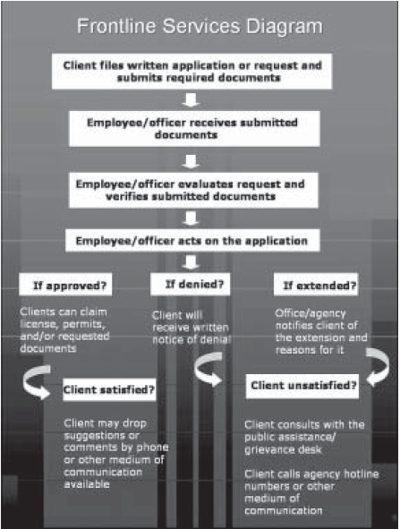

Slide 12
Anti-Red Tape Act of 2007
How long must it take for applications or requests to be acted upon?
Applications or requests must be acted upon within the period prescribed in the agency or office’s Citizen’s Charter which should not be longer than five (5) working days for simple transactions and ten (10) working days for complex transactions from the date of receipt.

Slide 13
Anti-Red Tape Act of 2007
What is the difference between a simple transaction and a complex transaction?

Slide 14
Anti-Red Tape Act of 2007
Simple Transaction
It refers to requests or applications submitted by clients of a government office or agency which only require ministerial actions on the part of the public officer or employee, or that which present only inconsequential issues for the resolution by an officer or employee of said government office.

Slide 15
Anti-Red Tape Act of 2007
Complex Transaction
It refers to requests or applications submitted by clients of a government office which necessitate the use of discretion in the resolution of complicated issues by an officer or employee of said government office, such transaction to be determined by the office concerned.

Slide 16
Anti-Red Tape Act of 2007
What acts can be considered as a light offense for erring public officials?
Refusal to accept application and/or request within the prescribed period or any document submitted by the client

Slide 17
Anti-Red Tape Act of 2007
What acts can be considered as a light offense for erring public officials?
Failure to act on an application and/or request or failure to refer back to the client a request which cannot be acted upon due to lack of requirements within the prescribed period

Slide 18
Anti-Red Tape Act of 2007
What acts can be considered as a light offense for erring public officials?
Failure to attend to clients who are within the premises of the office or agency concerned prior to the end of the working hours and during lunch break

Slide 19
Anti-Red Tape Act of 2007
What acts can be considered as a light offense for erring public officials?
Failure to render frontline services within the prescribed period on an application and/or request without due cause

Slide 20
Anti-Red Tape Act of 2007
What acts can be considered as a light offense for erring public officials?
Failure to give the client a written notice on the disapproval of an application or request
Imposition of additional irrelevant requirements other than those listed

Slide 21
Anti-Red Tape Act of 2007
What are the penalties for light offenses?
First offense – 30 days suspension without pay and mandatory attendance in Values Orientation Program
Second offense – Three (3) months suspension without pay
Third offense – Dismissal and perpetual disqualification from public service

Slide 22
Anti-Red Tape Act of 2007
What act can be considered as a grave offense?
Fixing and/or collusion with fixers in consideration of economic and/ or other gain or advantage which can be committed by insiders or outsiders of the office.

Slide 23
Anti-Red Tape Act of 2007
Who is a FIXER?
refers to any individual whether or not officially involved in the operation of a government office or agency who has access to people working therein, and whether or not in collusion with them, facilitates speedy completion of transactions for pecuniary gain or any other advantage or consideration.

Slide 24
Anti-Red Tape Act of 2007
What are the penalties for fixers?
Fixers can be charged with imprisonment not exceeding six (6) years or a fine of not less than 20,000 pesos but not more than 200,000 pesos or both fine and imprisonment at the discretion of the court.

Slide 25
Source/Reference:
Primer on RA 9485: The Anti-Red Tape Act of 2007
Local Government Academy (LGA)
Department of the Interior and Local Government (DILG)

