Slide 1
Value and ethics of public responsibility
Rodalyn G. Salvaleon-Tusoy
MPA Student

Slide 2
SCOPE OF THE PRESENTATION
Public Office
Values and Public Administration
Administrative Ethics
Code of Ethics for Public Service

Slide 3
what is ethical behavior?
Ethical Behavior
- what is accepted as “good” and “right” in the context of the governing moral code
Values
broad beliefs about what is or is not appropriate behavior

Slide 4
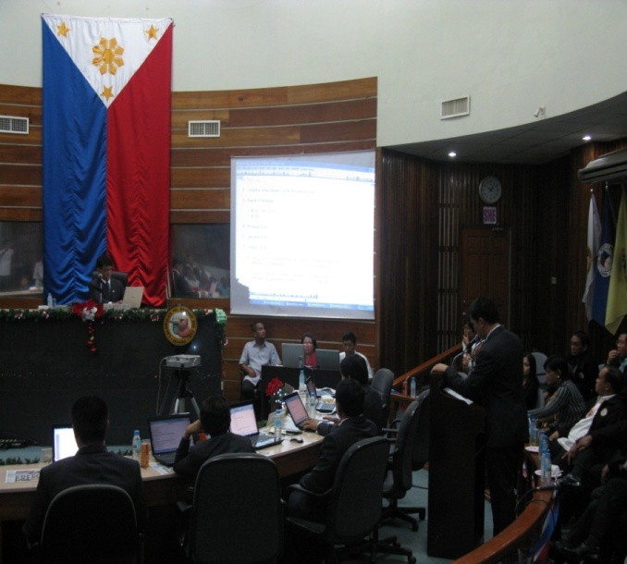

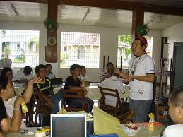
PUBLIC OFFICE
Public office is both a duty and a position of great importance in a government bureaucracy.

Slide 5
Public office is a public trust. Public officers and employees must at all times be accountable to the people, serve them with utmost responsibility, integrity and loyalty, and efficiency, act with patriotism and justice, and lead modest lives.
Section 1 of Article XI of the 1987 Constitution of the Republic of the Philippines

Slide 6
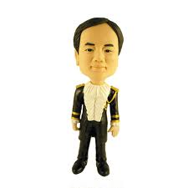
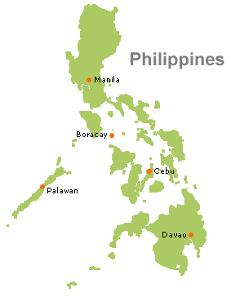


Slide 7

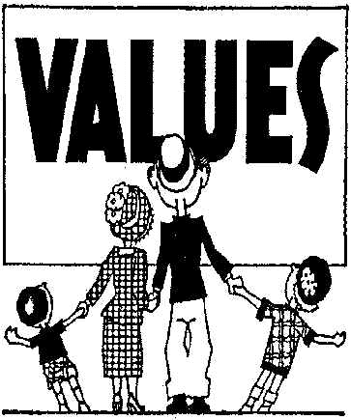
values of public administration
The sum of the values of the people in a society it serves.
It changes as rapidly as do the people values

Slide 8

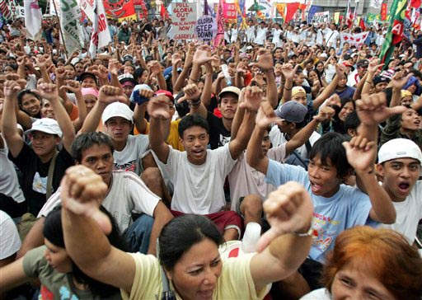

Government
People
Public Administration

Slide 9
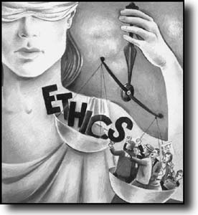
Administrative ethics
Ethics is a way of life
“Society’s view of what constitutes appropriate behavior by its public officials”

Slide 10

Ethics in the workplace
What is an ethical dilemma?
Situation that requires choosing a course of action

Slide 11
Examples of ethical dilemmas
Should I support my bosses incorrect views?
Should I sign a false document?
Should I accept a gift from a client?
Should I give special treatment to a friend of boss’ friend?

Slide 12
Ethical Dilemmas
Confronting conflicting responsibilities is the most typical way public administrators experience ethical dilemmas.
- Terry Cooper
What Are Your Responsibilities?
To the public
To the stakeholders
To the organization
To the profession
To your colleagues
To yourself

Slide 13
Nine causes/factors of negative behavior in government:
1. The difficulty of coping the economic realities because of unrealistic salary levels of government employee;
2. The excessive desire for wealth and the “good life” among other higher-echelon government officials;
3. Low moral standards or values
4. An administrative behavior that facilitates or support corruption

Slide 14
Nine causes/factors of negative behavior in government:
5. Related to the preceding factor, strong corrupting influence of clientele
6. Bad example set by the leadership
7. The kinship system
8. A cumbersome system of justice
9. Unenforceable and obsolete laws

Slide 15
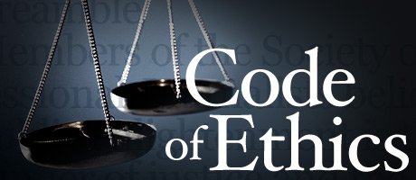
Code of ethics for pubic service
Code of Ethics s a self-regulation manual among professionals

Slide 16

For most public servants the taking of an oath of loyalty merely formalizes a resolution already made. It amounts to an outer expression of an inner dedication - the legal aspects of a code of ethics by which the public employee is guided in all his official acts and by which he expects all his fellow workers to proceed
John A. Vieg

Slide 17
Executive order no. 217
1. Have faith in Divine Providence that guides the destinies of men and nations.
2. Love your country for it is the home of your people, the seat of your affections, and the source of your happiness and well being. Its defense is your primary duty. Be ready at all times to sacrifice and die for it if necessary.
3. Respect the Constitution which is the expression of your sovereign will. The government is your government. It has been established for your safety and welfare. Obey the laws and see that they are observed by all and that public officials comply their duties.

Slide 18
Executive order no. 217
4. Pay your taxes willingly and promptly. Citizenship implies not only rights but also obligations.
5. Safeguard the purity of suffrage and abide by the decisions of the majority.
6. Love and respect your parents. It is your duty to serve them gratefully and well.
7. Value your honor as you value your life. Poverty with honor is preferable to wealth with dishonor.
8. Lead a clean and frugal life. Do not indulge in frivolity or pretense. Be simple in your dress and modest in your behavior.

Slide 19
Executive order no. 217
9. Live up to the noble traditions of your people. Venerate the memory of the heroes. Their lives point the way to duty and honor.
10. Be industrious. Be not afraid or ashamed to do manual labor. Productive toil is conducive to economic security and adds to wealth of the nation.
11. Rely on your efforts for your progress and happiness. Be not easily discouraged. Persevere in the pursuit of your legitimate ambitions.
12. Do your work cheerfully, thoroughly and well. Work badly is worse than work undone. Do not leave for tomorrow what you can do today.

Slide 20
Executive order no. 217
13. Contribute to the welfare of your community and promote social justice. You do not live for yourself and your families alone. You are part of society to which you owe definite responsibilities.
14. Cultivate the habit of using goods made in the Philippines. Patronize the product and trades of your countrymen.
15. Use and develop our natural resources and conserve them for posterity. They are inalienable heritage of its people. Do not traffic with your citizenship.

Slide 21
CODE OF ETHICS FOR PUBLIC OFFICERS AND EMPLOYEES
Respect and uphold the Constitution and laws of the Republic of the Philippines.
Observe the highest standard of morality, integrity, honesty, loyalty, and devotion to the public weal.
Perform his tasks thoroughly, faithfully, and efficiently.
Be physically and mentally fit for public service and live within his income.
Expose corrupt practices in the public services without fear or favor.

Slide 22
CODE OF ETHICS FOR PUBLIC OFFICERS AND EMPLOYEES
VI. Serve the public courteously, justly and impartially regardless of kinship, friendship, social standing, religious or political differences
VII. Discharge duties promptly without thought of gifts, benefits or any remuneration which may influence the proper performance of official functions.
VIII. Engage in no business with the Government or with any private party, either directly or indirectly, which will be inconsistent with his position as a public servant.
IX. Divulge no confidential information coming to him by the nature of his office or duties.

Slide 23
CODE OF ETHICS FOR PUBLIC OFFICERS AND EMPLOYEES
X. Uphold, respect, and observe these principles, ever conscious that public office is a public trust which he should neither violate, nor should he allow suspicion to raise that such has been abused or betrayed.
Memorandum Circular No. 109 was issued on March 30, 1965 by the President of the Philippine Republic

Slide 24

Parting video to ponder
YouTube(January 21, 2010). cccvideovault. What are community values?. Retrieved from https://www.youtube.com/watch?v=eKz2R61YUV0

Slide 25
References:
Jose P. Leveriza. Chapter 20: Value and Ethics of Public Responsibility. Public Administration: The Business of Government. Second Edition
Google images for the pictures and icons
YouTube(January 21, 2010). cccvideovault. What are community values?. Retrieved from https://www.youtube.com/watch?v=eKz2R61YUV0

