Slide 1
AI-Driven Accessibility Checker for UI Design
Using WCAG and Machine Learning
- ROJA SHURUTHIKA KATHIRAVAN (G39829724)

Slide 2
Objective
Develop a tool that evaluates UI designs for accessibility issues using ML
➤ Based on WCAG (Web Content Accessibility Guidelines)
➤ Focus on contrast, font size, readability, and screen reader support

Slide 3
Dataset Overview
• Source:
- Manually done
- Figma API for real-world design file extraction
- Synthetic datasets created for accessibility pattern learning
• Size: 125 labeled screenshots (currently)
• Key Features Extracted:
- Color contrast ratio
- Element size & spacing
- Font size & type
- Alt text presence

Slide 4
Algorithms and models used
Supervised Learning Approach
Algorithms Used:
- Random Forest Regressor: to predict accessibility score (0–100)
- Logistic Regression: to classify pass/fail accessibility status
Why These Models?
- Both work well with structured, labeled data
- Good performance even with small custom datasets
- Allow easy integration into a rule-based + ML hybrid system

Slide 5
Preliminary Analysis & Findings
• Alt text often missing in many designs
→ Visual elements lack proper screen reader descriptions

Slide 6
Challenges
• Limited real-world UI datasets labeled for accessibility
• Variability in design standards across industries:
- Health: prioritize clarity & large fonts for older users
- Education: focus on content hierarchy & text readability

Slide 7
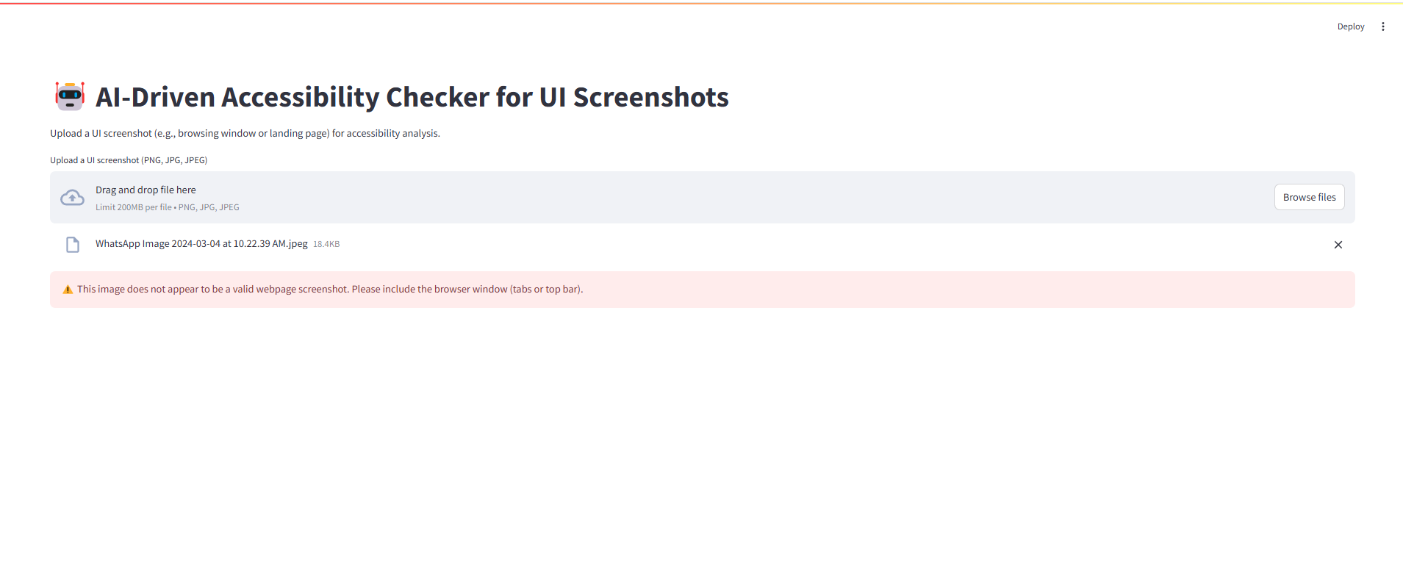
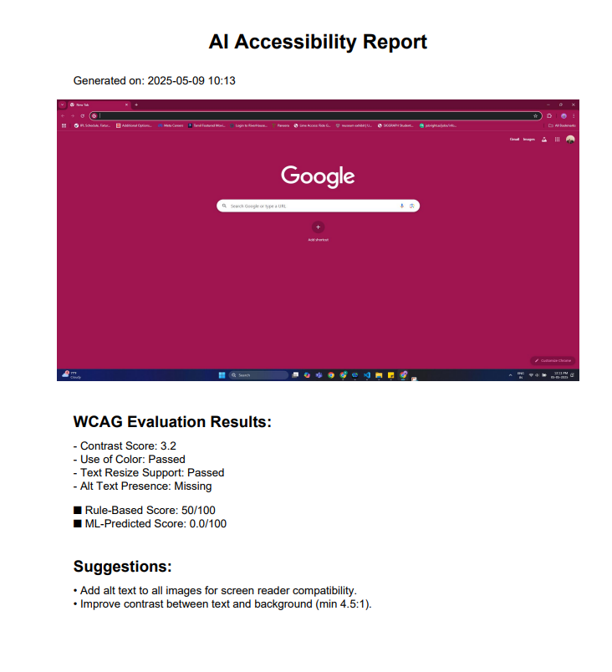
Result

