Slide 1

Traffic Accident Severity Prediction System
A machine learning-powered solution that predicts accident severity in real-time, helping authorities respond faster and save lives.

Slide 2

The Challenge We're Solving
Road traffic accidents result in significant human and economic costs worldwide. Emergency response teams need accurate, immediate information about accident severity to allocate resources effectively and save lives.
Our system bridges this critical gap by analyzing environmental, traffic, and weather data in real-time to predict whether an accident will result in fatal injury, serious injury, or slight injury—enabling faster, smarter emergency response.

Slide 3








System Architecture Overview
Data Collection
ML Pipeline
Accident records with environmental, traffic, and weather parameters
Feature engineering, model training, and evaluation
Flask API
Prediction Output
Real-time prediction interface
Severity classification with confidence scores
The system integrates machine learning models with a responsive web application, enabling emergency dispatchers and traffic management systems to assess accident severity within seconds of receiving incident data.

Slide 4

Dataset Overview
Key Attributes
Dataset Characteristics
Time and day of week
15,000 records with balanced severity classes (5,000 each of Fatal, Serious, and Slight injuries).
Weather conditions
Vehicle type and speed
Synthetic but realistic data designed to simulate real-world accident patterns across diverse conditions.
Driver experience level
Combines environmental, situational, and driver-related parameters for comprehensive analysis.
Collision type
Road conditions and alignment
Traffic density
Temperature

Slide 5





Data Preprocessing Pipeline
Data Cleaning
Handle missing values, remove duplicates, standardize text formats, and validate ranges.
Encoding
Apply Label Encoding to ordinal features and One-Hot Encoding to nominal categories.
Scaling
Normalize numerical features using StandardScaler for consistent model input.
Validation
Verify data integrity and save preprocessed dataset for model training.

Slide 6
Feature Engineering
Derived features that capture temporal and behavioral patterns critical to accident severity.
Hour
Day or Night
Is Weekend
Speed Category
Extracted from time data (0-23) to detect peak accident hours and visibility patterns.
Binary classification (6AM-6PM = Day) capturing lighting conditions affecting severity.
Weekend indicator (1/0) revealing behavioral differences in driving patterns.
Binned into Low/Moderate/High (0-40, 40-80, 80-120 km/h) as risk factor.

Slide 7






Severity Classification Framework
Fatal Injury
Serious Injury
Slight Injury
Our three-tier classification system aligns with international accident reporting standards. Fatal injuries require immediate multi-agency response, serious injuries need rapid hospital transport, while slight injuries can be managed with standard emergency protocols. The ML model learns these distinctions from historical patterns.

Slide 8
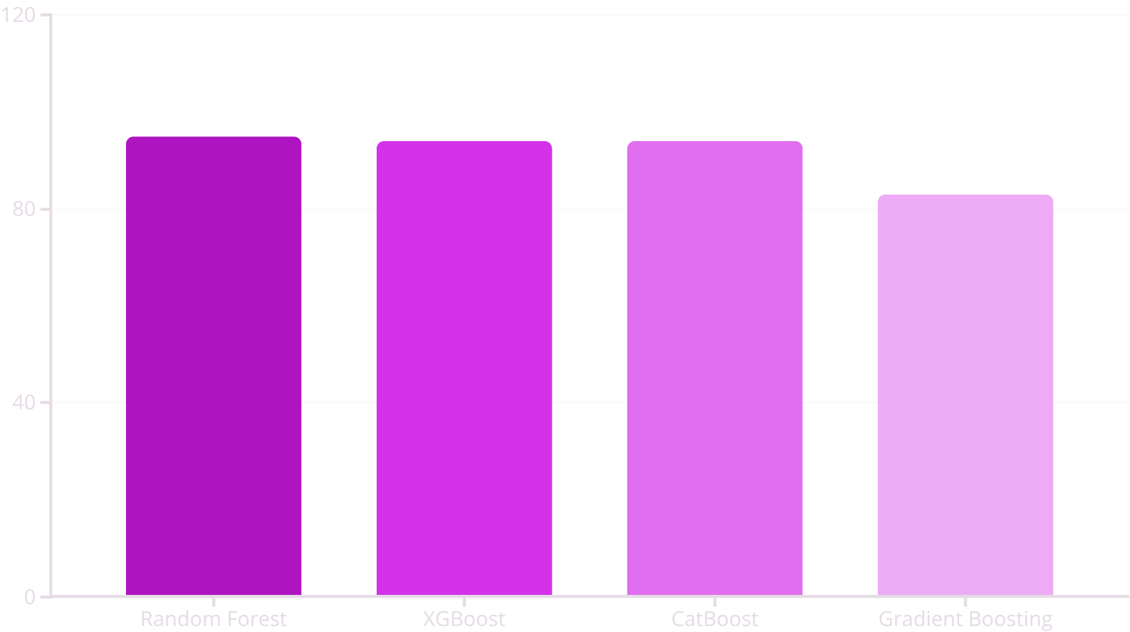
Model Training & Comparison
Algorithms Tested
01
Random Forest
Ensemble of decision trees with averaging to reduce overfitting.
02
XGBoost
Gradient boosting with regularization for high accuracy.
03
CatBoost
Optimized for categorical data with ordered boosting.
04
Gradient Boosting
Sequential tree building correcting residual errors.

Slide 9

94.78% Accuracy
Random Forest: The Winning Model
95%
94%
94%
Precision
Recall
F1-Score
Correctly identified positive cases across all severity classes.
Successfully captured actual positive instances in the dataset.
Balanced performance between precision and recall metrics.

Slide 10
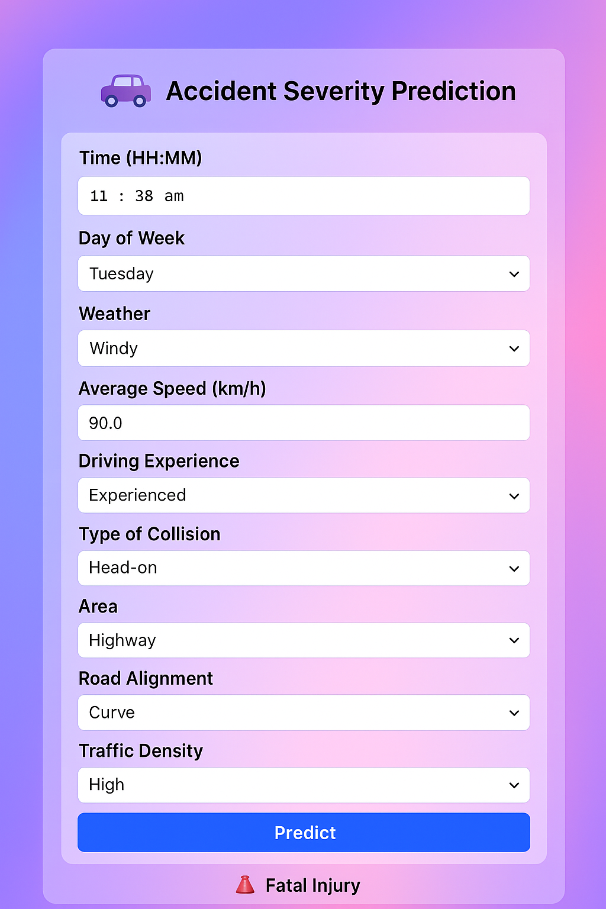
Flask Web Application
1
User Input
Web form captures accident parameters: time, weather, speed, road conditions, and driver details.
2
Processing
Backend applies feature engineering, encoding, and scaling using saved preprocessors.
3
Prediction
Random Forest model classifies severity in real-time with instant results.
4
Display
Clear visual output shows predicted severity level to the user.
The system processes predictions in milliseconds, making it suitable for real-time traffic management applications.

Slide 11
Impact and Future Scope
Key Achievements
Future Enhancements
High Accuracy System
Integration with IoT sensors and GPS for automatic data collection
Live weather and traffic API connections
Mobile application development
Cloud deployment for 24/7 accessibility
Advanced visualization dashboards
94.78% accuracy enables reliable severity predictions for emergency response.
Real-Time Deployment
Flask web interface provides instant predictions for practical use.
Scalable Architecture
Modular design ready for cloud deployment and API integration.
By predicting accident severity in real-time, we enable emergency services to allocate resources more effectively, potentially saving lives through faster, more informed response decisions.

Slide 12
Conclusion
The system accurately predicts traffic accident severity levels — Fatal, Serious, or Slight — using real-time input factors.
The Random Forest model achieved 94.78% accuracy, confirming the system’s efficiency and reliability.
Demonstrates an end-to-end AI workflow from data preprocessing to Flask deployment, laying the groundwork for future integration with IoT and live traffic data.

