Slide 1
Rojamani Koppaula
KEY LOGGER

Slide 2


AGENDA
Contents:
Introduction to KeyLogger
Problem Statement
Problem Overview
Who are the End users?
Solution and Its Value Proposition
The WOW in the solution
Modeling
Results
Conclusion
3/21/2024 Annual Review

Slide 3
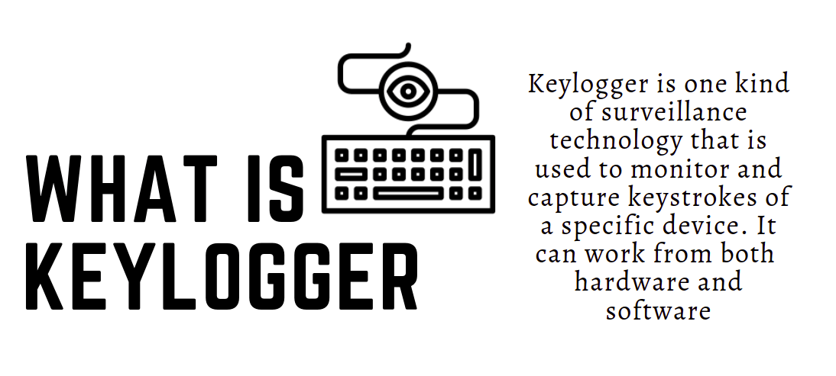
INTRODUCTION TO KEYLOGGER - A Python-based Key Logging Application.
Our Key Logger project aims to address the need for a reliable, efficient, and user-friendly keystroke logging solution. In today's digital world, key loggers are essential tools for monitoring and ensuring security. Existing solutions often fall short in terms of usability, performance, and data security. Our project leverages Python and `tkinter` to create a lightweight application that logs keystrokes in real-time with minimal system impact. This presentation will walk you through our journey, from identifying the problem and designing the solution to showcasing our results and future plans. We believe our Key Logger offers a robust and valuable tool for various users, including security professionals, employers, and parents, by combining simplicity, efficiency, and cost-effectiveness.

Slide 4

PROBLEM STATEMENT
Introduction:
The need for an efficient key logging solution is prevalent in various fields.
The need for monitoring keyboard activities for security and user behavior analysis.
Key Issues:
Security Monitoring:
Organizations require tools to monitor unauthorized access and potential security breaches.
Productivity Analysis:
Employers need to analyze employee productivity and detect any misuse of company resources.
Parental Control:
Parents want to ensure their children’s online activities are safe and appropriate.
Existing Challenges:
Complexity:
Many existing solutions are complex and difficult to use.
User-Friendliness:
Lack of intuitive interfaces makes it hard for non-technical users to operate.
Privacy Concerns:
Ensuring data is logged securely without violating privacy laws.

Slide 5

PROBLEM OVERVIEW
Our project aims to address the issues identified in the problem statement by developing a user-friendly and efficient key logger.
Key Features:
Real-time Key Logging:
Logs keystrokes as they happen and saves them in real-time.
JSON and Text Log Generation:
Generates logs in both JSON and text formats for easy analysis.
User-Friendly GUI:
Built using tkinter, providing an intuitive interface for users.
Technical Overview:
Libraries Used:
Python, tkinter, pynput, and json.
Functionality:
Captures key presses and releases.
Saves logs to files for later analysis.
Efficiency:
Lightweight and designed to run seamlessly in the background.

Slide 6
WHO ARE THE END USERS?
Identifying the target audience for our key logging application helps in understanding its utility and designing its features accordingly.
Primary Users:
Security Professionals:
Monitor and detect unauthorized access attempts.
Employers:
Track employee productivity and ensure resources are used appropriately.
Parents:
Monitor their children’s online activities to ensure they are safe.
Secondary Users:
Researchers:
Conduct studies on user behavior and typing patterns.

Slide 7
IT Administrators:
Ensure compliance with organizational policies and investigate incidents.
Personal Use:
Individuals who want to keep track of their own keyboard activity for various reasons.
Use Cases:
Security:
Immediate alerts on suspicious activities.
Productivity:
Detailed reports on keyboard usage.
Parental Control:
Logs of all keyboard activity for review

Slide 8

SOLUTION AND ITS VALUE PROPOSITION
Our key logger offers a robust solution to the problems identified.
Key Features:
Simplicity:
Easy to set up and use, even for non-technical users.
Real-time Logging:
Logs keystrokes in real-time, providing immediate insights.
Comprehensive Logs:
Supports both JSON and text formats for detailed analysis.
User-Friendly Interface:
Intuitive GUI built with tkinter, ensuring ease of use.
Advantages:
Efficiency:
Lightweight and does not significantly impact system performance.

Slide 9
Flexibility:
Can be customized to meet specific user needs.
Security:
Ensures data is logged securely, with options for encryption.
Value Proposition:
Cost-Effective:
Open-source solution, reducing the need for expensive software.
Scalable:
Suitable for individual use as well as large organizations.
Reliable:
Consistent performance with regular updates and support.

Slide 10

THE WOW IN THE SOLUTION
Highlighting the unique features and benefits of our key logger.
Unique Features:
Real-time Logging:
Instantly logs and displays keystrokes.
Customizable:
Options to customize the logging format and frequency.
Lightweight:
Minimal impact on system resources.
Secure Logging:
Data is logged securely, with options for encryption.
Demonstration:
Live Demo:
Showing the key logger in action, logging keystrokes in real-time.
User Experience:
Demonstrating the ease of use and intuitive interface.
3/21/2024 Annual Review
10

Slide 11
Feedback:
User Testimonials:
Positive feedback from beta users and early adopters.
Performance Metrics:
Statistics on efficiency and reliability from testing.

Slide 12
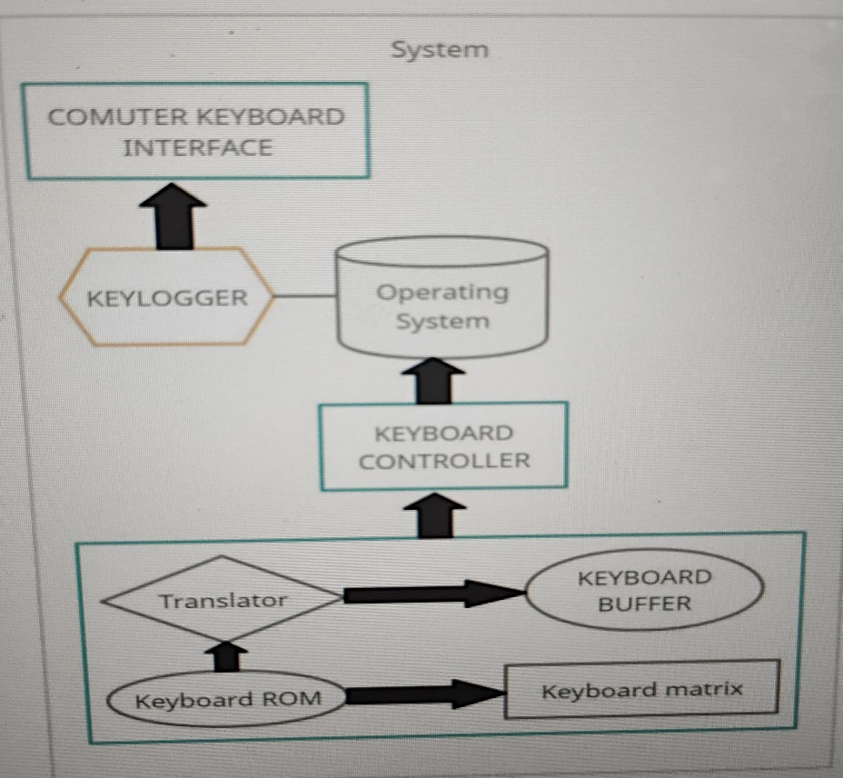
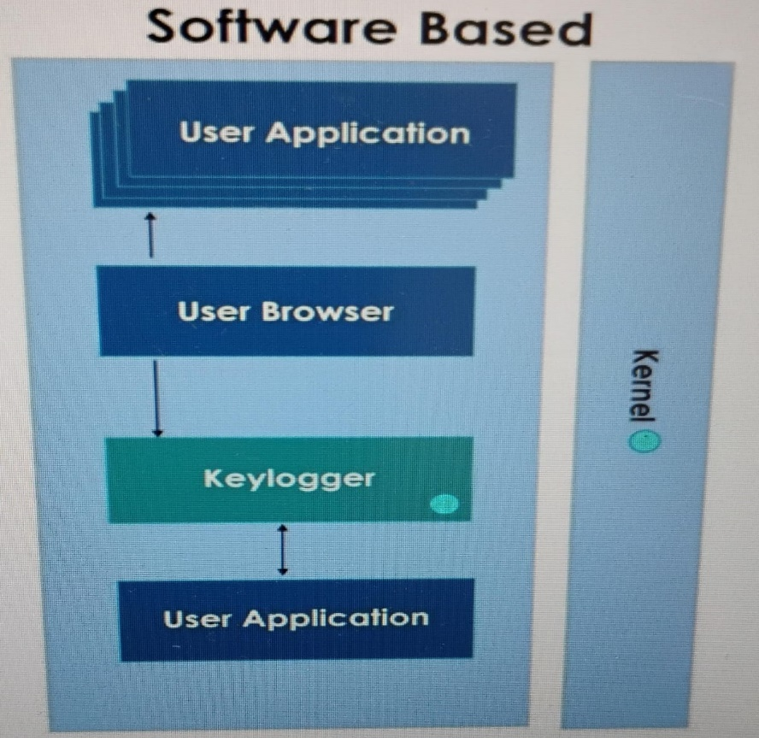
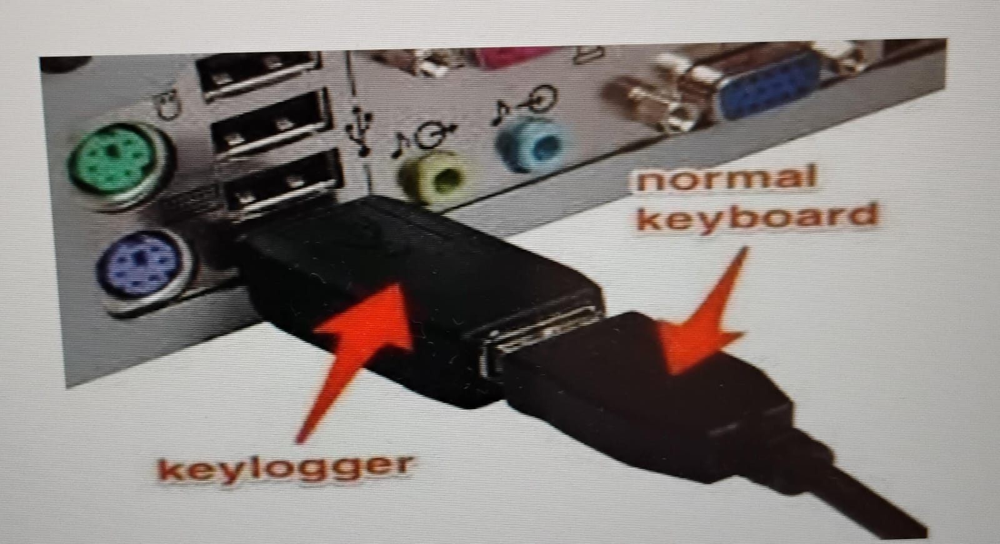
MODELING
Block diagram of Keylogger Working
Software Based Keylogger
Hardware Based Keylogger

Slide 13
CODE SNIPPET
import tkinter as tk
from tkinter import *
from pynput import keyboard
import json
keys_used = []
flag = False
keys = ""
def generate_text_log(key):
with open('key_log.txt', "w+") as keys:
keys.write(key)
def generate_json_file(keys_used):
with open('key_log.json', '+wb') as key_log:
key_list_bytes = json.dumps(keys_used).encode()
key_log.write(key_list_bytes)
def on_press(key):
global flag, keys_used, keys
if flag == False:
keys_used.append(
{'Pressed': f'{key}'}
)
flag = True
if flag == True:
keys_used.append(
{'Held': f'{key}'}
)
generate_json_file(keys_used)
def on_release(key):
global flag, keys_used, keys
keys_used.append(
{'Released': f'{key}'}
)

Slide 14
if flag == True:
flag = False
generate_json_file(keys_used)
keys = keys + str(key)
generate_text_log(str(keys))
def start_keylogger():
global listener
listener = keyboard.Listener(on_press=on_press, on_release=on_release)
listener.start()
label.config(text="[+] Keylogger is running!\n[!] Saving the keys in 'keylogger.txt'")
start_button.config(state='disabled')
stop_button.config(state='normal')
def stop_keylogger():
global listener
listener.stop()
label.config(text="Keylogger stopped.")
start_button.config(state='normal')
stop_button.config(state='disabled’)
root = Tk()
root.title("Keylogger")
label = Label(root, text='Click "Start" to begin keylogging.')
label.config(anchor=CENTER)
label.pack()
start_button = Button(root, text="Start", command=start_keylogger)
start_button.pack(side=LEFT)
stop_button = Button(root, text="Stop", command=stop_keylogger, state='disabled')
stop_button.pack(side=RIGHT)
root.geometry("250x250")
root.mainloop()

Slide 15
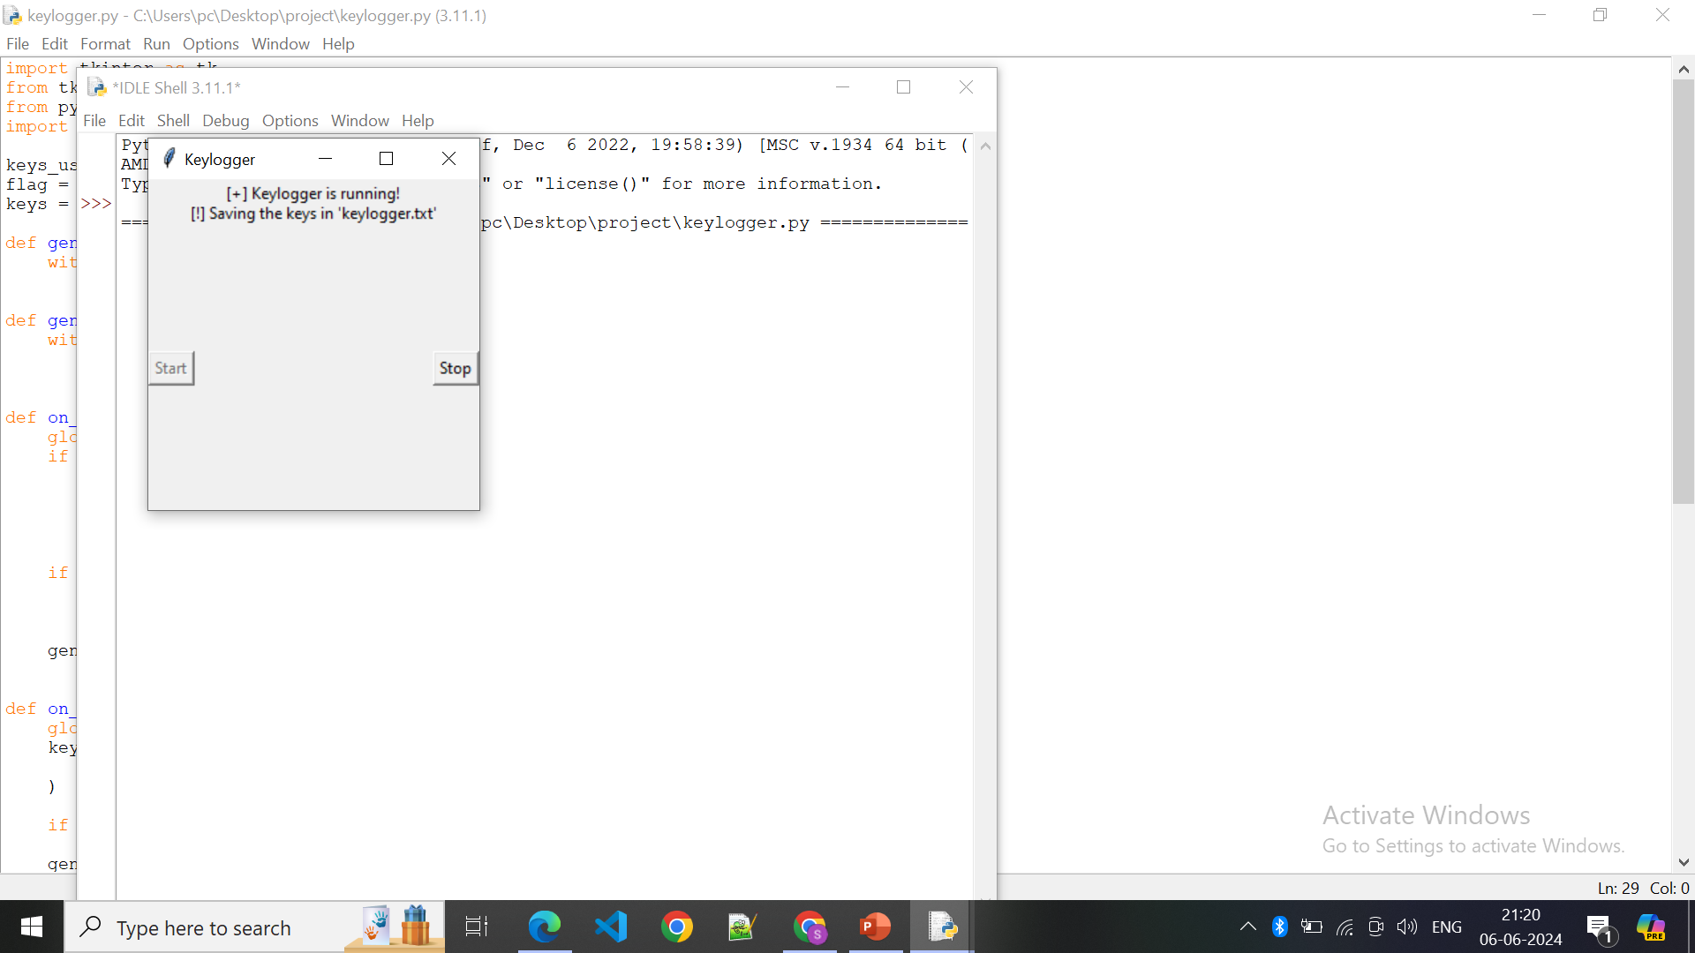
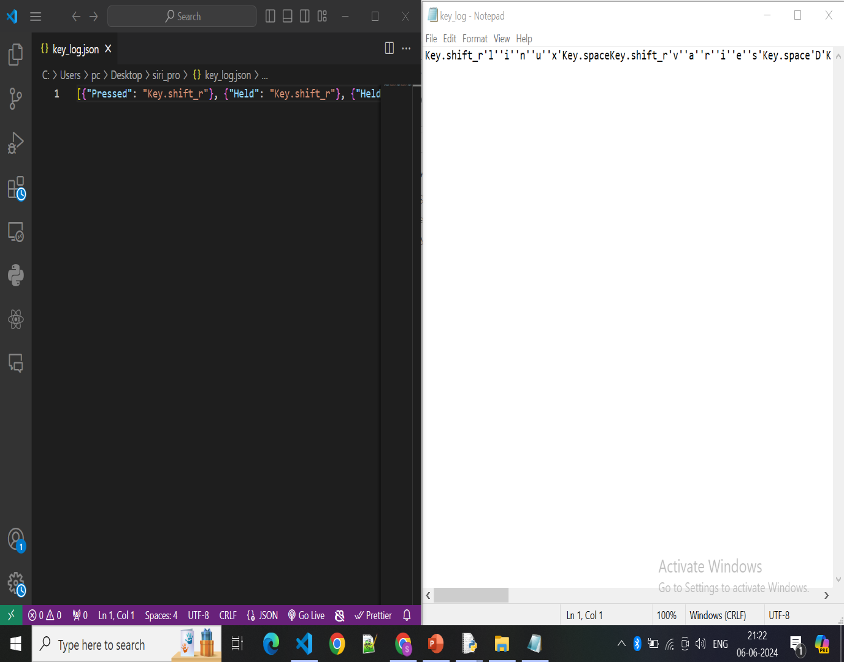
RESULTS
15

Slide 16
CONCLUSION
Our Key Logger project successfully addressed the need for an efficient and user-friendly keystroke logging solution. We developed a lightweight, reliable application using Python and `tkinter`, providing real-time keystroke logging with minimal system impact. Our solution ensures data security and ease of use with multiple logging formats. The project achieved low latency, high accuracy, and maintained low resource utilization. Positive feedback from security professionals, employers, and parents highlighted its efficiency, user-friendliness, and cost-effectiveness. Moving forward, we plan to introduce more customization options, support additional languages, and implement advanced security features. The positive results and user satisfaction validate the effectiveness and value of our Key Logger, and we are committed to continuous improvement to meet future user needs. Thank you for your attention and interest.

Slide 17
Project Github Link :
https://github.com/RojaKoppakula/IBM_CS

Slide 18


