Slide 1
Forecasting Bitcoin and Ethereum Crypto currencies
Using Multi-linear Regression, QDA, KNN, K fold, and LSTM models
Roja Reddy Sareddy and Manizheh Zand
Computer and Electrical Engineering Department Santa Clara University
March 15, 2022
(Computer and Electrical Engineering DeparForecasting Bitcoin and Ethereum Crypto cu
tment)
rrencies

Slide 2
Summary
Why we should be concerned about crypto-currency
Research
Our Model Prediction
Conclusion
(Computer and Electrical Engineering DeparForecasting Bitcoin and Ethereum Crypto cu
tment)
rrencies

Slide 3
Why we should be concerned about crypto-currency
Why we should be concerned about crypto-currency
(Computer and Electrical Engineering DeparForecasting Bitcoin and Ethereum Crypto cu
tment)
rrencies

Slide 4
Bitcoin and Ethereum Cyptocurrencies
Why we should be concerned about crypto-currency
Advantages Disadvantages
Different types of Digital Currency Who should invest
See the ”EVIL” Models
Data Source
(Computer and Electrical Engineering DeparForecasting Bitcoin and Ethereum Crypto cu
tment)
rrencies

Slide 5
Bitcoin
Why we should be concerned about crypto-currency
How and who started?
In 2008, Satoshi Nakamoto, Born: 5 April 1975 (age 46) (claimed); Japan (claimed), wrote an 8 pages white paper, A Peer-to-Peer Electronic Cash System [1]. In 2010, Bitcoin value was $0.0008 and by April 2013, it jumped to $250
Who is accepting bitcoin as a payment[2]?
Microsoft, Wikipedia, Paypal, Starbucks AT & T, Overstock,Twitch, Amazon Home Depot, Whole Food, CheapAir,
Newegg, Namecheap,Rakuten, KFC, Burger King
Values
If you invested $100 in 2010, by today, you would have $ 4.9 billions
(Computer and Electrical Engineering DeparForecasting Bitcoin and Ethereum Crypto cu
tment)
rrencies

Slide 6
Ethereum
Why we should be concerned about crypto-currency
Founder
Vitalik Buterin , 27 year old Russian, came up with the idea when he was 19.
Who is accepting Ethereum as a payment[3]?
OverStock, Travala.com, Snel OpenBazaar, Peddler.com, Galaxus Ethlance, Sirin Labs, Mobisun TapJets
Volumes and Values
Start value in Aug 2015 $.66, and $2,611.43 Mar 11,2022. Bitcoin correlation for Ethereum is 0.916[4]. Your investment of $100 back in 2015, would worth $400,000 today.
(Computer and Electrical Engineering DeparForecasting Bitcoin and Ethereum Crypto cu
tment)
rrencies

Slide 7
Is Bitcoin or Ethereum correlated to the Stock market?
Why we should be concerned about crypto-currency
Historical correlations with Stock market
While bitcoin is often described as an alternative to gold, its historical price action suggests it’s more closely related to stocks[5].
How long does it take to mine one Ethererum and one Bitcoin?
It takes around 7.5 days to mine Ethereum as of September 13, 2021 [6]
Depending on the cost of electricity in a miner’s area, it could potentially cost $73,000 to process one bitcoin in a month’s time[7]
Is it too late to buy Bitcoin now?
The market cap for Bitcoin is $1 Trillion now, the 10th most valuable asset in the world [8]
Bitcoin supply is capped at 21 million by design[8]
(Computer and Electrical Engineering DeparForecasting Bitcoin and Ethereum Crypto cu
tment)
rrencies

Slide 8
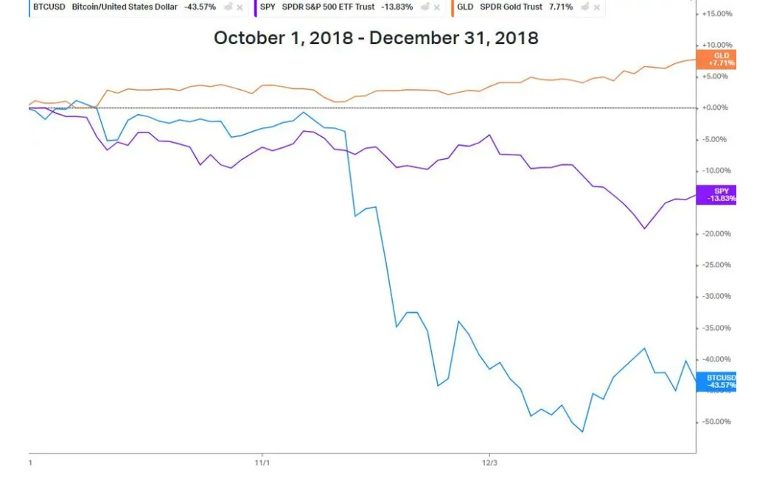
Is bitcoin a ”gold safe-haven”[5]?
Why we should be concerned about crypto-currency
Figure: Gold in 2018 vs SP500 and Bitcoin[5]
(Computer and Electrical Engineering DeparForecasting Bitcoin and Ethereum Crypto cu
tment)
rrencies

Slide 9
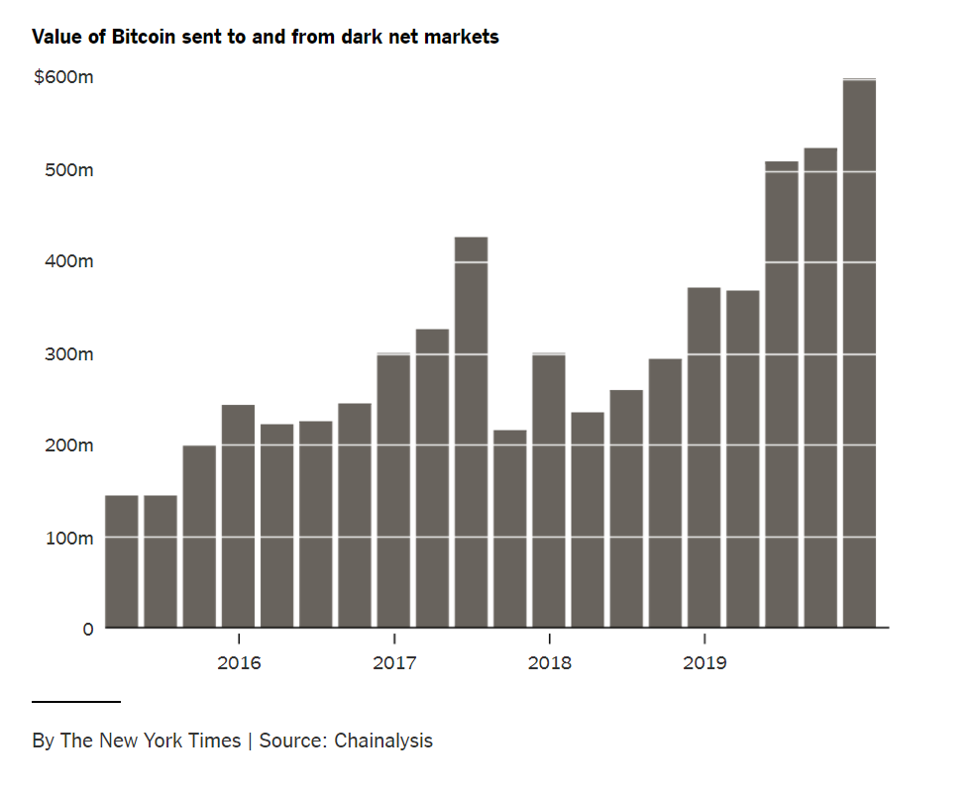
See the Evil
Why we should be concerned about crypto-currency
”Crypto money laundering rises 30%, report finds”[11]
Figure: Bitcoin is still popular among currency speculators, and illicit activity accounts for only 1 percent of all Bitcoin transactions. But that nearly doubled from the previous year. Illegal activity appeared to be one of the few parts of the Bitcoin economy impervious to changes in price, according to Chainalysis’s new Crypto Crime Report[10]
(Computer and Electrical Engineering DeparForecasting Bitcoin and Ethereum Crypto cu
tment)
rrencies

Slide 10
Models
Why we should be concerned about crypto-currency
Deep Learning
LSTM model
Machine learning
Multi-Linear Regression
Quadratic Discriminant Analysis (QDA) K Nearest Neighborhood (KNN)
K-fold Cross validation
(Computer and Electrical Engineering DeparForecasting Bitcoin and Ethereum Crypto cu
tment)
rrencies

Slide 11
Data Source
Why we should be concerned about crypto-currency
NASDAQ
Gold SP 500
Tesla Bitcoin
Investing.com
Ethereum Bitcoin
(Computer and Electrical Engineering DeparForecasting Bitcoin and Ethereum Crypto cu
tment)
rrencies

Slide 12
Research
Research
(Computer and Electrical Engineering DeparForecasting Bitcoin and Ethereum Crypto cu
tment)
rrencies

Slide 13
Long Term Short Term Memory, LSTM model
Research
How important it is to remember the past
Humans don’t start their thinking from scratch every second. As you read this essay, you understand each word based on your understanding of previ- ous words. You don’t throw everything away and start thinking from scratch again. Your thoughts have persistence[9].
(Computer and Electrical Engineering DeparForecasting Bitcoin and Ethereum Crypto cu
tment)
rrencies

Slide 14
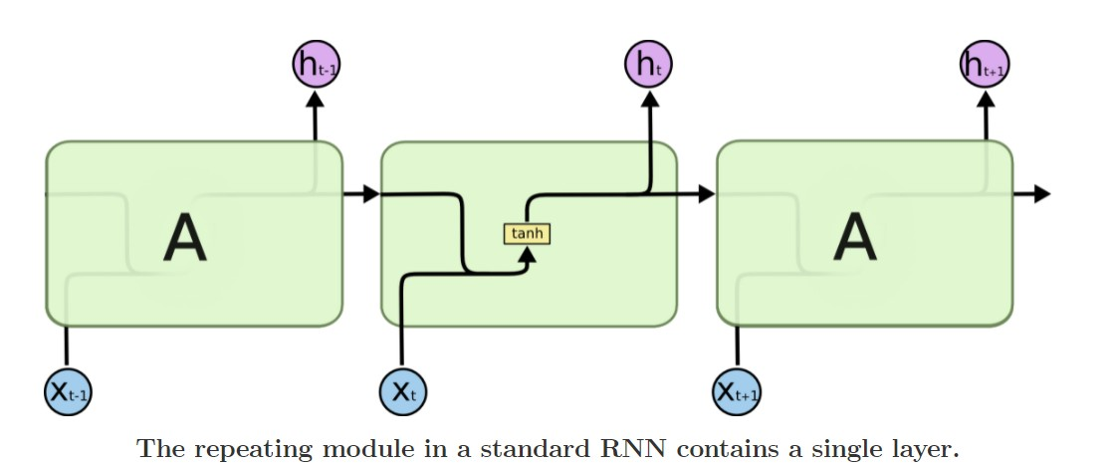
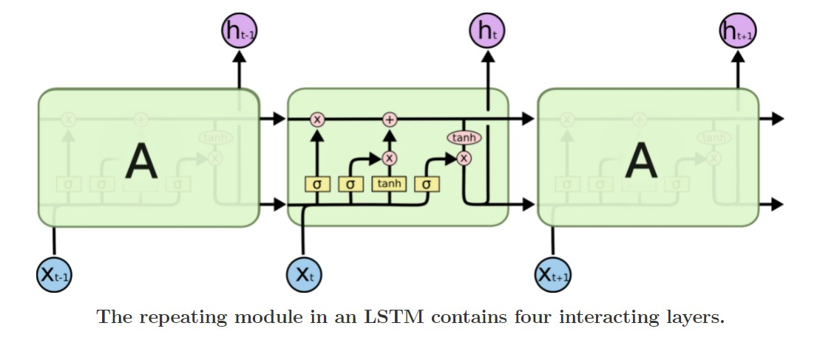
LSTM model vs Standard RNN model
Research
(a) Standard RNN.
(b) LSTM.
Figure: One Layer LSTM vs One Layer Standard RNN[9].
(Computer and Electrical Engineering DeparForecasting Bitcoin and Ethereum Crypto cu
tment)
rrencies

Slide 15
LSTM model
Research
(a) Standard RNN.
(b) LSTM.
Figure: One Layer LSTM vs One Layer Standard RNN[9].
(Computer and Electrical Engineering DeparForecasting Bitcoin and Ethereum Crypto cu
tment)
rrencies

Slide 16
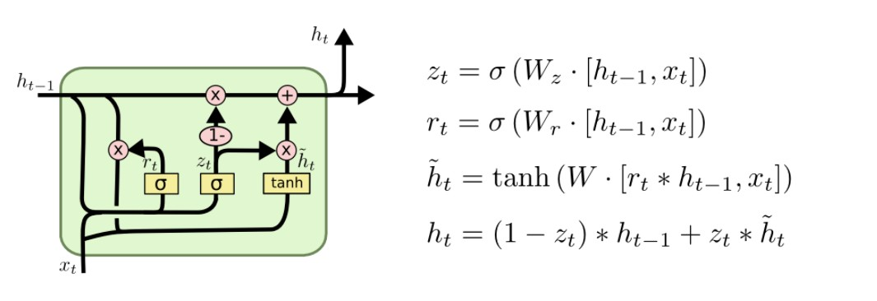
LSTM inner layer
Research
Figure: popular LSTM variant, introduced by Gers Schmidhuber (2000)[9]
(Computer and Electrical Engineering DeparForecasting Bitcoin and Ethereum Crypto cu
tment)
rrencies

Slide 17
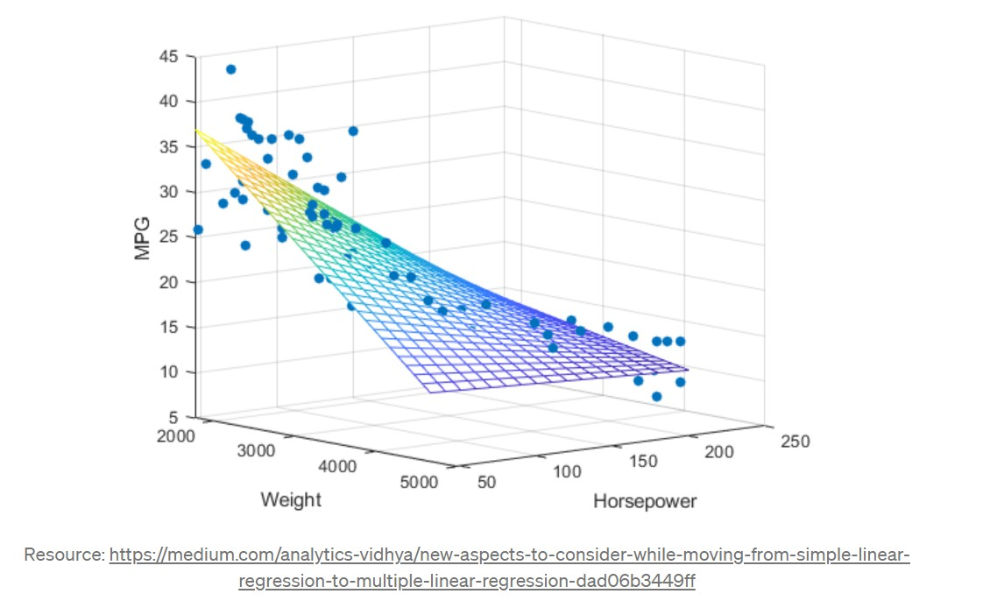
Multi Linear Regression Model[12]
Research
A statistical technique that uses several explanatory variables to predict the outcome of a response variable.
Multiple regression is an extension of linear (OLS) regression that uses just one explanatory variable.
MLR is used extensively in econometrics and financial inference.
Figure: MLR Weight and Horse Power to predict MPG
(Computer and Electrical Engineering DeparForecasting Bitcoin and Ethereum Crypto cu
tment)
rrencies

Slide 18
Multi Linear Regression Model Equations and Definitions, Lecture
Research
yˆ_{i} = β₀ + β₁x_{i1} + β₂x_{i2} + ... + β_{p}x_{ip}
Residual=r_{i} = e_{i} = y_{i} − yˆ_{i}
Standard Residual= r_{i} = e_{i}/stdDev(e_{i}) = √ ^{ei}
MSE(1−pii)
Outlier: A data point whose response does not follow the general data trend (that is, an extreme y value)
High Leverage: A data point with extreme predictor x values
Influential: Observations that unduly influence regression, Cook’s distance
Quantile-Quantile plot will tell the Residuals are normally distributed results.
(Computer and Electrical Engineering DeparForecasting Bitcoin and Ethereum Crypto cu
tment)
rrencies

Slide 19
When we need to use Ridge Regression
Research
In ordinary least squares fitting, estimates regression coeﬀicients
β₀, β₁, ..., β_{p} by minimizing RSS
∑
ˆ
2
RSS =
n
(y − y )
∑
i=1
i i
RSS =
n
(y_{i}β^{ˆ}₀ − β^{ˆ}₁x_{i1}, ..., β^{ˆ}_{p}x_{ip})²
i=1
Ridge regression minimized :
∑
ˆ
2
RSS + λ
p
j=1
β
j
Cross validation is used to estimate λ
(Computer and Electrical Engineering DeparForecasting Bitcoin and Ethereum Crypto cu
tment)
rrencies

Slide 20
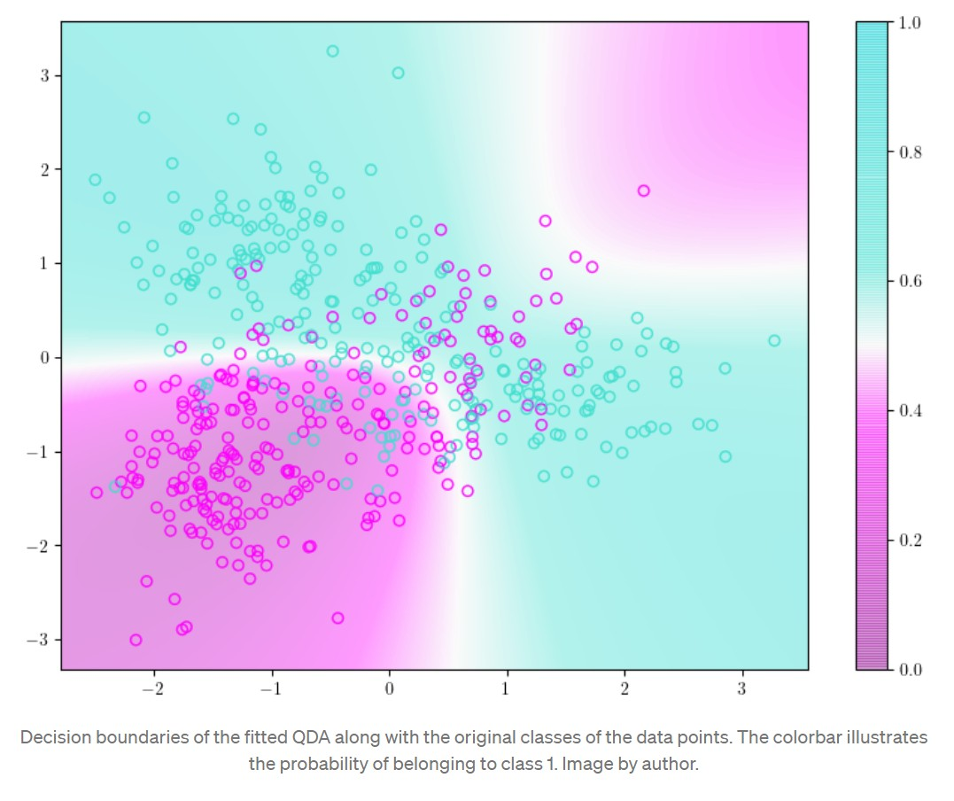
Quadratic Discriminant Analysis
Research
Quadratic Discriminant Analysis (QDA) is a generative model. QDA assumes that each class follow a Gaussian distribution. The class-specific prior is simply the proportion of data points that belong to the class. The class-specific mean vector is the average of the input variables that belong to the class.
Figure: Data over the decision boundary
(Computer and Electrical Engineering DeparForecasting Bitcoin and Ethereum Crypto cu
tment)
rrencies

Slide 21
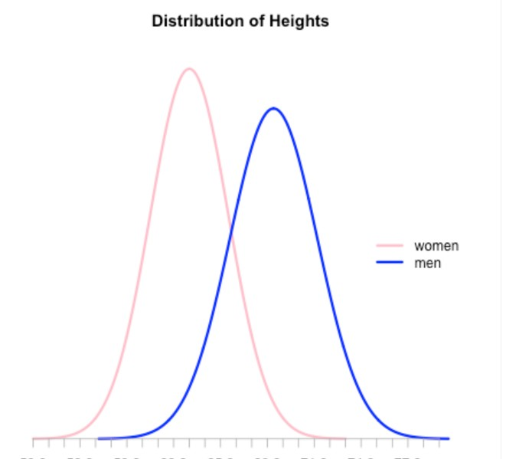
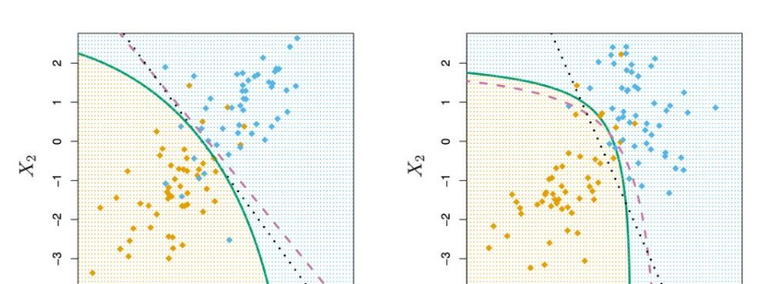
Quadratic Discriminant Analysis equations and definitions
Research
The probability density function for a normal distribution N (µ, σ²) is:
f (x|µ, σ ) =
2 1
exp
−(x−µ)²
√
_{σ}2
2πσ²
For a given distribution the likelihood of the distribution parameters being µ, σ² given the observation x is: L(µ, σ²|x) = f (x|µ, σ²) Classification Rule assign the observation x to the class with the greatest likelihood.yˆ = argmaxL(µ, σ²|x)
(Computer and Electrical Engineering DeparForecasting Bitcoin and Ethereum Crypto cu
tment)
rrencies

Slide 22
K-Nearest Neighborhood Algorithm (KNN)
Research
In statistics, the k-nearest neighbors algorithm (k-NN) is a non-parametric supervised learning method first developed by Evelyn Fix and Joseph Hodges in 1951,[1] and later expanded by Thomas Cover.[2] It is used for classification and regression. In both cases, the input consists of the k closest training examples in a data set. The output depends on whether
k-NN is used for classification or regression.
(Computer and Electrical Engineering DeparForecasting Bitcoin and Ethereum Crypto cu
tment)
rrencies

Slide 23
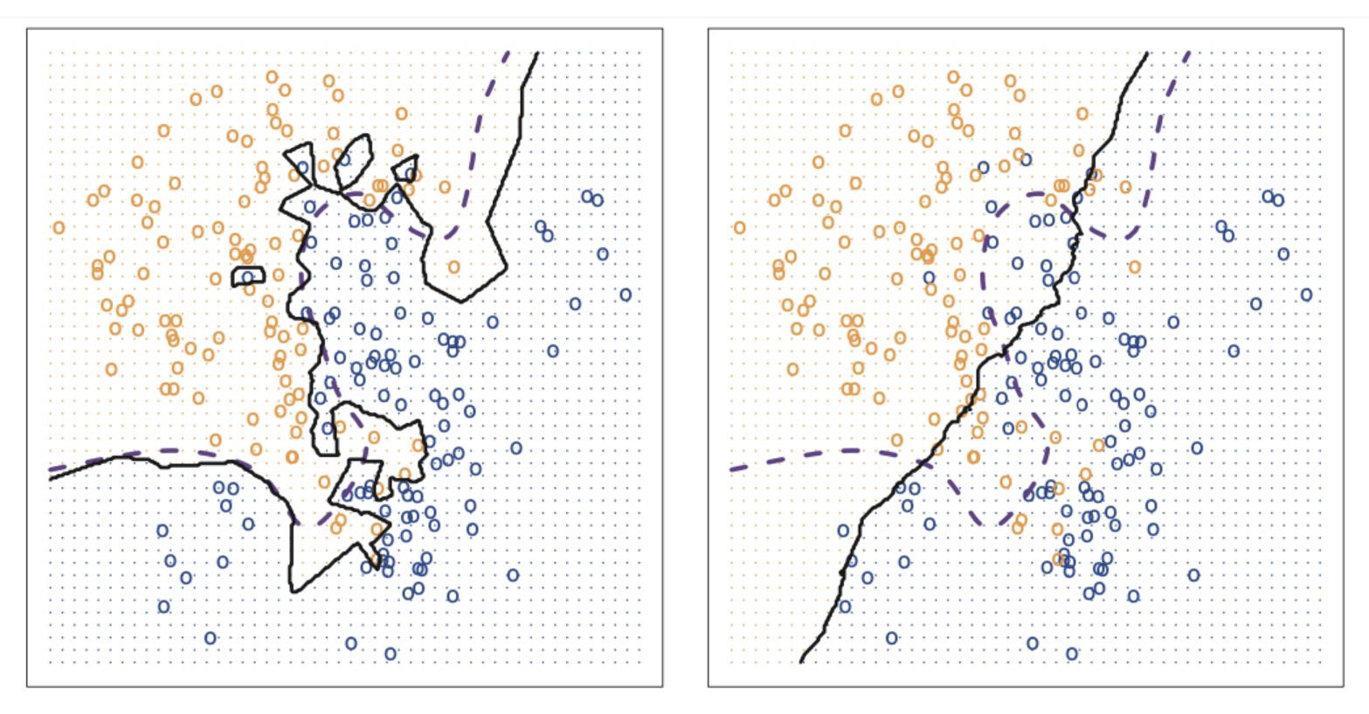
KNN equations and definition
Research
KNN classifier identifies the K points in the training data that are closest to x₀ represented byN₀ the conditional probability for class j
as the fraction of points in N₀ whose response values equal j:
∑
Pr = (Y = j|x = x ) =
1
(I(y = j)
0
K
i
Classifies the test observation x₀ to the class with the largest probability.
Figure: Boundary decision KNN
(Computer and Electrical Engineering DeparForecasting Bitcoin and Ethereum Crypto cu
tment)
rrencies

Slide 24
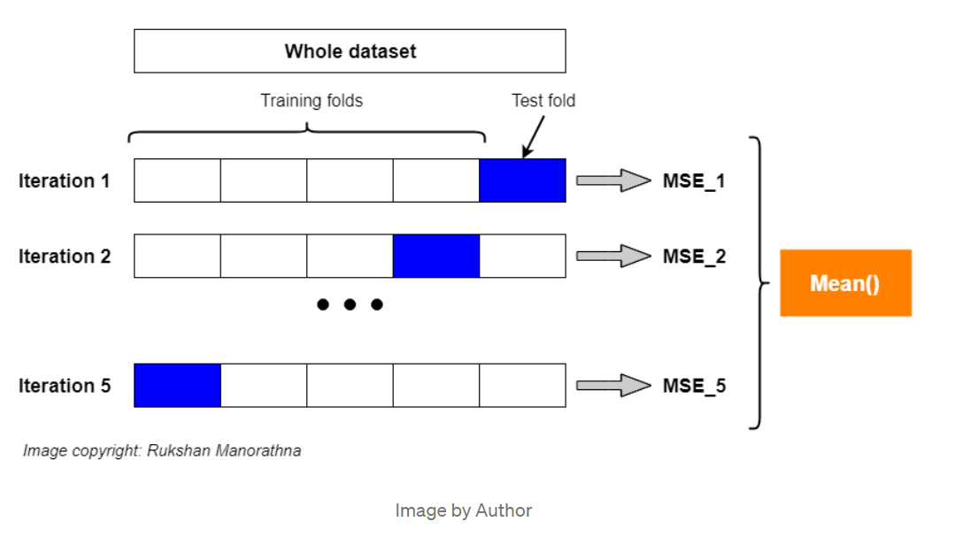
K-fold Cross Validation
Research
It is a data partitioning strategy using data to build a more generalized model
The intention is to train data to predict the ”unseen” data avoiding over-fit
It used to evaluate a model’s performance It is used for hyper-parameter tuning
LOOCV is a special case, k=n; useful working with small dataset
Figure: 5-fold cross-validation for evaluating a model’s performance
(Computer and Electrical Engineering DeparForecasting Bitcoin and Ethereum Crypto cu
tment)
rrencies

Slide 25
Our Model Prediction
Our Model Prediction
(Computer and Electrical Engineering DeparForecasting Bitcoin and Ethereum Crypto cu
tment)
rrencies

Slide 26
Hypothesis
There exists a positive correlation between the Price of Bitcoin(ETH) for a day and Price of Tesla,gold and S&P Stocks.
Relevant Null Hypothesis:
H0: There is no relationship between the Price of Bitcoin(ETH) and Price of Tesla,gold and S&P Stocks.
Alternative Hypothesis:
H1: There exists a relationship between the Price of Bitcoin(ETH) and Price of Tesla,gold and S&P Stocks.

Slide 27
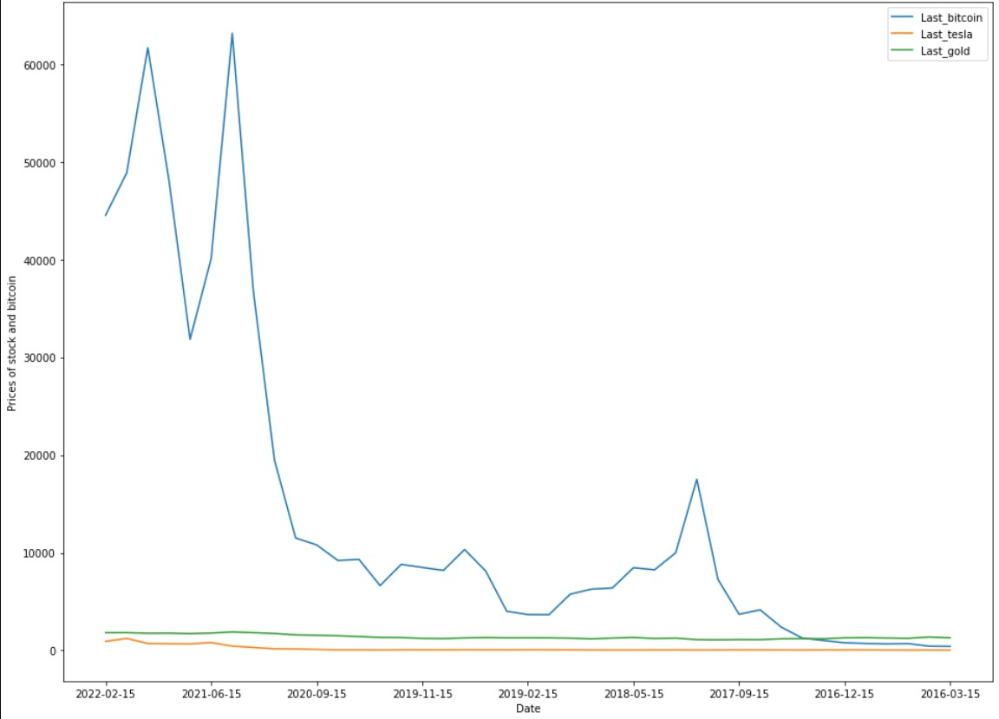
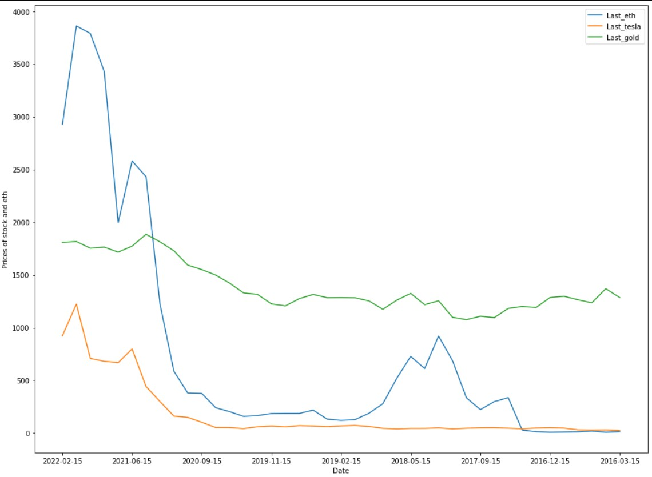
How Bitcoin and Ethereum did in 2018
Our Model Prediction
Figure: Bitcoin crash and recovery vs Gold and Tesla
Figure: Ethereum crash and recovery vs Gold and Tesla
(Computer and Electrical Engineering DeparForecasting Bitcoin and Ethereum Crypto cu
tment)
rrencies

Slide 28
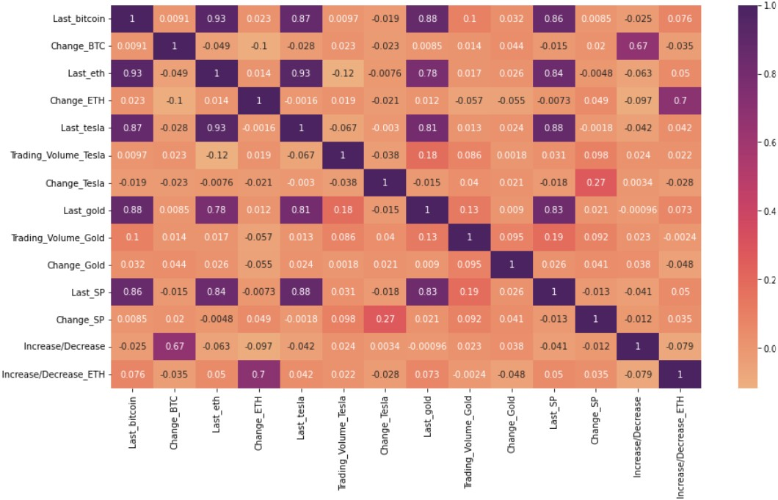
How Bitcoin and Ethereum are correleted to the stock market?
Our Model Prediction
Figure: Correlation
(Computer and Electrical Engineering DeparForecasting Bitcoin and Ethereum Crypto cu
tment)
rrencies

Slide 29
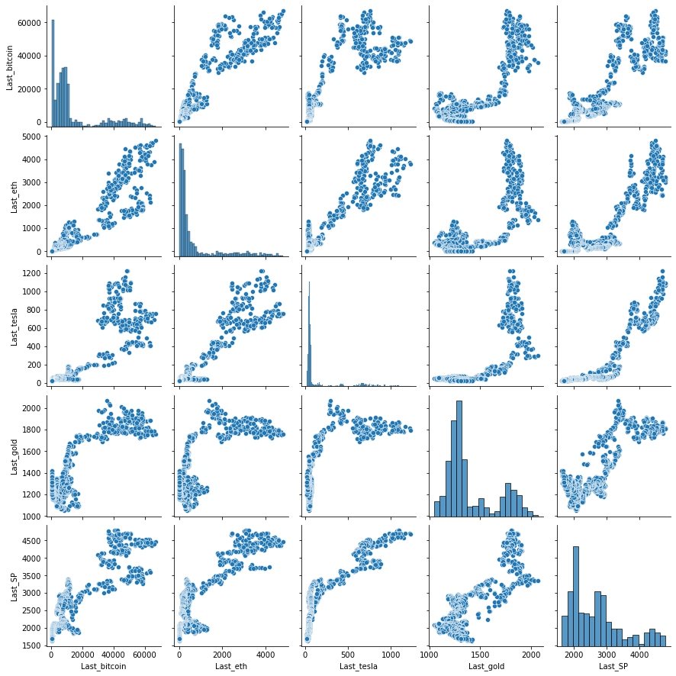
Pairwise Plot

Slide 30
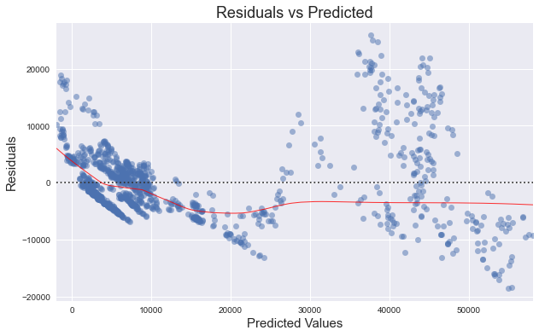
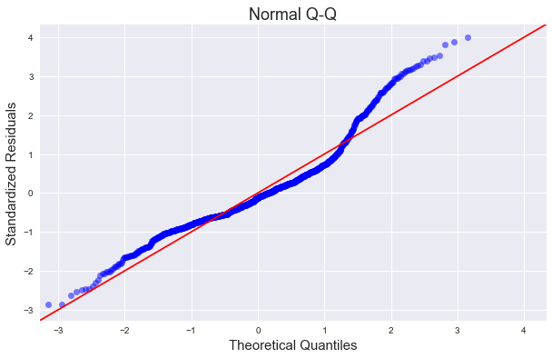
Diagnostic Plots

Slide 31
Conclusion
Conclusion
(Computer and Electrical Engineering DeparForecasting Bitcoin and Ethereum Crypto cu
tment)
rrencies

Slide 32
What we learned
Conclusion
Models pros and cons?
We used the following models: Multi-Linear Regression
Quadratic Discriminant Analysis (QDA) K Nearest Neighborhood (KNN)
K-fold Cross validation
Long Term Short Term Memory (LSTM)
(Computer and Electrical Engineering DeparForecasting Bitcoin and Ethereum Crypto cu
tment)
rrencies

Slide 33
References
[1]"Using machine learning to predict future bitcoin prices" https://towardsdatascience.com/using-machine-learning-to-predict-future-bitcoin-prices-6637e7bfa58f
[2]"Time-Series Forecasting: Predicting Stock Prices Using An LSTM Model" https://towardsdatascience.com/lstm-time-series-forecasting-predicting-stock-prices-using-an-lstm-model-6223e9644a2f
[3]" There are 23 bitcoin datasets available on data.world.” https://data.world/datasets/bitcoin
[4]"Ethereum Historical Dataset" https://www.kaggle.com/prasoonkottarathil/ethereum-historical-dataset
[5]" Is bitcoin an uncorrelated asset?" https://www.marketwatch.com/story/is-bitcoin-an-uncorrelated-asset-these-stocks-and-funds-boast-correlations-higherand-lowerthan-coinbase-11622826320

Slide 34
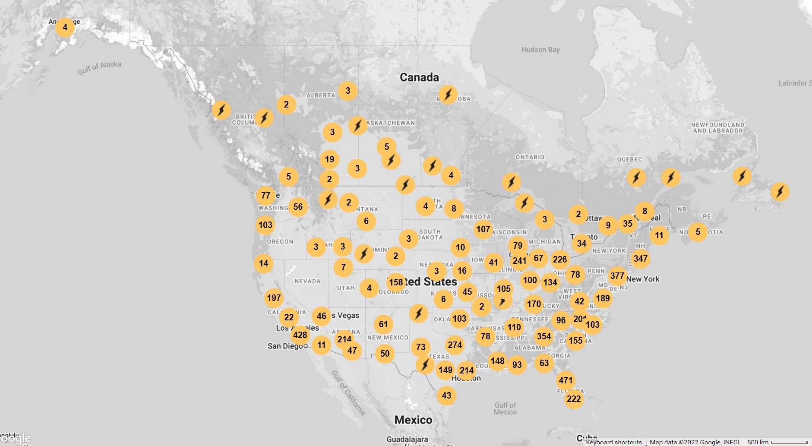
The End
Figure: Some of Bitcoin ATM locations! Are we late?
(Computer and Electrical Engineering DeparForecasting Bitcoin and Ethereum Crypto cu
tment)
rrencies

