Slide 1
Australia Retail Turnover
Trends, drivers, seasonality & forecasting (Tableau Desktop)
Rojan Poudel
Presentation

Slide 2
Why collect retail turnover data? (Business demand)
Business questions we answer
Decision support needs
1) How has retail turnover changed over time?
2) Which states drive the largest share?
3) Which industries drive turnover the most?
4) Which months are consistently higher/lower?
5) What does the near-term future look like (forecast)?
Monitor consumer demand trends (growth patterns/declines).
Compare state and industry performance.
Determine seasonal trends for hiring, inventory, and promotions.
Use for budgeting and planning purposes.
Inform policy and investment choices (public and private sectors)
Notes:
[Sources]
- https://www.abs.gov.au/methodologies/retail-trade-australia-methodology/mar-2025

Slide 3
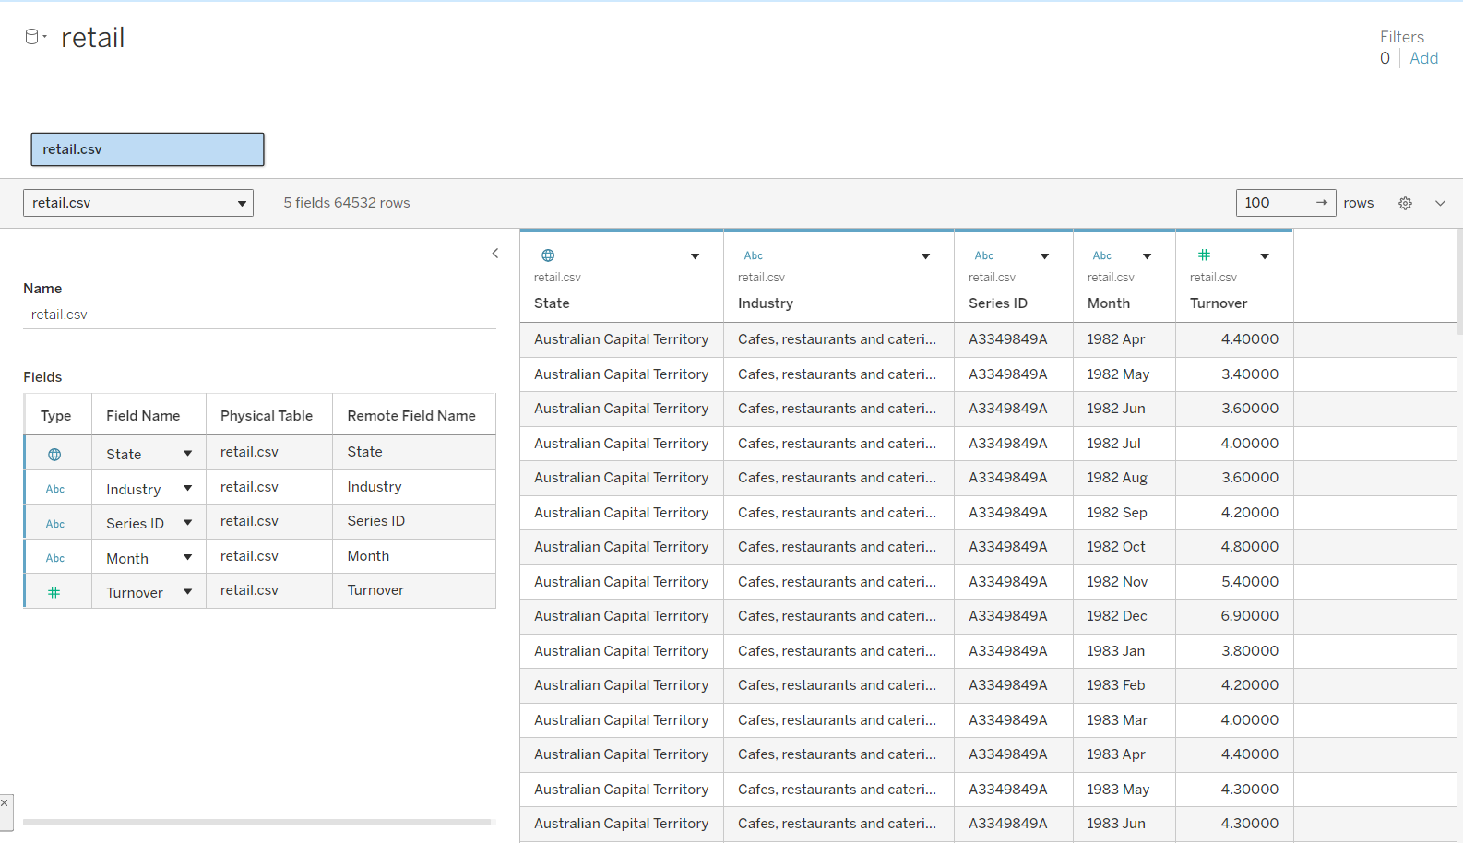
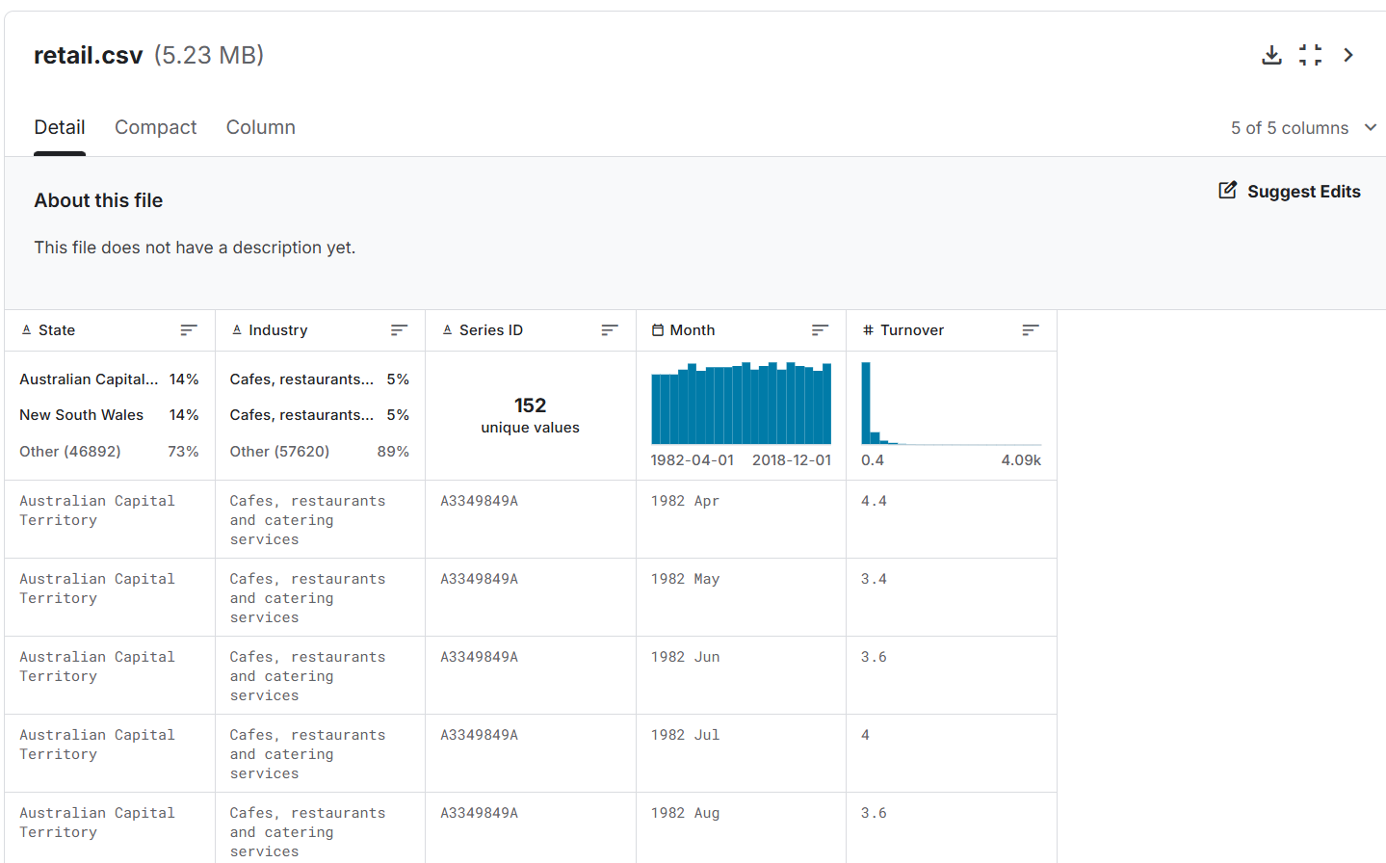
Dataset overview
dataset preview screenshot
Source & structure
Public dataset (Kaggle) based on Australian retail turnover
Granularity: monthly time series
Coverage: states/territories and retail industries
Typical fields: State, Industry, Month, Turnover, Series ID
Rows: ~64k (enough for robust visualization)
Metric definition (Turnover)
Retail turnover is the value of sales/takings by retail businesses, reported monthly and categorized by industry and state/territory.
Notes:
[Sources]
- https://www.kaggle.com/datasets/kanyaweechomming101/australia-monthly-retail-turnover-data
- https://www.abs.gov.au/methodologies/retail-trade-australia-methodology/mar-2025

Slide 4
Research questions, hypotheses & approach
Analytics layers (what we did)
Research questions
How has total retail turnover changed over time?
Which states contribute the most to turnover?
Which industries contribute the most to turnover?
Is there strong month-by-month seasonality?
Can we forecast near-term turnover using time-series methods?
Descriptive analytics:
• Trends over time
• State/industry comparisons
• Seasonality (heatmap)
Predictive analytics:
• Forecasting (time series)
• Trend model / regression (R², equation)
Hypotheses (examples)
H1: Turnover shows a significant upward long-run trend.
H2: Turnover differs across states/territories (uneven contribution).
H3: Turnover has recurring seasonal peaks (e.g., holiday months).
H4: Time-series forecasting predicts short-term turnover within a confidence range.

Slide 5
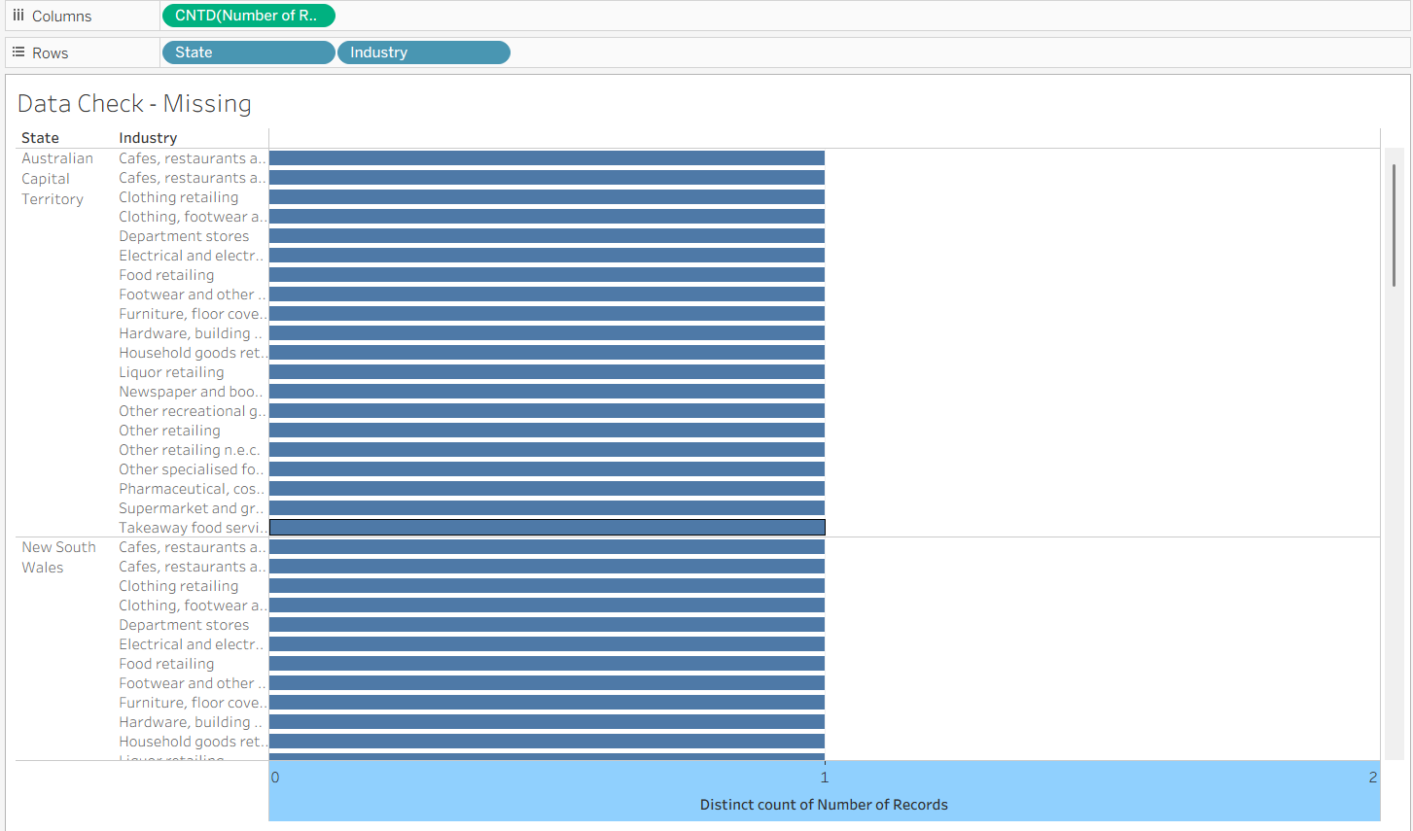
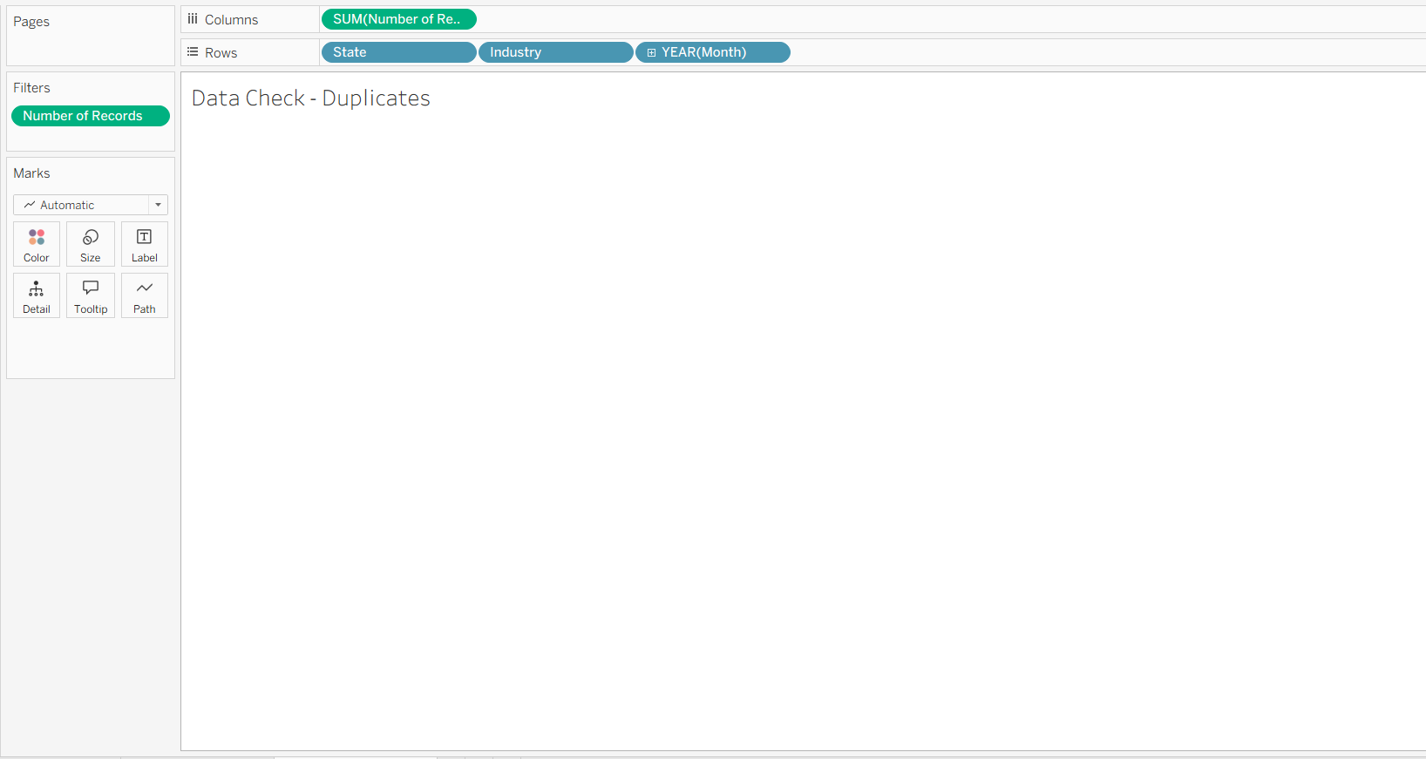
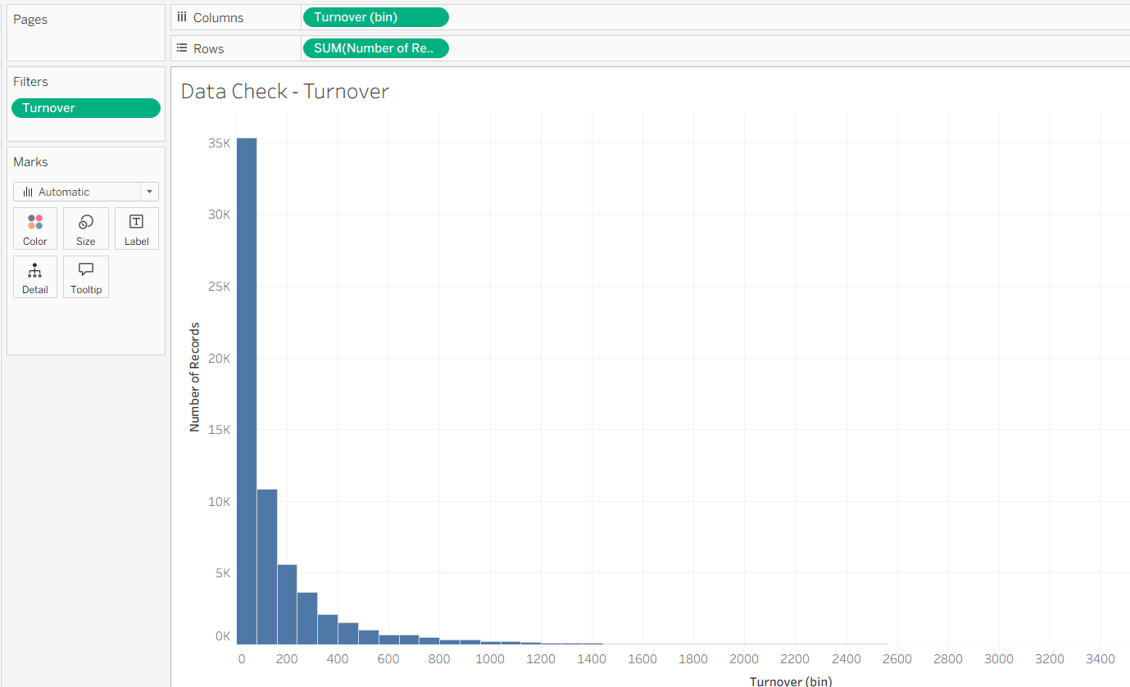
Data preparation & readiness checks
Screenshots evidence
What we prepared / cleaned
Converted Month to a proper Date type
Created Turnover_Clean to remove invalid negatives
Created Year, Month Name, Year-Month fields for analysis
Checked missing values (State/Industry)
Checked duplicates (State–Industry–Month uniqueness)
Reviewed distribution/outliers with histogram

Slide 6
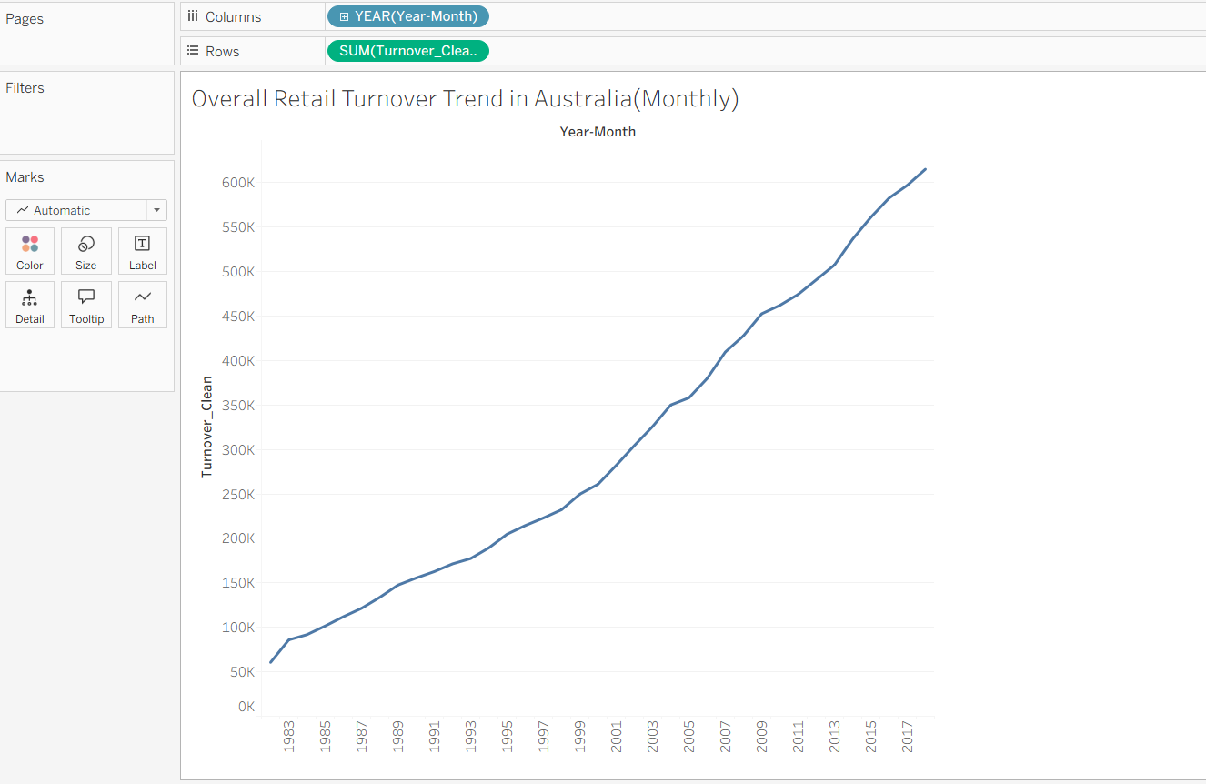
Descriptive Insight 1: Overall trend
How total turnover changes over time
On the whole, the retail turnover in Australia has been steadily increasing over the years, with the most rapid growth being recorded after the year 2000 and, more so, after 2013.

Slide 7
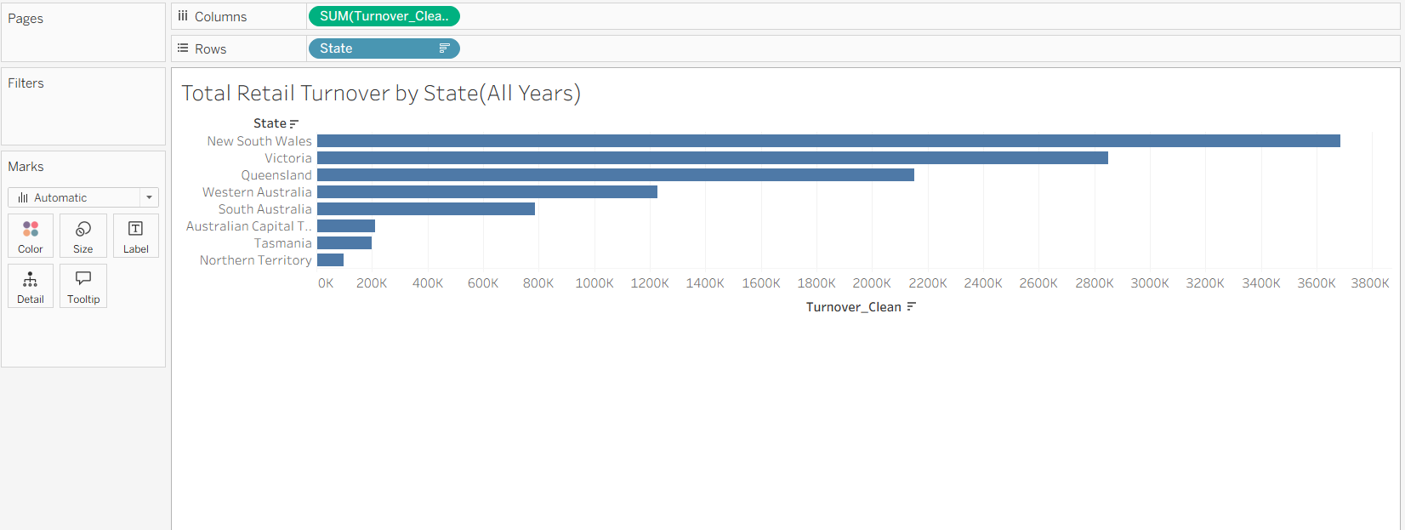
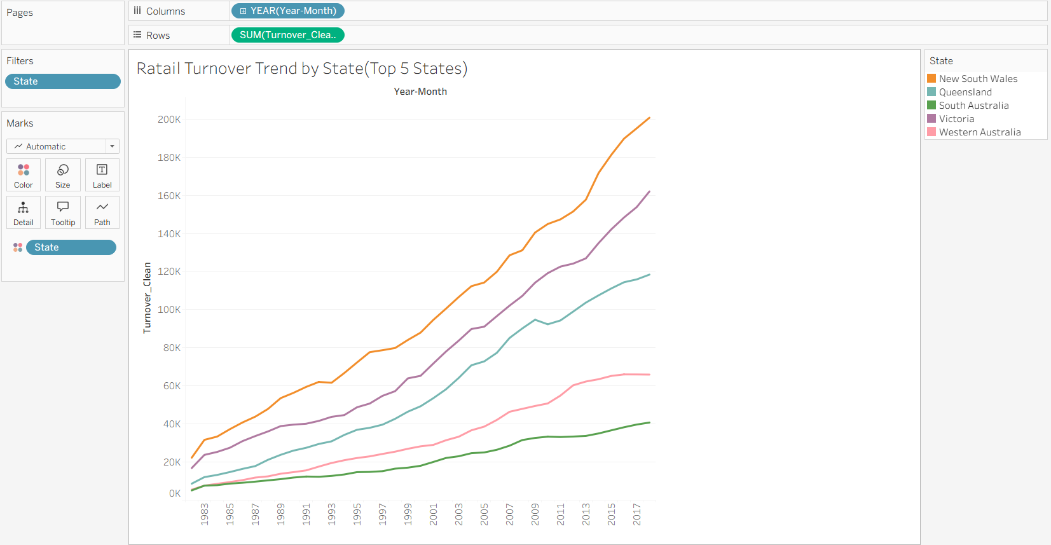
Descriptive Insight 2 : State differences
Which states contribute the most (and how they trend)
The retail turnover is dominated by the larger states of NSW and Victoria, followed by Queensland, while the smaller territories account for a relatively smaller share.
All the larger states record an increase in retail turnover over the years, with NSW and Victoria recording the most rapid growth, Queensland recording a steady growth, and South Australia recording the slowest growth among the top five states.

Slide 8
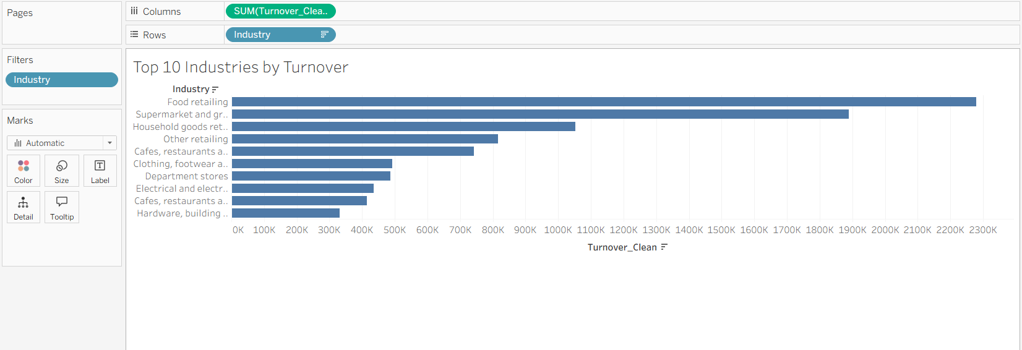
Descriptive Insight 3: Industry leaders
Top industries by total turnover
The retail sector turnover is highly concentrated, with food and supermarket sectors contributing the most, and discretionary sectors such as clothing, electronics, and department stores contributing less.
This analysis will enable the decision-maker to prioritize investment and forecasting in the essential sectors first and then use the discretionary sectors to track consumer confidence.

Slide 9
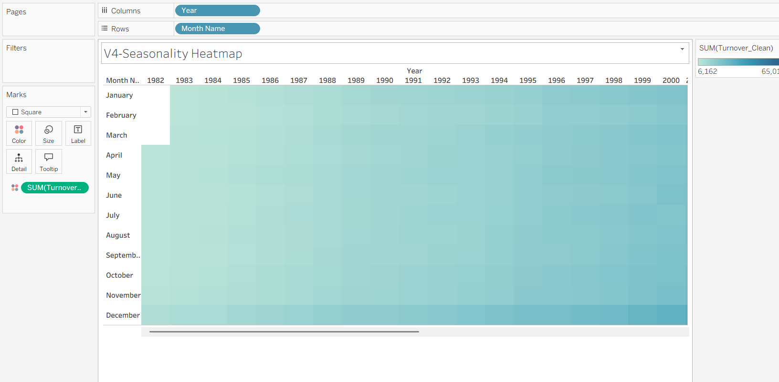
Descriptive Insight 4: Seasonality
Monthly patterns across years (heatmap)
This heatmap provides information on the growth and seasonality of the turnover, which increases every year and also changes every month.
Notes:
[Sources]
- https://www.abs.gov.au/articles/changes-seasonality-retail-turnover

Slide 10
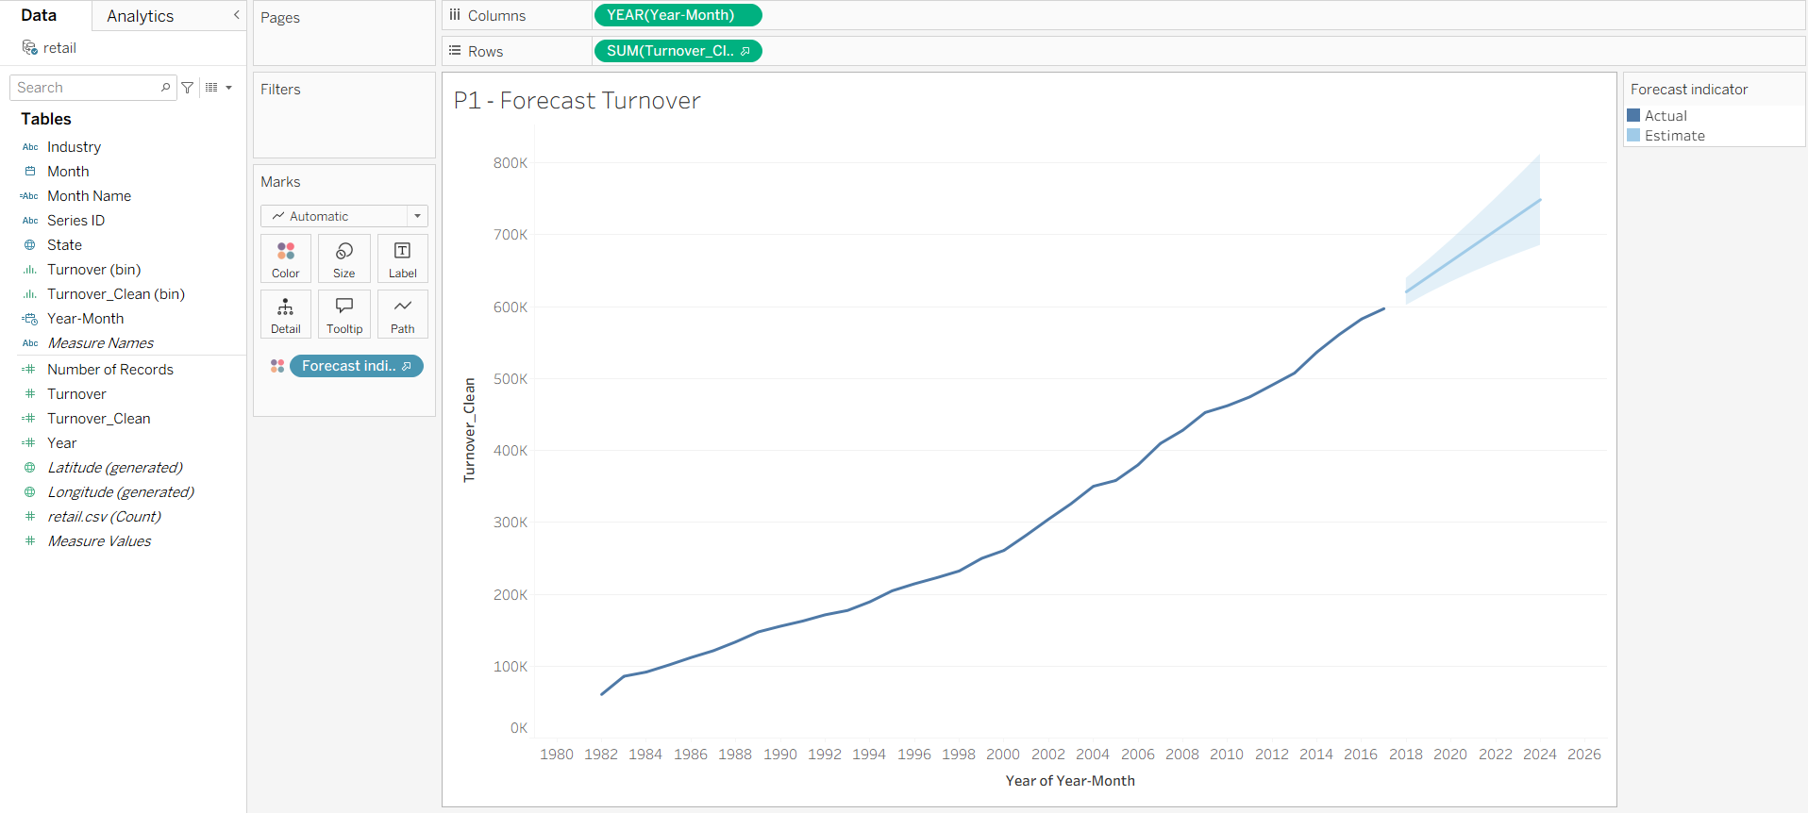
Predictive Analysis 1: Time-series forecast
Forecasting future turnover (Tableau Forecast)
This forecast indicates that retail turnover will continue to grow, and the shaded area represents the uncertainty of our predictions as we move further into the future.
Forecast: This is a prediction based on past data. The confidence band represents risk/uncertainty and should be used for planning purposes rather than predictions.
Notes:
[Sources]
- https://www.abs.gov.au/articles/changes-seasonality-retail-turnover

Slide 11
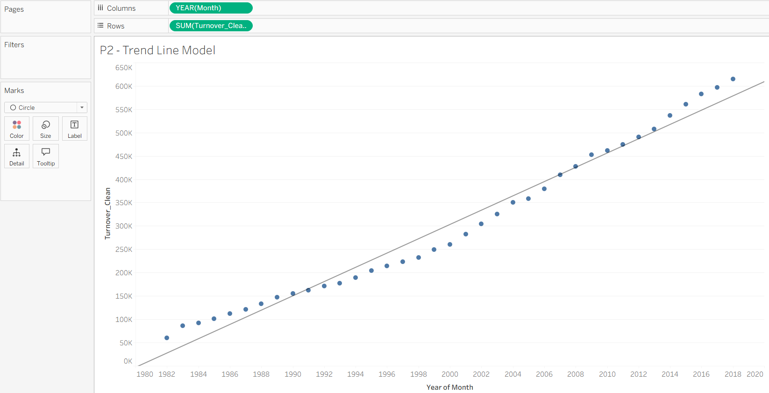
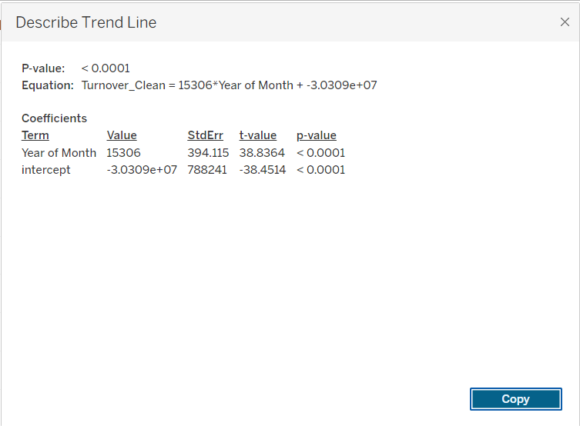
Predictive Analysis 2: Trend model / regression
Trend line model (with R²)
Turnover grows rapidly over time (slope = 15,306 per year, p-value < 0.0001).
The trend line is a simple prediction tool, and the later years indicate that perhaps the growth is no longer linear.
The intercept is simply where the line would be if Year = 0, which doesn’t have any practical meaning.

Slide 12
Analytics layers & BI scenario & Model evaluation & modelling alternatives
What we did
How stakeholders use it
How we would check the forecast
Limits + better options
Descriptive: highlighted the trend, top states/industries with the highest turnover, and monthly seasonality.
Predictive: applied a simple forecast to predict the future turnover.
Goal : convert data into actions (stock, staff, and budgeting decisions).
Operations: make informed decisions about staffing and inventory to match peak periods.
Finance: set budgets and track financials by applying (YoY/MoM) growth trends.
Managers: review performance data for various states and industries to focus on poor-performing regions.
Alerts: receive notifications about unexpected changes to make informed decisions by reforecasting.
Simple linear trend models can sometimes neglect abrupt changes or variations in growth rates.
More complex patterns can be handled by including other variables such as lagged variables, rolling averages, or tree-based models. Models such as ETS or ARIMA can also be used to handle seasonality and trend variables.
Set aside the last 12 months of data for testing purposes.
Test the accuracy of the model using MAE (Mean Absolute Error) and MAPE (Mean Absolute Percentage Error) and display the results in an Actual vs. Forecast graph.
Assess the forecast errors. If there are months that have errors, then it is a sign that the model requires improvement.

Slide 13
Big Data context & scalable analytics pipeline & Visualization rationale for stakeholders
If this becomes ‘Big Data’
Simple scalable workflow
Why these charts (easy for decisions)
Having data at the store and SKU level gives more insight than having data at the monthly level.
Having data at the daily or real-time level gives more lead time to react to changes in demand.
Adding other variables such as price, promotions, income levels, and population size gives more accurate forecasts.
A good data pipeline has a clear workflow: collect, clean, integrate, analyze, model, and monitor. This is an end-to-end process that supports scalable insights.
Data validation, such as checking for missing values and outliers, ensures that the data is reliable. A change log is used to record all changes made, which supports traceability.
Access control is used to protect sensitive data. Reporting is done at an aggregated level to ensure that sensitive data is not exposed
Line Chart: Best for displaying trends over a period of time, making it easy to see where there is growth or a decline.
Bar Chart: Excellent for comparing data from different states or industries.
Heatmap: Good for seeing the peaks of different months at a glance.
Forecast Line: Provides additional information to help with planning and budgeting decisions.
Design Tip: Use each chart to communicate one message.

Slide 14
Ethics, limitations
Ethics / privacy / security
Steps involved in data cleaning (dealing with duplicates, missing values) could impact results.
I record all modifications and do not manipulate data to “force” a particular result.
Although the data is public, I am not allowed to identify specific individuals or small groups of people.
I am only reporting aggregate results (state, industry, month) to preserve anonymity.
I am not claiming “cause and effect” if the analysis is simply illustrating trends/correlations.
Limitations
Key drivers (inflation, income, population, policy/events) are not given for the data set, so we can only discuss trends and not confirm the causes of the trends.
Linear trend line/forecast may underestimate or overestimate if there are changes or shocks in growth.
State/industry/month level of data means that differences at the local or business level are masked.
Notes:
[Sources]
- https://www.kaggle.com/datasets/kanyaweechomming101/australia-monthly-retail-turnover-data
- https://www.abs.gov.au/methodologies/retail-trade-australia-methodology/mar-2025

Slide 15
Conclusion
In conclusion, from my analysis, it is clear that the retail turnover in Australia has been steadily increasing over the years, with the main contribution coming from the major states and the essential retail industries. The results from the seasonality analysis show the monthly demand patterns that can be used to make decisions, while the models show that the retail turnover will continue to increase in the future.
Notes:
[Sources]
- https://www.kaggle.com/datasets/kanyaweechomming101/australia-monthly-retail-turnover-data
- https://www.abs.gov.au/methodologies/retail-trade-australia-methodology/mar-2025

