Slide 1
Library Management System
Database Project
Group Members:
Rojan Poudel
Nikesh Adhikari
Course: DBMS
Instructor/Tutor: Abhinash Jha

Slide 2
Project Overview
Purpose: Make it easy to manage books, members, staff, and borrowing transactions.
Achievements:
Drafted a detailed Enhanced Entity-Relationship Diagram (EERD)
Created a normalized relational database schema
Implemented and tested using SQL Server and MongoDB
Key Features:
Data accuracy and consistency
Security and role awareness
Multi-user support and efficiency

Slide 3

Database Design
Key Entities: Books, Members, Staff, Borrowing Transactions
Relationships:
  1-to-many (Members → Borrowing)
  Many-to-many resolved via Borrowing Transactions table
Specialization: Staff → Librarian, Admin
Normalization: Ensures minimal redundancy and consistent data

Slide 4
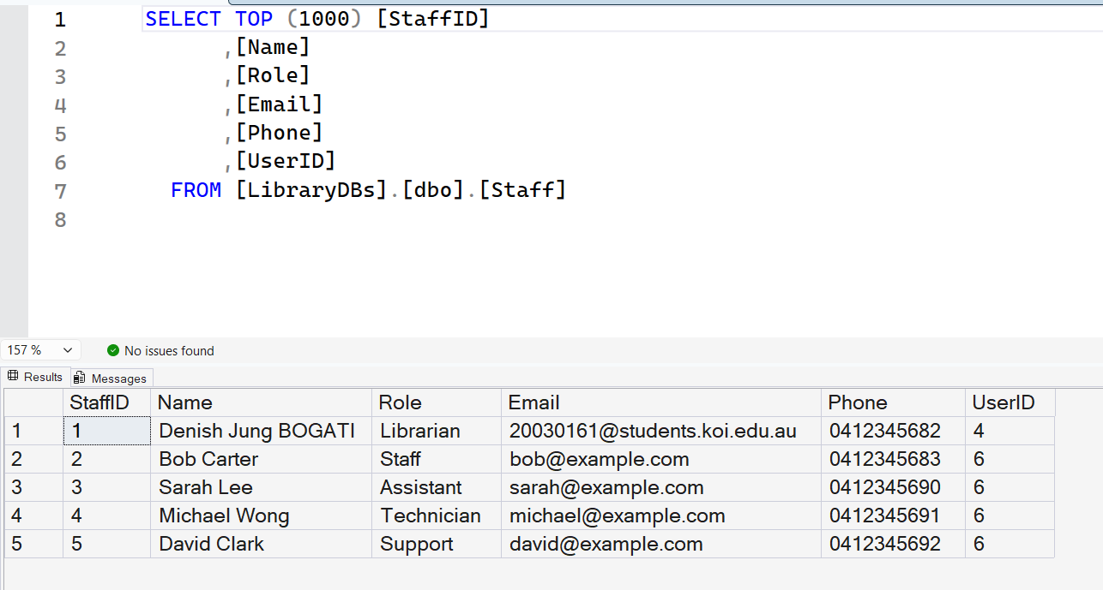
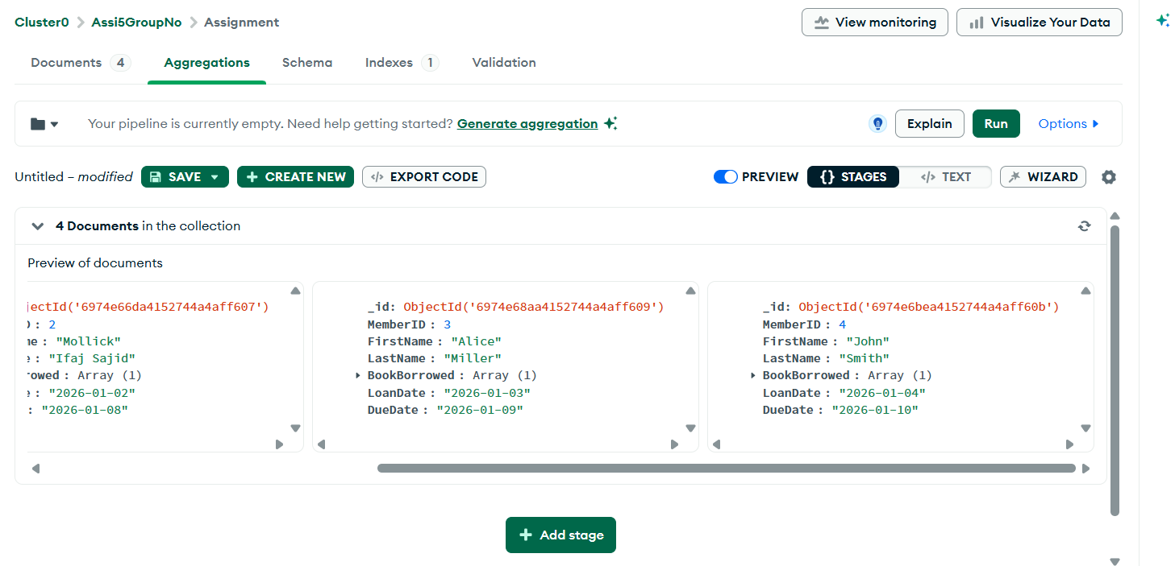
SQL & NoSQL Implementation
SQL Server: Tables, primary & foreign keys, constraints, sample data
MongoDB: Collection for flexible data, documents inserted, queries tested
Advantages:
  SQL for structured data
  NoSQL for flexible, scalable storage

Slide 5
Transaction Management & Concurrency
Ensures multi-user updates without conflicts
Features:
  Atomic transactions, rollback for errors
  Access control for sensitive data
  Backup and recovery for reliability
Example: Borrowing a book updates both member and book records

Slide 6
Conclusion
Database fulfills system requirements: secure, efficient, and scalable
Effectively supports day-to-day library operations
Demonstrates real-world application of database concepts (SQL + NoSQL)
Shows teamwork, planning, and ethical data handling

Slide 7
References
Microsoft Learn (SQL Server Docs)
MongoDB Manual
Studio 3T Documentation
Elmasri & Navathe, Fundamentals of Database Systems

