Slide 1

Summer Project Proposal on Driving Center Management System of Suman Driving Center
Presented By
Mingma Dolma Lama
11658/20
Supervised By
Er. Dhiraj Kumar Jha

Slide 2
Introduction
Suman Driving Center is a driving center where people can learn and get license trial of scooter, bike and car.
It is located in two different location i.e Sukedhara and Jorpati.
This organization has flat hierarchy as there is direct trainer under the owner of the organization.

Slide 3
Objectives
To create a better UI
To be able to book a course in the organization digitally
To be able to keep track of the data of the course completion
To be able to keep track of trainee’s progress

Slide 4
LITERATURE REVIEW
In the current study, we will describe a system based on imitation learning, i.e., a system that learns to interpret basic aspects of the road (lanes) in the same way as its driver, reproducing the driver’s actions. (Irene Markelic, 2011).
Instructor Training and Quality: Studies focusing on the qualifications, training, and teaching methodologies of driving instructors. Research may investigate the correlation between instructor competence and student outcomes, as well as strategies for enhancing instructor effectiveness in delivering driver education.
It refers to the time that feedback takes from an enterprise according to the customer’s request when the service response system is stimulated by external forces, and it is also known as the customer’s request. (SHULIN LAN, 2019)
Internet of Things (IoT) is the domain chosen for this project work. (B.Pavithra, 2019)
By synthesizing findings from existing literature in these areas, researchers can gain insights into the effectiveness, challenges, and opportunities associated with driving centers in promoting safe and responsible driving behavior.

Slide 5
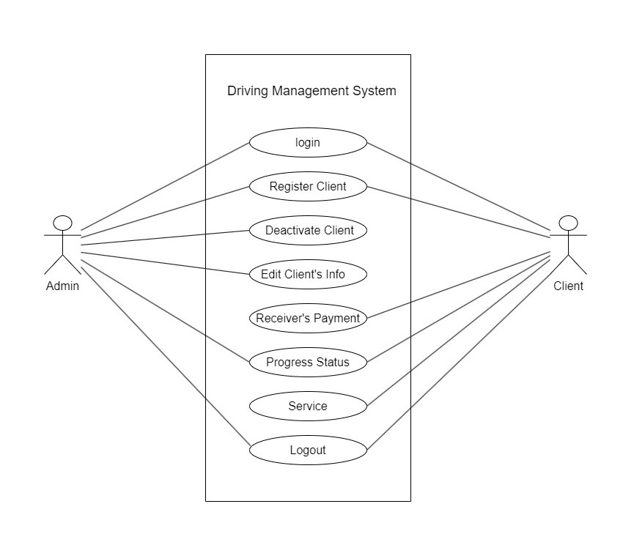
System Analysis

Slide 6
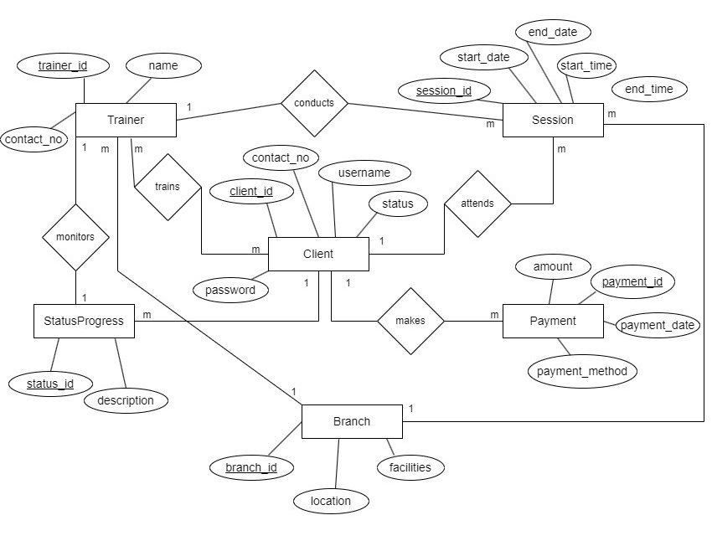

Slide 7
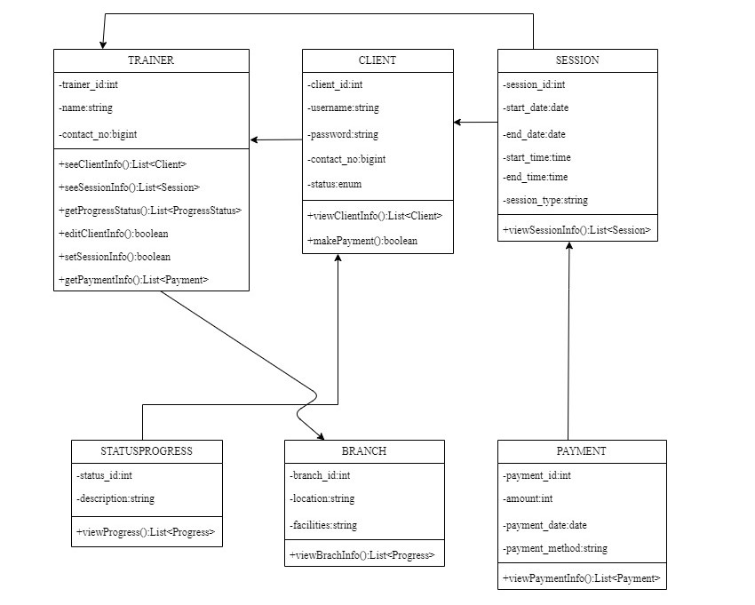
System Design
Fig: Descriptive Class Diagram

Slide 8
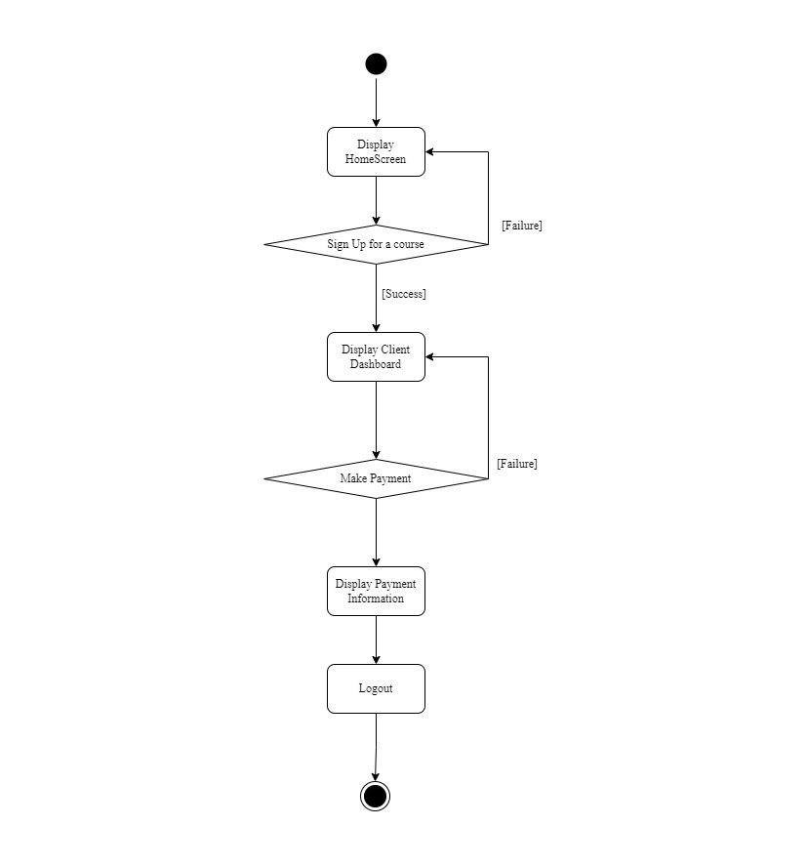
Activity Diagram

Slide 9
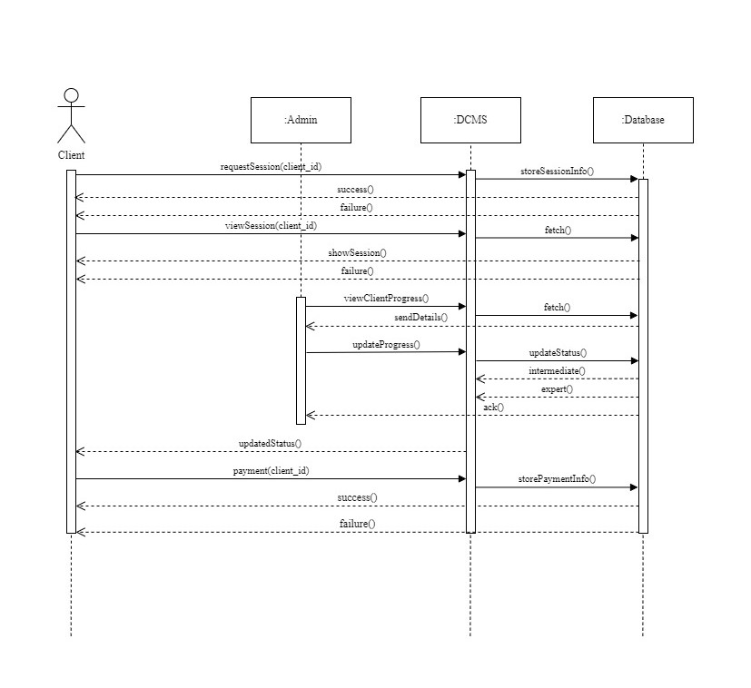
Sequence Diagram

Slide 10
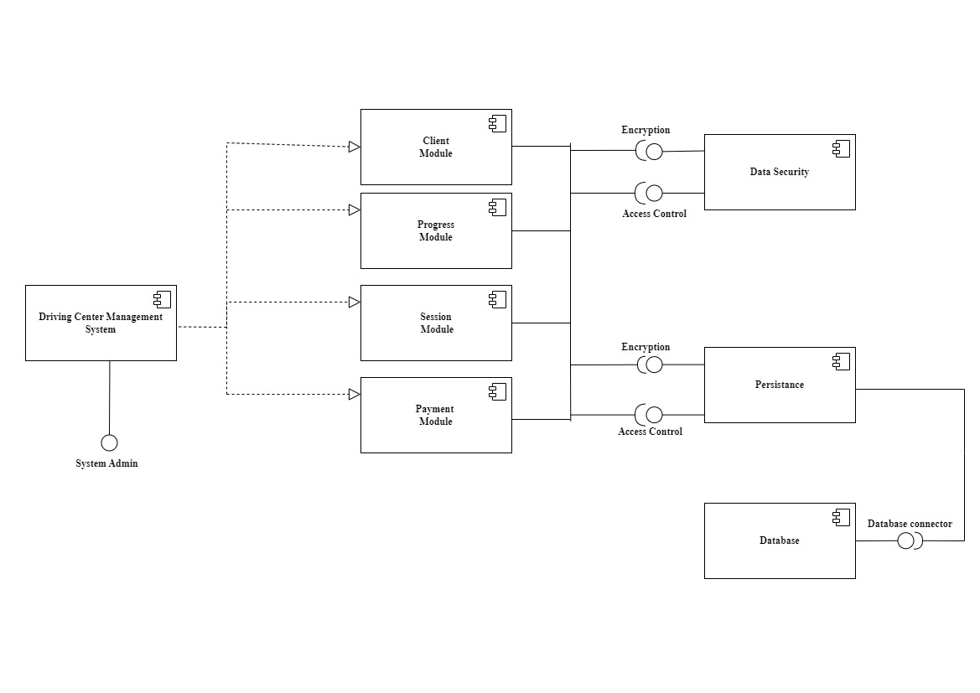
Component Diagram

Slide 11
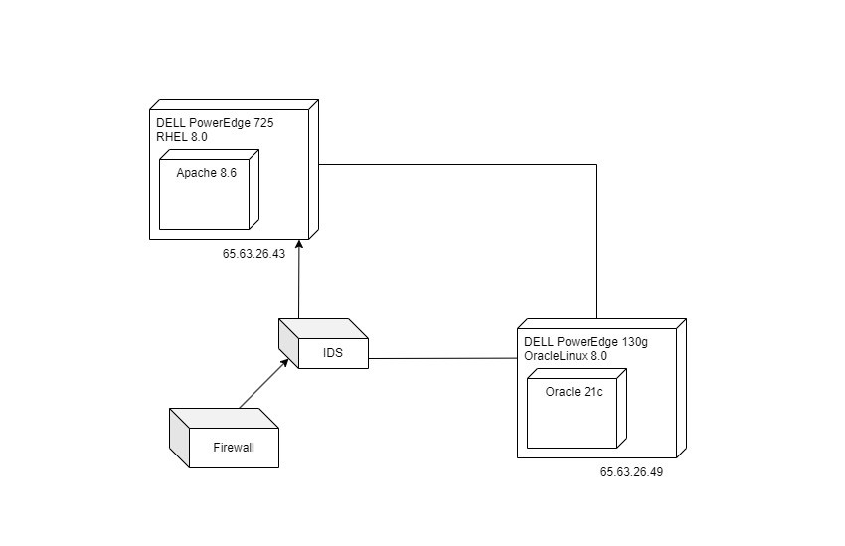
Deployment Diagram

Slide 12
Testing Methodology
Unit testing
Integration testing
System testing

Slide 13
CONCLUSION
As per the objective this system was completed in time. This project intends to provide solution to manual organization management problems and also provides information. It provides the most flexible and adaptable standard management system solution for Suman Driving Center.

Slide 14
References
B.Pavithra, S. S. (2019). RFID based Smart Automatic Vehicle Management.
Irene Markelic, A. K.-N. (2011). The Driving School System: Learning Basic Driving Skills From a Teacher in a Real Car. IEEE TRANSACTIONS ON INTELLIGENT TRANSPORTATION SYSTEMS, VOL. 12, NO. 4, DECEMBER 2011.
Ramez Elmasri, S. B. (2015). Fundamental of Database Systems. New York: Pearson.
SHULIN LAN, C. Y.-H. (2019). Online Car-Hailing System Performance Analysis Based on Bayesian Network. S. Lan et al.: Online Car-Hailing System Performance Analysis Based on Bayesian Network.
Sommerville, I. (2009). Software Engineering. New York: Pearson.

Slide 15
Appendix

Slide 16
Thank you

