Slide 1
Battle Engine and 3D Print Scheduler
HBO-ICT System design
Student:
Rokas Pazera (551495)
Date: 02-11-2026
Notes:
Target: about 15 s
Good morning. I am Rokas Pazera, student 551495. In the next seven minutes I present my two System Design assignments: first the Battle Engine, designed with the four layers of C4, then the refactoring of the 3D print scheduler.

Slide 2

Exam assignment 1 - Battle Engine
A rules engine for one turn-based battle: 6 interface methods, no UI, no AI, no storage
Notes:
Target: about 10 s
The Battle Engine runs one turn-based battle between the human player and the computer. It is a rules engine only: no user interface, no AI and no storage.

Slide 3
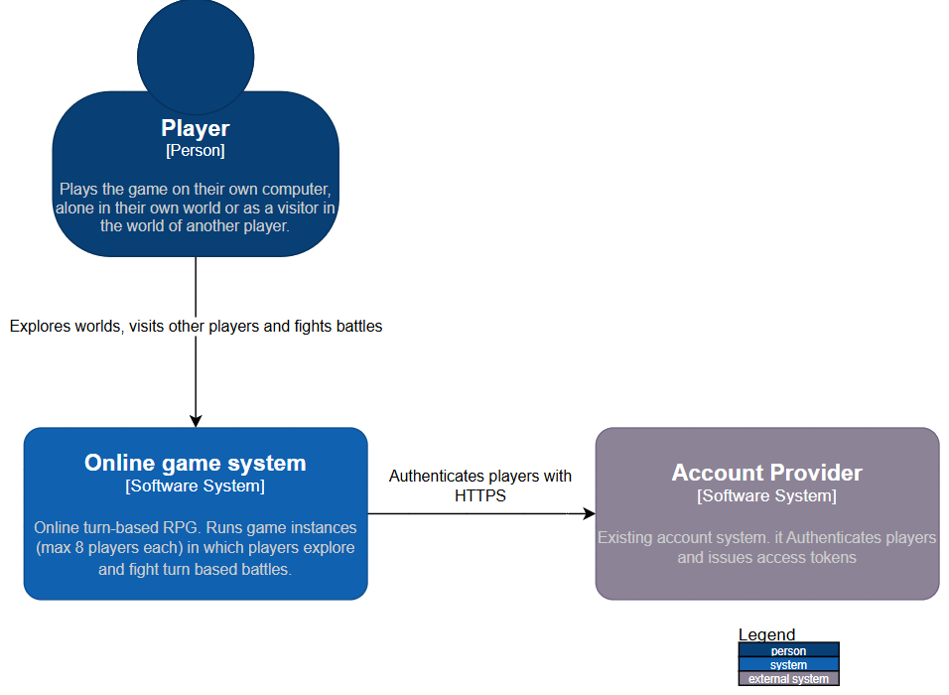
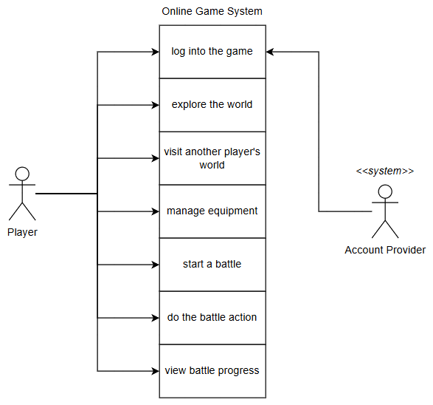
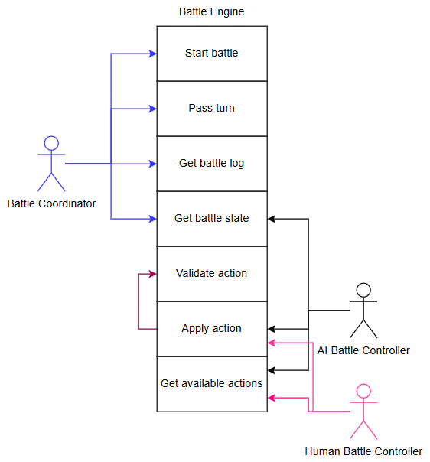
EA1: C4 Layer 1 (Context)
C4: system context
UML use case: Online Game System
UML use case: Battle Engine
The whole game is one system. The Account Provider is the only external system.
What the Player can do. Login goes through the Account Provider.
The 6 interface methods are the use cases of the engine.
Notes:
Target: about 35 s
At layer 1 the whole online game is one software system. The Player is the only user, and the existing Account Provider is the only external system. It is used to log in.
The use case diagram in the middle shows what a player can do. On the right I made the Battle Engine itself the subject. The other parts of the game instance are its actors, and its six interface methods are the use cases. Apply action always includes validate action.

Slide 4
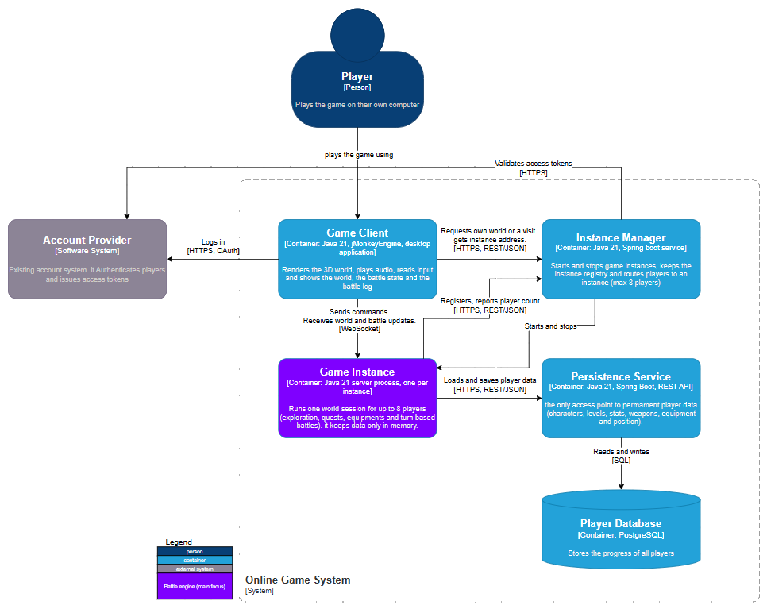
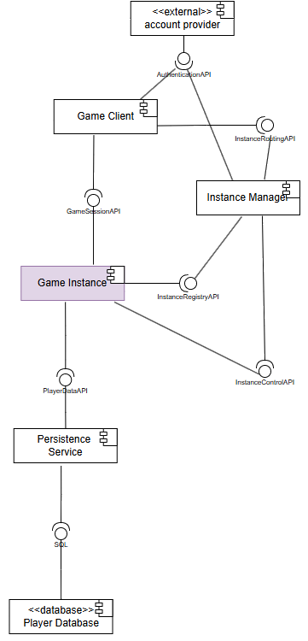
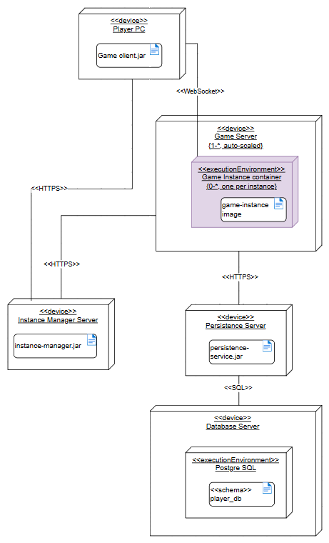
EA1: C4 Layer 2 (Containers)
C4: container diagram
UML component
UML deployment
Container per instance: auto-scaled game servers, a crash stays local
WebSocket client to instance, REST/HTTPS for the services
Persistence Service is the only access to the database
Notes:
Target: about 45 s
Layer 2 splits the system by how the game is played: always online, instances that start and stop, and at most eight players per instance. That gives five containers. The Game Instance, in purple, runs the Battle Engine and keeps its data only in memory.
The deployment diagram shows one container per instance on auto-scaled game servers, so a crashing instance cannot affect another one. Between the client and the instance I chose a WebSocket, because the server must push the moves of the computer. For the services I chose REST over HTTPS, because those are short request and response calls.

Slide 5
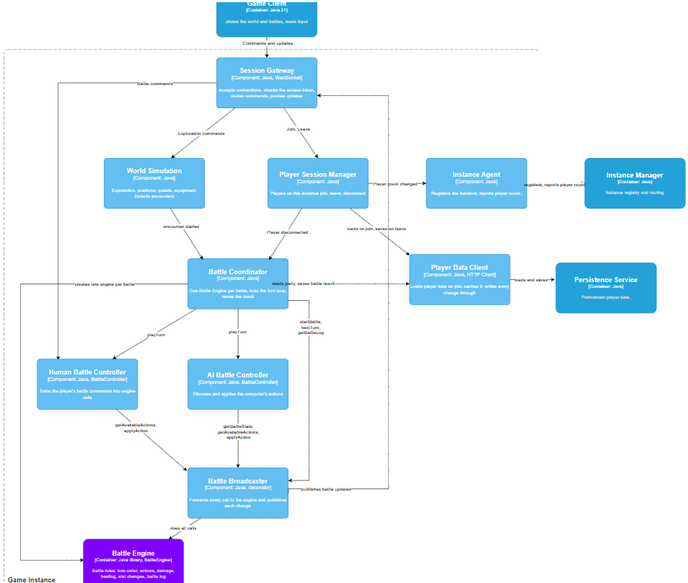
EA1: C4 Layer 3 (Components)
C4: components of the Game Instance
Battle Coordinator owns the turn loop
Only it starts a battle, passes the turn and saves the result, so the AI cannot pass the human's turn.
1
Human and AI share one interface
Both provide BattleController, so the coordinator treats both players the same way.
2
Battle Broadcaster is a Decorator
It wraps the engine and pushes every new state to the client. The engine knows nothing about networking.
3
Notes:
Target: about 40 s
Layer 3 zooms in on the Game Instance and shows who uses the engine. Three decisions matter here.
One: the Battle Coordinator owns the turn loop. Only it starts a battle, passes the turn and saves the result, so the AI can never pass the turn of the human player.
Two: the human and the AI controller provide the same BattleController interface, so the coordinator treats both players the same way.
Three: the Battle Broadcaster is a decorator around the engine. It sends every new state to the client, so the engine itself knows nothing about networking.

Slide 6
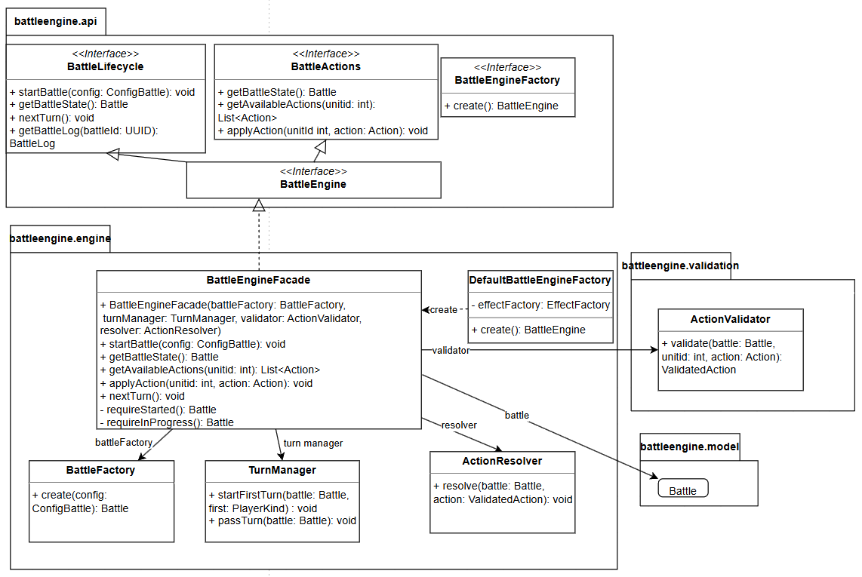
EA1: C4 Layer 4 (Interface and facade)
UML class diagram: battleengine.api and battleengine.engine
Interface Segregation
BattleActions for the controllers, BattleLifecycle for the coordinator. A controller cannot call nextTurn().
1
Facade
BattleEngineFacade hides BattleFactory, TurnManager, ActionValidator and ActionResolver.
2
No Singleton, only snapshots
One facade per battle: up to 8 players fight at once. getBattleState() returns a deep copy.
3
Notes:
Target: about 45 s
Layer 4 is the focus of this assignment. I split the six methods into two interfaces: BattleActions for the controllers and BattleLifecycle for the coordinator. Now the compiler stops a controller from calling nextTurn.
BattleEngineFacade is the only implementation. It hides the factory, the turn manager, the validator and the resolver, so a caller does not need to know the order of the steps.
I considered a Singleton and rejected it, because up to eight players can fight at the same time. Every battle gets its own facade. And getBattleState returns a deep copy, so no live object leaves the engine and every change goes through the rules.

Slide 7
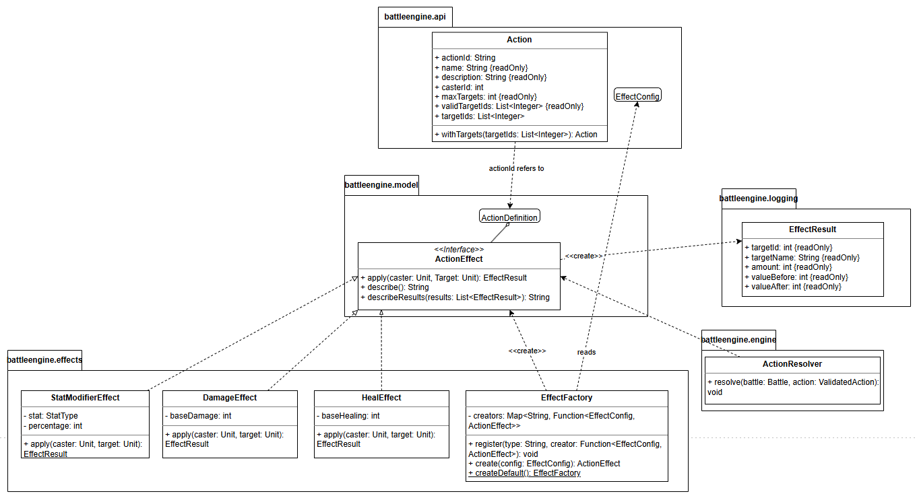
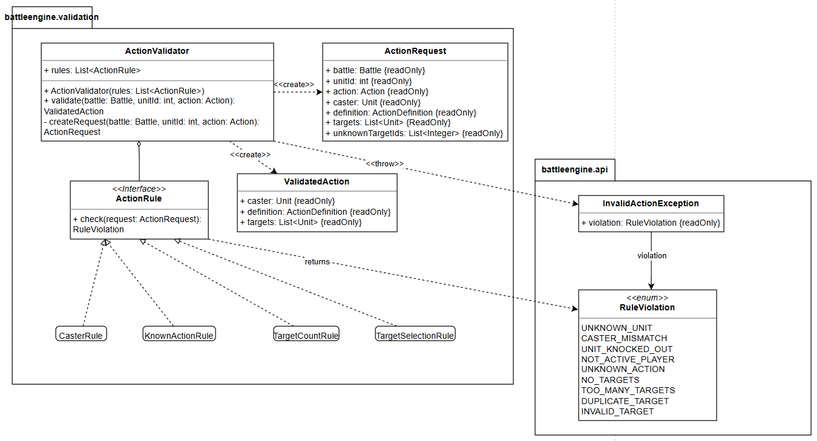
EA1: C4 Layer 4 (Actions, effects and validation)
Actions and effects
Validation
Strategy: one ActionEffect per effect type
Effects combine: “hit and lower defence” needs no new code.
Rules run before anything changes
The first violation throws, so a battle is never half changed.
Notes:
Target: about 40 s
On the left: ActionDefinition is what a unit can do, Action is only the request with ids. The effects use the Strategy pattern: damage, heal and stat change each implement ActionEffect. An action holds a list of effects, so an action like hit and lower defence needs no new code. The alternative, one Action class with a switch, changes with every new type.
On the right: applyAction first runs a fixed list of rules. The first violation throws an InvalidActionException, so a battle is never half changed. A new rule is one new class in the list.

Slide 8
Exam assignment 2 - 3D printer case
Analyse, redesign and refactor the scheduler that tells Jack which print to start on which printer
Notes:
Target: about 10 s
The second assignment is the 3D print scheduler. It tells Jack which print to start on which printer. I analysed the code, redesigned it and refactored it.

Slide 9
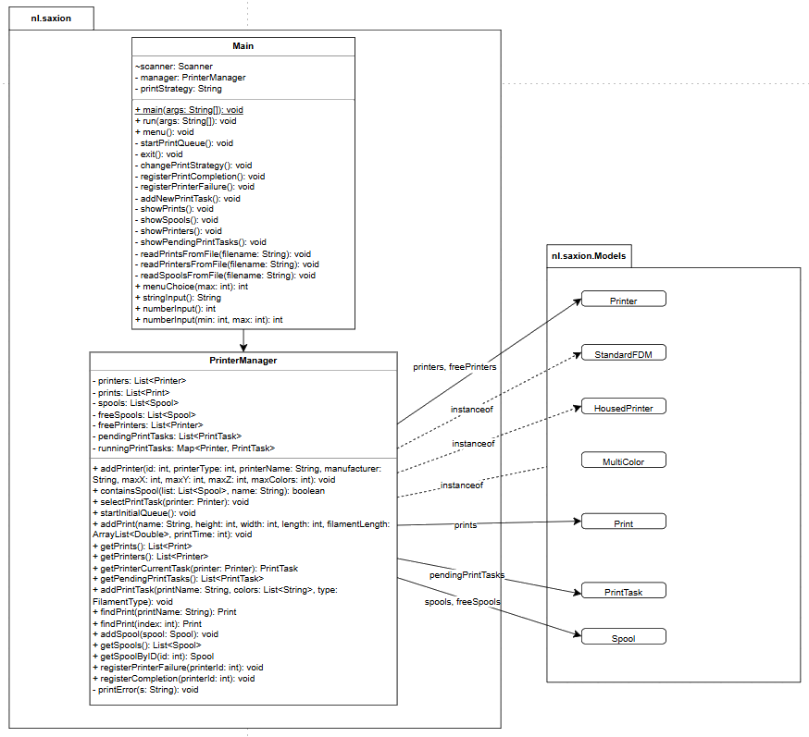
EA2: Code analysis
Original class diagram
God classes, no separation
Main mixes menu and file reading. PrinterManager does the rest: selectPrintTask is 110 lines, 6 levels deep.
1
Printer types are not used as types
instanceof branches in PrinterManager decide what a printer can print. A new type means 6 changes.
2
Fake strategy, state in 3 places
The strategy menu only changes a String. Spools live in 3 places, synced by hand: null spool crash.
3
Notes:
Target: about 45 s
This is the original class diagram. I found three main problems.
One: two god classes and no separation. Main mixes the menu with file reading, and PrinterManager does everything else. Its selectPrintTask method was 110 lines with six levels of nesting.
Two: printer types are not used as types. instanceof branches in PrinterManager decide what a printer can print, so a new printer type means changes in six places.
Three: the strategy menu only changed a String, and the spools lived in three places that had to be kept in sync by hand. That caused real bugs, for example a crash on a null spool.

Slide 10
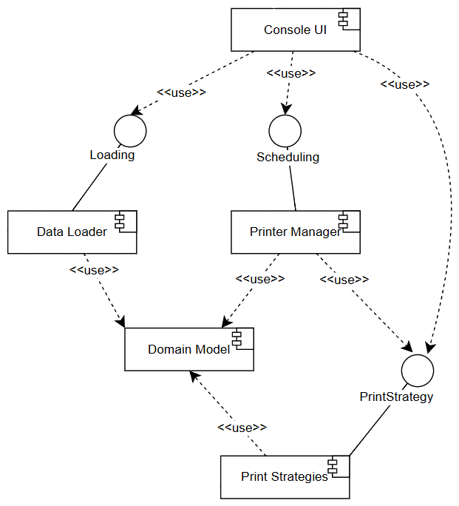
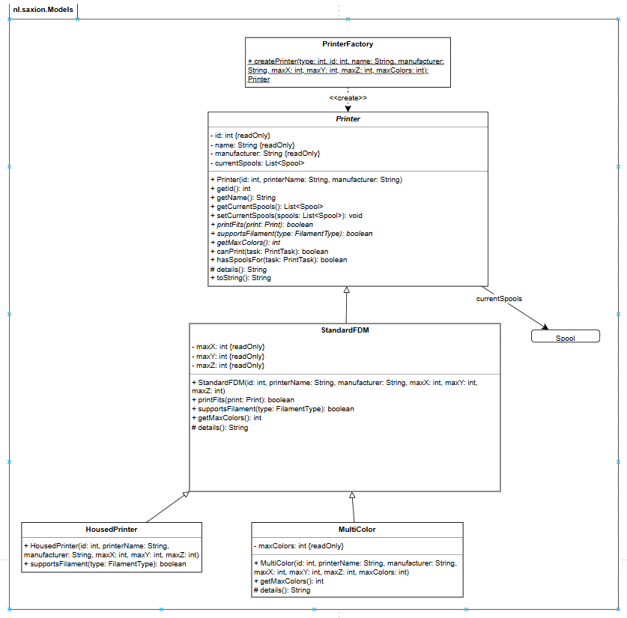
EA2: (Re)design (Components and printers)
Layer 3: components
Layer 4: printer model
Fix 1: one job each
Main is only the console UI, DataLoader reads the files, PrinterManager keeps the queue.
1
Fix 2: printers know what they can print
canPrint() is written once in Printer (Template method). Subclasses answer printFits, supportsFilament and getMaxColors. PrinterFactory is the only place with type numbers.
2
Notes:
Target: about 40 s
Now every component has one job: the console UI, the data loader, the printer manager, the strategies and the domain model. That solves problem one.
For problem two, the printers now know what they can print. canPrint is written once in Printer as a template method. Each subclass only answers: does the print fit, is the filament supported, and how many colours. PrinterFactory is the only place with the type numbers. I kept the subclasses instead of one class with flags, because a new rule fits better in a subclass.

Slide 11
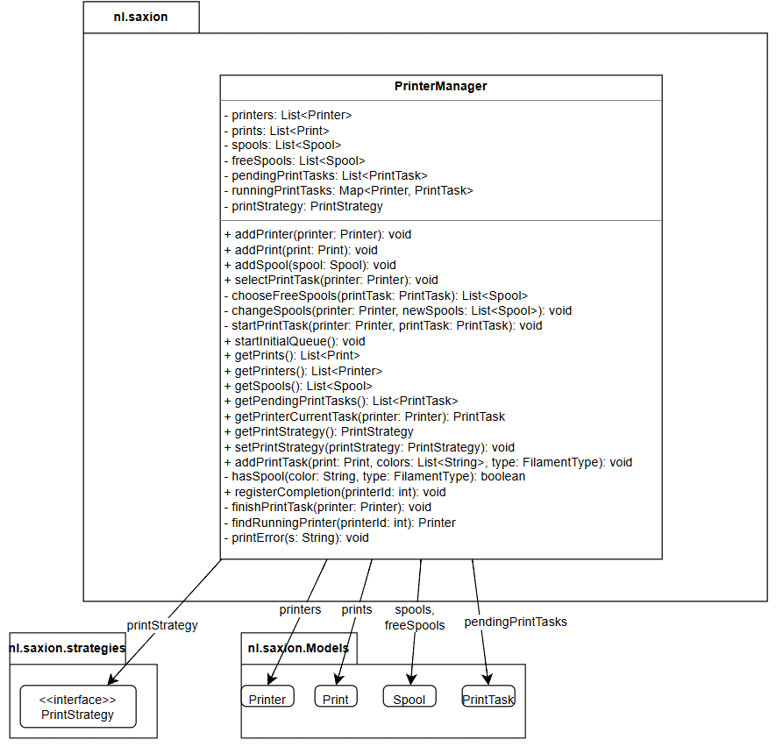
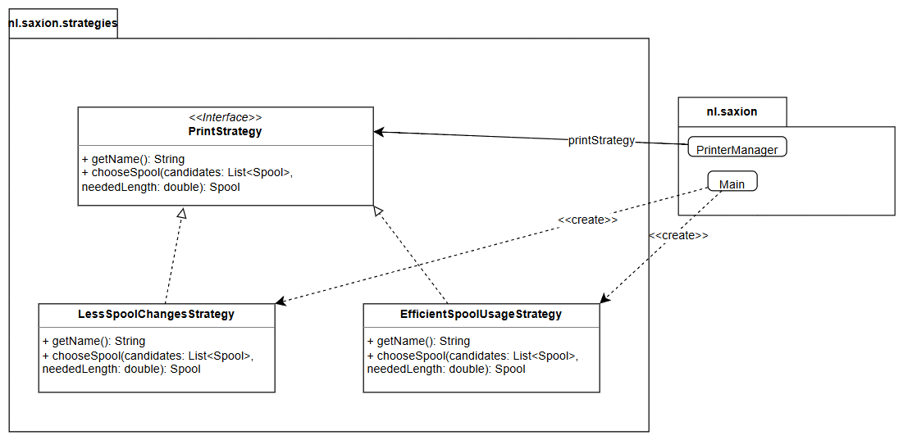
EA2: (Re)design (Scheduling and strategy)
Layer 4: PrinterManager
Layer 4: nl.saxion.strategies
Fix 3: a real Strategy with one decision
PrinterManager only knows PrintStrategy.chooseSpool(). Rejected: a strategy for the whole task, because every strategy would copy the same two passes.
3
Notes:
Target: about 30 s
For problem three I used the Strategy pattern, with one decision only: which free spool to use. My first idea was a strategy that picks the whole next task. When I wrote out both strategies, they needed the same two passes, so that code would be copied into every strategy.
Now PrinterManager only knows the PrintStrategy interface. I also did not make PrinterManager a Singleton, because the tests would then share global state.

Slide 12
EA2: Refactored code
1. selectPrintTask: 110 lines with instanceof, now 23
2. Printer.canPrint(): Template method
public void selectPrintTask(Printer printer) {
if (runningPrintTasks.containsKey(printer)) {
return;
}
// pass 1: keep the loaded spools
for (PrintTask printTask : pendingPrintTasks) {
if (printer.canPrint(printTask) && printer.hasSpoolsFor(printTask)) {
startPrintTask(printer, printTask);
return;
}
}
// pass 2: change spools, the strategy picks them
for (PrintTask printTask : pendingPrintTasks) {
if (printer.canPrint(printTask)) {
List<Spool> chosenSpools = chooseFreeSpools(printTask);
if (chosenSpools != null) {
changeSpools(printer, chosenSpools);
startPrintTask(printer, printTask);
return;
}
}
}
}
public boolean canPrint(PrintTask task) {
return printFits(task.getPrint())
&& supportsFilament(task.getFilamentType())
&& task.getColors().size() <= getMaxColors();
}
3. PrintStrategy: one decision
public interface PrintStrategy {
String getName();
Spool chooseSpool(List<Spool> candidates,
double neededLength);
}
23
lines in selectPrintTask (was 110)
0
instanceof checks left
9/9
unit tests pass
Notes:
Target: about 35 s
Three code changes stand out. First, selectPrintTask went from 110 to 23 lines. Pass one keeps the loaded spools, pass two changes spools through the strategy. There is no instanceof any more. Splitting the method also showed a bug: a busy printer could lose its task. That check is now the first if.
Second, canPrint in Printer: the steps are fixed and the subclasses fill in their part. Third, the PrintStrategy interface with one method, chooseSpool. All nine unit tests pass.

Slide 13
Takeaways
1
2
3
Design from the interface outward
EA1 started at the 6 methods. Every C4 layer set limits for the next: an in-memory instance gives an engine without storage.
Patterns only where behaviour differs
In EA2 the strategy only chooses the spool. A strategy for the whole task would have copied code instead of removing it.
Testability checks the design
Without file reading and instanceof in PrinterManager, each of the 9 tests builds its own small situation and checks the state.
Thank you. Questions?
Notes:
Target: about 20 s
To wrap up, three things I learned. Design from the interface outward. Use a pattern only where the behaviour really differs. And use testability as a check of the design.
Thank you. I am happy to answer questions or to show the code.

