Slide 1

Certificates
How does Alice (browser) obtain PU_{Bob} ?
Browser Alice
Server Bob
CA
choose
(PR,PU)
PU and
proof “I am Bob”
check
proof
PU_{CA}
PU_{CA}
PU_{CA}
issue Cert with PR_{CA} :
verify
Cert
Bob’s key is PU
Bob’s key is PU
Bob uses Cert for an extended period (e.g. one year)

Slide 2
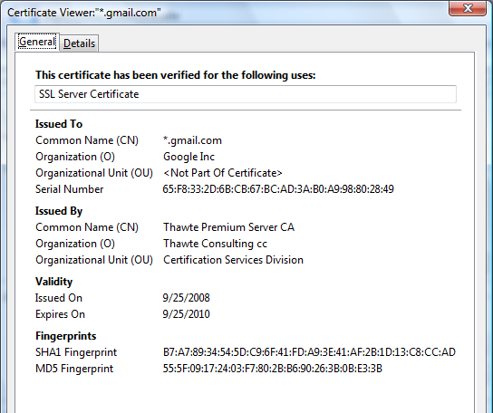
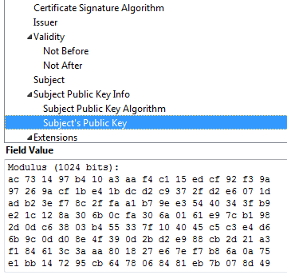
Certificates: Example
Important fields:

Slide 3
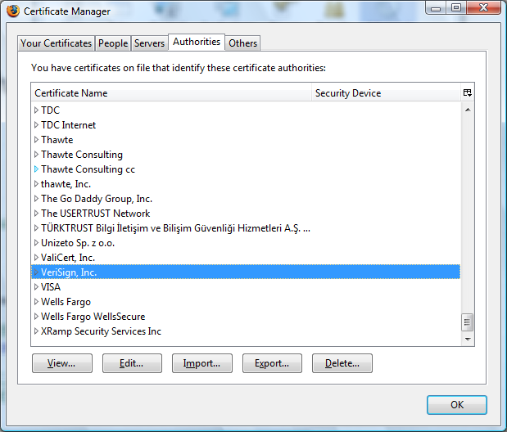
Certificates: Example
Browsers accept certificates from a large number of CAs

Slide 4
HTTPS:// and FTPS:// and….
Have you done any of the following today?
E-shopping: Amazon, Ebay, Audible, …
Checked your Email
Visited a social networking site: Facebook, Twitter, …
Used a secure FTP
Used Voice over IP
Used Google
Used any URL starting with https:// and a green lock
Congratulations, you’ve used TLS/SSL!

Slide 5
Brief overview of SSL/TLS
browser
server
client-hello
cert
server-hello + server-cert (PU)
PR
key exchange (several options)
rand. k
client-key-exchange: E(PU, k)
k
Finished
HTTP data encrypted with KDF(k)
Note: KDF ? Key derivation function
Most common: server authentication only

Slide 6
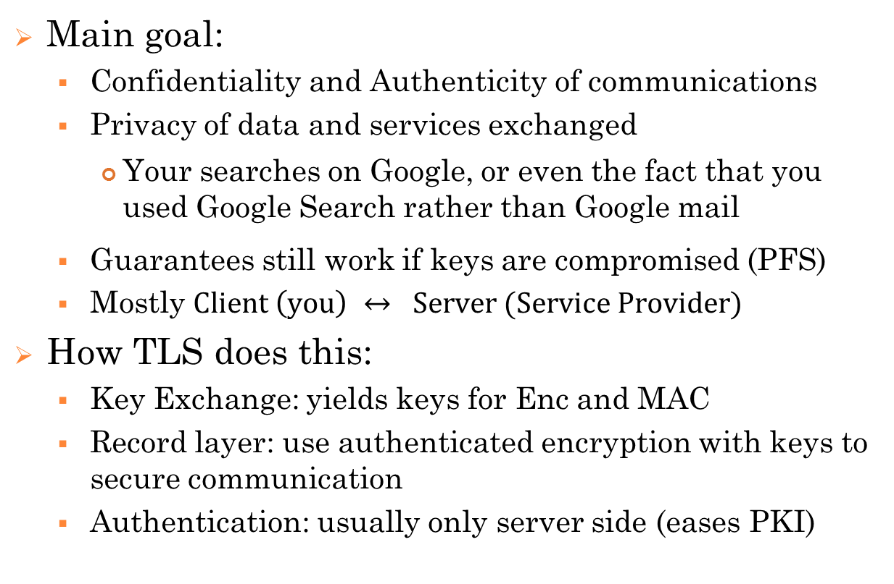
What TLS does
Main goal:
Confidentiality and Authenticity of communications
Privacy of data and services exchanged
Your searches on Google, or even the fact that you used Google Search rather than Google mail
Guarantees still work if keys are compromised (PFS)
Mostly $Client \left(you\right) ↔ Server (Service Provider)$
How TLS does this:
Key Exchange: yields keys for Enc and MAC
Record layer: use authenticated encryption with keys to secure communication
Authentication: usually only server side (eases PKI)

Slide 7
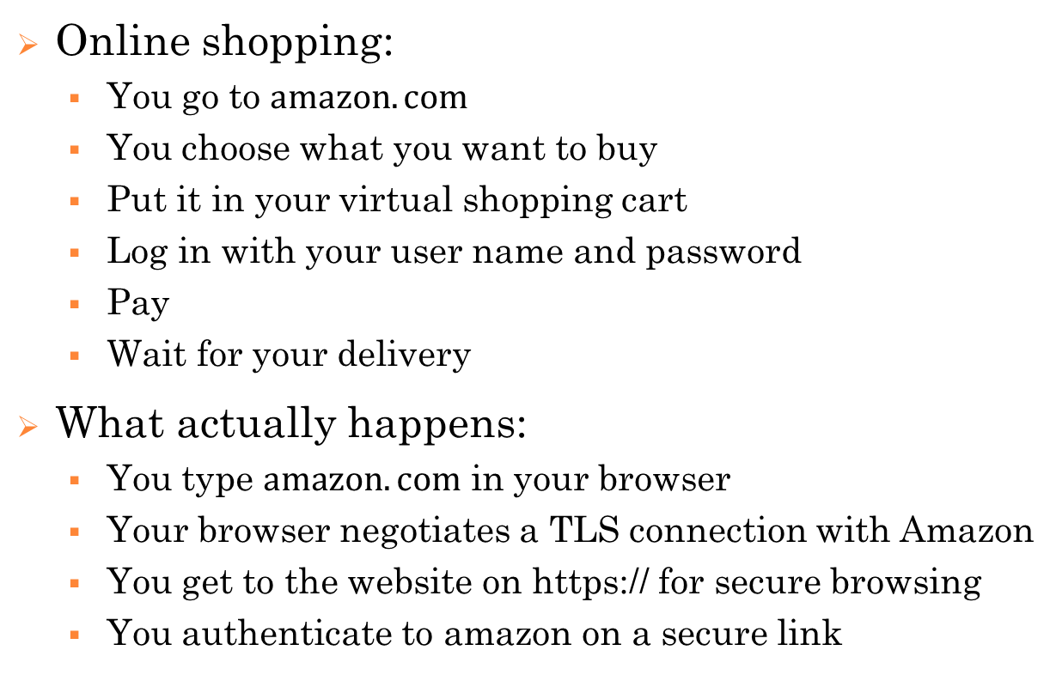
The Client-Server Scenario
Online shopping:
You go to $amazon.com$
You choose what you want to buy
Put it in your virtual shopping cart
Log in with your user name and password
Pay
Wait for your delivery
What actually happens:
You type $amazon.com$ in your browser
Your browser negotiates a TLS connection with Amazon
You get to the website on https:// for secure browsing
You authenticate to amazon on a secure link

Slide 8
A bit of History
Started out as Secure Socket Layer (SSL)
Developed by Netscape around 1995
Main goal: secure communication over the Internet
Changed to Transport Layer Security (TLS) in 1999
Secure communication over the Internet: https
… but also: secure file sharing (ftp), secure emailing etc.
Heavily standardised
Some implementations:
OpenSSL
BoringSSL, mbedTLS
s2n: TLS by Amazon

Slide 9
Protocols
Record Protocol
“raw” transmission of data
uses a so called cipher spec to determine how to encrypt/decrypt and authenticate/verify data
The cipher spec says which encryption and other algorithms to use for this
adds a sequence number and a MAC to the raw data all of which is then encrypted → % replay attacks
Handshake Protocol
Authenticated key exchange - see below
Change Cipher Spec Protocol
change from one cipher spec to another
Alert Protocol
This is a one message protocol used to signal error mes-sages to the other side.

Slide 10















The TLS (1.2) Handshake (AKE)
Client
SERVER
Pick $N_{C}$
$$1.′Hello^{′}, N_{C}$$
Pick $N_{S}, {PU}_{S}$
Pick ${PU}_{C}$
$${2.N}_{S}, Cert({PU}_{S}){, PU}_{S}$$
3. check$Cert({PU}_{S})$
EPUS$\left(PMS\right)$, $Cert({PU}_{C}){, PU}_{C}$
4. check$Cert({PU}_{C})$
Compute $PMS$
EPUS$(PMS)$
Compute PMS, MS
4. MS$←PRF (PMS; N_{C}|N_{S})$
MACMS(viewS)
MACMS(viewC)

Slide 11
Main ideas
S authenticates itself by being able to send a finished message with a correct MAC, thus proving that it was able to compute PMS and hence knows PRS
C authenticates itself by being able to sign a message containing the encryption of PMS
This acts as a sort of signature from C on PMS, but is not enough on its own because signing an encryption does not prove that you know the plaintext
However, C establishes this knowledge by sending a correct “finished" message at the end

Slide 12
Main ideas
It is an important point that the parties send a MAC on all messages sent in the protocol, including in the hand-shake
By MAC'ing the entire view, each party can check that the other party had the same view of the protocol, i.e., the attacker did not change any messages!

Slide 13
Main ideas
Sequence numbers
Prevents replay attacks (replaying packages during ongoing session)
Nounces
Prevents replay attack (connection replay; sends messages in exactly same sequence next day!)

Slide 14
Connection closure
Can’t just terminate session – denial of service
In the type field state whether the record serves to terminate SSL
If S receives TCP FIN before receives a closure SSL record, something is up!

