Slide 1
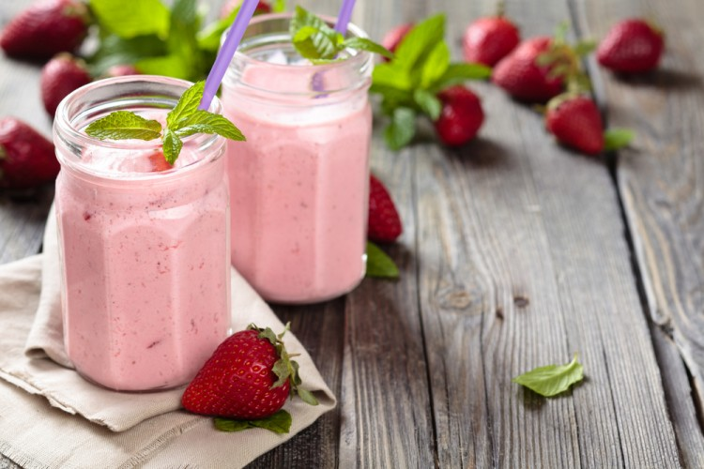
Enough for 2 people
The cooking time is 10 minutes
Samothy fruit
ingredients
- Yogurt: can
- Milk: 1.5 liters
- Stranger Frut: 4 large spoons
- Fruit: as desired (summer fruit)
preparation method
1- Beat the summer fruit and grapefruit into the blender so that a soft mixture is formed.
2- Add two spoons of this mixture to each cup.
3- Mix cold milk, yogurt, and distribute this mixture to coupons - more summer fruit and grapefruit mix immediately and feet.

Slide 2
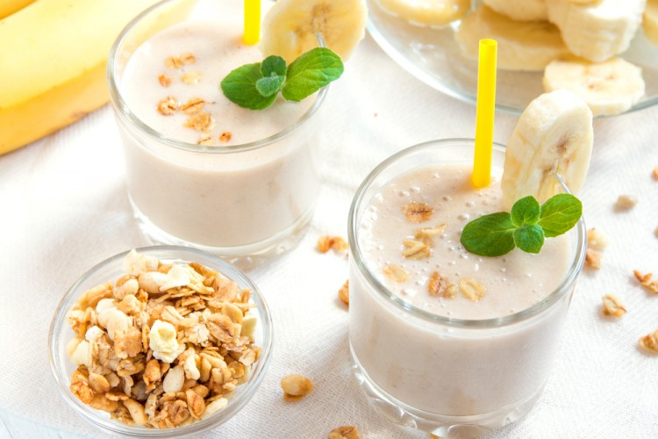
Enough for 1 people
The cooking time is 10 minutes
Samothy banana with peanut butter and oats
ingredients
- bananas: 1 pill (cut)
- Milk: half a cup
- oats: 2 large spoons
- peanut butter: large spoon
- Honey: Big spoon
preparation method
1- In the electric mixer place bananas, milk, oats, peanut butter, honey and mixer ingredients for a few minutes until they are all homogeneous.
2- My typical style in the front cups and feet immediately.

Slide 3
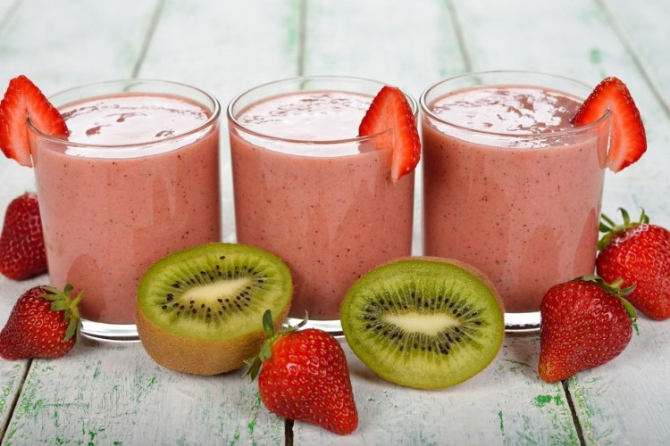
Enough for 3 people
The cooking time is 10 minutes
Samothe Strawberries and Kiwi
ingredients
- Kiwi: 5 pills (peeling)
- strawberry: cup
- yogurt: cup
- Ice cubes: as desired
- Water: cup
- sugar: big spoon
preparation method
1- Place ironing, strawberries, yogurt, sugar, water, and ice cubes in the electric blender pitcher.
2- Mix the components well so they're completely homogeneous.
3- He decorated himself with strawberries and kiwis, then his feet were cold.

Slide 4
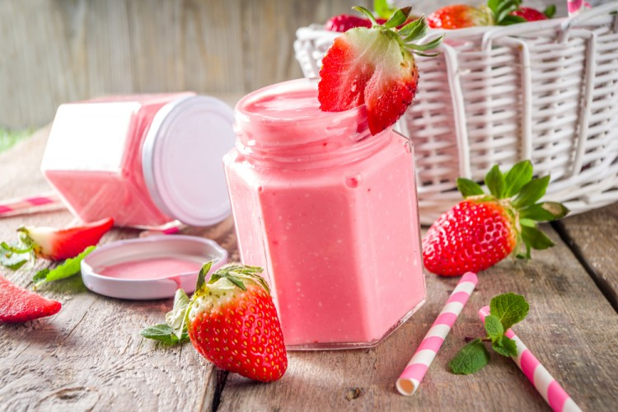
Enough for 2 people
The cooking time is 10 minutes
Smoothy strawberries with coconuts
ingredients
- strawberries: 2 cups (correct pills)
- Sugar: 2 large spoon
- ice cubes: cup
- coconut milk: cup
preparation method
1- Cut strawberry pills into small pieces, mix them with sugar and ice, and hide them at medium speed until a soft mixture is formed.
2- A coconut milk boy with blender on medium speed until a soft mixture and his feet are formed immediately.

Slide 5
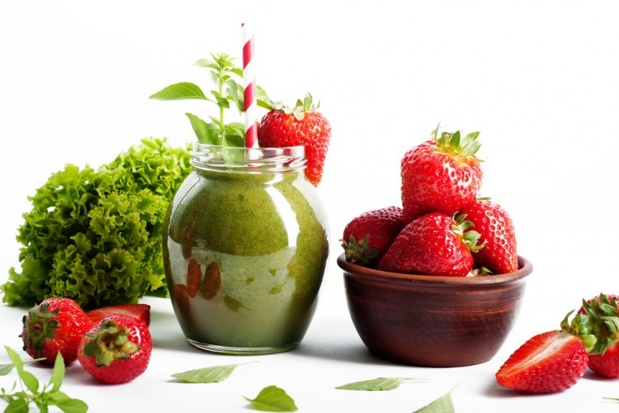
Enough for 1 people
The cooking time is 10 minutes
Smoothy spinach and strawberry
ingredients
- almond milk: half a cup (unsweetened and cold)
- Milk: 3 cups (cold)
- spinach paper: cup
- bananas: 1 pill
- strawberry: half a cup (frozen)
preparation method
1- Put almond milk, yogurt, spinach leaves, bananas, and strawberries into the blender.
2- Mix all components up to homogeneity.
3- The drink boy is in the puppet and his feet are immediately.

