Slide 1
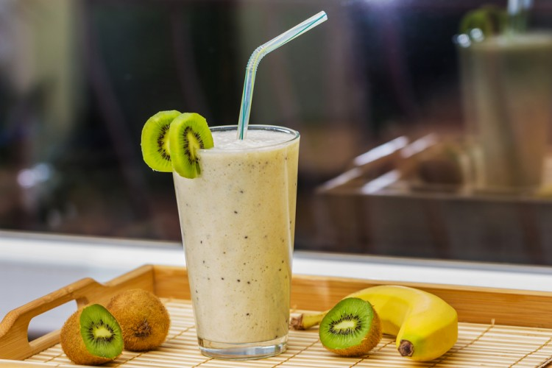
Enough for 2 people
The cooking time is 10 minutes
kiwi and banana
ingredients
- bananas: 2 pills (cut)
- Kiwi: 3 pills (slide)
- Milk: 2 cups
- Water: half a cup
- Honey: Big spoon
preparation method
In the electric mixer bowl, place bananas, kiwi, milk, water, and honey.
Mix the components well for several minutes until they are homogeneous.
He poured the juice into the front cups and decorated it with banana slices, then his feet were cold.

Slide 2
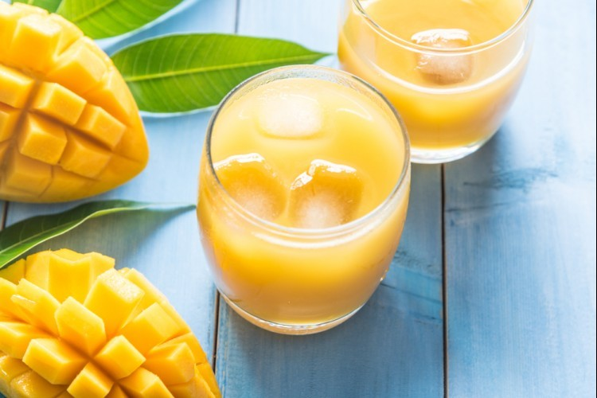
Enough for 2 people
The cooking time is 10 minutes
Mango juice oranges
ingredients
Mango: 2 pills
- orange juice: cup
- Ice cubes: half a cup
- Milk: 1/2 cup (liquid)
- Honey: Big spoon
preparation method
Place mango, orange juice, snow, milk, and honey in the electric blender bowl.
Mix the ingredients well for about 10 minutes until they are homogeneous.
He poured the juice into the front cups, then his feet were cold.

Slide 3
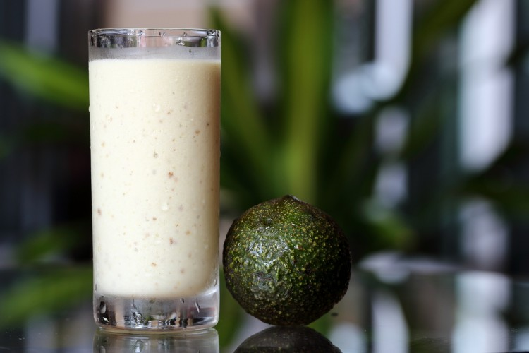
Enough for 4 people
The cooking time is 10 minutes
Date and avocado
ingredients
- Avocados: 2 pills (peeling and halved)
- Honey: 3 large spoons
- milk: liter
- date paste: 2 large spoon
preparation method
In the electric mixer bowl put milk, avocado, date paste, and honey.
Mix components for several minutes well so they're completely homogeneous.
Pour the juice into the front cups, then the feet.

Slide 4
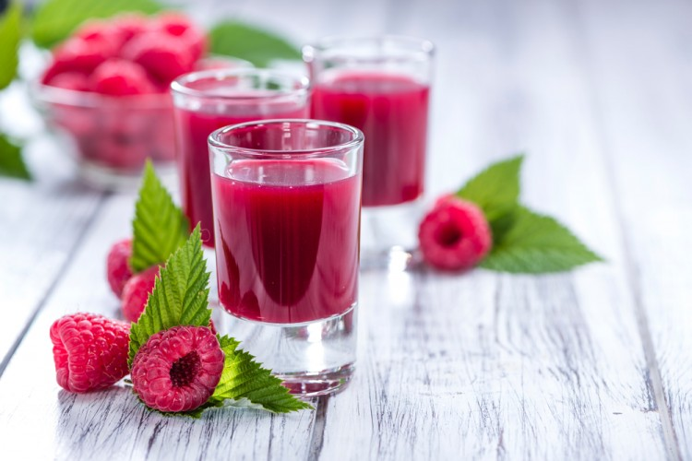
Enough for 3 people
The cooking time is 10 minutes
fresh berries
ingredients
- orange juice: cup and quarter
- Bananas: 1 pill (peeled and cut rings)
- raspberry: cup and quarter (ice)
- Yogurt: half a cup
- sugar: big spoon
preparation method
Put orange juice, banana rings, iced berries, sugar, and yogurt in the electric blender bowl.
Mix the ingredients well so you have a homogeneous strength, then put the mixture in the fridge until it's completely cooled.
Boy the berries juice in the front cups, then his feet cold.

Slide 5
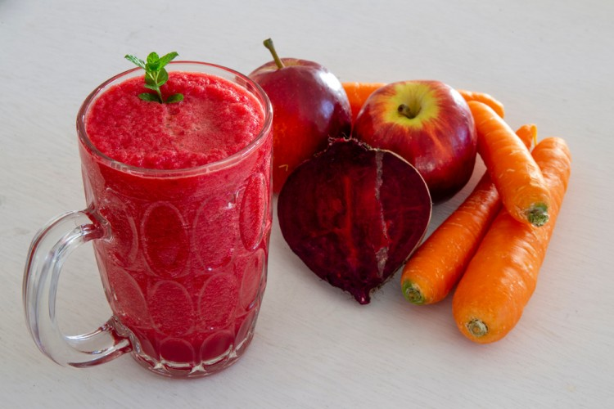
Enough for 1 people
The cooking time is 10 minutes
beet juice
ingredients
- Beet: 1 pill (small)
- apples: half a grain
- Celery: 2 sheets
- lemon juice: half a pill
preparation method
Wash the beets, apples, and celery thoroughly, then peel them, cut them into cubes, and remove the insides.
Place components in the electrical and mixer well.
Add lemon juice on the mixture, then have a good heart and clear it.
Put the juice in the fridge, and then his feet are cold.

