Slide 1
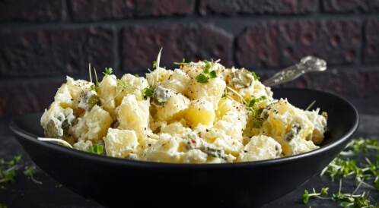
The ingredients to prepare the white potato salad
Components
1.3 kilograms of potatoes.
4 large eggs.
⅓ Cup Shabbat.
2 legs like a sizable knight.
Medium-sized onion.
White sauce components
2 cup mayonnaise.
Four cups of fresh chopped parsley.
2 large spoon of brown mustard.
2 large spoon white vinegar.
Big spoon sugar.
small spoon of salt.
½ teaspoon black pepper.
6
00.30
vegetable preparation method
Peel the potatoes, boil them with salt water, and let them cool a little.
Chop onion, carpet, and celery.
Boil the eggs, let them cool, and then untie them.
Cut the potatoes into slices or small pieces.
Place it in a large bowl with the eggs and chopped vegetables.
White sauce preparation method
Bring a medium-sized bowl.
Add all the sauce ingredients, and mix them well together.
The way the white potato salad works
Pour sauce over potatoes and veggies, and their heart is good.
Make sure the potatoes are not broken or broken down as much as possible.
Place the white potato salad in the fridge for at least two hours before serving it.
The white salad with the potatoes is cold.

Slide 2
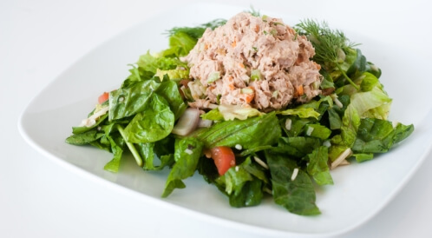
The Ingredients to Prepare a Tuna Authority
Components
2 little tuna cans, about 155 grams.
Four Cobb Mayonnaise.
Kars stalk.
2 large spoon of red onions.
½ large spoon mustard.
spice components
Large spoon with chopped parsley.
Big spoon garlic.
small spoon of salt.
spray black pepper.
Steps to Prepare Tuna Authority
Cut the green onion and celery into cubes.
Pour the tuna out of the liquid, put it in a deep bowl.
Add mayonnaise, celery, onion, parsley, garlic, mustard, salt, pepper.
Mix the ingredients well so they completely overlap each other.
Offer a cold tuna salad, and dine on it with lettuce leaves, or sandwich as desired.
4
00.15

Slide 3
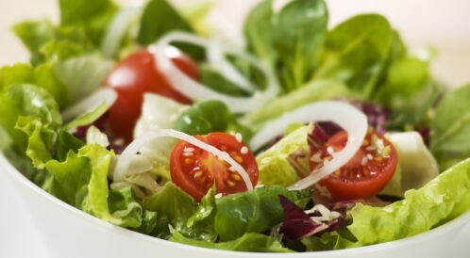
Simple green salad
Components
Medium-sized Roman head.
3 little tomato pills.
peeled cucumber.
Little onion.
small spoon of salt.
spray black pepper.
additional components as desired
olive oil.
vinegar.
Steps
Cut the lettuce leaves into small pieces, and move them to a convenient dish.
Peel the option, and cut it into slices.
Cut the onion and tomatoes into slices.
Add cucumber, tomatoes and onions to the lettuce dish.
Add salt and pepper, and sprinkle a little oil and vinegar as desired.
Flip the ingredients well together to blend completely.
Offer a cold green salad dish, and take it immediately.
4
00.10

Slide 4
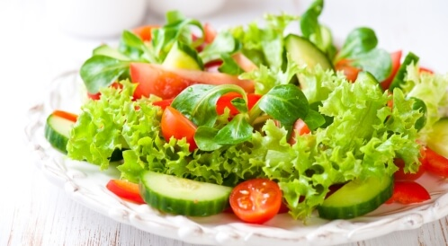
lettuce/vegetable salad
Components
450g cucumber.
450 grams of tomatoes.
450 grams V.
200 grams of fresh grapefruit.
Four cups of onion chip sliced thin.
2 large spoon olive oil.
small spoon of salt.
spray black pepper.
Plug-ins at will
garlic.
vinegar.
Steps
Cut cucumbers, lettuce and tomatoes into rough pieces.
Chop soft, and then bring a large bowl.
Add cucumber, tomatoes, lettuce, carp, onions, olive oil, salt and pepper.
Mix the ingredients well so they blend completely.
Add a little garlic and vinegar as desired.
Give a lettuce salad cold or warm.
6
00. 15

Slide 5
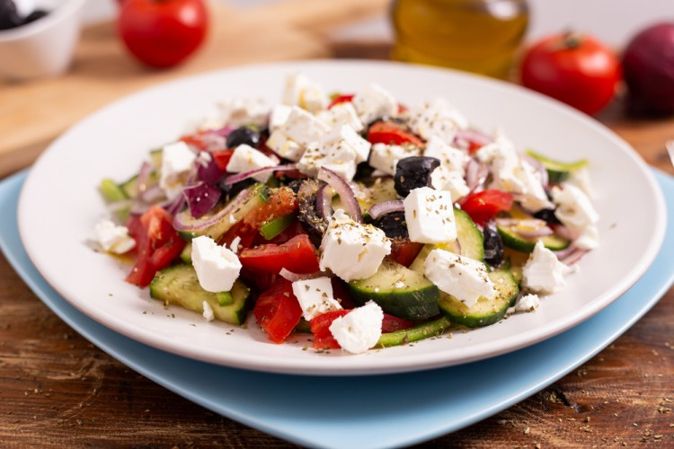
ingredients
- Colored pepper: 4 pills (red, yellow, orange)
- Olive oil: one quarter cup
- onion: half cup (cube)
- Parsley: One quarter cup (fresh and minced)
- Fita cheese: three-quarters of a cup
- lemon juice: big spoon
preparation method
Protect the oven at 190 degrees Celsius.
Wash the pepper, place it in the baking tray, and pour the olive oil over it.
Bake for 35 minutes until it wilts and starts to turn brown.
Take the colored pepper out of the oven and cover it with aluminum foil or kitchen towel and let it cool.
Remove the outer shell from the grilled pepper as well as the seeds and then cut it into a thin cut and place it in a large bowl.
Add the parsley, lemon juice, oil, and feta cheese over the pepper and put the salad in the fridge until it cool a little before presenting.
3
00.30
Pepper salad and cheese

