Slide 1
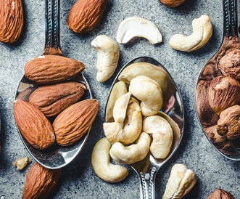
Mixed Nuts

