Slide 1
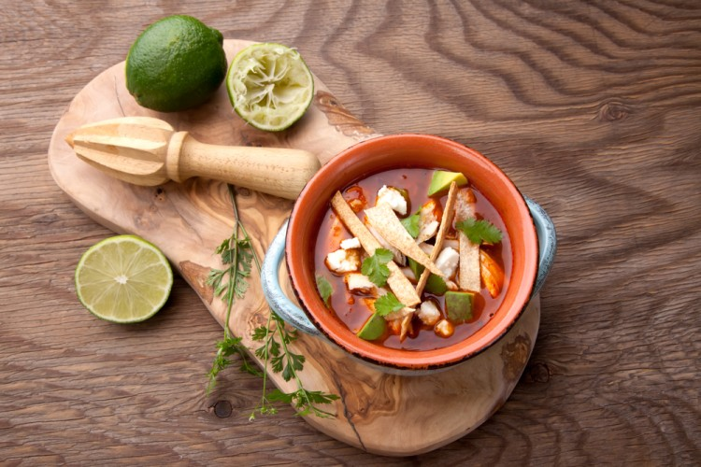
Enough for 6 people
The cooking time is 60 minutes
Avocado chicken soup
ingredients
- vegetable oil: large spoon
- Onion: 1 pill (small and chopped)
- garlic: 3 lobes (syllable)
- Chicken gravy: 6 cups
- Wild thyme: small spoon (dried)
- Chicken breast: 3 chickens (bone and skin removed)
- Coriander: one quarter cup
- Tomato: 3 pills
- Avocados: 3 pills
- Salt: as desired
preparation method
Heat the oil in a large pot, fry the onion, and garlic for a minute.
Add gravy, chicken, and dried wild thyme.
Let the mixture boil on a quiet fire for an hour.
Get the chicken out of the pot and use two forks to cut it.
Put the chicken in the pot again, and add the salt as desired.
Cut coriander, tomato, avocado, add vegetables to soup, and leave it for 15 minutes before applying

Slide 2
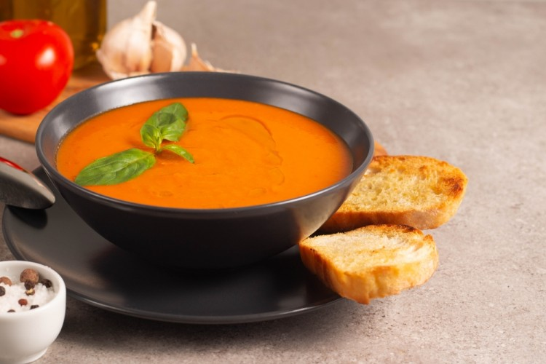
Enough for 3 people
The cooking time is 30 minutes
Tomato pumpkin soup
ingredients
- Yellowed: 2 cups (cut)
- Karima: Half a cup
- salt: sprinkle
- Black pepper: spray
- Chicken gravy: 2 cups
- onion: 1 pill
- Tomato: 2 pills (grilled)
- Brown rice: half a cup (boiled)
- Butter: 2 large spoons
preparation method
In the pot of putting butter on the fire until it melts, then add the onion, the squash, and leave the ingredients a little bit until the onion is red.
Make chicken gravy, add brown rice, and grilled tomatoes.
Leave the mixture on the fire for half an hour and then lift it up to cool a little.
Hit the soup in the blender, put it back on the fire, and add the fresh cream while keeping the constant shuffle for two minutes and then her feet.

Slide 3
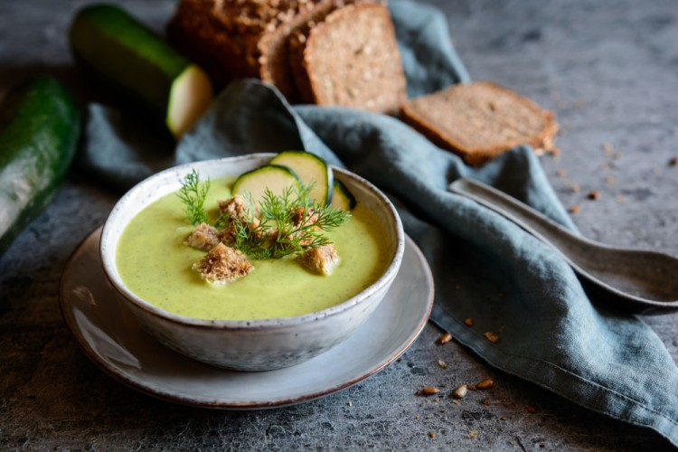
Enough for 4 people
The cooking time is 30 minutes
Creme zucchini
ingredients
- Zucchini: Half a kilo (laundry)
- milk: cup
- Gravy: liter
- Salt: as desired
- Black pepper: spray
- onion powder: small spoon
- Vegetable oil: little
preparation method
Cut the zucchini into small cubes, place them in a pot on the fire, and scatter them a little with oil until they wither.
The zucchini wear powder, salt, black pepper, and then my heart of ingredients.
Add the gravy, then leave the soup until it is ripe, and then the milk boy after it boils.
Put the soup in the electric mixer bowl and hit the ingredients a little.
Pour the soup into the application, and the feet are hot

Slide 4
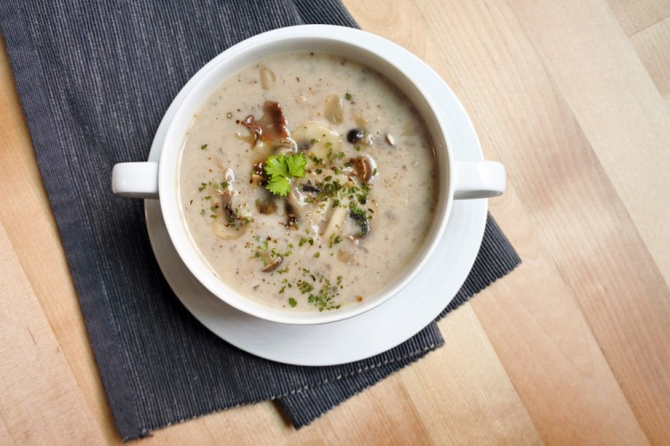
Enough for 4 people
The cooking time is 30 minutes
cream mushroom soup
ingredients
- mushrooms: 2 cups (sliced)
- onion: 1 pill (chopped off)
- milk: cup
- Cooking cream: cup
- Chicken gravy: 2 cups
- Flour: 2 large spoons
- Butter: 2 large spoons
- Black pepper: spray
- salt: sprinkle
preparation method
Put the butter in a pot on the fire, then add the chopped onion and distort it until it withers, and then add the mushroom and my heart the ingredients for several minutes.
Add the flour and my heart is fast for a second.
Add the milk while continuing to move quickly.
Add the chicken gravy, cream, then drench with salt, black pepper and stir, and leave the soup for about 25 minutes on medium fire until fully ripe.
Hit the soup with the electric bat until it's soft. And you can heat it up again.
Pour the soup into the application, and the feet are hot.

Slide 5
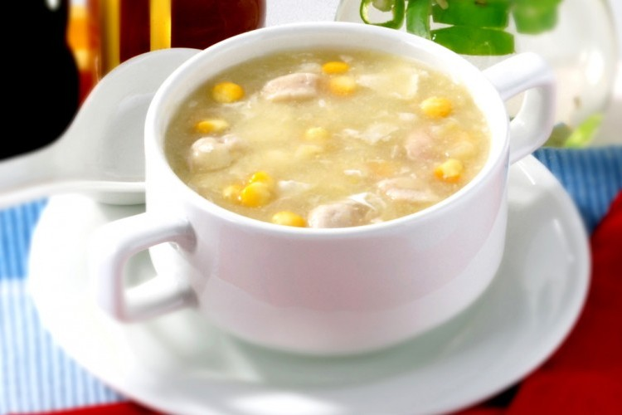
Enough for 4 people
The cooking time is 40 minutes
chicken corn soup
ingredients
- Chicken chest: cup (stripped of skin, boiled and cube cut)
- Corn: cup (canned)
- Chicken gravy: 3 cups
- milk: cup
- lemon juice: big spoon
- Starter: Large spoon
- Soy sauce: small spoon
- Eggs: 1 pill
- Water: 3 large spoons
preparation method
Clear a corn can of water and place it in a pot on fire and add boiled chicken cubes, chicken soup, milk and lemon juice, then leave them on the fire for a bit.
Melt the starch with cold water in a side bowl, then pour the mixture into the pot on fire and manually multiply the ingredients with a constant flip until near boiling.
Add soy and egg sauce before boiling, and re-multiply by hand until completely homogeneous, then leave the pot on a quiet fire for about 2 to 3 minutes.
Pour corn soup with chicken in the application, and its feet are hot

