Slide 1





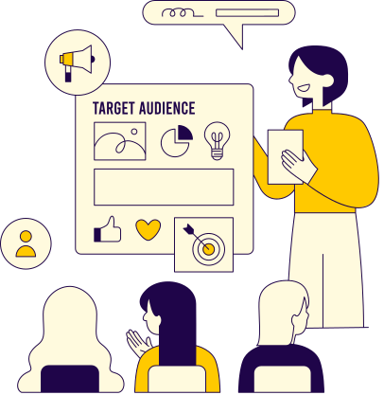
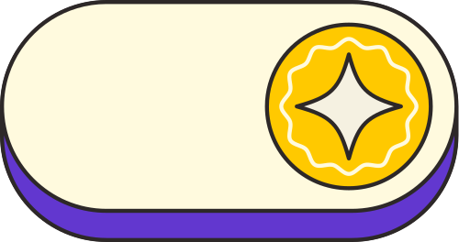


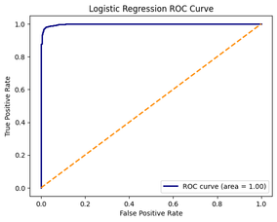
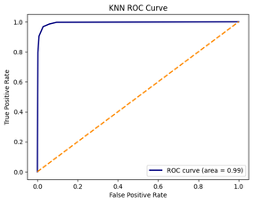
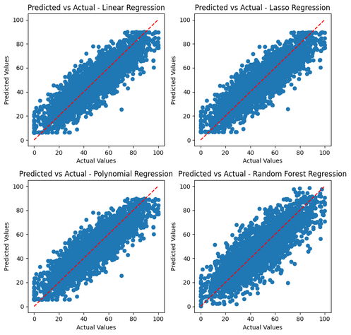
CSE271 – DATA SCIENCE METHODOLOGY
MOBILE USAGE IMPACTS
This project explores the relationship between smartphone usage patterns and indicators of addiction and stress among users. We applied both regression and classification models to analyze how features such as screen time, notifications, and night usage influence user well-being.
Data Preprocessing
Target Variables
Check for NULL values
Ensure proper data formatting for variables
Apply Data Scaling
Apply Data Splitting
Classification:
Addicted/Not Addicted
High Stress Risk/Low Stress Risk
Regression:
Stress Level
Rokaya Ramy
22-101171
Regression Models
Classification Models
Multiple Linear Regression
Lasso Regression
Polynomial Regression
Random Forest Regression
Used to predict the user’s Stress Level
Logistic Regression
Used to Predict the Addiction Status of the user
K-Nearest Neighbors
Used to predict the user’s Stress Risk
Jana Sherif
22-101234
Regression Evaluation
Classification Evaluation
Linear Regression R²: 0.7573590356729519
Linear Regression RMSE: 9.93278328159293
Lasso Regression R²: 0.757460789708498
Lasso Regression RMSE: 9.9307003547258
Polynomial Regression R²: 0.7573384937058408
Polynomial Regression RMSE: 9.933203727064205
Random Forest R²: 0.661072397529568
Random Forest RMSE: 11.739304507793152
Logistic Regression Metrics:
Accuracy: 0.9801324503311258
Precision: 0.978386167146974
Recall: 0.9826338639652678
F1 Score: 0.9805054151624548
K-Nearest Neighbors Metrics
Accuracy: 0.9705665930831494
Precision: 0.9425414364640884
Recall: 0.9682179341657208
F1 Score: 0.9552071668533034
Summary
References
From the analysis, smartphone usage proved to be a strong predictor of stress and addiction. Logistic Regression and KNN achieved 98% and 97% accuracy, respectively. Regression results showed a mostly linear relationship, with linear models outperforming Random Forest. These findings support the use of usage data as an indicator of well-being.
https://www.geeksforgeeks.org/python-mean-squared-error/
https://vwo.com/website-heatmap/how-to-read-heatmap/#:~:text=Reading%20a%20heat%20map%20is,and%20green%20signify%20low%20values
https://www.geeksforgeeks.org/random-forest-regression-in-python/
Models Evaluation Visualization

